Slide 1
Modeling of Crowd Evacuation With Assailants via a Fuzzy Logic Approach
Martin Božič, Jakob Maležič, Marija Marolt

Slide 2
Fuzzy logic
Modeling people behaviour
Modeling assailants behaviour
For guidance, models use knowledge of surrounding buildings and pedestrians

Slide 3
People categories
Category 1 (Pedestrians are unaware of influence of assailants)
Category 2 (Pedestrians are aware of assailants, but they are not directly threatened by them)
Category 3 (Pedestrians are directly threatened by assailants)

Slide 4
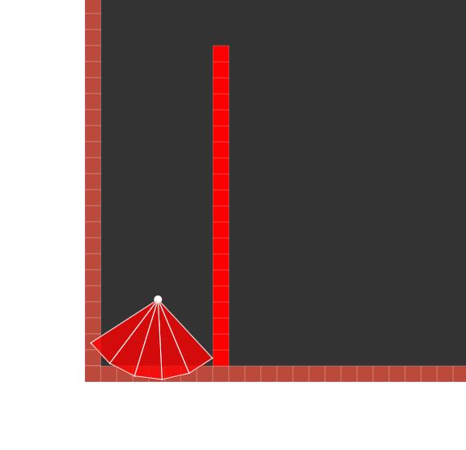
The local obstacle-avoiding behaviour
Helps pedestrians and assailants avoid front obstacles

Slide 5
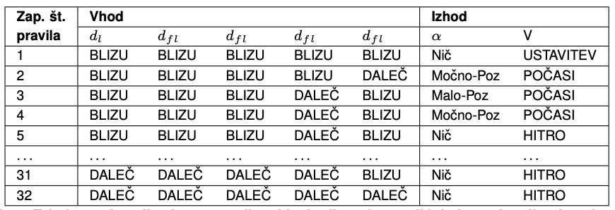
Fuzzy rules table for obstacle-avoiding behaviour

Slide 6
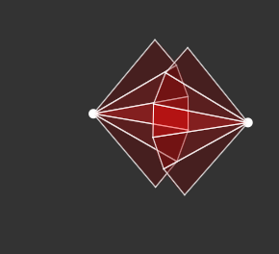
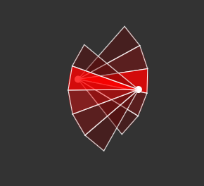
Regional path searching behaviour
- Path searching behaviour consists of collision risk with other pedestrians and impact of obstacles in front of current pedestrian

Slide 7
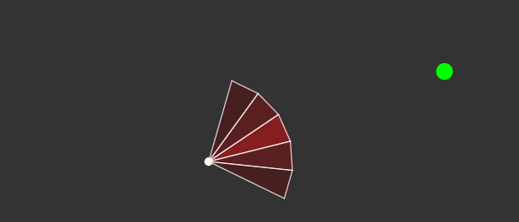
Goal-seeking behaviour
- Helps every pedestrian find closest path to it's goal.
- It takes into account person and goal orientation and distance from person to it's goal.

Slide 8
Integration of multiple behaviours
It takes into account the outputs of all three fuzzy logic methods.
Method puts importance to each method according to the distance of person to it's goal, distance to the nearest obstacle in front of current person and movement of other people directly in front of current person.

Slide 9
Model of assailant
Always picks the nearest possible person and set's it as his goal.
If he doesn't see any person, he scans and walks randomly in room, until he doesn't find someone.
His behaviour is similar to other pedestrians, with the main difference in approaching other pedestrians instead of avoiding them.

Slide 10
User interface
User can place pedestrians, assailants and obstacles of various sizes in room
He can set room dimensions
He can clean whole room and start placing people and obstacles over again
User can set local and global goal positions
User can save or load saved rooms
He can start simulations and download simulation results
He can show/hide vision arcs of assailants and pedestrians

Slide 11
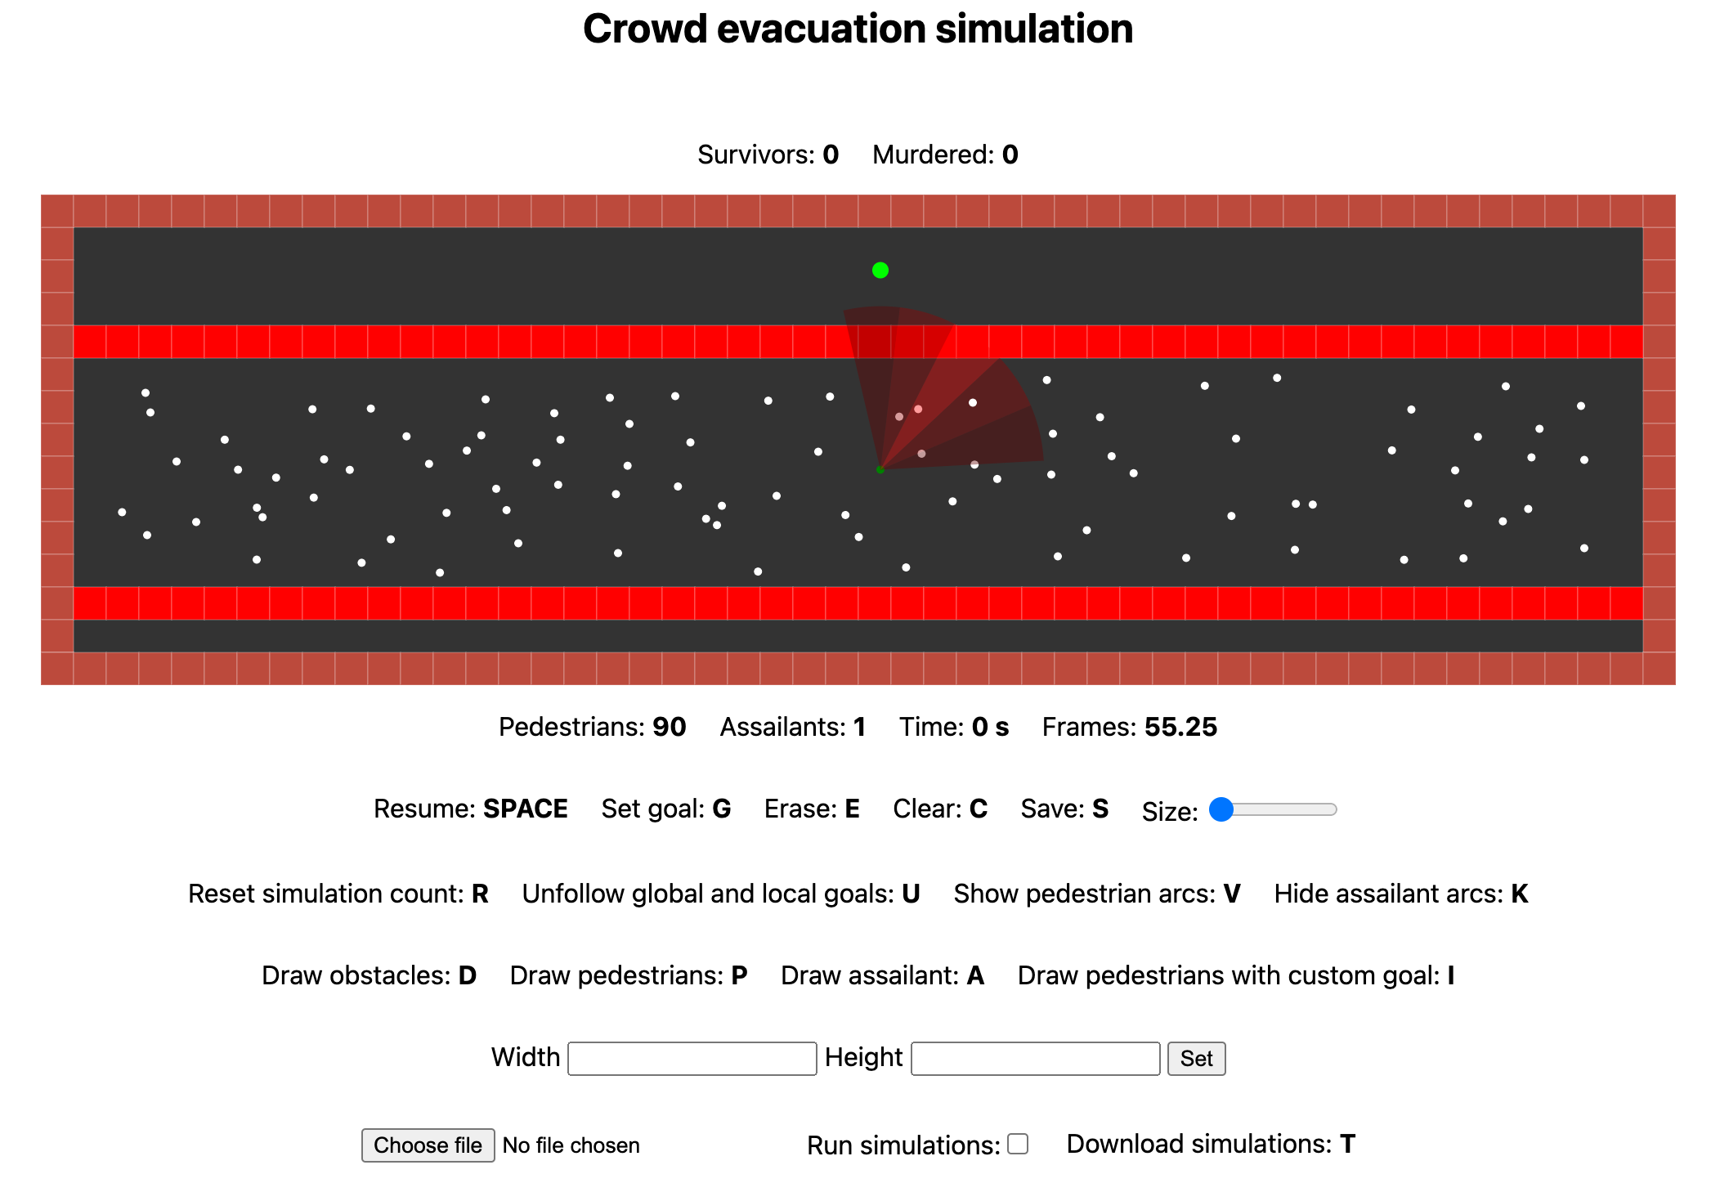
An example of 90 people moving in hallway, with assailant appearing in the middle

Slide 12
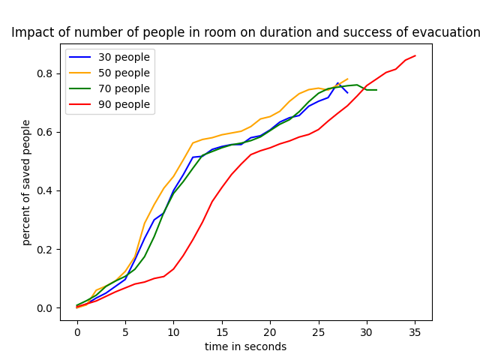
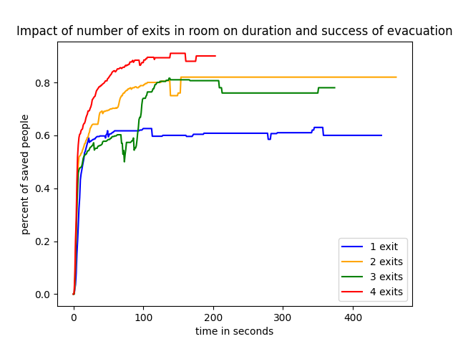
Results

Slide 13
Overview
We think that we managed to achieve starting goal, which was to implement platform for simulating crowd evacuation in different places, which can be generated by users
If we started all over again, we would put more attention to code optimisation, because it took us a lot of time in the end, to optimise everything, so everything can run in real time

Slide 14
Challenges
Picking the right parameters and values for all fuzzy logic methods
Making user interface, that is simple, intuitive and complex enough, so users are able to run simulations in it
Code optimisation, so it can run in realtime on every browser

