Slide 1






IX Taller GBIF de Modelización de
Nichos Ecológicos
Sesión 2:
Aprendiendo a modelizar
Blas M. Benito

Slide 2
CONTENIDOS
TEORÍA Y PRÁCTICA DE MÉTODOS DE MODELADO:
  GLM
  GAM
  RANDOM FOREST
  MAXENT
EVALUACIÓN DE MODELOS
APLICACIÓN DE “THRESHOLDS”
PROYECCIÓN DE MODELOS (TIEMPO Y ESPACIO)

Slide 3
SCRIPT DE R
Trabajaremos con
2_modelos.R

Slide 4
CALIBRANDO MODELOS

Slide 5
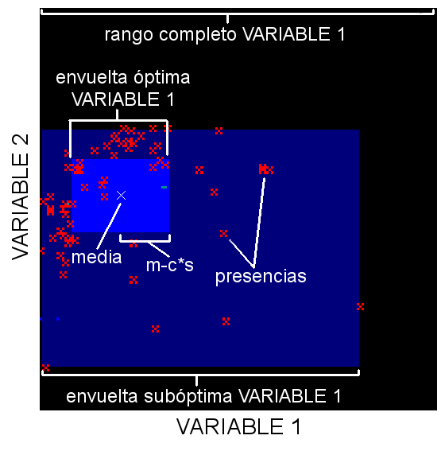
BIOCLIM
Envuelta bioclimática cuadrangular
  [m-c*s, m+c*s]
    m = media
    c = % desviación
    s = desviación
  Solo requiere presencias
www.esapubs.org/

Slide 6
MÉTODOS DE REGRESIÓN

Slide 7
GENERALIZED LINEAR MODELS
Permiten modelar respuestas no lineales
Los residuos pueden seguir distintas distribuciones de probabilidad: normal, binomial, Poisson, binomial negativa, gamma
Notes:
GLM son una amplia familia de modelos estadísticos que incluyen regresión lineal y análisis de la varianza.
Un GLM requieren una variable respuesta (presencia y ausencia), variables predictoras, y una función de vínculo que describe la relación entre el valor esperado de la variable respuesta y los predictores.
Una regresión logística es un GLM con distribución binomial y función de vínculo logística (logit link).
Los GLM en R se ajustan usando métodos de máxima verosimilitud, y en ecología, el método de selección de modelos más común incluye un proceso iterativo de simplificación en el que los modelos se comparan mediante AIC (Akaike Information Criterion).
Para modelar datos de solo presencia se usan puntos aleatorios de background.

Slide 8
¿COMO FUNCIONA?
Según complejidad de las curvas
  Logística
  Polinomio 2º, 3º, 4º, ... grado
Según los datos de ausencia
  Ausencia
  Pseudo-ausencia
  Background
Según las interacciones entre variables
  Sin interacción
  Con interacción
Notes:
GLM son una amplia familia de modelos estadísticos que incluyen regresión lineal y análisis de la varianza.
Un GLM requieren una variable respuesta (presencia y ausencia), variables predictoras, y una función de vínculo que describe la relación entre el valor esperado de la variable respuesta y los predictores.
Una regresión logística es un GLM con distribución binomial y función de vínculo logística (logit link).
Los GLM en R se ajustan usando métodos de máxima verosimilitud, y en ecología, el método de selección de modelos más común incluye un proceso iterativo de simplificación en el que los modelos se comparan mediante AIC (Akaike Information Criterion).
Para modelar datos de solo presencia se usan puntos aleatorios de background.

Slide 9
NÚMERO MÍNIMO DE PRESENCIAS
Necesitamos al menos 5 presencias (y 5 ausencias, si el modelo es de presencia-ausencia) por cada variable.
Necesitamos otras 5 presencias por cada término polinomial:
  1º grado: 5 presencias
  2º grado: 10 presencias
  And so on.
Notes:
GLM son una amplia familia de modelos estadísticos que incluyen regresión lineal y análisis de la varianza.
Un GLM requieren una variable respuesta (presencia y ausencia), variables predictoras, y una función de vínculo que describe la relación entre el valor esperado de la variable respuesta y los predictores.
Una regresión logística es un GLM con distribución binomial y función de vínculo logística (logit link).
Los GLM en R se ajustan usando métodos de máxima verosimilitud, y en ecología, el método de selección de modelos más común incluye un proceso iterativo de simplificación en el que los modelos se comparan mediante AIC (Akaike Information Criterion).
Para modelar datos de solo presencia se usan puntos aleatorios de background.

Slide 10
GENERALIZED ADDITIVE MODELS
(GAM)
Método de regresión no paramétrico
Variables predictivas suavizadas (smoothing)
Modelado de respuestas no lineales
Requiere tamaños de muestra grandes (más que GLM)
Notes:
GLM son una amplia familia de modelos estadísticos que incluyen regresión lineal y análisis de la varianza.
Un GLM requieren una variable respuesta (presencia y ausencia), variables predictoras, y una función de vínculo que describe la relación entre el valor esperado de la variable respuesta y los predictores.
Una regresión logística es un GLM con distribución binomial y función de vínculo logística (logit link).
Los GLM en R se ajustan usando métodos de máxima verosimilitud, y en ecología, el método de selección de modelos más común incluye un proceso iterativo de simplificación en el que los modelos se comparan mediante AIC (Akaike Information Criterion).
Para modelar datos de solo presencia se usan puntos aleatorios de background.

Slide 11
MAXENT
Regresión de Poisson con penalización Lasso.
Puede trabajar con un número bajo de presencias.
Requiere background.
La complejidad del modelo se controla con el regularization multiplier.
Está disponible en una aplicación Java con interfaz gráfico.
Nosotros usamos el paquete “maxnet”.

Slide 12
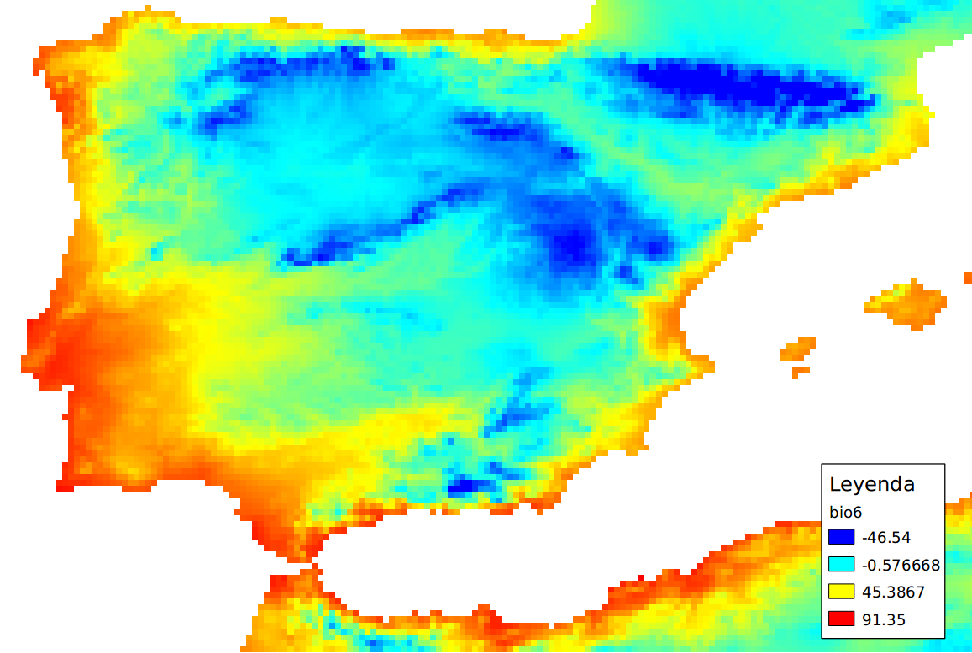
PREDICTOR
Bio6 → temperatura del mes más frío

Slide 13
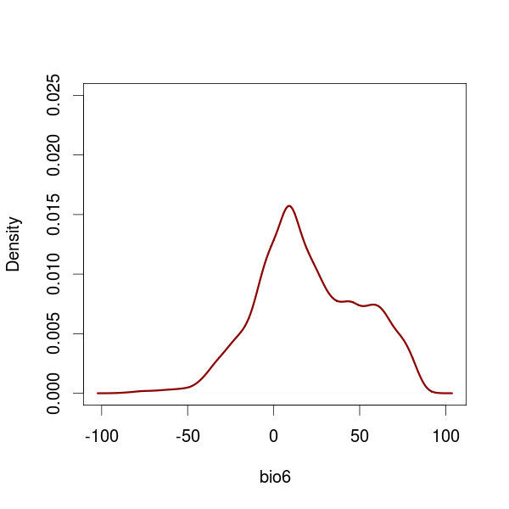
DENSIDAD DEL BACKGROUND

Slide 14
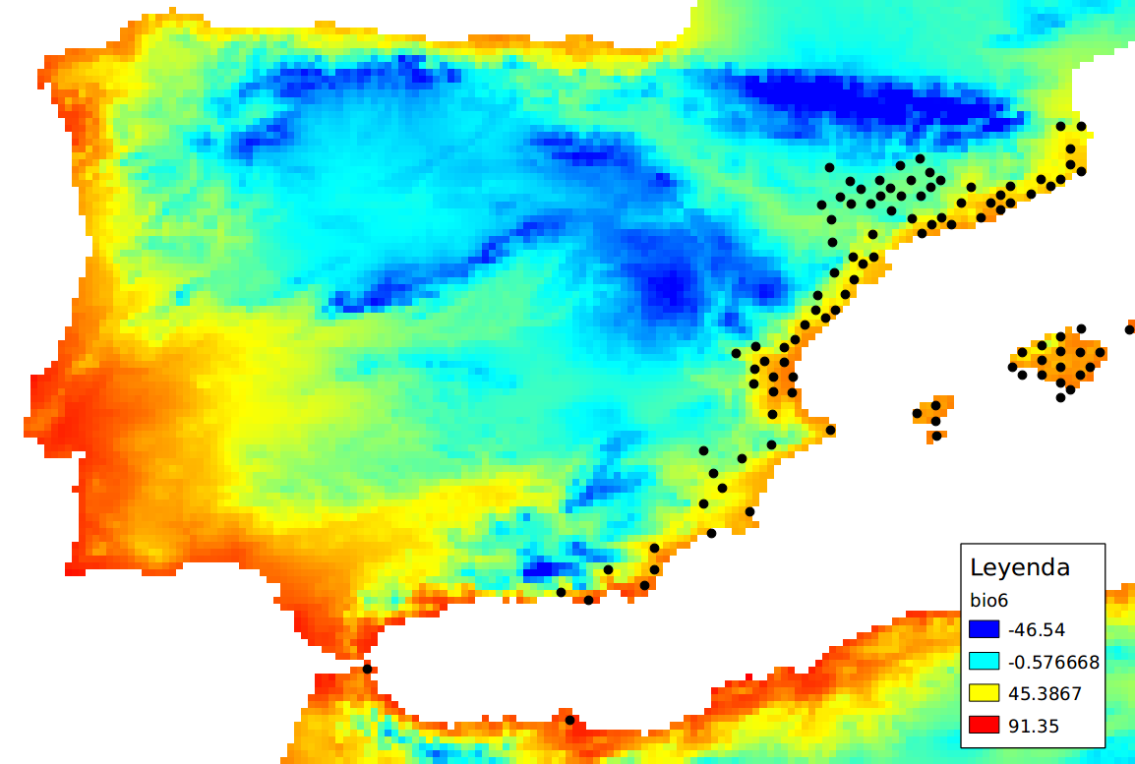
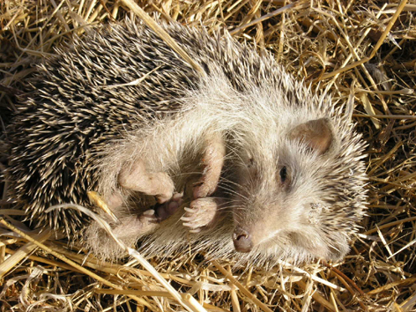
PRESENCIA
Atelerix algirus

Slide 15
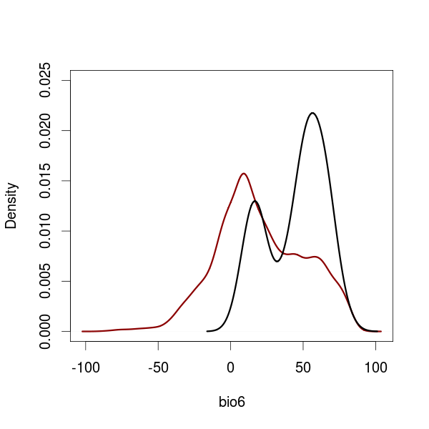
DENSIDAD DE LA PRESENCIA

Slide 16
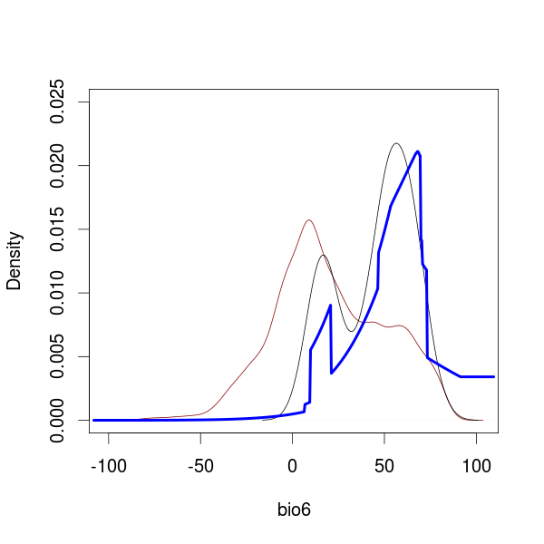
MAXENT FIT (max complejidad)

Slide 17
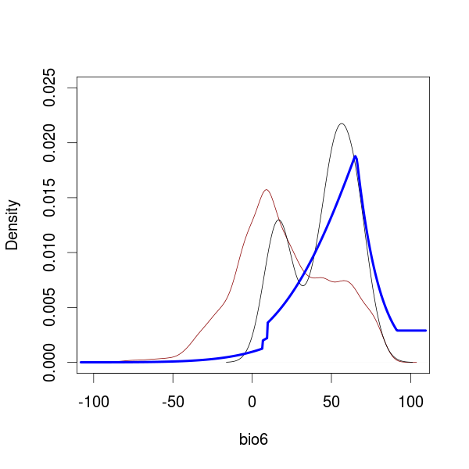
MAXENT FIT
Regularization multiplier = 3

Slide 18
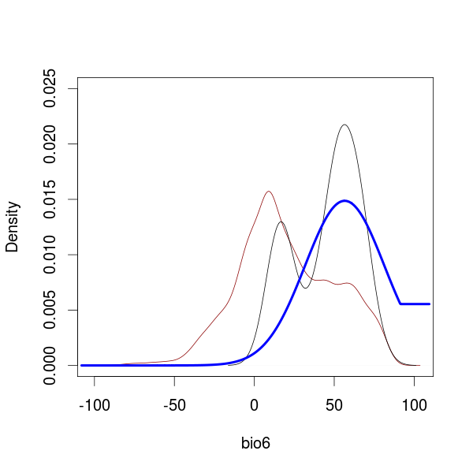
MAXENT FIT
Regularization multiplier = 6

Slide 19
ÁRBOLES DE
CLASIFICACIÓN Y REGRESIÓN

Slide 20
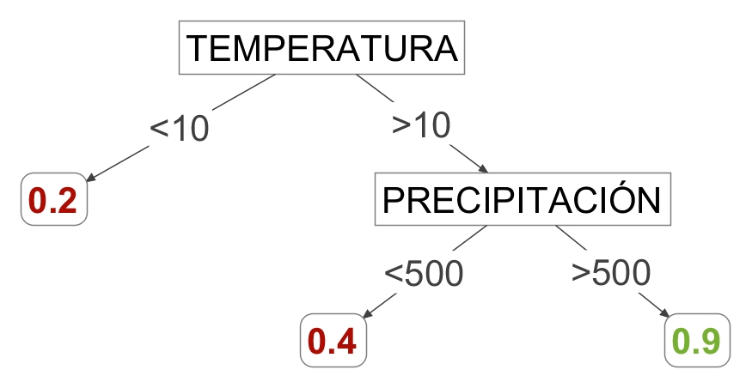
ÁRBOL DE REGRESIÓN
nodo
nodo terminal

Slide 21
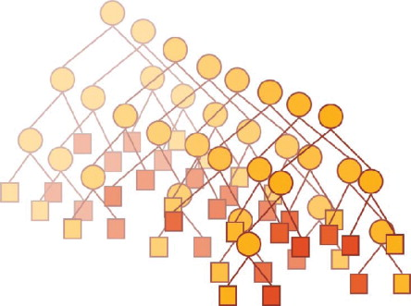
RANDOM FOREST
Fuente: Gedeck et al. 2010 Progress in Medicinal Chemistry

Slide 22
RANDOM FOREST
Parámetros importantes:
  ntree: número de árboles a calibrar
  mtry: número de variables usadas en cada árbol
  nodesize: número mínimo de casos en cada nodo terminal
  maxnode: número máximo de nodos terminales

Slide 23
RANDOM FOREST
Por cada árbol:
  Selecciona 60% de datos al azar
  Calibra un árbol de regresión, tomando mtry variables seleccionadas al azar en cada split
  Evalúa el árbol con el 40% de los datos no usados para calibrarlo
Una vez calibrados todos los árboles
  Calcula el resultado de un nuevo caso (celda) para cada uno de los árboles
  Calcula la moda del resultado de todos los árboles

Slide 24
RANDOM FOREST
Ventajas
  Muy potente
  Puede manejar gran cantidad de datos
  Analiza interacción de variables
Inconvenientes
  Potencial sobreajuste a los datos
  El resultado es difícil de interpretar

Slide 25
EVALUACIÓN DE MODELOS

Slide 26
EVALUACIÓN
Artículo clave:
Fielding AH y Bell JF 1997. A review of methods for the assessment of prediction errors in conservation presence/absence models. Environmental Conservation 24(1), 38-49
(2856 citas en abril de 2014)
Notes:
Predicting the distribution of endangered species from habitat data is frequently perceived to be a useful technique. Models that predict the presence or absence of a species are normally judged by the number of prediction errors. These may be of two types: false positives and false negatives. Many of the prediction errors can be traced to ecological processes such as unsaturated habitat and species interactions. Consequently, if prediction errors are not placed in an ecological context the results of the model may be misleading. The simplest, and most widely used, measure of prediction accuracy is the number of correctly classified cases. There are other measures of prediction success that may be more appropriate. Strategies for assessing the causes and costs of these errors are discussed. A range of techniques for measuring error in presence/absence models, including some that are seldom used by ecologists (e.g. ROC plots and cost matrices), are described. A new approach to estimating prediction error, which is based on the spatial characteristics of the errors, is proposed. Thirteen recommendations are made to enable the objective selection of an error assessment technique for ecological presence/absence models.

Slide 27
SOLO-PRESENCIA EN
MODELOS BINARIOS
Notes:
Predicting the distribution of endangered species from habitat data is frequently perceived to be a useful technique. Models that predict the presence or absence of a species are normally judged by the number of prediction errors. These may be of two types: false positives and false negatives. Many of the prediction errors can be traced to ecological processes such as unsaturated habitat and species interactions. Consequently, if prediction errors are not placed in an ecological context the results of the model may be misleading. The simplest, and most widely used, measure of prediction accuracy is the number of correctly classified cases. There are other measures of prediction success that may be more appropriate. Strategies for assessing the causes and costs of these errors are discussed. A range of techniques for measuring error in presence/absence models, including some that are seldom used by ecologists (e.g. ROC plots and cost matrices), are described. A new approach to estimating prediction error, which is based on the spatial characteristics of the errors, is proposed. Thirteen recommendations are made to enable the objective selection of an error assessment technique for ecological presence/absence models.

Slide 28
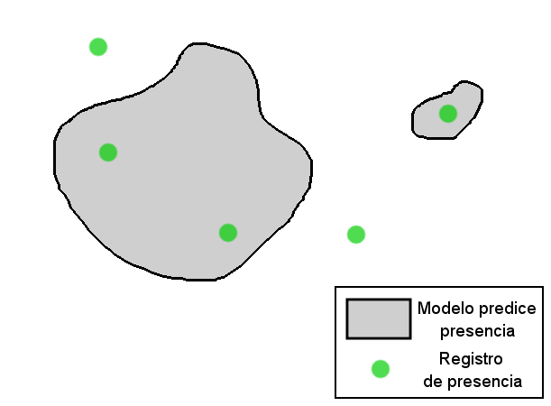
EVALUACIÓN
5 presencias
3 aciertos
Sensibilidad=0,6
2 errores de OMISIÓN
Notes:
Predicting the distribution of endangered species from habitat data is frequently perceived to be a useful technique. Models that predict the presence or absence of a species are normally judged by the number of prediction errors. These may be of two types: false positives and false negatives. Many of the prediction errors can be traced to ecological processes such as unsaturated habitat and species interactions. Consequently, if prediction errors are not placed in an ecological context the results of the model may be misleading. The simplest, and most widely used, measure of prediction accuracy is the number of correctly classified cases. There are other measures of prediction success that may be more appropriate. Strategies for assessing the causes and costs of these errors are discussed. A range of techniques for measuring error in presence/absence models, including some that are seldom used by ecologists (e.g. ROC plots and cost matrices), are described. A new approach to estimating prediction error, which is based on the spatial characteristics of the errors, is proposed. Thirteen recommendations are made to enable the objective selection of an error assessment technique for ecological presence/absence models.

Slide 29
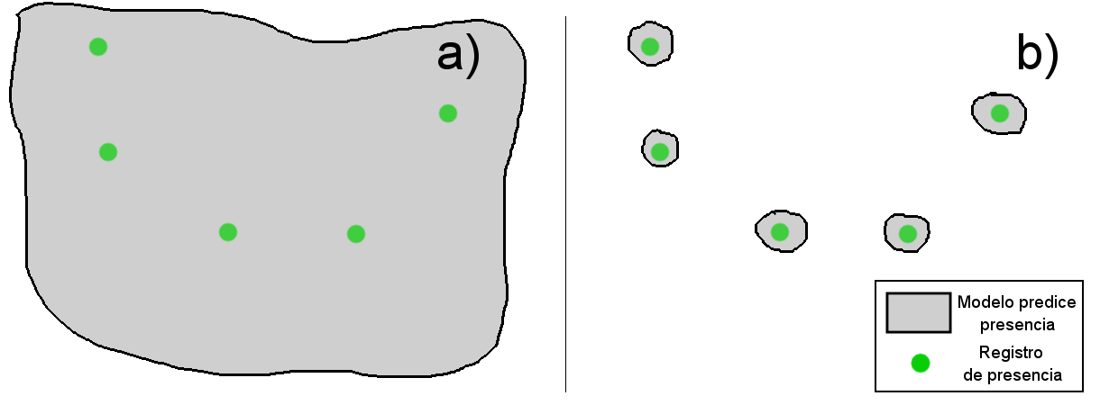
EVALUACIÓN
Sensibilidad=1 Sensibilidad=1
¿Error de comisión? ¿Sobreajuste?
Notes:
Predicting the distribution of endangered species from habitat data is frequently perceived to be a useful technique. Models that predict the presence or absence of a species are normally judged by the number of prediction errors. These may be of two types: false positives and false negatives. Many of the prediction errors can be traced to ecological processes such as unsaturated habitat and species interactions. Consequently, if prediction errors are not placed in an ecological context the results of the model may be misleading. The simplest, and most widely used, measure of prediction accuracy is the number of correctly classified cases. There are other measures of prediction success that may be more appropriate. Strategies for assessing the causes and costs of these errors are discussed. A range of techniques for measuring error in presence/absence models, including some that are seldom used by ecologists (e.g. ROC plots and cost matrices), are described. A new approach to estimating prediction error, which is based on the spatial characteristics of the errors, is proposed. Thirteen recommendations are made to enable the objective selection of an error assessment technique for ecological presence/absence models.

Slide 30
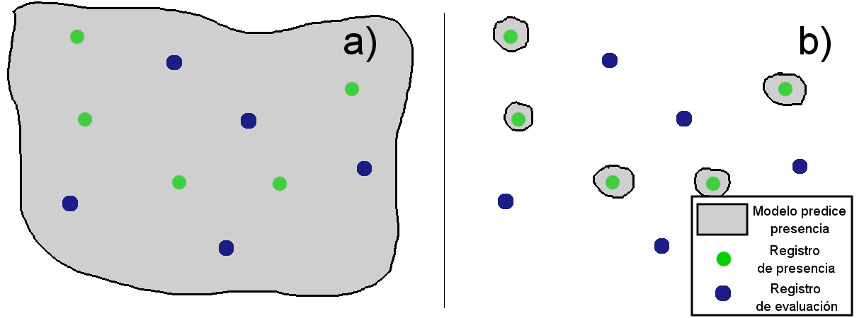
EVALUACIÓN
Sensibilidad=1 Sensibilidad=0
¿? ¡Sobreajuste!
Notes:
Predicting the distribution of endangered species from habitat data is frequently perceived to be a useful technique. Models that predict the presence or absence of a species are normally judged by the number of prediction errors. These may be of two types: false positives and false negatives. Many of the prediction errors can be traced to ecological processes such as unsaturated habitat and species interactions. Consequently, if prediction errors are not placed in an ecological context the results of the model may be misleading. The simplest, and most widely used, measure of prediction accuracy is the number of correctly classified cases. There are other measures of prediction success that may be more appropriate. Strategies for assessing the causes and costs of these errors are discussed. A range of techniques for measuring error in presence/absence models, including some that are seldom used by ecologists (e.g. ROC plots and cost matrices), are described. A new approach to estimating prediction error, which is based on the spatial characteristics of the errors, is proposed. Thirteen recommendations are made to enable the objective selection of an error assessment technique for ecological presence/absence models.

Slide 31
PRESENCIA – AUSENCIA EN MODELOS BINARIOS
Notes:
Predicting the distribution of endangered species from habitat data is frequently perceived to be a useful technique. Models that predict the presence or absence of a species are normally judged by the number of prediction errors. These may be of two types: false positives and false negatives. Many of the prediction errors can be traced to ecological processes such as unsaturated habitat and species interactions. Consequently, if prediction errors are not placed in an ecological context the results of the model may be misleading. The simplest, and most widely used, measure of prediction accuracy is the number of correctly classified cases. There are other measures of prediction success that may be more appropriate. Strategies for assessing the causes and costs of these errors are discussed. A range of techniques for measuring error in presence/absence models, including some that are seldom used by ecologists (e.g. ROC plots and cost matrices), are described. A new approach to estimating prediction error, which is based on the spatial characteristics of the errors, is proposed. Thirteen recommendations are made to enable the objective selection of an error assessment technique for ecological presence/absence models.

Slide 32
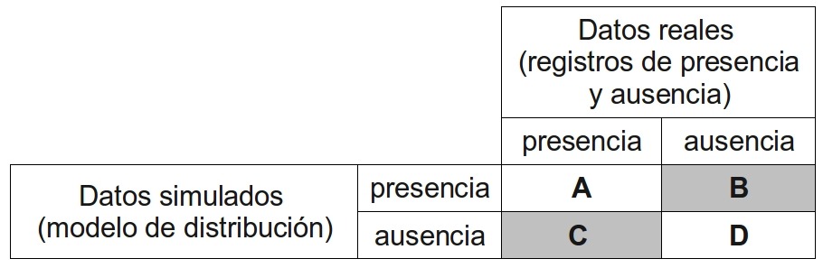
MATRIZ DE CONFUSIÓN
A → presencias acertadas
D → ausencias acertadas
B → ausencias fallidas (falsos positivos o error de comisión)
C → presencias fallidas (falsos negativos o error de omisión)
SENSIBILIDAD = A/(A+C)
ESPECIFICIDAD = D/(B+D)
Notes:
Predicting the distribution of endangered species from habitat data is frequently perceived to be a useful technique. Models that predict the presence or absence of a species are normally judged by the number of prediction errors. These may be of two types: false positives and false negatives. Many of the prediction errors can be traced to ecological processes such as unsaturated habitat and species interactions. Consequently, if prediction errors are not placed in an ecological context the results of the model may be misleading. The simplest, and most widely used, measure of prediction accuracy is the number of correctly classified cases. There are other measures of prediction success that may be more appropriate. Strategies for assessing the causes and costs of these errors are discussed. A range of techniques for measuring error in presence/absence models, including some that are seldom used by ecologists (e.g. ROC plots and cost matrices), are described. A new approach to estimating prediction error, which is based on the spatial characteristics of the errors, is proposed. Thirteen recommendations are made to enable the objective selection of an error assessment technique for ecological presence/absence models.

Slide 33
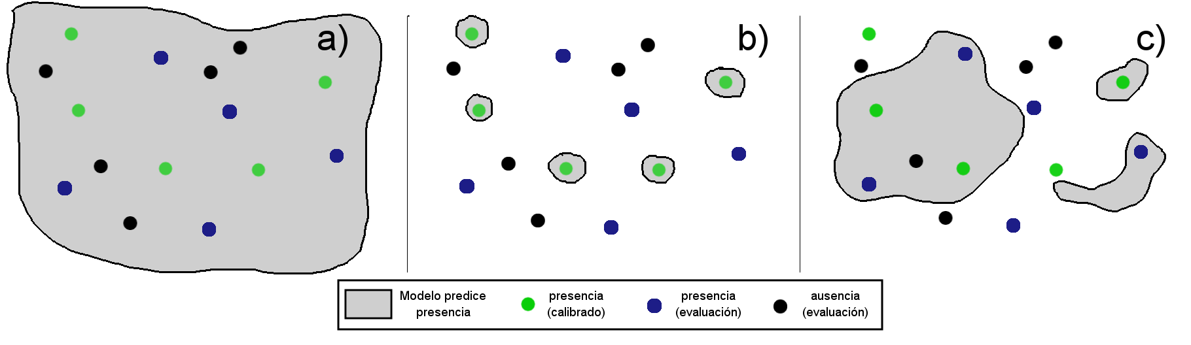
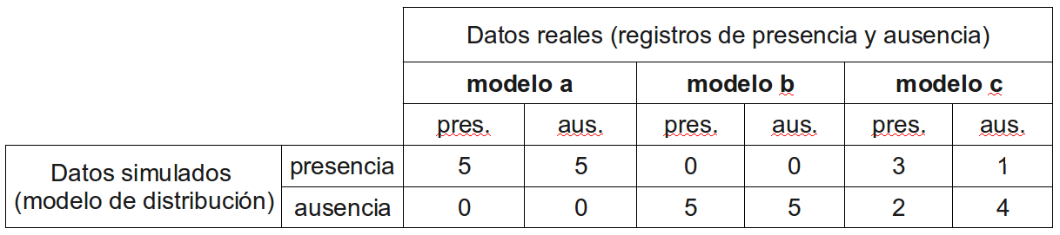
EVALUACIÓN
Notes:
Predicting the distribution of endangered species from habitat data is frequently perceived to be a useful technique. Models that predict the presence or absence of a species are normally judged by the number of prediction errors. These may be of two types: false positives and false negatives. Many of the prediction errors can be traced to ecological processes such as unsaturated habitat and species interactions. Consequently, if prediction errors are not placed in an ecological context the results of the model may be misleading. The simplest, and most widely used, measure of prediction accuracy is the number of correctly classified cases. There are other measures of prediction success that may be more appropriate. Strategies for assessing the causes and costs of these errors are discussed. A range of techniques for measuring error in presence/absence models, including some that are seldom used by ecologists (e.g. ROC plots and cost matrices), are described. A new approach to estimating prediction error, which is based on the spatial characteristics of the errors, is proposed. Thirteen recommendations are made to enable the objective selection of an error assessment technique for ecological presence/absence models.

Slide 34
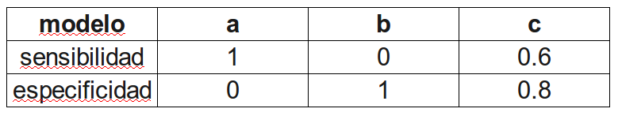
EVALUACIÓN
Notes:
Predicting the distribution of endangered species from habitat data is frequently perceived to be a useful technique. Models that predict the presence or absence of a species are normally judged by the number of prediction errors. These may be of two types: false positives and false negatives. Many of the prediction errors can be traced to ecological processes such as unsaturated habitat and species interactions. Consequently, if prediction errors are not placed in an ecological context the results of the model may be misleading. The simplest, and most widely used, measure of prediction accuracy is the number of correctly classified cases. There are other measures of prediction success that may be more appropriate. Strategies for assessing the causes and costs of these errors are discussed. A range of techniques for measuring error in presence/absence models, including some that are seldom used by ecologists (e.g. ROC plots and cost matrices), are described. A new approach to estimating prediction error, which is based on the spatial characteristics of the errors, is proposed. Thirteen recommendations are made to enable the objective selection of an error assessment technique for ecological presence/absence models.

Slide 35
PRESENCIA – AUSENCIAS
EN MODELO CONTINUO
Notes:
Predicting the distribution of endangered species from habitat data is frequently perceived to be a useful technique. Models that predict the presence or absence of a species are normally judged by the number of prediction errors. These may be of two types: false positives and false negatives. Many of the prediction errors can be traced to ecological processes such as unsaturated habitat and species interactions. Consequently, if prediction errors are not placed in an ecological context the results of the model may be misleading. The simplest, and most widely used, measure of prediction accuracy is the number of correctly classified cases. There are other measures of prediction success that may be more appropriate. Strategies for assessing the causes and costs of these errors are discussed. A range of techniques for measuring error in presence/absence models, including some that are seldom used by ecologists (e.g. ROC plots and cost matrices), are described. A new approach to estimating prediction error, which is based on the spatial characteristics of the errors, is proposed. Thirteen recommendations are made to enable the objective selection of an error assessment technique for ecological presence/absence models.

Slide 36
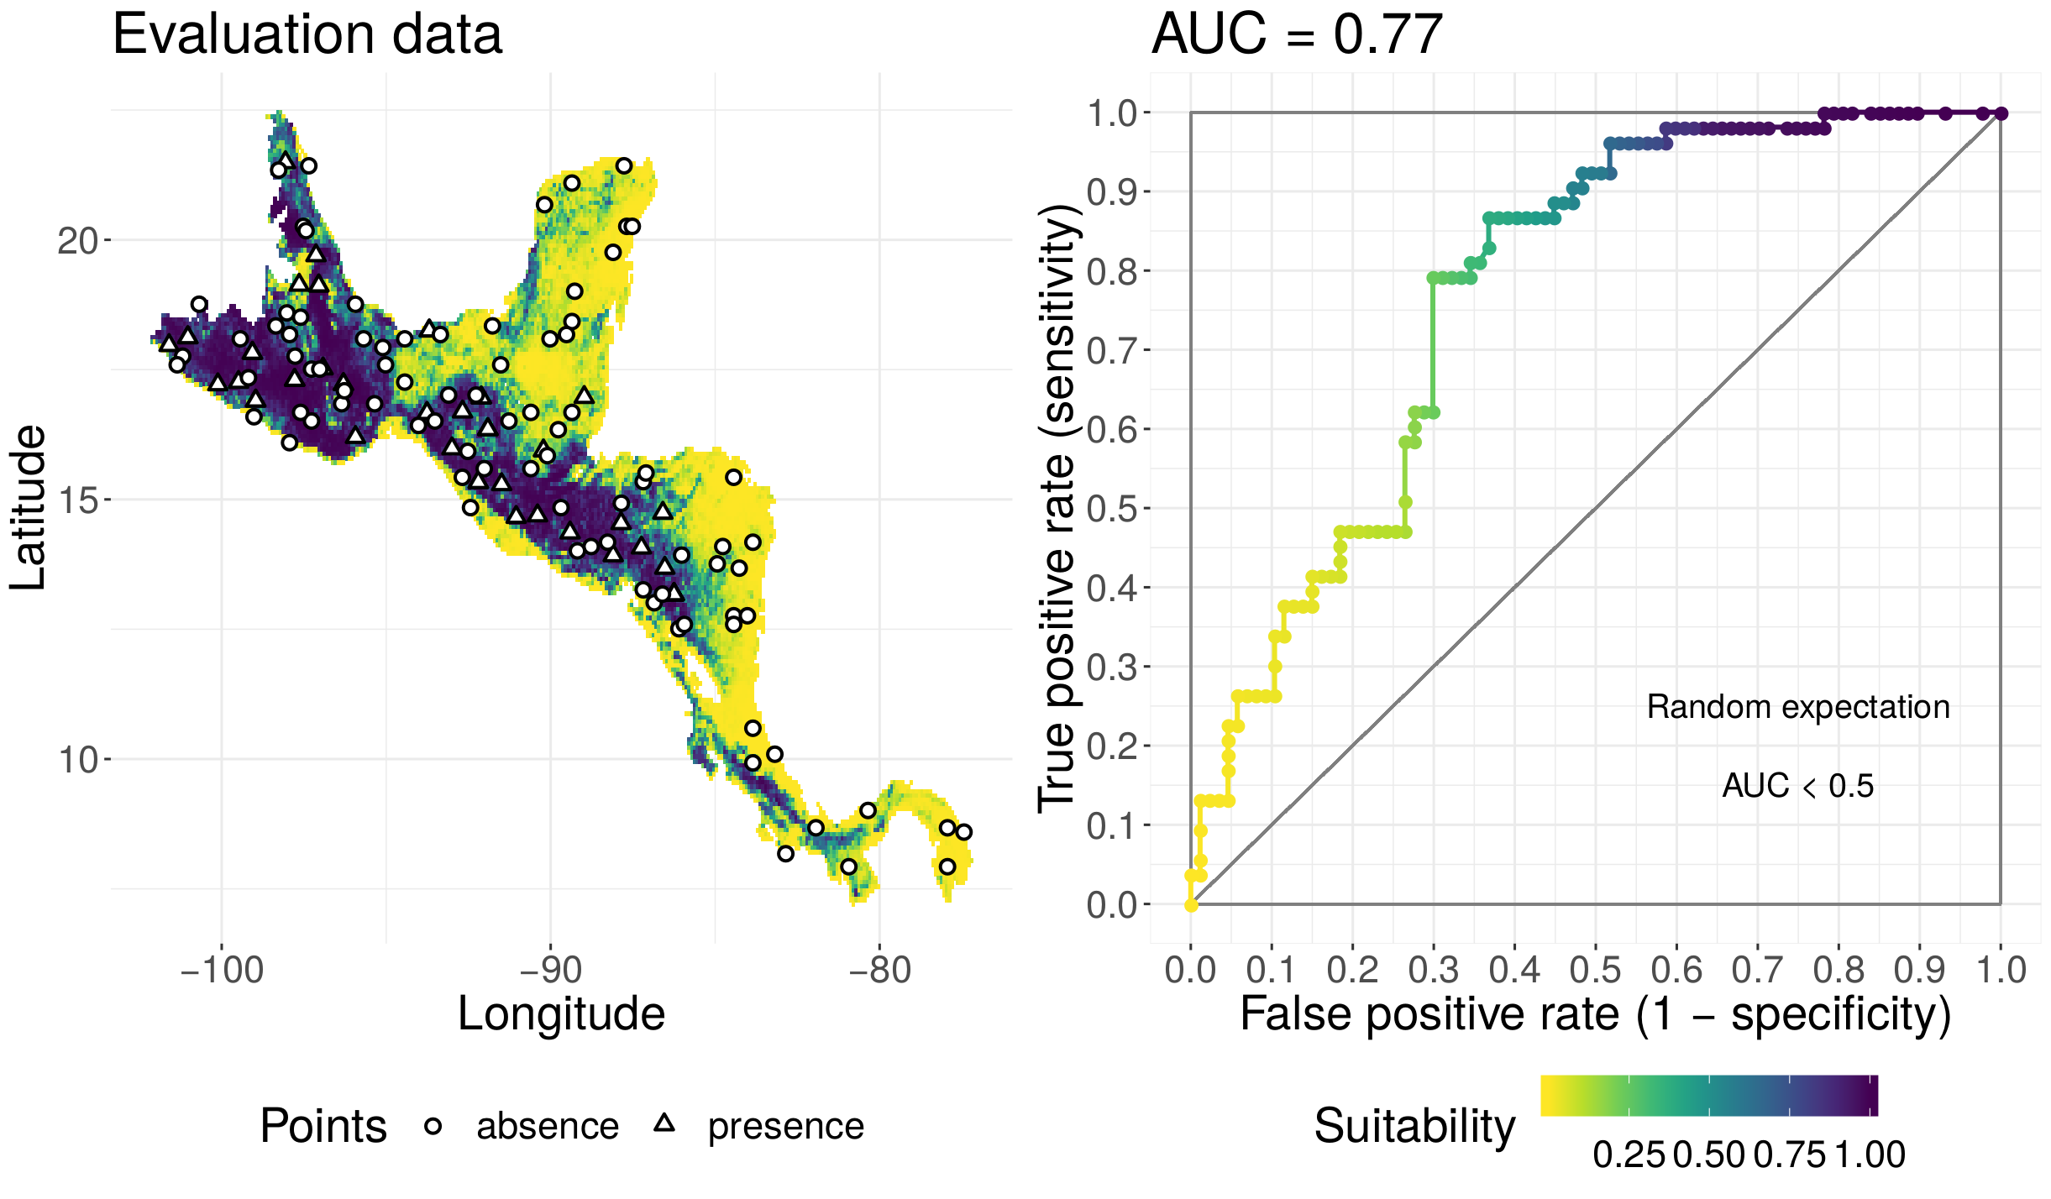
CURVA ROC
Notes:
Predicting the distribution of endangered species from habitat data is frequently perceived to be a useful technique. Models that predict the presence or absence of a species are normally judged by the number of prediction errors. These may be of two types: false positives and false negatives. Many of the prediction errors can be traced to ecological processes such as unsaturated habitat and species interactions. Consequently, if prediction errors are not placed in an ecological context the results of the model may be misleading. The simplest, and most widely used, measure of prediction accuracy is the number of correctly classified cases. There are other measures of prediction success that may be more appropriate. Strategies for assessing the causes and costs of these errors are discussed. A range of techniques for measuring error in presence/absence models, including some that are seldom used by ecologists (e.g. ROC plots and cost matrices), are described. A new approach to estimating prediction error, which is based on the spatial characteristics of the errors, is proposed. Thirteen recommendations are made to enable the objective selection of an error assessment technique for ecological presence/absence models.

Slide 37
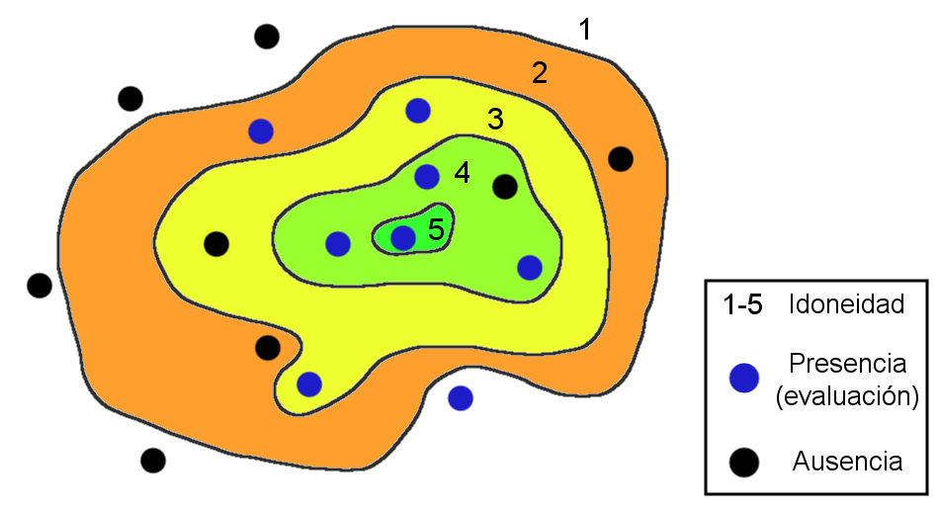
CURVA ROC
Notes:
Predicting the distribution of endangered species from habitat data is frequently perceived to be a useful technique. Models that predict the presence or absence of a species are normally judged by the number of prediction errors. These may be of two types: false positives and false negatives. Many of the prediction errors can be traced to ecological processes such as unsaturated habitat and species interactions. Consequently, if prediction errors are not placed in an ecological context the results of the model may be misleading. The simplest, and most widely used, measure of prediction accuracy is the number of correctly classified cases. There are other measures of prediction success that may be more appropriate. Strategies for assessing the causes and costs of these errors are discussed. A range of techniques for measuring error in presence/absence models, including some that are seldom used by ecologists (e.g. ROC plots and cost matrices), are described. A new approach to estimating prediction error, which is based on the spatial characteristics of the errors, is proposed. Thirteen recommendations are made to enable the objective selection of an error assessment technique for ecological presence/absence models.

Slide 38
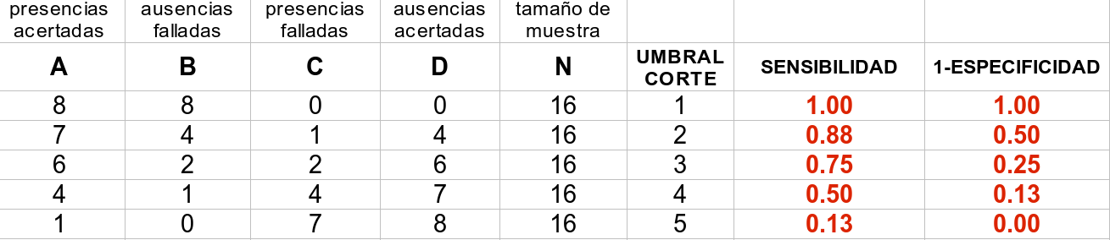
CURVA ROC
Observa que en lugar de la especificidad, usamos 1-especificidad
Notes:
Predicting the distribution of endangered species from habitat data is frequently perceived to be a useful technique. Models that predict the presence or absence of a species are normally judged by the number of prediction errors. These may be of two types: false positives and false negatives. Many of the prediction errors can be traced to ecological processes such as unsaturated habitat and species interactions. Consequently, if prediction errors are not placed in an ecological context the results of the model may be misleading. The simplest, and most widely used, measure of prediction accuracy is the number of correctly classified cases. There are other measures of prediction success that may be more appropriate. Strategies for assessing the causes and costs of these errors are discussed. A range of techniques for measuring error in presence/absence models, including some that are seldom used by ecologists (e.g. ROC plots and cost matrices), are described. A new approach to estimating prediction error, which is based on the spatial characteristics of the errors, is proposed. Thirteen recommendations are made to enable the objective selection of an error assessment technique for ecological presence/absence models.

Slide 39
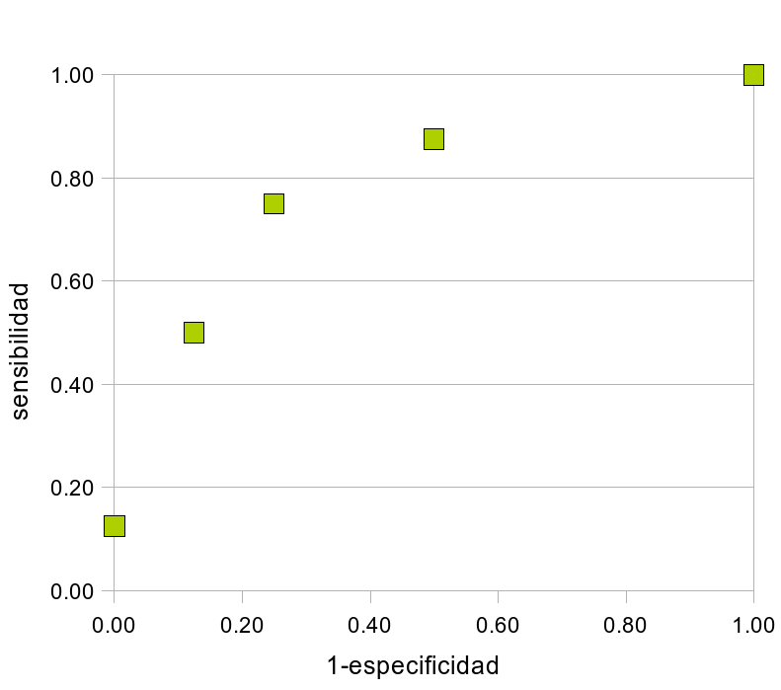
CURVA ROC
Notes:
Predicting the distribution of endangered species from habitat data is frequently perceived to be a useful technique. Models that predict the presence or absence of a species are normally judged by the number of prediction errors. These may be of two types: false positives and false negatives. Many of the prediction errors can be traced to ecological processes such as unsaturated habitat and species interactions. Consequently, if prediction errors are not placed in an ecological context the results of the model may be misleading. The simplest, and most widely used, measure of prediction accuracy is the number of correctly classified cases. There are other measures of prediction success that may be more appropriate. Strategies for assessing the causes and costs of these errors are discussed. A range of techniques for measuring error in presence/absence models, including some that are seldom used by ecologists (e.g. ROC plots and cost matrices), are described. A new approach to estimating prediction error, which is based on the spatial characteristics of the errors, is proposed. Thirteen recommendations are made to enable the objective selection of an error assessment technique for ecological presence/absence models.

Slide 40
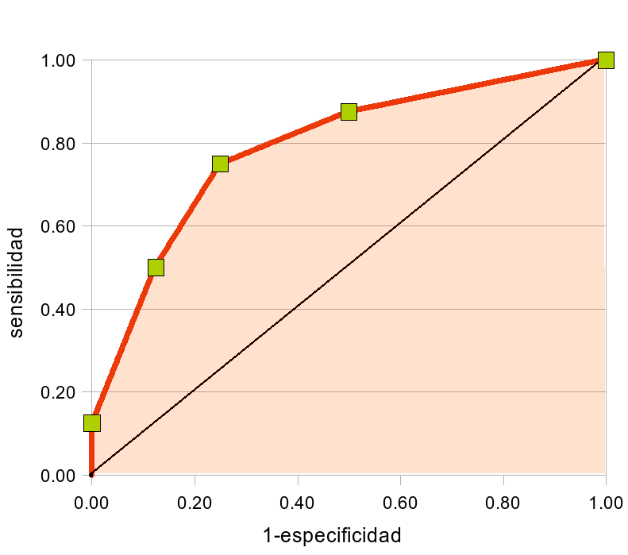
CURVA ROC
Notes:
Predicting the distribution of endangered species from habitat data is frequently perceived to be a useful technique. Models that predict the presence or absence of a species are normally judged by the number of prediction errors. These may be of two types: false positives and false negatives. Many of the prediction errors can be traced to ecological processes such as unsaturated habitat and species interactions. Consequently, if prediction errors are not placed in an ecological context the results of the model may be misleading. The simplest, and most widely used, measure of prediction accuracy is the number of correctly classified cases. There are other measures of prediction success that may be more appropriate. Strategies for assessing the causes and costs of these errors are discussed. A range of techniques for measuring error in presence/absence models, including some that are seldom used by ecologists (e.g. ROC plots and cost matrices), are described. A new approach to estimating prediction error, which is based on the spatial characteristics of the errors, is proposed. Thirteen recommendations are made to enable the objective selection of an error assessment technique for ecological presence/absence models.

Slide 41
CURVA ROC
Area Under the Curve ROC ( “Receiver Operating Characteristic”) -> probabilidad de que, seleccionando al azar una presencia y una ausencia, el modelo clasifique con un valor de idoneidad mayor a la presencia que a la ausencia.
Suponiendo AUC = 0.74, el modelo dará mayor valor de idoneidad a las presencias un 74% de las veces
Notes:
Predicting the distribution of endangered species from habitat data is frequently perceived to be a useful technique. Models that predict the presence or absence of a species are normally judged by the number of prediction errors. These may be of two types: false positives and false negatives. Many of the prediction errors can be traced to ecological processes such as unsaturated habitat and species interactions. Consequently, if prediction errors are not placed in an ecological context the results of the model may be misleading. The simplest, and most widely used, measure of prediction accuracy is the number of correctly classified cases. There are other measures of prediction success that may be more appropriate. Strategies for assessing the causes and costs of these errors are discussed. A range of techniques for measuring error in presence/absence models, including some that are seldom used by ecologists (e.g. ROC plots and cost matrices), are described. A new approach to estimating prediction error, which is based on the spatial characteristics of the errors, is proposed. Thirteen recommendations are made to enable the objective selection of an error assessment technique for ecological presence/absence models.

Slide 42
PRESENCIA – ALEATORIOS
EN MODELO CONTINUO
Notes:
Predicting the distribution of endangered species from habitat data is frequently perceived to be a useful technique. Models that predict the presence or absence of a species are normally judged by the number of prediction errors. These may be of two types: false positives and false negatives. Many of the prediction errors can be traced to ecological processes such as unsaturated habitat and species interactions. Consequently, if prediction errors are not placed in an ecological context the results of the model may be misleading. The simplest, and most widely used, measure of prediction accuracy is the number of correctly classified cases. There are other measures of prediction success that may be more appropriate. Strategies for assessing the causes and costs of these errors are discussed. A range of techniques for measuring error in presence/absence models, including some that are seldom used by ecologists (e.g. ROC plots and cost matrices), are described. A new approach to estimating prediction error, which is based on the spatial characteristics of the errors, is proposed. Thirteen recommendations are made to enable the objective selection of an error assessment technique for ecological presence/absence models.

Slide 43
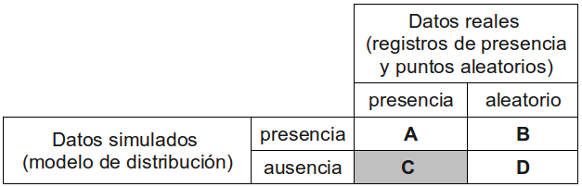
MATRIZ DE CONFUSIÓN MODIFICADA
A → presencias acertadas
D → ya no es un acierto
B → ya no es un error
C → presencias fallidas (falsos negativos o error de omisión)
Notes:
Predicting the distribution of endangered species from habitat data is frequently perceived to be a useful technique. Models that predict the presence or absence of a species are normally judged by the number of prediction errors. These may be of two types: false positives and false negatives. Many of the prediction errors can be traced to ecological processes such as unsaturated habitat and species interactions. Consequently, if prediction errors are not placed in an ecological context the results of the model may be misleading. The simplest, and most widely used, measure of prediction accuracy is the number of correctly classified cases. There are other measures of prediction success that may be more appropriate. Strategies for assessing the causes and costs of these errors are discussed. A range of techniques for measuring error in presence/absence models, including some that are seldom used by ecologists (e.g. ROC plots and cost matrices), are described. A new approach to estimating prediction error, which is based on the spatial characteristics of the errors, is proposed. Thirteen recommendations are made to enable the objective selection of an error assessment technique for ecological presence/absence models.

Slide 44
CURVA ROC CON PUNTOS ALEATORIOS
Cambia el significado: AUC es la probabilidad de que un punto de presencia seleccionado al azar tenga un valor de idoneidad más alto que el de un punto aleatorio seleccionado al azar.
Pero ahora AUC siempre será menor que 1, porque siempre habrá puntos aleatorios sobre áreas de hábitat idóneo.

Slide 45
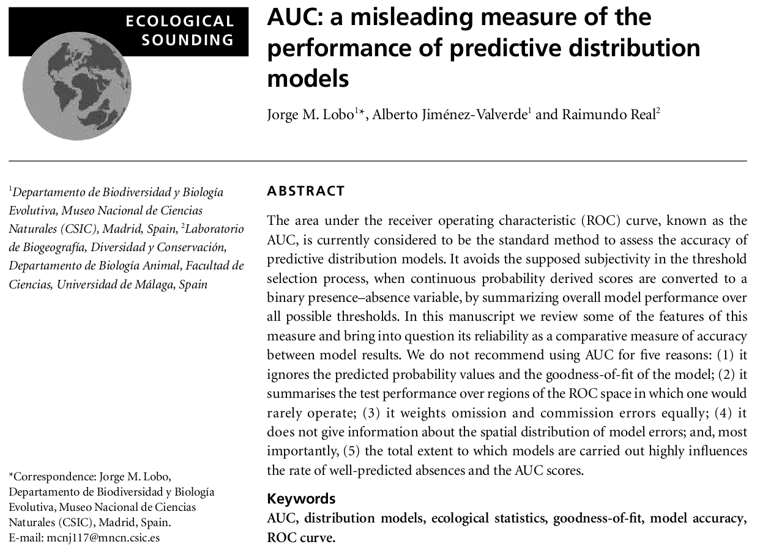

Slide 46
ALGUNOS PROBLEMAS DE AUC
Considera regiones del espacio ROC en los que no se trabaja, como los extremos de la curva, en los que las tasas de error son elevadas.
Pondera por igual los errores de comisión y omisión.
No informa de distribución espacial de los errores.
Las áreas de trabajo amplias resultan en valores de AUC más altos.
No pueden compararse modelos de distintas especies.

Slide 47
MÉTODOS PARA CALCULAR AUC
Datos independientes: 1 solo valor de AUC por modelo
Sin datos independientes: Cross validation
  Data splitting: separas un conjunto de datos para calibrar el modelo, y otro para evaluar
  K-fold: separación de los datos en n grupos. Calibras con n-1 y evalúas con 1.
  Bootstrap: partición iterativa de los datos, para calibrar con unos, y evaluar con otros.
  Leave-one-out: para muestras pequeñas.

Slide 48
CALCULANDO AUC CON DISMO
La función dismo::evaluate() calcula AUC a partir de (dos posibilidades):
1
  p: valores de idoneidad de las presencias
  a: valores de idoneidad de las ausencias
2
  p: coordenadas de las presencias
  a: coordenadas de las ausencias
  x: mapa del modelo

Slide 49
CALCULANDO AUC CON DISMO
La función devuelve:
  auc y pauc: AUC y p-valor de AUC
  cor y pcor: biserial correlation (R2 y p-value)
  ODP: overall diagnostic power (b + d)/N
  CCR: correct classification rate (a + d)/N
  TPR: true positive rate (sensitivity) a/(a + c)
  TNR: true negative rate (specificity) d/(b + d)
  FPR: false positive rate b/(b + d)
  FNR: false negative rate c/(a + c)
  PPP: positive predictive power a/(a + b)
  NPP: negative predictive power d/(c + d)
  MCR: Misclassification rate (b + c)/N
  OR: Odds-ratio (a x d)/(c x b)
  Kappa: Cohen's kappa

Slide 50
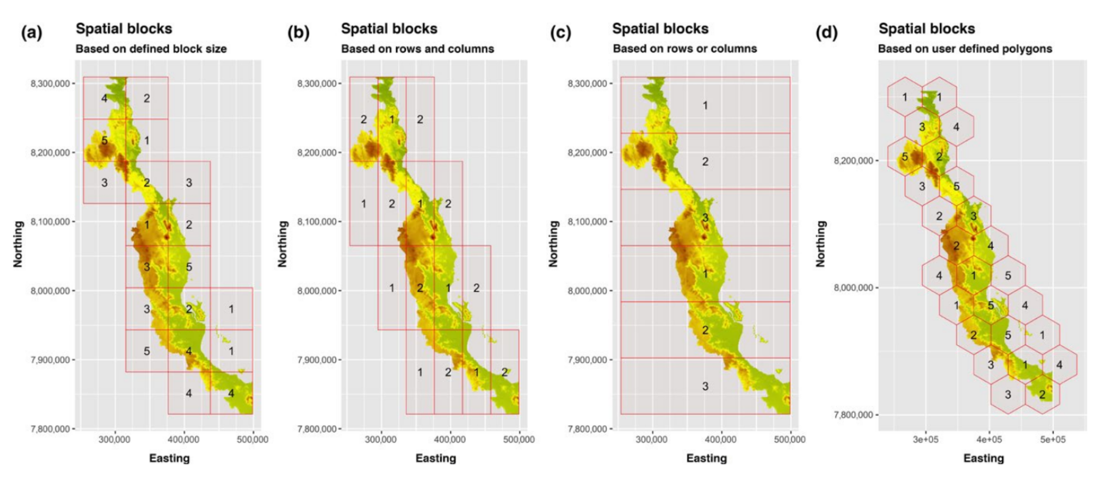
PARTICIÓN GEOGRÁFICA
R package: blockCV: https://github.com/rvalavi/blockCV
Teóricamente es una aproximación ideal, pero no la usamos en el curso porque el paquete está roto en este momento.

Slide 51
AÚN ASÍ...
Es una buena herramienta para comparar modelos para la misma especie y área de trabajo

Slide 52
BOYCE INDEX
Método de evaluación para solo-presencia
Lo calculamos con ecospat::ecospat.boyce()
Correlación entre idoneidad y (presencias predichas partido de presencias esperadas para cada valor de idoneidad)
Requiere:
  Idoneidad predicha para todo el área
  Idoneidad de las presencias
Rango entre -1 y 1
  1 el modelo predice bien las presencias
  0 el modelo no predice presencias mejor que lo esperado por azar
  -1 modelo predice ausencia donde hay presencias

Slide 53
ENSAMBLADO DE MODELOS

Slide 54
ENSAMBLADO
JW Gibbs (1878): Muchas copias de un sistema consideradas simultáneamente. Cada copia representa un estado posible del sistema.
JM Bates y CWJ Granger (1969): Un ensamblado tiene una probabilidad de error menor que cualquiera de sus constituyentes individuales.
Araújo y New 2006: Al promediar varios modelos la señal objetivo emerge del ruido asociado a los errores e incertidumbres de los modelos individuales.

Slide 55
ENSAMBLADO
Las “copias” varían a lo largo de varios ejes
Condiciones iniciales (tanto presencias como variables)
Tipos de modelos
Parámetros de los modelos

Slide 56
ENSAMBLADO
Espacio de modelos posibles

Slide 57
ENSAMBLADO
Tu modelo
Espacio de modelos posibles

Slide 58
ENSAMBLADO
Tu modelo
Espacio de modelos posibles
Mejor modelo posible

Slide 59
ENSAMBLADO
Tu modelo
Espacio de modelos posibles
error
Mejor modelo posible

Slide 60
ENSAMBLADO
Tu modelo
Espacio de modelos posibles
Error más reducido
Mejor modelo posible

Slide 61
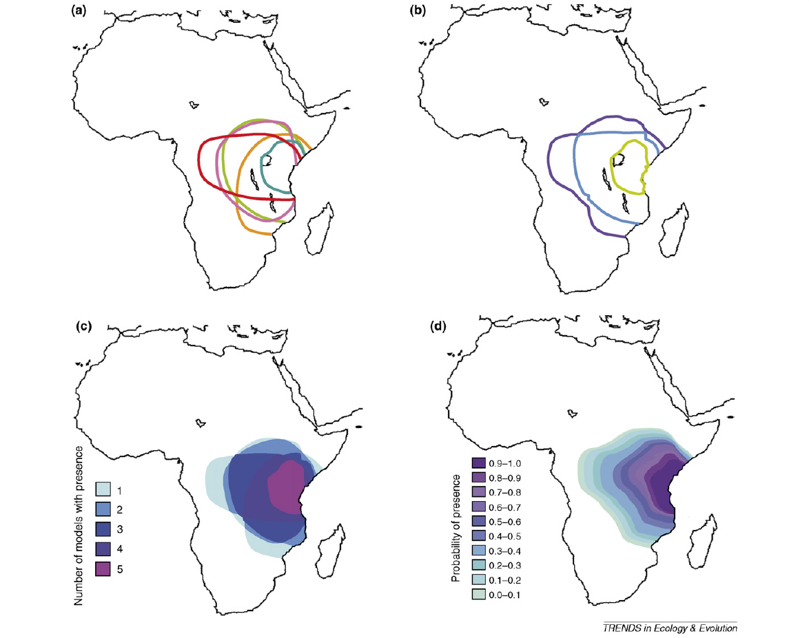
MÉTODOS DE ENSAMBLADO

Slide 62
MÉTODOS DE ENSAMBLADO
Mediana **
Media aritmética ** (buen método, Marmion 2009)
Media ponderada según valores de AUC **
Selección de modelos con mayor AUC
PCA: primer componente refleja la tendencia general. Se seleccionan los modelos más relacionados con este componente, y se les calcula la mediana
Ojo con las escalas de valores de los modelos, deben ser todas iguales!

Slide 63
APLICACIÓN DE THRESHOLDS

Slide 64
DE CONTINUO A BINARIO
Un mapa de valores binarios (0 o 1) es más fácil de comprender que uno continuo (0 a 1)
Para transformar MDE continuos en binarios:
  seleccionamos un valor de referencia: umbral (threshold)
  asignamos valor 1 a todas las celdas por encima del umbral
  asignamos valor 0 a todas las celdas por debajo del umbral

Slide 65
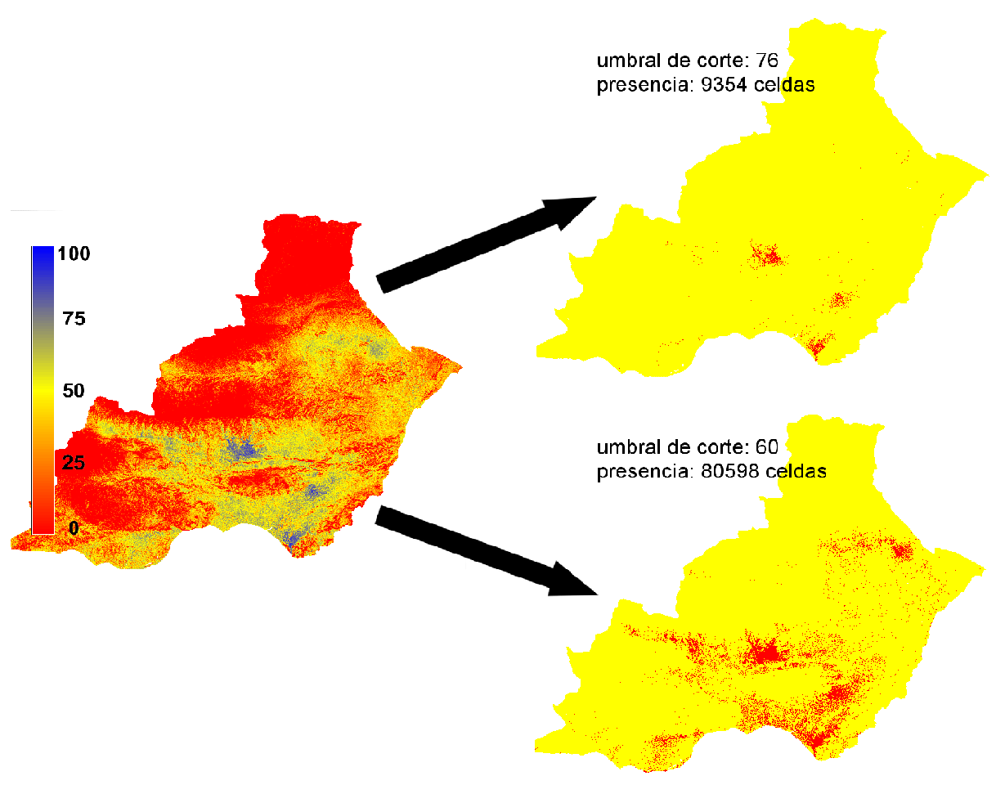
DE CONTINUO A BINARIO

Slide 66
DE CONTINUO A BINARIO
¿Cómo seleccionamos el umbral?...
  Liu et al. 2005
  Jiménez-Valverde y Lobo 2007
  Freeman y Moisen 2008
    Selección subjetiva
    Selección “objetiva”

Slide 67
SELECCIÓN DE UMBRAL
“El umbral se selecciona para maximizar la concordancia entre la distribución observada y la modelada” (Liu et al 2005)
maximización de Kappa (no recomendado)
punto de curva ROC con pendiente = 1
valor con igual sensibilidad y especificidad
y muchos más en Freeman y Moisen (2008)
Estos criterios requieren datos de presencia - ausencia!

Slide 68
'COSAS' IMPORTANTES
La elección del umbral depende del objetivo del modelo, no hay una norma fija
Los modelos de especies con pocas presencias o mal ajuste son muy sensibles a la elección del threshold
No hay obligación de aplicar un threshold a un modelo, salvo que tu análisis concreto lo requiera
Siempre es mejor usar la versión continua de un modelo

Slide 69
THRESHOLD CON R
Con R podemos calcular las estadísticas de las presencias sobre el modelo para tomar decisiones
También podemos ver el gráfico de densidad los valores de las presencias sobre el modelo con 'extract', 'density' y 'plot' para decidir manualmente un punto de corte
La función 'evaluate' de dismo ofrece herramientas para calcular thresholds

Slide 70
PROYECCIÓN DE MODELOS DE DISTRIBUCIÓN EN EL ESPACIO Y EN EL TIEMPO

Slide 71
ANÁLISIS DE INVASIONES BIOLÓGICAS
Broenninmann et al. 2007. Evidence of climatic niche shift during biological invasions. Ecology Letters 10, 701-709
Objetivo: Comprobar cambios en nicho ecológico durante invasión biológica
Métodos: MDE de especie invasora en rango nativo en invadido
Resultados: La especie cambia sus requerimientos ecológicos durante la invasión
Conclusiones: Los MDE predicen áreas de introducción de especies invasoras, pero no rangos de invasión
Notes:
Cartografía automática de especies: Los MDE son útiles para generar cartografías de presencia de especies de bajo coste, porque obtienen buenos resultados con un volumen limitado de datos. Estas aplicaciones tienen poca salida en la literatura especializada, pero se usan en entornos de gestión. Aún así hay algún ejemplo:
Location: Oman.
Methods: A Classification Tree Analysis (CTA) was used to model the presence/absence of seven rangeland communities and agricultural areas based on seven selected environmental predictor variables. The latter were either obtained from existing digital datasets or derived from a digital elevation model and satellite images, whereas the grazing intensity was spatially modelled with the kernel density estimation technique. The resulting decision rules of a CTA were applied for predictive mapping within the study area (400 km2, resolution of 5 m) by means of ENVI's decision tree classifier.
Results: Altitude, grazing intensity and landform revealed the highest predictive power.

Slide 72
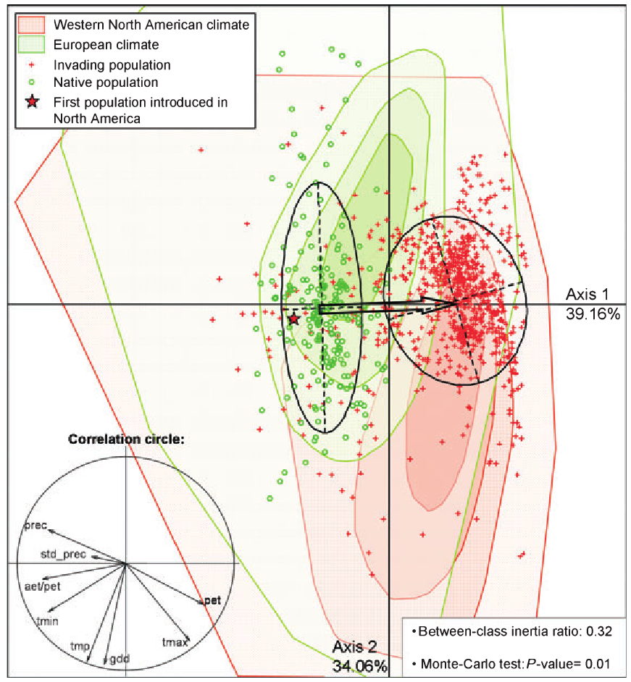
Broenninmann et al. 2007
Notes:
Cartografía automática de especies: Los MDE son útiles para generar cartografías de presencia de especies de bajo coste, porque obtienen buenos resultados con un volumen limitado de datos. Estas aplicaciones tienen poca salida en la literatura especializada, pero se usan en entornos de gestión. Aún así hay algún ejemplo:
Location: Oman.
Methods: A Classification Tree Analysis (CTA) was used to model the presence/absence of seven rangeland communities and agricultural areas based on seven selected environmental predictor variables. The latter were either obtained from existing digital datasets or derived from a digital elevation model and satellite images, whereas the grazing intensity was spatially modelled with the kernel density estimation technique. The resulting decision rules of a CTA were applied for predictive mapping within the study area (400 km2, resolution of 5 m) by means of ENVI's decision tree classifier.
Results: Altitude, grazing intensity and landform revealed the highest predictive power.

Slide 73
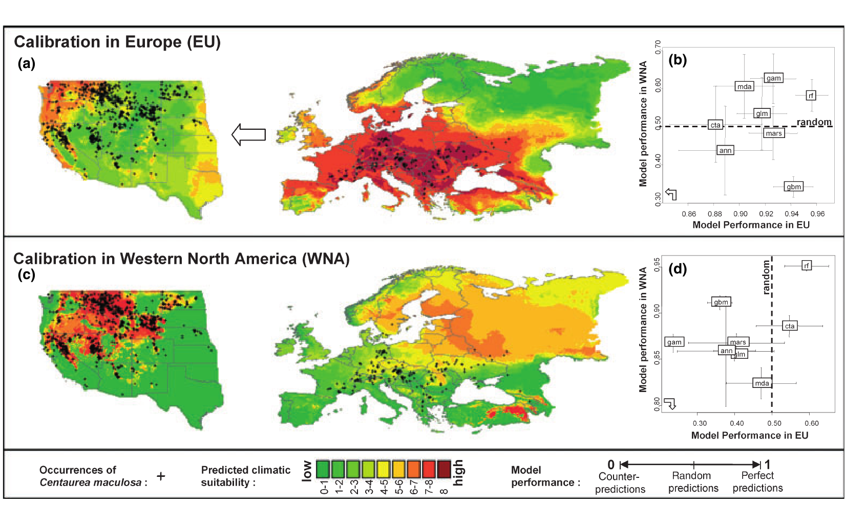
Broenninmann et al. 2007
Notes:
Cartografía automática de especies: Los MDE son útiles para generar cartografías de presencia de especies de bajo coste, porque obtienen buenos resultados con un volumen limitado de datos. Estas aplicaciones tienen poca salida en la literatura especializada, pero se usan en entornos de gestión. Aún así hay algún ejemplo:
Location: Oman.
Methods: A Classification Tree Analysis (CTA) was used to model the presence/absence of seven rangeland communities and agricultural areas based on seven selected environmental predictor variables. The latter were either obtained from existing digital datasets or derived from a digital elevation model and satellite images, whereas the grazing intensity was spatially modelled with the kernel density estimation technique. The resulting decision rules of a CTA were applied for predictive mapping within the study area (400 km2, resolution of 5 m) by means of ENVI's decision tree classifier.
Results: Altitude, grazing intensity and landform revealed the highest predictive power.

Slide 74
ANÁLISIS DE PALEODISTRIBUCIONES
Lorenzen et al. 2011. Species-speciﬁc responses of Late Quaternary megafauna to climate and humans. Nature 479, 359-364
Objetivo: Aclarar efecto del clima y el hombre en la distribución de a megafauna del Cuaternario
Métodos: MDE, registro fósil, ADN
Resultados: Especies presentan respuestas diferentes a cambio de clima y efecto humano
Conclusiones: El cambio del clima explica algunas extinciones, pero otras no pueden entenderse sin la acción del hombre
Notes:
Cartografía automática de especies: Los MDE son útiles para generar cartografías de presencia de especies de bajo coste, porque obtienen buenos resultados con un volumen limitado de datos. Estas aplicaciones tienen poca salida en la literatura especializada, pero se usan en entornos de gestión. Aún así hay algún ejemplo:
Location: Oman.
Methods: A Classification Tree Analysis (CTA) was used to model the presence/absence of seven rangeland communities and agricultural areas based on seven selected environmental predictor variables. The latter were either obtained from existing digital datasets or derived from a digital elevation model and satellite images, whereas the grazing intensity was spatially modelled with the kernel density estimation technique. The resulting decision rules of a CTA were applied for predictive mapping within the study area (400 km2, resolution of 5 m) by means of ENVI's decision tree classifier.
Results: Altitude, grazing intensity and landform revealed the highest predictive power.

Slide 75
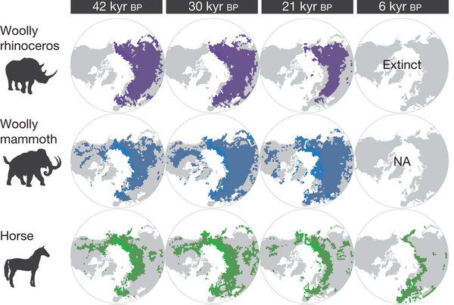
Lorenzen et al. 2011
Notes:
Cartografía automática de especies: Los MDE son útiles para generar cartografías de presencia de especies de bajo coste, porque obtienen buenos resultados con un volumen limitado de datos. Estas aplicaciones tienen poca salida en la literatura especializada, pero se usan en entornos de gestión. Aún así hay algún ejemplo:
Location: Oman.
Methods: A Classification Tree Analysis (CTA) was used to model the presence/absence of seven rangeland communities and agricultural areas based on seven selected environmental predictor variables. The latter were either obtained from existing digital datasets or derived from a digital elevation model and satellite images, whereas the grazing intensity was spatially modelled with the kernel density estimation technique. The resulting decision rules of a CTA were applied for predictive mapping within the study area (400 km2, resolution of 5 m) by means of ENVI's decision tree classifier.
Results: Altitude, grazing intensity and landform revealed the highest predictive power.

Slide 76
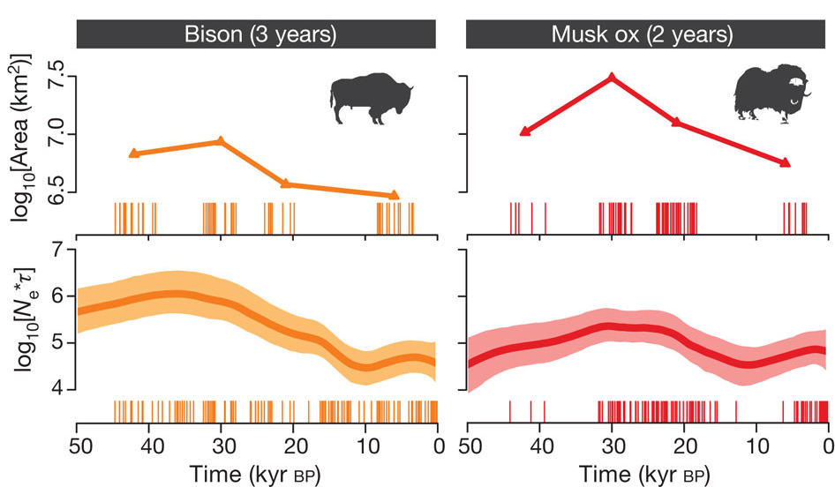
Lorenzen et al. 2011
Notes:
Cartografía automática de especies: Los MDE son útiles para generar cartografías de presencia de especies de bajo coste, porque obtienen buenos resultados con un volumen limitado de datos. Estas aplicaciones tienen poca salida en la literatura especializada, pero se usan en entornos de gestión. Aún así hay algún ejemplo:
Location: Oman.
Methods: A Classification Tree Analysis (CTA) was used to model the presence/absence of seven rangeland communities and agricultural areas based on seven selected environmental predictor variables. The latter were either obtained from existing digital datasets or derived from a digital elevation model and satellite images, whereas the grazing intensity was spatially modelled with the kernel density estimation technique. The resulting decision rules of a CTA were applied for predictive mapping within the study area (400 km2, resolution of 5 m) by means of ENVI's decision tree classifier.
Results: Altitude, grazing intensity and landform revealed the highest predictive power.

Slide 77
CAMBIO CLIMÁTICO Y MIGRACIÓN
Skov y Svenning 2004. Potential impact of climatic change on the distribution of forest herbs in Europe. Ecography 27, 366-380
Objetivo: Evaluar consecuencias del Cambio Climático en la distribución plantas europeas
Métodos: Envueltas bioclimáticas difusas
Resultados: Observan pérdidas moderadas de hábitat para todas las especies
Conclusiones: La escasa dispersión natural de estas plantas va a impedirles migrar al ritmo exigido por el cambio climático
Notes:
Cartografía automática de especies: Los MDE son útiles para generar cartografías de presencia de especies de bajo coste, porque obtienen buenos resultados con un volumen limitado de datos. Estas aplicaciones tienen poca salida en la literatura especializada, pero se usan en entornos de gestión. Aún así hay algún ejemplo:
Location: Oman.
Methods: A Classification Tree Analysis (CTA) was used to model the presence/absence of seven rangeland communities and agricultural areas based on seven selected environmental predictor variables. The latter were either obtained from existing digital datasets or derived from a digital elevation model and satellite images, whereas the grazing intensity was spatially modelled with the kernel density estimation technique. The resulting decision rules of a CTA were applied for predictive mapping within the study area (400 km2, resolution of 5 m) by means of ENVI's decision tree classifier.
Results: Altitude, grazing intensity and landform revealed the highest predictive power.

Slide 78
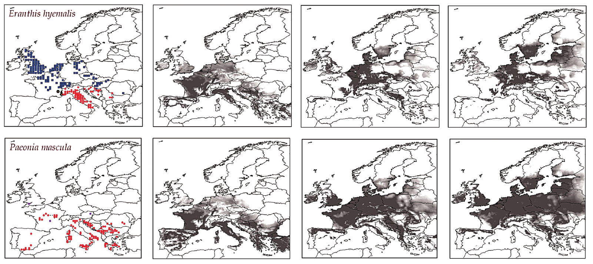
Skov y Svenning 2004
Notes:
Cartografía automática de especies: Los MDE son útiles para generar cartografías de presencia de especies de bajo coste, porque obtienen buenos resultados con un volumen limitado de datos. Estas aplicaciones tienen poca salida en la literatura especializada, pero se usan en entornos de gestión. Aún así hay algún ejemplo:
Location: Oman.
Methods: A Classification Tree Analysis (CTA) was used to model the presence/absence of seven rangeland communities and agricultural areas based on seven selected environmental predictor variables. The latter were either obtained from existing digital datasets or derived from a digital elevation model and satellite images, whereas the grazing intensity was spatially modelled with the kernel density estimation technique. The resulting decision rules of a CTA were applied for predictive mapping within the study area (400 km2, resolution of 5 m) by means of ENVI's decision tree classifier.
Results: Altitude, grazing intensity and landform revealed the highest predictive power.

Slide 79
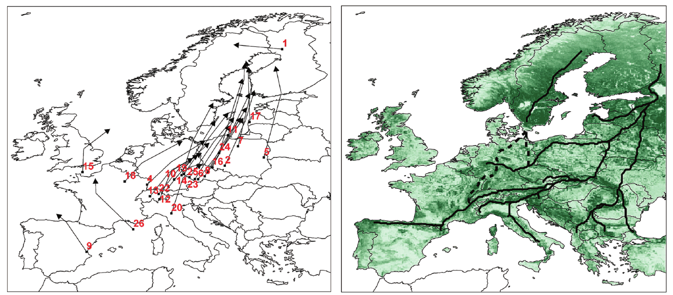
Skov y Svenning 2004
Notes:
Cartografía automática de especies: Los MDE son útiles para generar cartografías de presencia de especies de bajo coste, porque obtienen buenos resultados con un volumen limitado de datos. Estas aplicaciones tienen poca salida en la literatura especializada, pero se usan en entornos de gestión. Aún así hay algún ejemplo:
Location: Oman.
Methods: A Classification Tree Analysis (CTA) was used to model the presence/absence of seven rangeland communities and agricultural areas based on seven selected environmental predictor variables. The latter were either obtained from existing digital datasets or derived from a digital elevation model and satellite images, whereas the grazing intensity was spatially modelled with the kernel density estimation technique. The resulting decision rules of a CTA were applied for predictive mapping within the study area (400 km2, resolution of 5 m) by means of ENVI's decision tree classifier.
Results: Altitude, grazing intensity and landform revealed the highest predictive power.

Slide 80
¿COMO SE PROYECTA UN MODELO DE DISTRIBUCIÓN?
presencia
algoritmo
modelo
(espacio ecológico)
variables
calibrado
proyección
variables
calibrado
variables
proyección
modelo
modelo
proyectado

Slide 81
MULTIVARIATE ENVIRONMENTAL SIMILARITY SURFACES
(MESS)
Índice de similaridad entre el espacio ecológico que ocupan las presencias, y el espacio ecológico que hay en las variables de proyección.
Cuanto más diferente sean, más estaremos extrapolando.
Referencia: Elith J., Kearney M., & Phillips S. 2010. The art of modelling range shifting species. Methods in Ecology and Evolution, 1 :330-342.

Slide 82
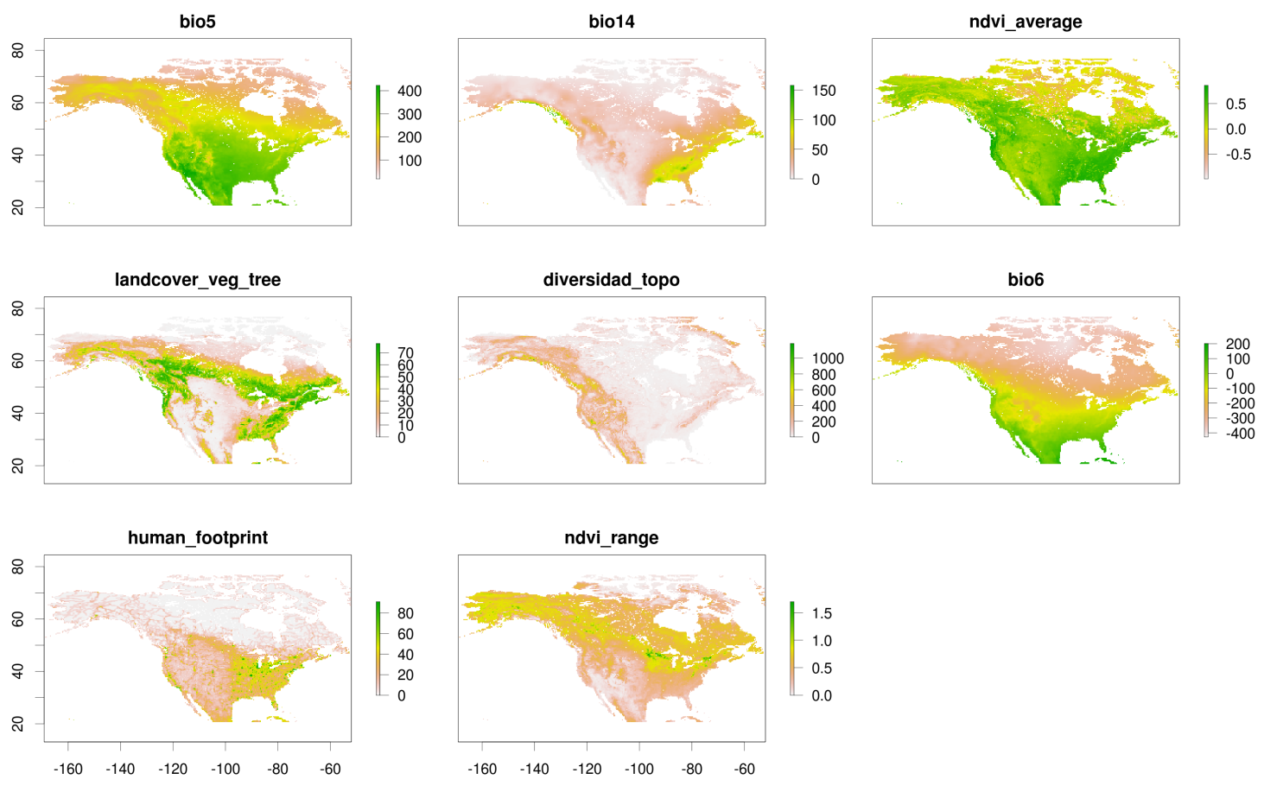
VARIABLES

Slide 83
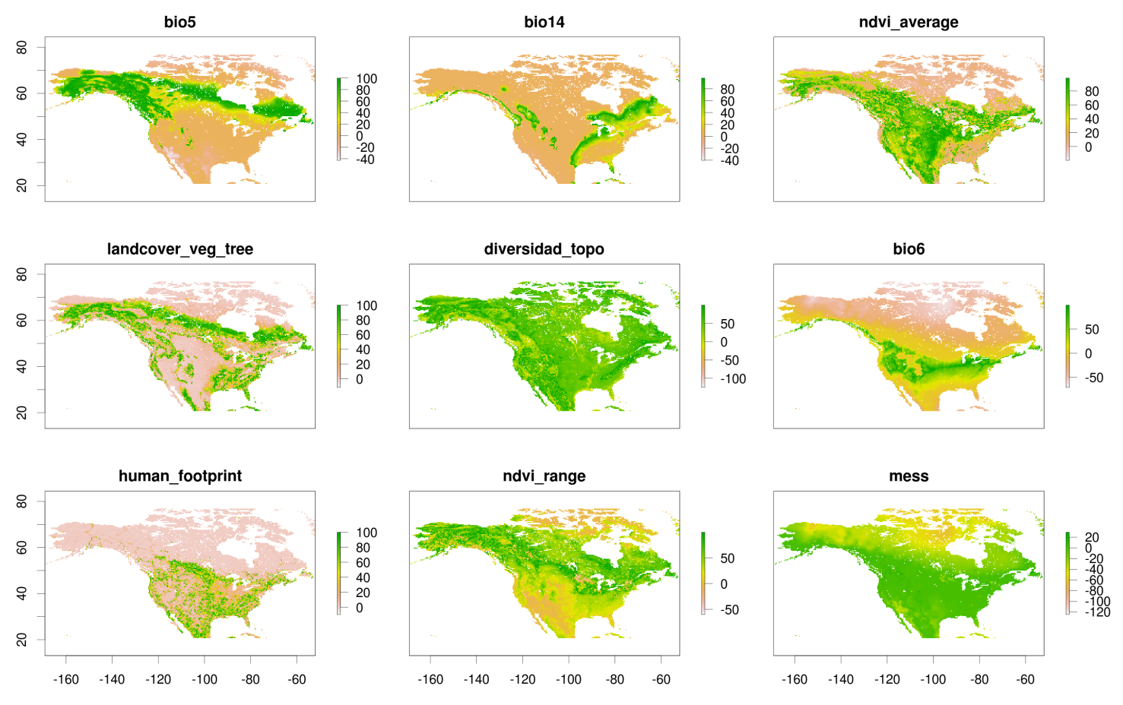
MESS

Slide 84
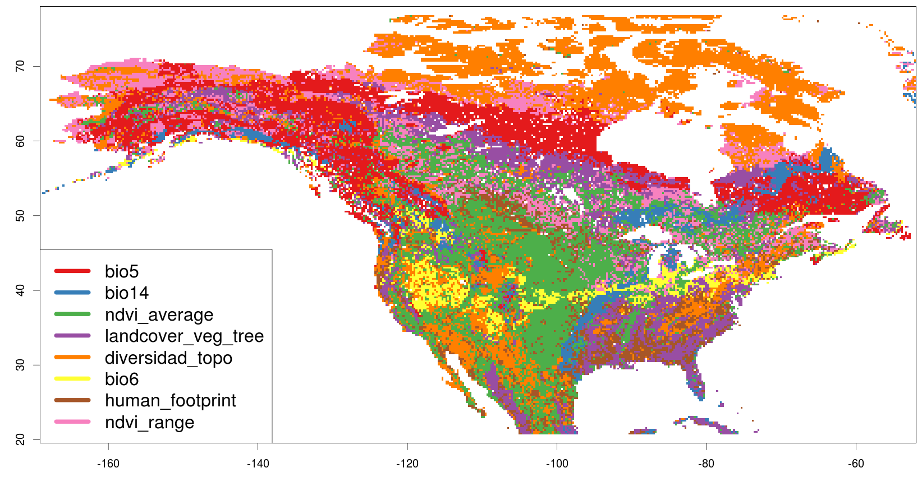
MESS (máximo)

Slide 85
PROYECCIÓN EN EL ESPACIO
Una región origen y una de destino
Calibramos el modelo en la de origen
Proyectamos el modelo en la de destino
Necesitamos tener las mismas variables CON LOS MISMOS NOMBRES para ambas regiones, idealmente a la misma resolución.
Uso más extendido: invasibilidad
Problemas: a million...

Slide 86
PROYECCIÓN EN EL TIEMPO
Una región y tiempo de origen y un tiempo de destino (pasado o futuro)
Calibramos el en origen y proyectamos en destino
Mismos nombres de las variables
Algunas variables no están disponibles para pasado o futuro (ndvi, human footprint, etc)
Suelen hacerse solo con clima y topografía
Uso más extendido: cambio climático, paleodistribuciones
Problemas: a million...

Slide 87
FUENTES DE PALEOCLIMA
Último interglacial (120 – 140 kyr BP) disponible en www.worldclim.org/past (resolución: 1 km)
Último máximo glacial (21 kyr BP) según los modelos CCSM y MIROC, procedente de PMIP3 (pmip3.lsce.ipsl.fr) y disponible en www.worldclim.org/past (resolución: 5km)
Holoceno medio (6 kyr BP) solo disponibles en PMIP3 (pmip3.lsce.ipsl.fr)
TraCE-21ka (21 kyr BP → presente) disponible en www.cgd.ucar.edu/ccr/TraCE a resolución grosera (2º, solo para escalas continentales)

Slide 88
¿COMO PODEMOS EVALUAR ESTOS MODELOS?
El AUC de un modelo actual no representa la capacidad predictiva del modelo en el pasado o el futuro
Los modelos de paleodistribución de plantas se pueden evaluar con polen fósil y macrorrestos
Los modelos de paleodistribución de animales se pueden evaluar con datos de registro fósil
Los datos de evaluación y los modelos deben ser coetáneos.

Slide 89
ALGUNAS PREMISAS
Una proyección NO representa la distribución futura o pasada (o en otro lugar) de una especie.
Una proyección SOLO representa donde habrá condiciones ecológicas similares a aquellas en las que se ha observado la especie (¡siempre que el modelo no extrapole!) .
Las proyecciones asumen que el nicho ecológico de las especies es constante.
Los mapas climáticos del pasado o futuro son ESCENARIOS, no representan la realidad.

Slide 90


