Slide 1
Component-based System Design in BIP
Wang Qiang 2019-6-14

Slide 2
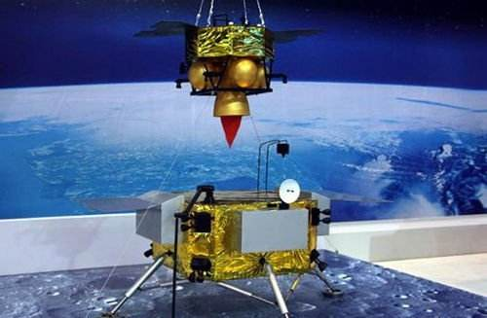


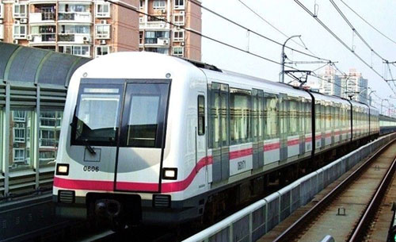

Safety critical systems
A computing system whose failure may cause injury or death to human beings.
It is thus important the ensure correctness with respect to essential safety properties.
Modern systems have reached limits of affordability due to exponential grow of SW and its complexity.
Notes:
Laser 2005 - Summer School on Software Engineering
2
Laser 2005 - Summer School on Software Engineering
2
2

Slide 3
System design: an overview
System design is the process leading to a mixed software-hardware system meeting given requirements.

Slide 4
System design: current practice
70% requirements and design bugs
80% late bug detection and correction at high cost
Bugs are introduced early but detected (too) lately.
It is computationally infeasible to detect all bugs using verification.
D.Galin. Software quality assurance: from theory to implementation. Pearson/Addison-Wesley (2004).
Notes:
Laser 2005 - Summer School on Software Engineering
4
Laser 2005 - Summer School on Software Engineering
4
4

Slide 5


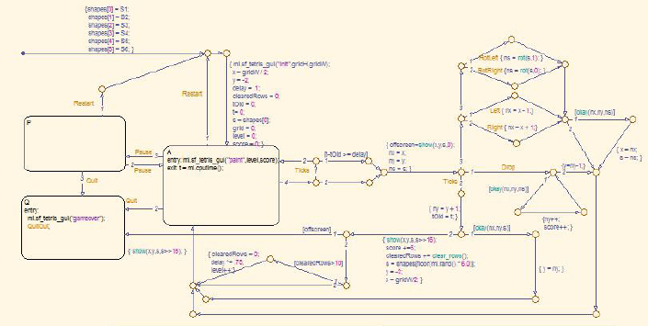
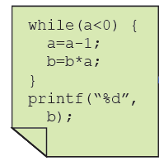

Model-based system design
Functional and nominal correctness analysis (e.g. model checking)
Domain specific language (e.g. AADL,BIP)
Requirements
Model / Specification
Code generation
Code
Component based design specializes model based design approach in the way that model are constructed by composing individual components using connectors.
Notes:
A domain specific language to construct a formal model of the system
A formal specification language to formalize the requirements
Formal, systematic , too-supported analyzes

Slide 6
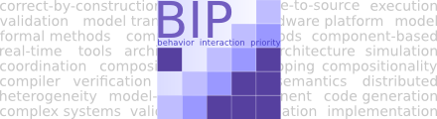
BIP (Behavior-Interaction-Priority)
A component-based framework for complex system design that features correctness-by-construction
It provides an expressive modeling language
Execution: synchronous and asynchronous components
Interaction: function call, broadcast, rendezvous
Abstraction levels: hardware, application software
It provides a toolchain to support model validation & verification, automated code generation on given platforms, and performance analysis.

Slide 7
BIP framework
aadl
lustre
simulink
BIP Language
parser
BIP compiler
model transformer
BIP Meta Model
transformers
model checker
code generator
C++
executable
BIP engine

Slide 8
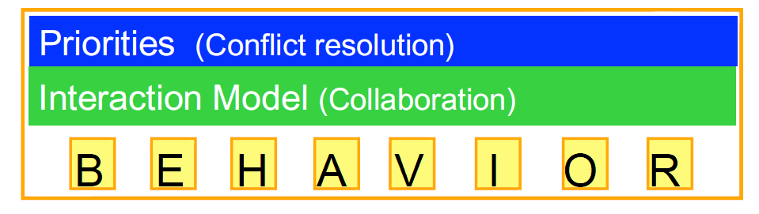
BIP framework
BIP modeling language provides three primitives.
the behavior specified by a set of components
a set of interactions which defines the possible synchronizations and communications between the components
a set of priorities used for resolving conflicts between interactions or for defining interaction schedule policies

Slide 9
BIP modeling language: component

Slide 10
Operational Semantics: component

Slide 11
BIP modeling language: interaction model
p1
[x>0] y=x+1
p2
x
y
Interaction: {p1,p2}
guard: x>0
action: y=x+1
START
START
p1
p2
END
END

Slide 12
Operational Semantics: interaction

Slide 13
BIP modeling language: interaction model
Interactions are structured in connectors in BIP.
A connector is a set of typed ports (i.e., triggers and synchrons).
A trigger can be executed alone without synchronizing with the others.
out1 is a trigger, all the others are synchrons.
Interactions: {tick1,tick2,tick3} {out1} {out1,in1} {out1,in3} {out1,in2,in3}

Slide 14
BIP modeling language: priority

Slide 15
BIP modeling language: an example
A simplified temperature control model of nuclear plant
The system consists of a controller interacting with an arbitrary number n of rods (e.g. 2) in the reactor.
When the temperature reaches 900 (resp. 450), a rod must be used to cool (resp. heat) the reactor to maintain the temperature between the bounds 450 and 900.
s1,(s3,0),s5
t++*
s1,(s3,901),s5
{cool,cool1}
s2,(s4,901),s5
cool1
heat1
cool
t++
heat
cool2
heat2
t--*
s1
s3
s5
s2,(s4,399),s5
cool1
heat1
cool
t>900
heat
t<450
cool2
heat2
{heat,heat1}
s2
s4
s6
s1,(s3,399),s5
t--

Slide 16
BIP toolchain
BIP toolchain consists of
the BIP compiler that generates codes
the engine that provides the runtime
the model checkers that perform deadlock and reachability analysis
various model transformers
executable
BIP Engine

Slide 17
BIP Engine
BIP compiler generates the source code from a model.
The source code is then linked with a runtime, called an engine, for the correct execution of the BIP model with respect to the BIP semantics.

Slide 18
BIP model checker
Currently it performs reachability check of error locations.
It is based on techniques combining CEGAR and POR
CEGAR to handle state explosion
POR to handle path explosion
cool1
heat1
cool
t++
heat
cool2
heat2
s1
s3
s5
cool1
heat1
cool
t>900
heat
t<450
cool2
heat2
s2
s4
s6
t--
“There is always only one rod in use.”
(s2,s6) is not reachable.

Slide 19
Hello World example
package HelloPackage
port type HelloPort_t()
atom type HelloAtom()
port HelloPort_t p()
place START,END
initial to START
on p from START to END
end
compound type HelloCompound()
component HelloAtom c1()
end
end
p
START
p
END

Slide 20
Multiparty synchronization
@cpp(include="stdio.h")
package HelloPackage
extern function printf(string, int)
port type HelloPort_t()
atom type HelloAtom(int id)
export port HelloPort_t p()
place START,END
initial to START
on p from START to END do {printf("Hello World from %d\n", id);}
end
connector type ThreeRendezVous(HelloPort_t p1, HelloPort_t p2, HelloPort_t p3)
define p1 p2 p3
end
p
p
p
START
START
START
p
p
p
END
END
END
c1(1)
c2(2)
c3(3)
compound type HelloCompound()
component HelloAtom c1(1), c2(2), c3(3)
connector ThreeRendezVous connect(c1.p, c2.p, c3.p)
end
end

Slide 21
Broadcasting
@cpp(include="stdio.h")
package HelloPackage
extern function printf(string, int)
port type HelloPort_t(int d)
atom type HelloAtom(int id)
data int myid
export port HelloPort_t p(myid)
place START,END
initial to START do {myid = id;}
on p from START to END do {printf("Hello World from %d\n", id);}
end
connector type ThreeRendezVous(HelloPort_t p1, HelloPort_t p2, HelloPort_t p3)
define p1’ p2 p3
on p1 p2 p3 down {p2.d=p1.d;p3.d=p1.d;}
on p1 p2 down {p2.d=p1.d;}
on p1 p3 down {p3.d=p1.d;}
end
p(d1)
p(d2)
p(d3)
START
START
START
p
p
p
END
END
END
c1(1)
c2(2)
c3(3)
compound type HelloCompound()
component HelloAtom c1(1), c2(2), c3(3)
connector broadcasting connect(c1.p, c2.p, c3.p)
end
end
Default priority: maximal progress
Others?

Slide 22
Hierarchical model
ep
@cpp(include="stdio.h")
package HelloPackage
// … definitions of HelloPort_t and HelloAtom
connector type SyncRecvs(HelloPort_t r1, HelloPort_t r2)
data int d
export port HelloPort_t ep(d)
define r1’ r2’
on r1 down{r1.d=d;}
on r2 down{r2.d=d;}
on r1 r2 down{r1.d=d;r2.d=d;}
end
connector type OneToOne(HelloPort_t s, HelloPort_t c)
define s’ c
on s c down { c.d = s.d; }
end
p
p
p
START
START
START
p
p
p
END
END
END
c1(1)
c2(2)
c3(3)
compound type RecvsCompound()
component HelloAtom c2(2), c3(3)
connector SyncRecvs sync(c2.p, c3.p)
export port sync.ep as p
end
compound type HelloCompound()
component HelloAtom c1(1)
component RecvsCompound rcvrs()
connector OneToOne brd(c1.p, rcvrs.p)
end

Slide 23
BIP Example
Demo

Slide 24
Real-time BIP

Slide 25
Real-time BIP

Slide 26
Real-time BIP
A timed temperature control model of nuclear plant
The system consists of a controller interacting with an arbitrary number n of rods (e.g. 2) in the reactor.
When the temperature reaches 900 (resp. 450), a rod must be used to cool (resp. heat) the reactor to maintain the temperature between the bounds 450 and 900.
s1,(s3,0),s5
t++*
s1,(s3,900),s5
t++
{cool,cool1}
s2,(s4,900),s5
cool1
heat1
cool
t<=900
heat
cool2
heat2
t--*
s1
s3
s5
s2,(s4,450),s5
cool1
heat1
cool
t>=900
heat
t=<450
cool2
heat2
{heat,heat1}
s2
s4
s6
s1,(s3,450),s5
t>=450

Slide 27
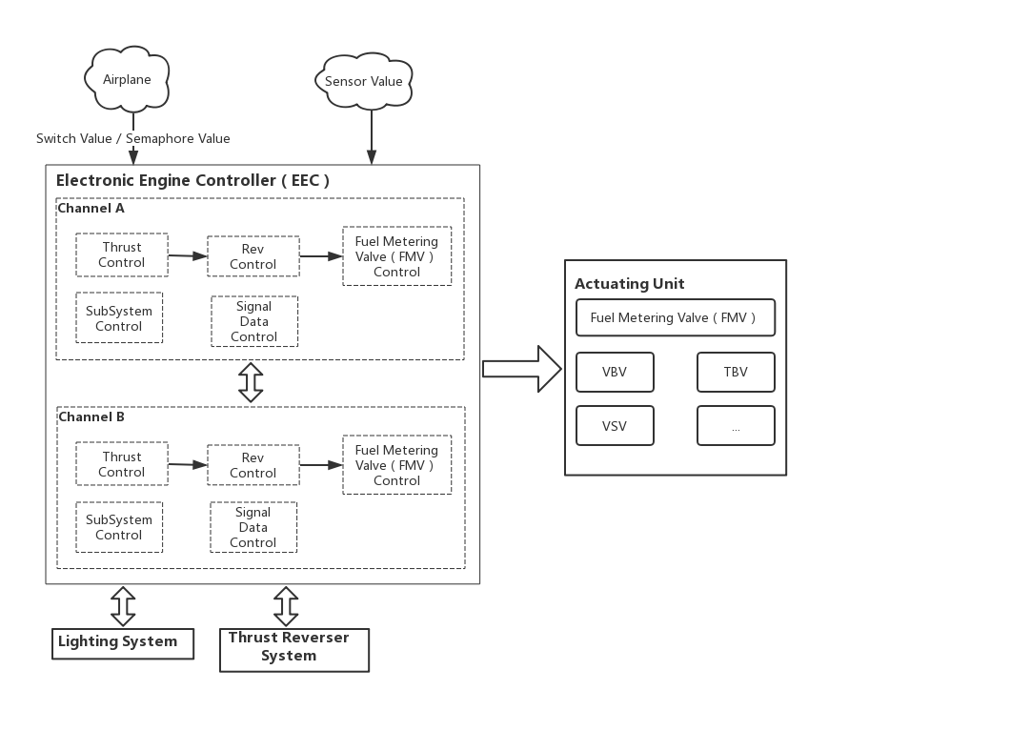
Case study: airplane control software
EEC controls the engine actuation system depending on
(1)the current condition of the flight
(2)the commands received from the cockpit
After receiving these inputs, EEC will process all the data up to 100 times per second, and compute the engine operating parameters.

Slide 28
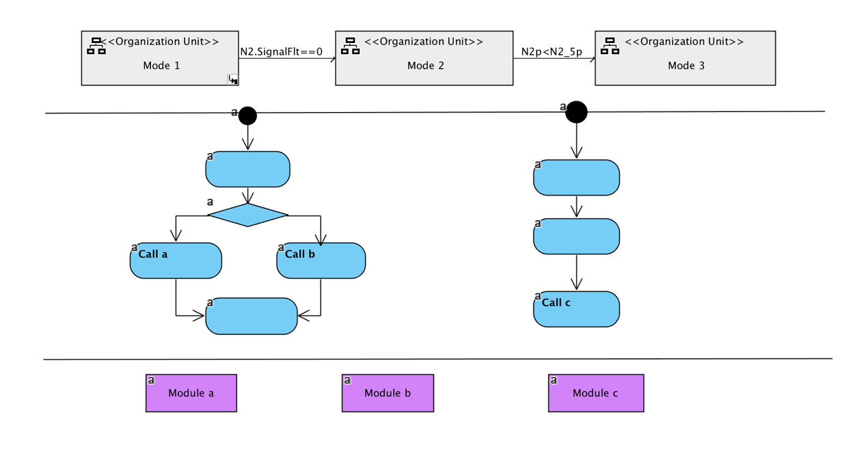
Case study: airplane control software
The control software maintains a set of flight modes (or states) and a set of guarded mode transitions.
In a certain mode, EEC performs some specific tasks periodically.
The tasks will change condition of the flight, which will results in the mode change.

Slide 29
Case study: airplane control software
Mode management
activate
output
activate
output
activate
output
task1
task2
task3
The top component specifies the mode transitions.
The bottom components specify the behavior of each task.
The connectors specify how the model management component and the task components interact.

Slide 30
Case study: mode management component
start
!PLA.BITSetTime
byslow
stand
!ChanSts
N2p<500
PLA.SelfFlt
slow
N2.SignalFlt
N2p>200
!FUELCTRL
P3b.SignalFlt
normal
gstart
wait
FUELCTRL
ChanSts
WheelLoadSignal
oil
N2_5p>1000
sabort
N2p<N2_5p ||
(N2.SignalFlt==1 && (duration(EmergencyStopTimerThsld,s, N2.SignalFlt==1)))
WfDem>30
ustop
There is a self-loop transition on each state to invoke the tasks.

Slide 31
Case study: task component
if(N2.SensorFlt == FAULT && Nac.SensorFlt == NOFAULT&& Nac.VoteData<1){
if((N2_1 -Nac_1) < ModelLimit * N2Design){
N2.ValidData = Nac.VoteData+ N2_1;
N2.SignalFlt = NOFAULT;
if(N2.SensorFlt == NOFAULT && Nac.SensorFlt == NOFAULT) {
N2.ValidData = N2_1;
N2. SignalFlt = FAULT;
}
}
if((N2_1 -Nac_1*NacVsN2)< ModelLimit){
N2.ValidData = Nac.VoteData+ N2_1;
N2.SignalFlt = NOFAULT;
}
}
if(N2.SensorFlt == FAULT && Nac.SensorFlt == FAULT&&N2r25p>2){
N2.ValidData = N2_1;
N2. SignalFlt = FAULT;
}
if(Nac.SensorFlt == NOFAULT && (N2_1 - Nac_1)>= ModelLimit * N2Design){
N2.ValidData = N2_1;
N2. SignalFlt = FAULT;
}
task1
idle
activate
output
work
compute
finish

Slide 32
Thanks!
Notes:
32
谢谢各位领导和专家，请提问！

