Slide 1

Acme Corp Data Analyst Team
Blake Ashford, Courtney Robison, Ryan Simpson, Lucy Kaplan, Savannah Cordry

Slide 2
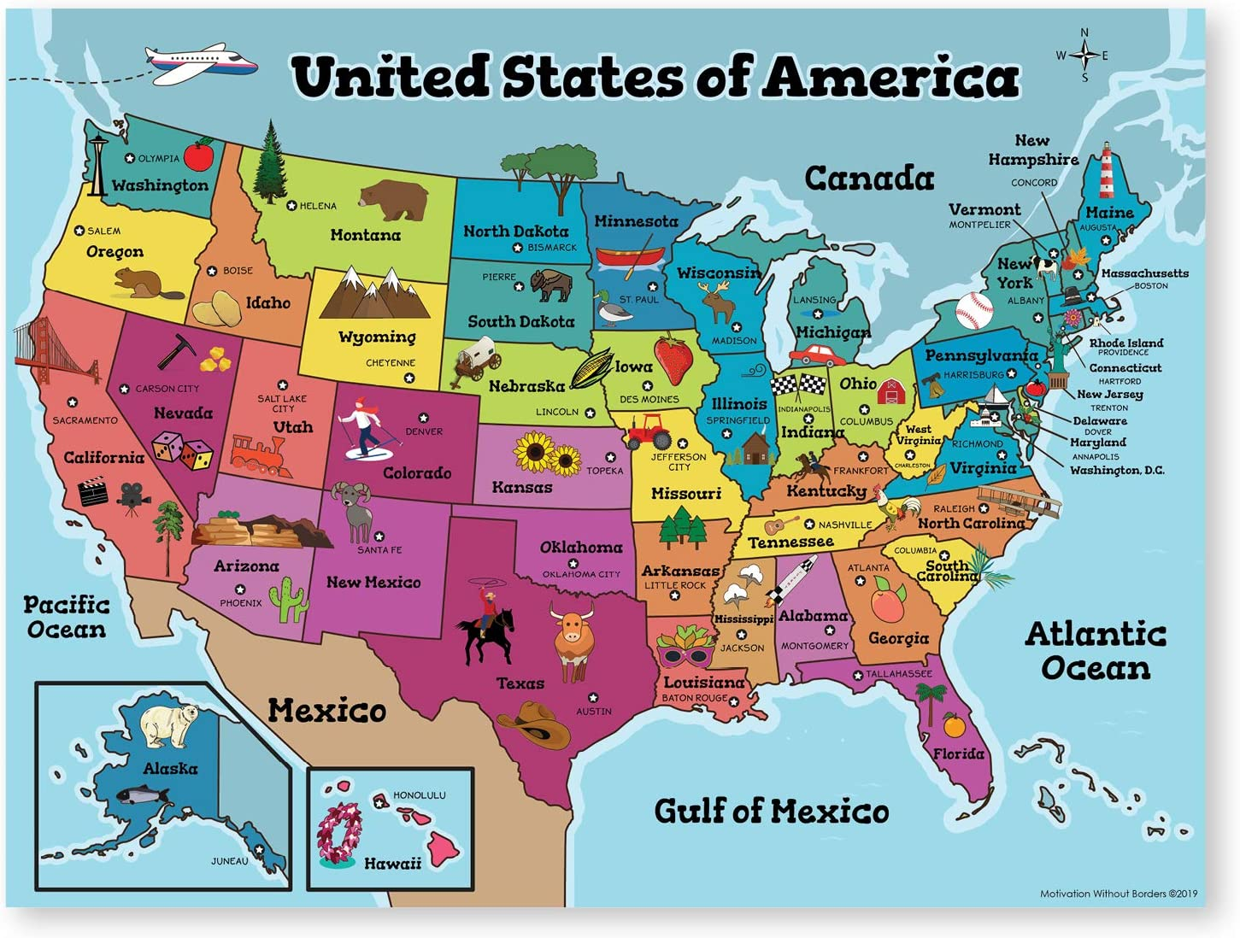

Where should Coyote Inc. build their new factory? The Acme Corp Data Analyst Team is here to find out!
Notes:
Define the core message or hypothesis of your project.
We are the Acme Corp Data Analyst Team and have been hired by Coyote Inc to help them find a location for their newest factory. Based on our analysis of this data, we will ultimately decide in what state Coyote Inc should build their newest factory.
Describe the questions you asked, and why you asked them
We asked ourselves, if we were starting a business, how would we figure out where to base it? Why does location matter? What factors about the location of a business are important?
Questions we asked: Which states would it cost Coyote Inc the least amount of money to have and run their factory? Which states have the highest productivity with the highest value for their product? (Basically, where can you get the most bang for your buck?)
Describe whether you were able to answer these questions to your satisfaction, and briefly summarize your findings
Elaborate on the questions you asked, describing what kinds of data you needed to answer them, and where you found it
We analyzed the Labor and Productivity data from the U.S. Bureau of Labor Statistics looking at the last five years of data (2015-2019).
In this scenario, we had the possibility to locate the new factory in any state in the US, so we compared the data across all 50 states.

Slide 3
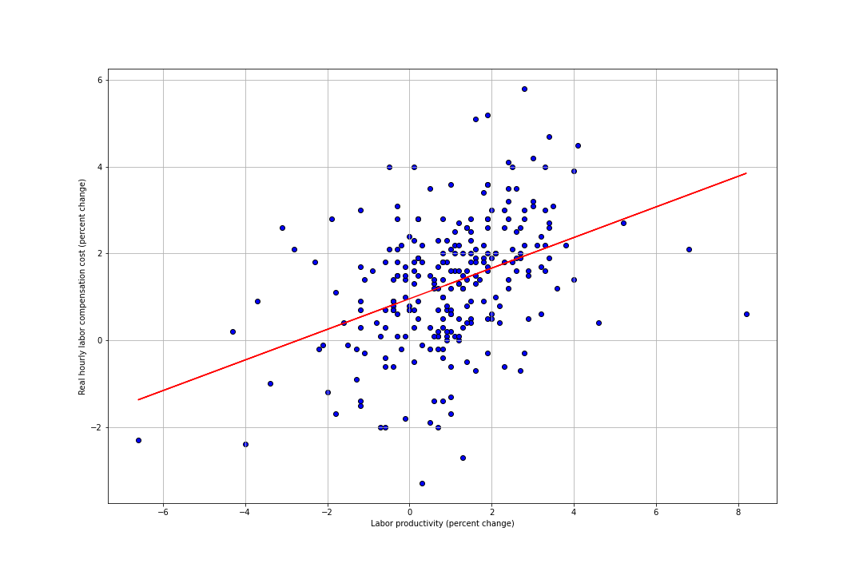
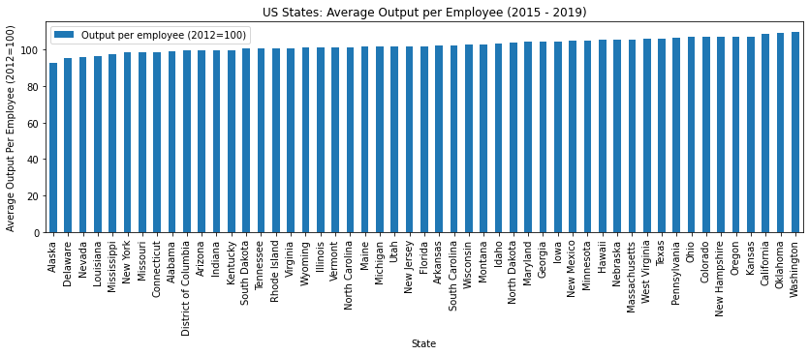
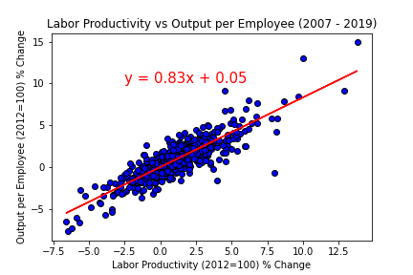
Data Cleanup and Exploration
Notes:
Describe the exploration and cleanup process
Discuss insights you had while exploring the data that you didn't anticipate
Discuss any problems that arose after exploring the data, and how you resolved them
Present and discuss interesting figures developed during exploration
In total there were about 35 columns in our data. We spent a large amount of time discussing the data, deciding which columns were going to help answer our questions.
There ended up being several columns that did not pertain to our questions and were removed from our copy of the data, such as number of employees and number of hours worked. We also spent a large amount of time trying to decipher what many of the columns meant and how they related to each other. We cleaned the data to remove missing values, and only kept the data from the last 5 years as to have the most current information.
Upon exploring the data, we discovered other pieces of information that could be useful in determining which states to recommend such as value of production and output per employee. We measured correlations between several combinations of variables to look for any patterns that would be important to note in our data. While visually it appears in the scatter plot pictured that there is a strong correlation between labor productivity and hourly labor compensation, the Pearson correlation coefficient was only 0.41. This was good news for us, as we were interested in finding a state with low compensation and high productivity. Our many comparisons did not reveal any significant correlations to be considered when moving forward with out analysis. We came to the conclusion that the factors we would mainly focus on to pick our state would be labor productivity and labor compensation.

Slide 4
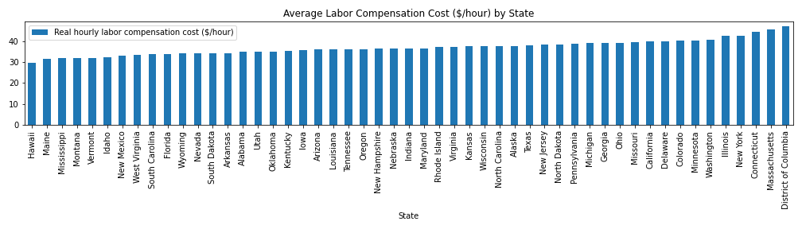
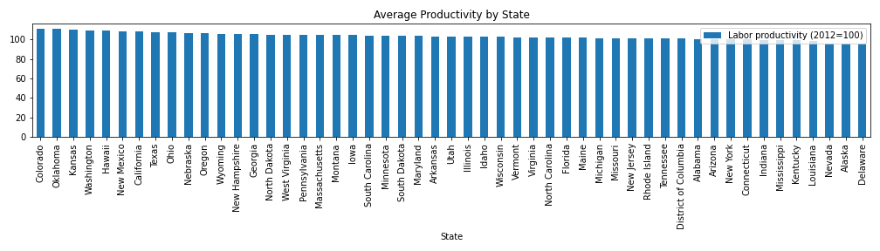
Data Analysis
Notes:
Discuss the steps you took to analyze the data and answer each question you asked in your proposal
Present and discuss interesting figures developed during analysis
We made bar charts to measure the states with the highest average productivity and the states with the lowest average labor compensation. We then picked out the values of the top 15 states for these variables. Of the states in the top 15 for highest productivity and lowest compensation, there were 3 states in common on these lists: Hawaii, New Mexico, and Wyoming.
We would then do further evaluation of these 3 states considering other variables to make our final choice.

Slide 5
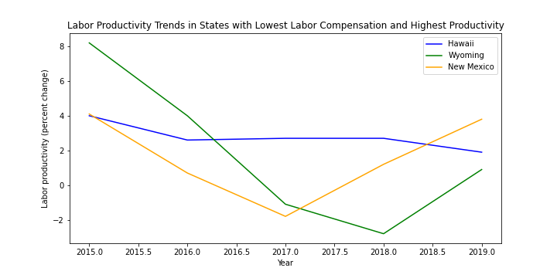
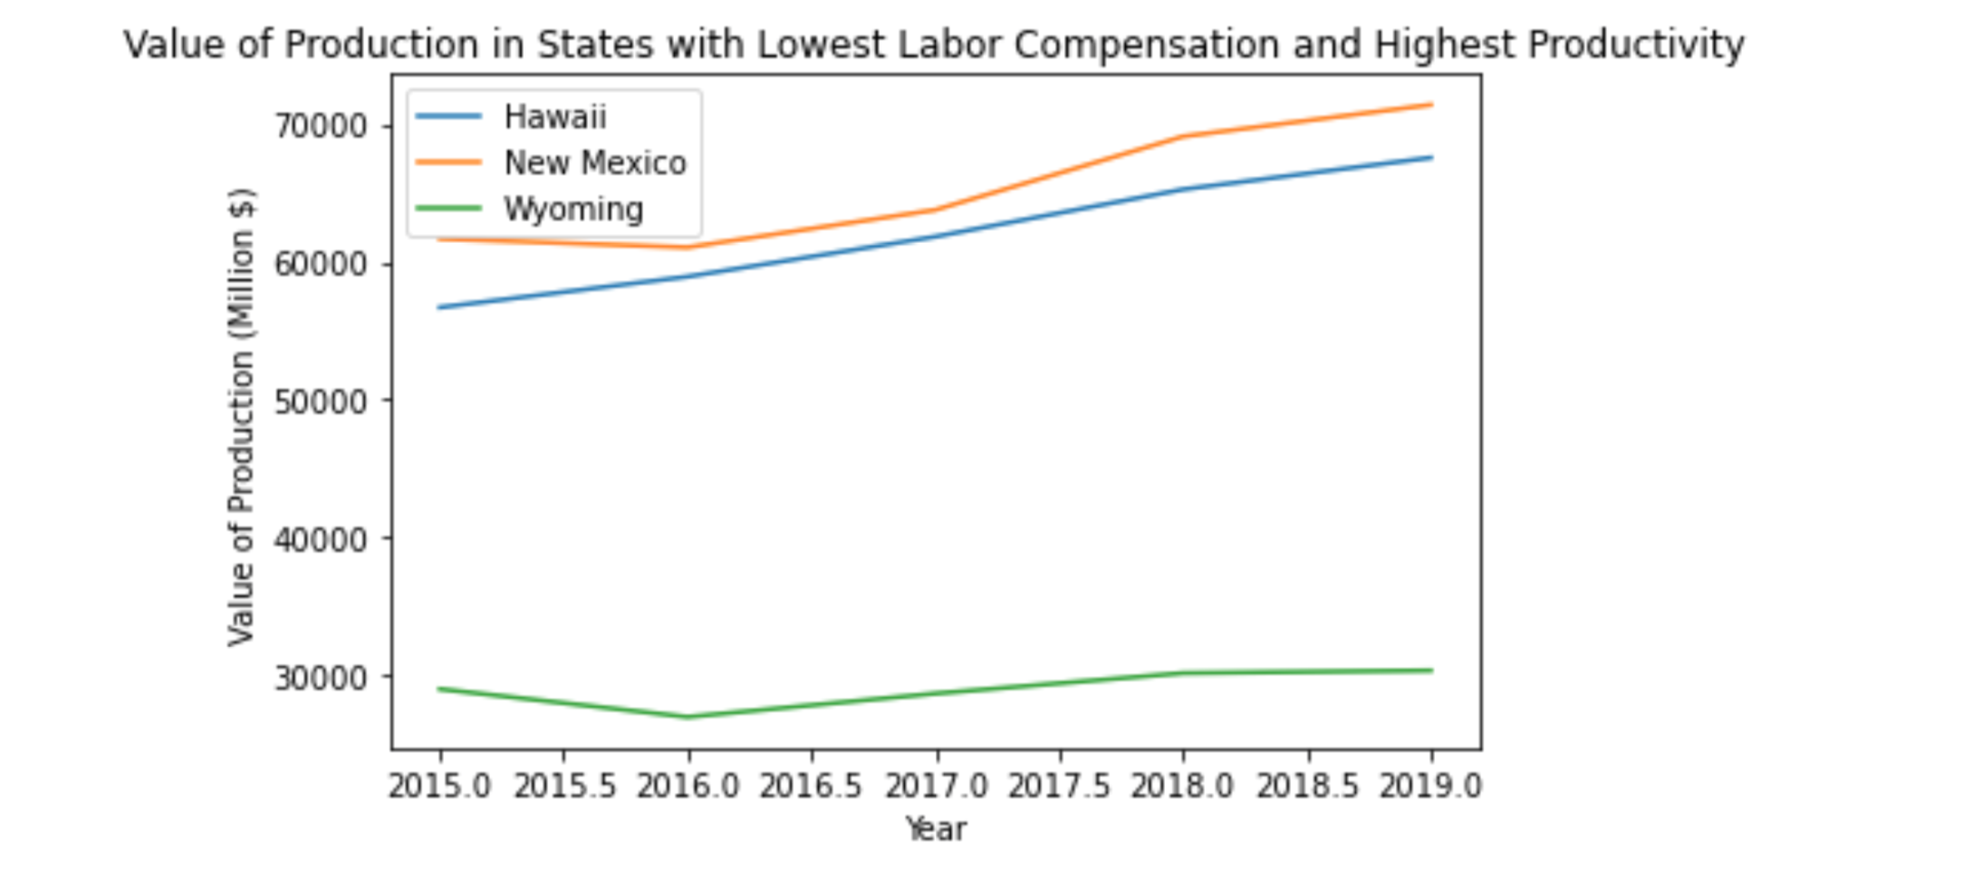
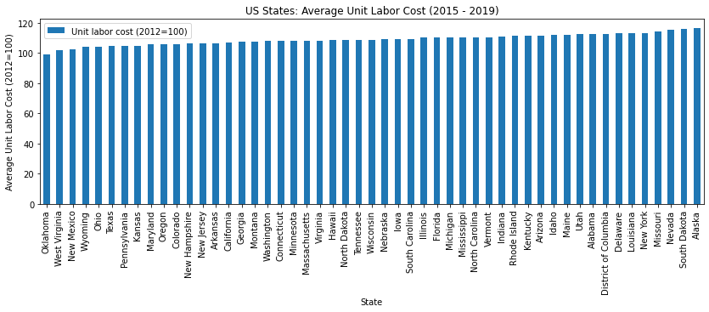
Data Analysis Cont.
Notes:
Once we had determined our top 3 states, we did further evaluation to narrow it down to our top choice.
We wanted to recommend a state that had a high value of production, so we looked to see which of our 3 states had the largest positive change over the last 5 years.
All 3 states showed positive change, Hawaii having the greatest value of change. However, New Mexico’s value of change was only slightly less than that of Hawaii and had an overall higher number for value of production.
We also measured the trend of labor productivity over the past 5 years. Hawaii’s trend showed little (but negative) change over the past 5 years. Wyoming showed a dramatic drop in labor productivity from 2015 to 2017, and recovered about 50% of that by 2019. New Mexico also showed a drop from 2015 to 2017, but recovered fully by 2019.
Additionally, we created a bar chart to show the states with the lowest unit labor cost. New Mexico was the 3rd state with the lowest unit labor cost, Wyoming was the 4th. Hawaii was much further down the chart.

Slide 6
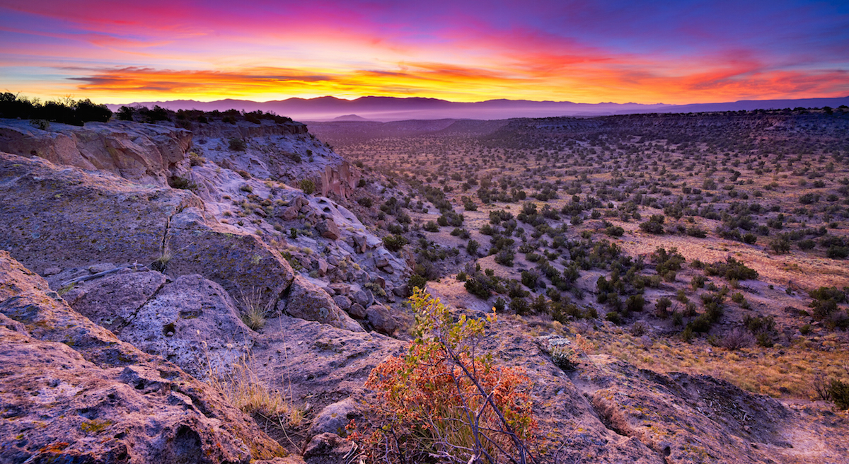
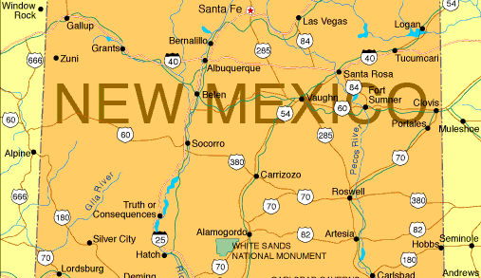
Desert here we come!
Questions?
Notes:
Discuss your findings. Did you find what you expected to find? If not, why not? What inferences or general conclusions can you draw from your analysis?
Discuss any difficulties that arose, and how you dealt with them
Discuss any additional questions that came up, but which you didn't have time to answer: What would you research next, if you had two more weeks?
Questions?
Ultimately, we decided on New Mexico for our recommendation to Coyote Inc as the location of their newest factory. This was based on the conclusions we drew from the data that New Mexico had: the highest average labor productivity in comparison with the lowest average labor compensation. New Mexico also showed to have the highest value of production (in both raw value and value of change over the past five years). Additionally, New Mexico appeared to have the highest value of positive change in labor productivity over the past 5 years.
Difficulties included defining terms used in the data set. Using logic and research, we had to interpret some of columns as best we could to use them as accurately as possible in our data. Some definitions were provided from the U.S. Bureau of Labor Statistics website, but not all.
Other factors we would have liked to consider but didn't have time for: cost of living, tax incentives, population size. What was the product they were selling? What kind of materials are available/cheapest in which areas for what we will be constructing in the factory? Will we be selling locally, or shipping nationwide/worldwide? Where are jobs needed? We also could’ve narrowed it down more (specific city to build in, instead of just state). We had a long list of other questions that we wanted to ask, but would’ve required additional time and additional data.

