Slide 1

Hardware for Computing Bézout's Coefficinets
& Binary GCD Algorithm
By Ryan Massie
Advisor: Dr. Firas Hassan

Slide 2
(Overview)
Background on RSA encryption
Bézout's Coefficients
Binary GCD Algorithm
Proposed Hardware Design
Simulation & Results

Slide 3
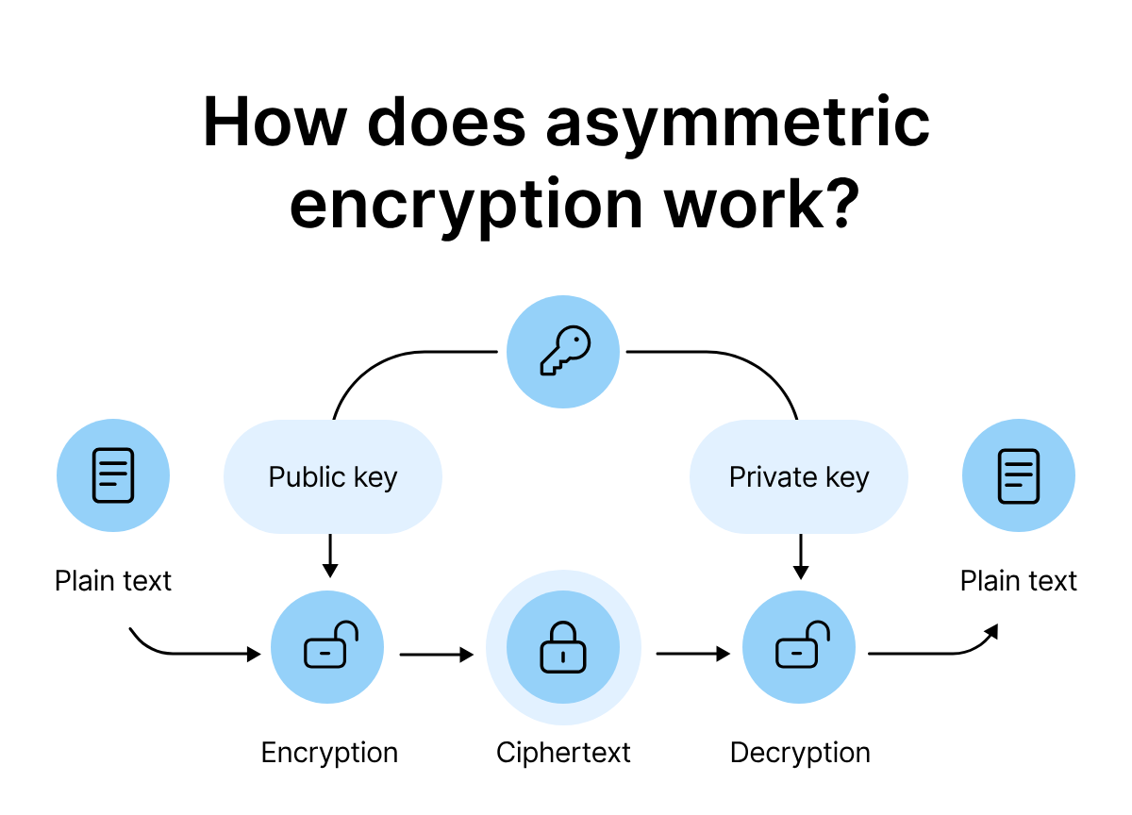
RSA Encryption Overview
RSA uses a pair of keys:
Public Key (e, n) – shared with everyone
Private Key (d, n) – kept secret by the owner
Messages encrypted with the public key can only be decrypted with the private key.
Applications:
Secure communications (HTTPS, VPNs)
Digital signatures (e.g., code signing)
Secure email (PGP/GPG)

Slide 4
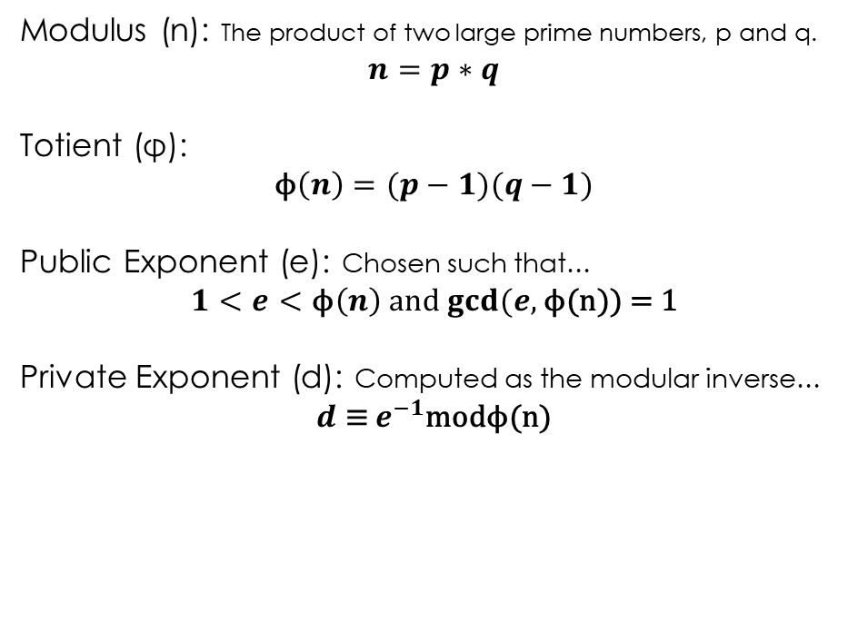
RSA Encryption Overview
Modulus (n): The product of two large prime numbers, p and q.
$$n=p∗q$$
Totient (φ):
$$\text{ϕ}\left(n\right)=(p−1)(q−1)$$
Public Exponent (e): Chosen such that…
$1<e<\text{ϕ}\left(n\right)$ and $gcd⁡(e,\text{ϕ}\text{(}\text{n}\text{)) = 1}$
Private Exponent (d): Computed as the modular inverse…
$$d \text{≡} e^{−1}\text{mod}\text{ϕ}\text{(}\text{n}\text{)}$$

Slide 5
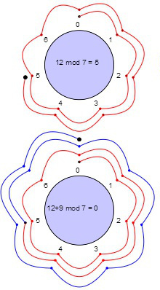

RSA Encryption Overview
Encryption:
$$\text{C}\text{=}M^{e}\text{mo}\text{d}\text{(}\text{n}\text{)}$$
Decryption:
$$\text{M}\text{=}C^{d}\text{mod}\text{(}\text{n}\text{)}$$
Recommended key bit size:
2048+

Slide 6
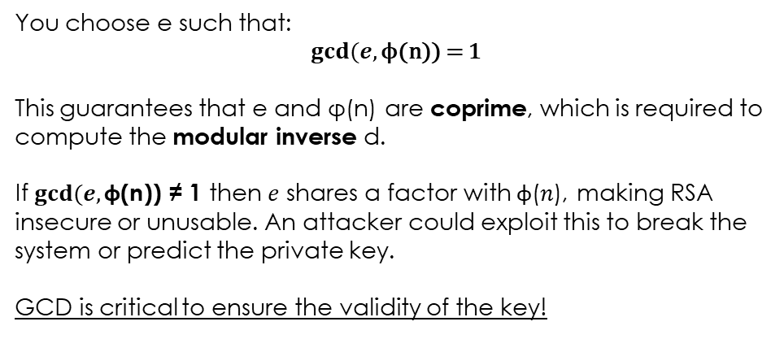
Greatest Common Factor (← Check) in RSA
You choose e such that:
$$gcd⁡(e,\text{ϕ}\text{(}\text{n}\text{)) = 1}$$
This guarantees that e and $\text{φ}\text{(}\text{n}\text{) }$are coprime, which is required to compute the modular inverse d.
If $gcd⁡(e,\text{ϕ}\text{(}\text{n}\text{))} \text{≠} \text{1}$then 𝑒 shares a factor with $\text{ϕ}$(𝑛), making RSA insecure or unusable. An attacker could exploit this to break the system or predict the private key.
GCD is critical to ensure the validity of the key!

Slide 7
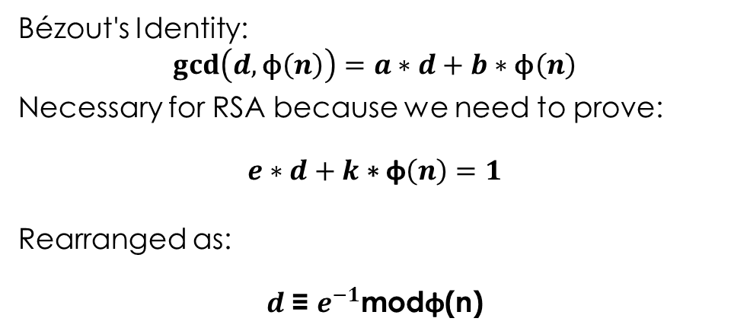
Bézout's Coefficients
Bézout's Identity:
$$\gcd\left(d,\text{ϕ}\left(n\right)\right)=a∗d+b∗\text{ϕ}\left(n\right)$$
Necessary for RSA because we need to prove:
$$e∗d+k\text{ ∗ }\text{ϕ}\left(n\right)=1$$
Rearranged as:
$$d \text{≡} e^{−1}\text{mod}\text{ϕ}\text{(}\text{n}\text{)}$$

Slide 8

RSA Requirements
3 important steps to using RSA
1. Select Private key (e)
Ensure 𝟏<𝒆<ϕ(𝒏)
2. Test if e and ϕ(𝒏) are coprime
Coprime if gcd[e, ϕ(𝒏)] = 1
3. Compute private key (d)
Compute Bézout’s Coefficients and use modular inverse → $d \text{≡} e^{−1}\text{mod}\text{ϕ}\text{(}\text{n}\text{)}$
Effective hardware design should check coprimeness & compute Bézout’s Coefficients simultaneously.

Slide 9
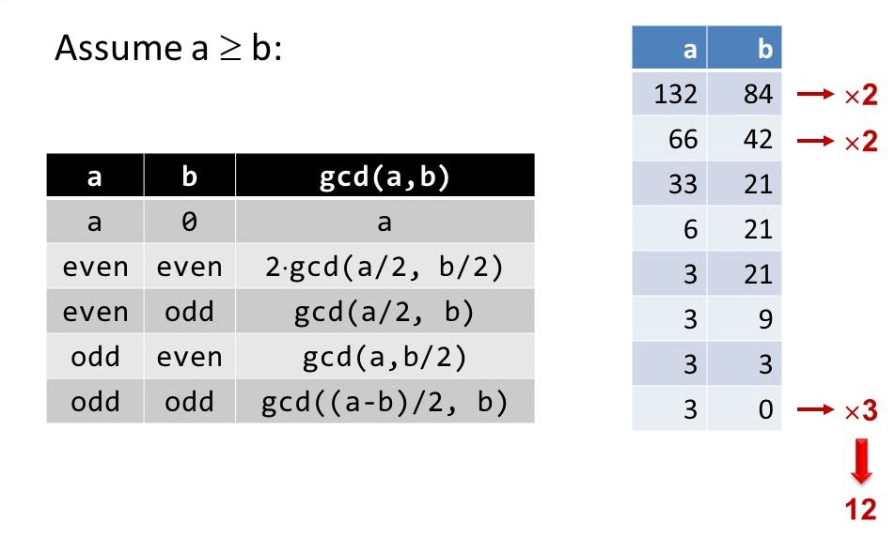
Binary GCD Algorithm (Stein’s)

Slide 10
Extended Euclid Vs Binary GCD Algorithm
Extended Euclidean Algorithm (EEA):
✅ Fewest Iterations
❌ Uses division/modulo
❌ Less efficient in hardware (Mult/Division)
Binary GCD Algorithm:
✅ Division-free
✅ Hardware-friendly (shifts, subtracts)
❌ More Iterations than standard (ensuring coefficients even)

Slide 11
Design Philosophy
Scalable
Memory Pointers
Control/Datapath
64 → 128 → 2048+
*p = 0x2
Instructions ←|→ Data
Controller works with any bit size (no changes required)
Eliminate hardware swapping (fewer steps)
Datapath optimization without changes to Controller

Slide 12
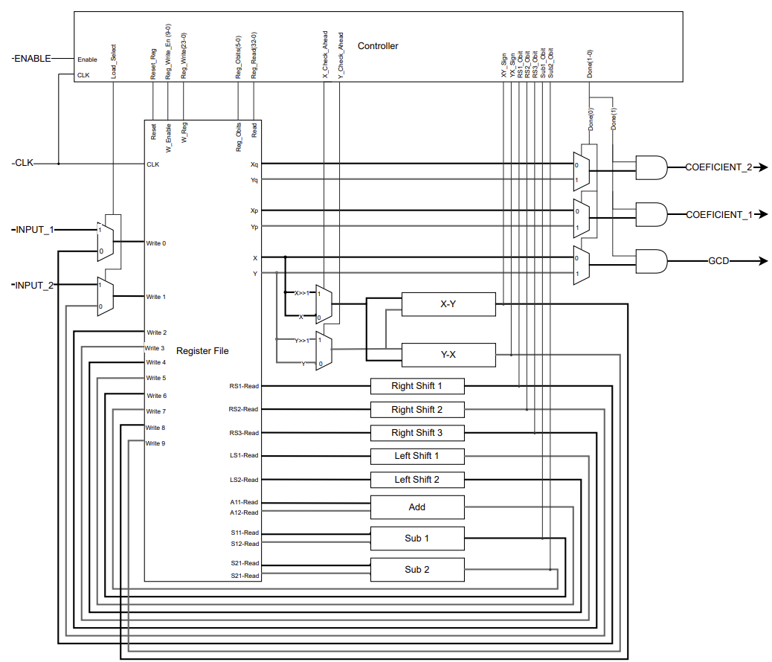
Hardware Overview
I/O:
4 Inputs
Enable
CLK
2 Inputs
3 Outputs
GCD
Coefficients
Major Components:
Controller
Register File
3 Right Shift
2 Left Shifts
Adder
4 Subtractors

Slide 13
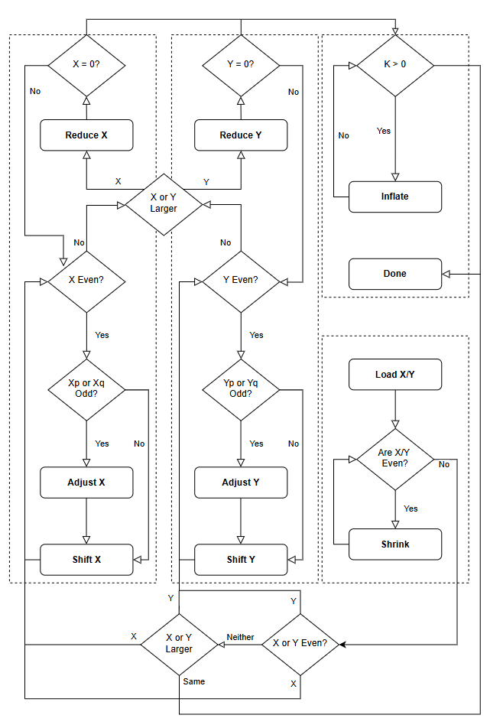
Controller
Abstract Inputs to X , Y
Coefficients Xp, Xq, Yp, Yq
State Machine:
LOAD
SHRINK
ADJUST X
SHIFT X
REDUCE X
ADJUST Y
SHIFT Y
REDUCE Y
INFLATE
DONE X
DONE Y
4 General Blocks
Loading
X
Y
Finishing
“Swaps” can only occur before a reduce (X – Y) or (Y – X)

Slide 14
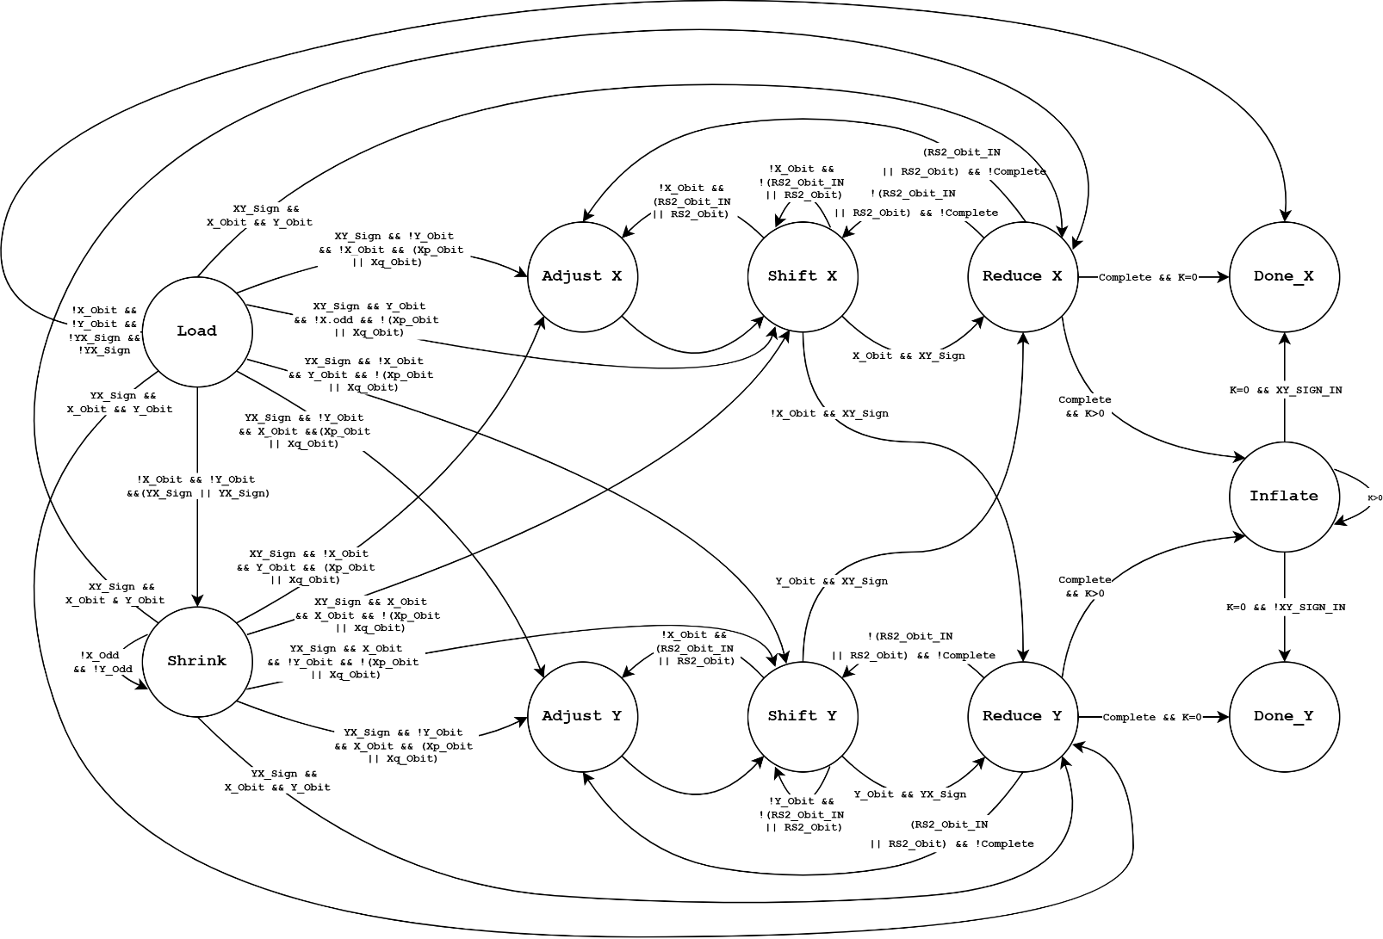
Full Controller State Machine

Slide 15
Extended Binary GCD Controller Example
Step # | X | Y | Xp | Xq | Yp | Yq | Step
1 | 10 | 12 | 1 | 0 | 0 | 1 | Load
2 | 5 | 6 | 1 | 0 | 0 | 1 | Shrink
3 | 5 | 6 | 1 | 0 | -6 | 6 | Adjust Y
4 | 5 | 3 | 1 | 0 | -3 | 3 | Shift Y
5 | 2 | 3 | 4 | -3 | -3 | 3 | Reduce X
6 | 2 | 3 | -2 | 2 | -3 | 3 | Adjust X
7 | 1 | 3 | -1 | 1 | -3 | 3 | Shift X
8 | 1 | 2 | -1 | 1 | -2 | 2 | Reduce Y
9 | 1 | 1 | -1 | 1 | -1 | 1 | Shift Y
10 | 1 | 0 | -1 | 1 | 0 | 0 | Reduce Y
11 | 2 | 0 | -1 | 1 | 0 | 0 | Inflate
12 | 2 | 0 | -1 | 1 | 0 | 0 | Done

Slide 16
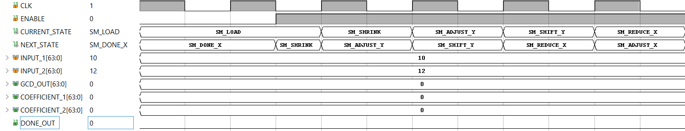
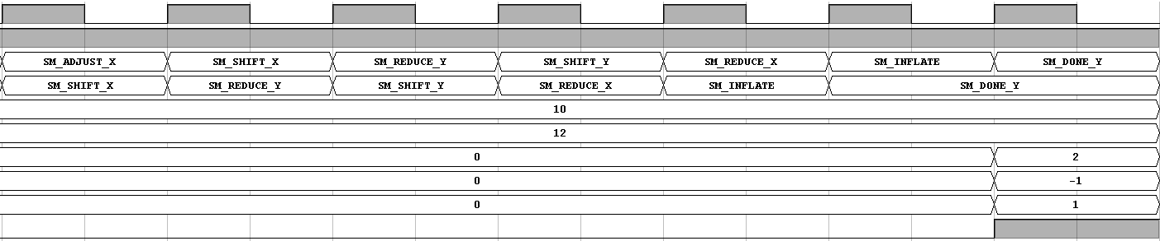
Simulation
Software: Vivado 2024.4
Inputs: 10, 12 → Results: 2, (-1, 1)

Slide 17
Results/Analysis
Extended Stein’s Algorithm in Hardware:
64-bit scalable hardware implementation
Efficient Bézout's coefficient computation
Uses binary shifts — no division/multiplication
Shifts complexity from Datapath to control logic
More iterations than Euclid, but faster cycles

Slide 18
Concluding Remarks
Future Work:
Fully optimize for RSA:
Coprimeness is already known
Remove unnecessary states (e.g., SHRINK, INFLATE)
Explore pipelining or parallelization
Power/area analysis
Compare with other hardware implantations

Slide 19

Thank You

