Slide 1
Study Notes
Week 2
Han Yi

Slide 2
Code
Batch Normalization: before activation function

Slide 3
Images
PIL: [W, H] (no channels)
numpy array: [H, W, C]
Tensor: [C, H, W] ([batch_size, C, H, W])
np.transpose()

Slide 4
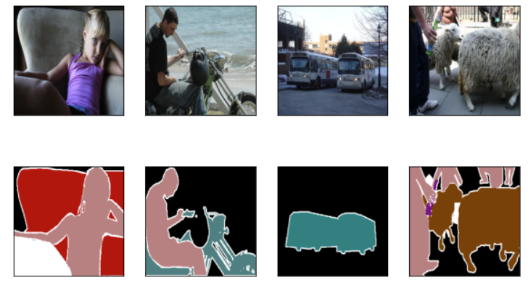
Dataset - Pascal VOC 2012 Segmentation
Classes: 20 foreground + 1 background + 1 border
Size: Sizes of each images are not the same, causing an error when reading batch from DataLoader. Rescaling may affect accuracy for segmentation tasks. Here we use random cropping to a fixed shape. (Be sure that images and their corresponding labels are cropped in the same way)
I have successfully implemented a custom package to read the VOC dataset and return a train DataLoader and a test DataLoader. Please refer to Blattvorhang/CV_Study_Notes (github.com) for more details.

Slide 5
Cross Entropy Loss
Function: nn.functional.cross_entropy(input, target, ignore_index=255)
Object: nn.CrossEntropyLoss()
Input: [N, C, H, W] Prediction value of each class (confidence level)
Target: [N, H, W] Real class of samples
Using CELoss provided by PyTorch does not need one-hot representation.
Avoid introducing unnecessary sequential relationships
Aggregation method within one batch: Average Loss (irrespective of the size of batches)

Slide 6
FCN – Key Points
Fully Connected Layer → Convolution: Probability of each class → pixel-wise segmentation
Transposed Convolution: Up-sample, “the weight layout is transposed from that of the convolution matrix”. nn.ConvTranspose2d()
Bilinear Interpolation: Used for initializing transposed convolutional layers
Skip Layers: Compensation for lost details in transposed convolution

Slide 7
FCN
Dataset: Pascal VOC 2012
Architecture: Using the pre-trained ResNet-18 as the backbone
Image Size: No fully connected layers, hence not restricted to the specific image size
Limitations: Independent pixels are classified without fully considering the relationship between pixels.

Slide 8
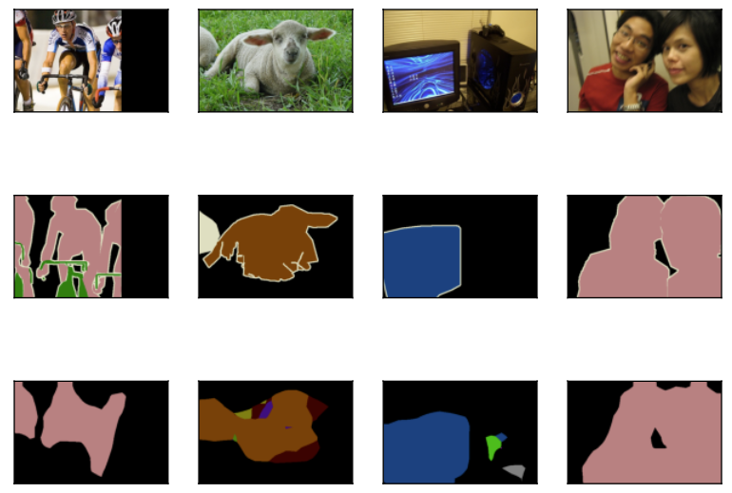
FCN
Result:
image
ground truth
prediction

Slide 9
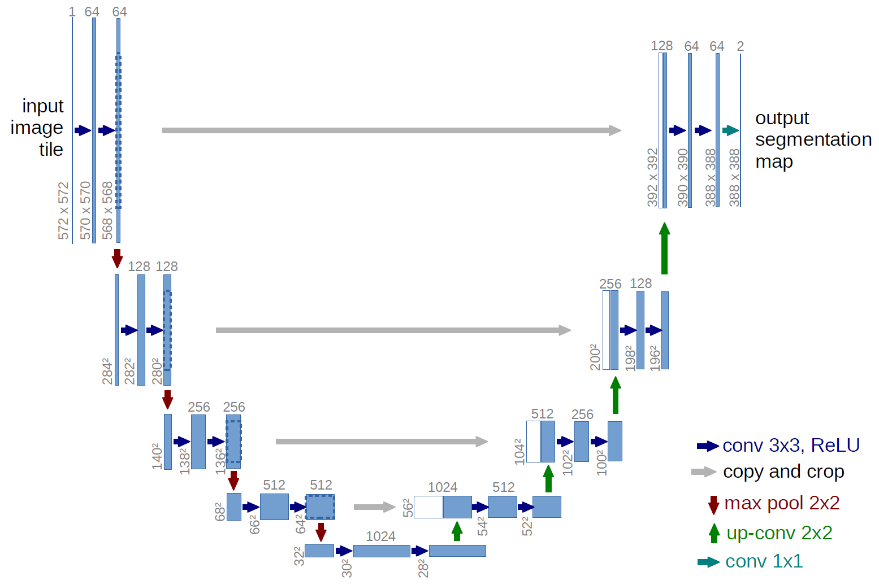
UNet – Encoder-Decoder
Encoder: (3x3 convolution → [BN] → ReLU) * 2 + 2x2 maxpooling
Decoder: Transposed convolution + concat + double 3x3 conv

Slide 10
UNet – Skip Connection
Concatenation (different from addition in FCN)
Dimension: channel
More information about high-level details (border), hence more advantageous for segmentation tasks

Slide 11
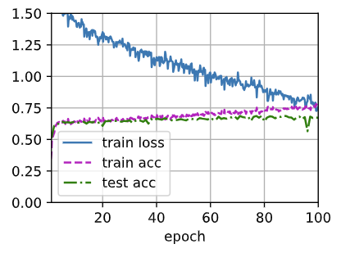
UNet
loss: 0.754
train acc: 0.768
test acc: 0.671

Slide 12
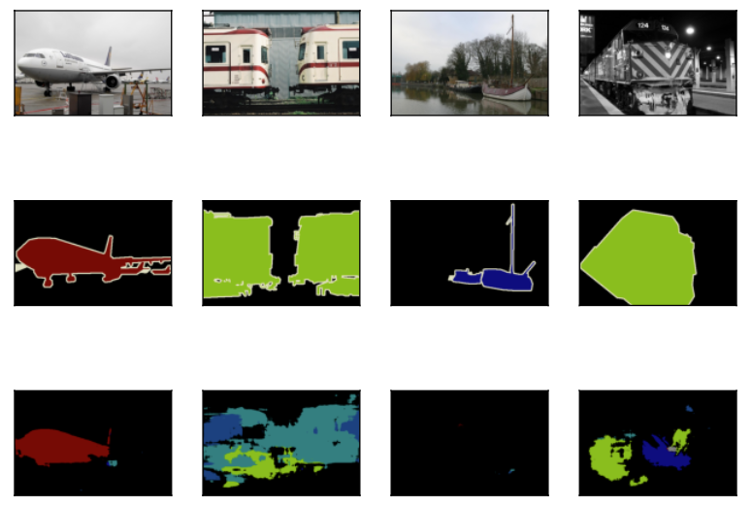
UNet
Result:
image
ground truth
prediction

Slide 13
UNet – Limitations
Initially designed for binary classification problems, thus not sufficiently complex for twenty-one-class classification

