Slide 1
Study Notes
Week 1
Han Yi

Slide 2
Training Process
Hyperparameters configuration
Dataset loading and splitting: train dataset and test dataset
Model definition (inheriting of nn.Module): layer by layer
Loss function and optimizer selection
Training: forward pass → backward pass and optimize in epochs
Test: torch.no_grad(), accuracy

Slide 3
Code
DataLoader: helps in efficiently loading and batching during training, loads data in batches
Transform: a sequence of transformations to be applied to the input images. (e.g.: converts images to PyTorch tensors and normalizes them)

Slide 4
Hyperparameters
num_epochs
batch_size
learning_rate

Slide 5
AlexNet
Image Size: AlexNet was originally designed for the ImageNet dataset, which contains color images of much higher resolution than MNIST. Therefore, it is necessary to resize the MNIST images to 224x224 to match the input size expected by the AlexNet model.
LRN (Local Response Normalization): enhances the contrast between responses and normalizes the activity of neurons relative to their neighbors, applied after ReLU. Between feature maps (inter-channel).
Dropout

Slide 6
AlexNet
Training Time: 17min on GTX 1650Ti, 10 epochs
Accuracy: 99.18%

Slide 7
Stereo Matching
correspondences are always co-linear in a pair of stereo images
One camera: intrinsic matrix
Two cameras: epipolar geometry, stereo rectification (to reduce time consumption)
Stereo matching: Disparity Estimation → Depth
Machine Learning-Based: disparity ground truth (supervised)
Disparity Confidence Measures
Trade-off: speed and accuracy – driving, indoor and outdoor

Slide 8
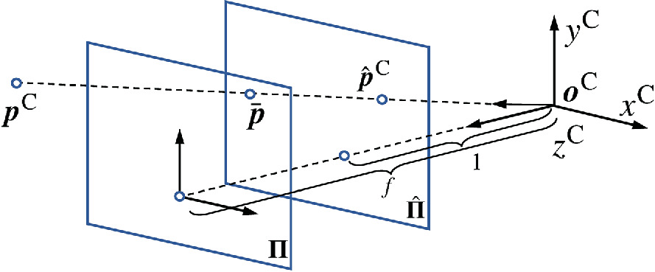

Stereo Matching
Question: Given that $f$ denotes the focal length and light refraction through camera lens exists, why is $p^{C}\overline{p}o^{C}$ a straight line?

