Slide 1
MINI PROJECT
ECU1: Vehicle Status Display and Control Interface

Slide 2
01
02
About project
Components
CONTENTS
CONTENTS
03
04
Software
Working

Slide 3
01
About project

Slide 4
About Project Phases
Check vehicle state
Read signals
check wheather the vehicle staus is active or not.
Read different signals from different sensors.
1
4
2
Design HMI
3
Show data on HMI
Design HMI interface to display all associated data.
Display all data recived from parts onto the HMI.

Slide 5
02
COMPONENTS

Slide 6
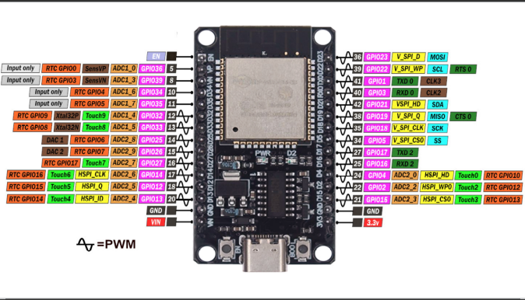
ESP-32

Slide 7
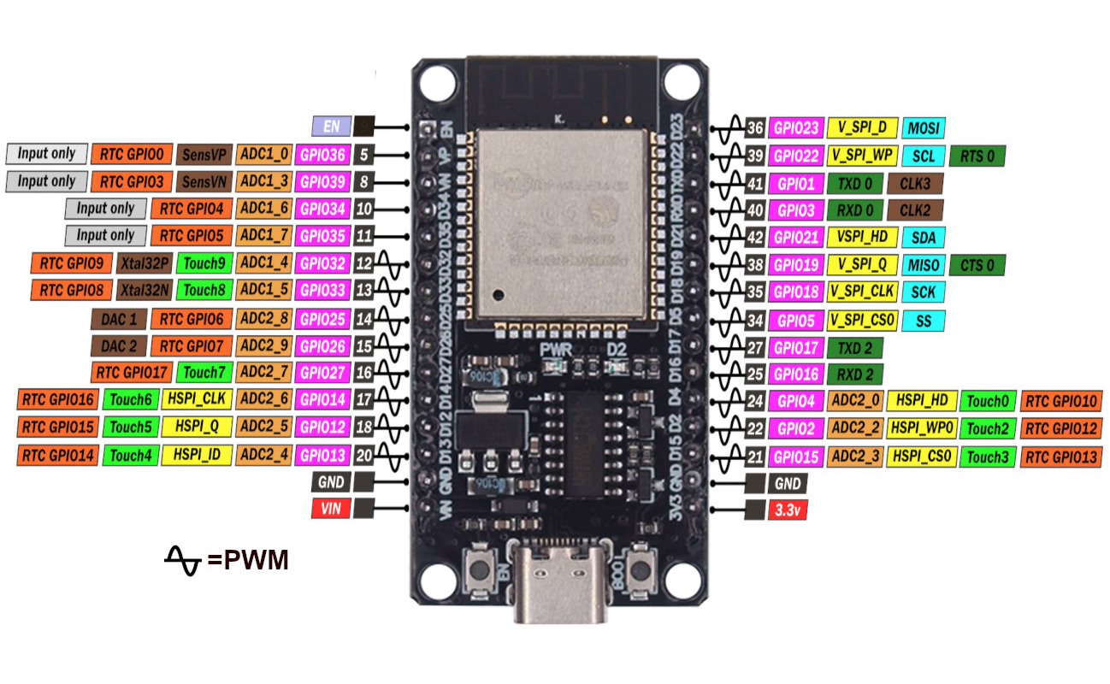
Features of esp32
Dual-Core Processor
Wi-Fi and Bluetooth
GPIO Pins
ADC/DAC
High Peripheral Support
Flash Memory(4MB)

Slide 8
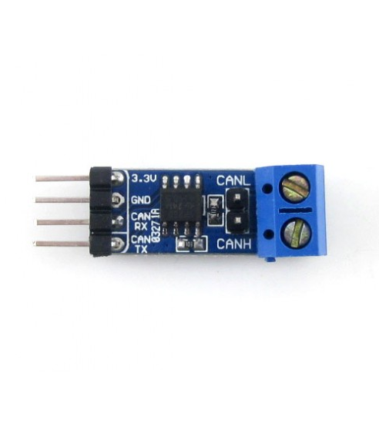
CAN transceiver
Features of CAN
Communication Protocol
ISO Standard(ISO 11898)
Efficient Data Transfer
Error Detection
Data transfer upto 1 Mbit/second

Slide 9
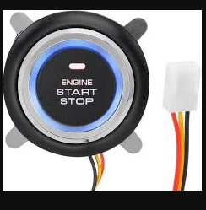
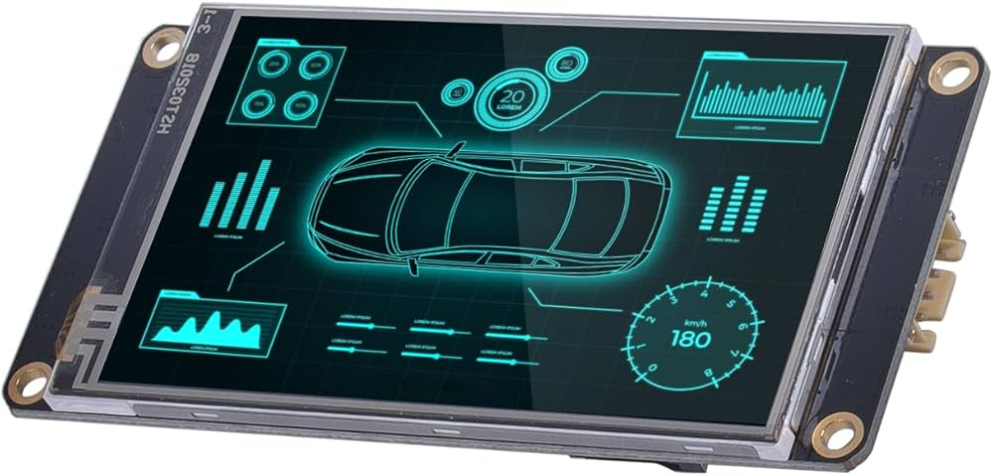
COMPONENTS
Preentations are communication tools.

Slide 10
03
SOFTWARE
AND
LIBRARIES

Slide 11

IDE
Libraries
1.ESP32 board extension
2.CAN controller header(CAN.h)
3.HMI header file
Arduino IDE used to program and flash code into the ESP32 board

Slide 12
04
WORKING

Slide 13
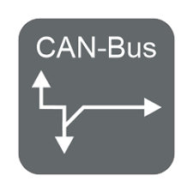
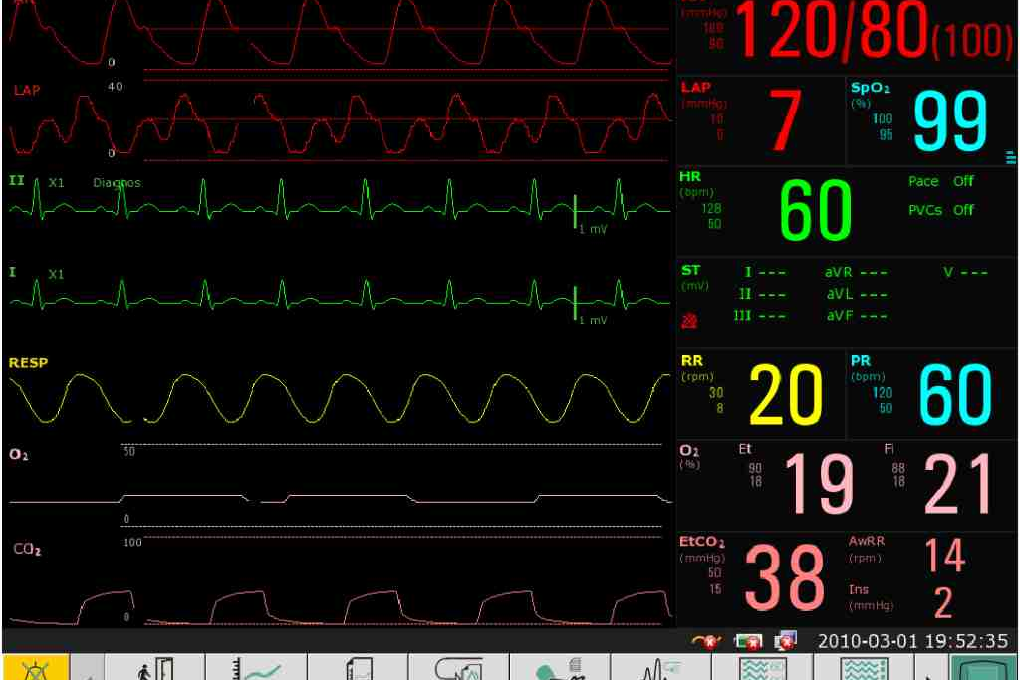

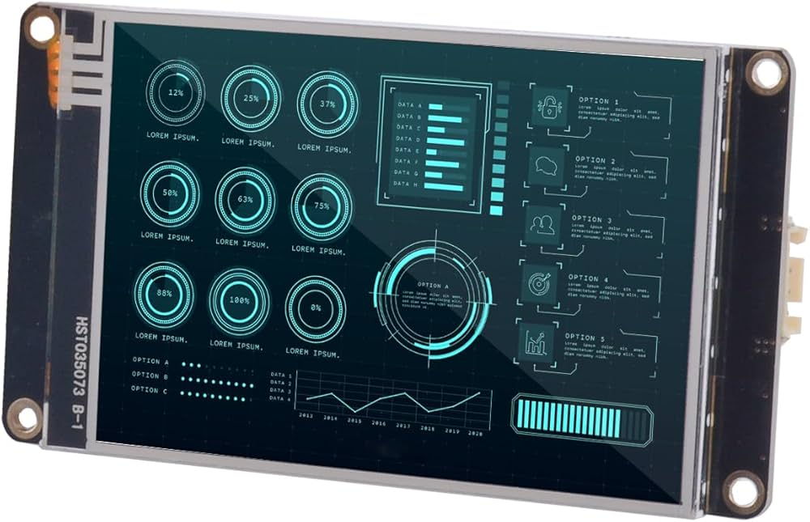
WORKING PHASES
Setting up CAN
Monitoring values
Finalise data
Display on HMI
Setting up CAN communication between boards.
Reading and monitoring signals from differnt boards.
Verify and finalise collected data.
Display vehicle staus and information on HMI.
01
02
03
04

Slide 14
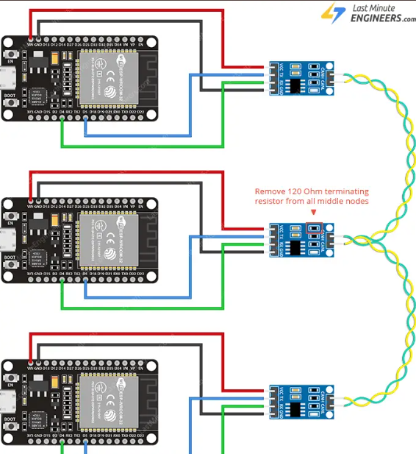
Setting up CAN
Include header
set CAN pins
start CAN communication at 500kbs
sending data through can
Send data over CAN
#include<CAN.h>
CAN.setpins(2,4);
if(!CAN.begin(500000)){
Serial.println("CAN failed");
while(1);
} else {
Serial.println("CAN Started");
}
CAN.beginPacket(0x11);
CAN.write((uint8_t*)&value,sizeof(value));
CAN.endpacket();

Slide 15
.Receive data over CAN
if(CAN.parsePacket()){
if(CAN.packetId()==0x12){
CAN.read((uint8_t*)&data,sizeof(data));
}
}
Serial.println(data);

Slide 16
Sample code
#include<CAN.h>
#define SPEED 5000000
int data;
int value = 10;
void setup() {
Serial.begin(9600);
CAN.setpins(2,4);
if(!CAN.begin(SPEED)){
Serial.println("CAN failed");
while(1);
} else {
Serial.println("CAN Started");
}
}
void loop() {
can_read();
can_send();
}
void can_read(){
if(CAN.parsePacket()){
if(CAN.packetId()==0x12){
CAN.read((uint8_t*)&data,sizeof(data));
}
}
Serial.println(data);
}
void can_read(){
CAN.beginPacket(0x11);
CAN.write((uint8_t*)&value,sizeof(value));
CAN.endpacket();
}

Slide 17
NEXT TASK
Establish CAN communication between different ECU’s
Send vehicle status through CAN
Monitor incoming values using CAN bus interface
Design HMI interface to display each values on appropriate fields

Slide 18
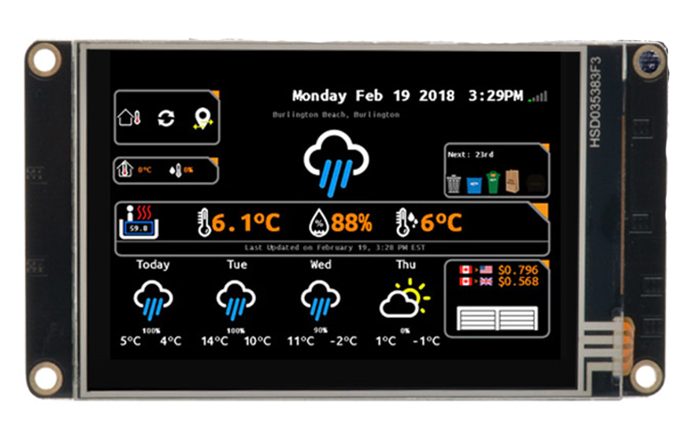
HMI DESIGN
I am using Nextion intelligent HMI display
TFT Touch Display:
Serial Communication
Reduced Development Time:
Low Power Consumption
Nextion Editor:

Slide 20
SAMPLE CODE 2 (using multiple core and a byte array)
CAN pin setting and initialization
CAN.setPins(18,19);
Serial.begin(115200);
if(!CAN.begin(500E3)){
Serial.println("can failed");
while(1);
}
Serial.println("CAN SETUP");
Assigning task to each cores of esp32
xTaskCreatePinnedToCore(send, "send msg", 1024, NULL, 1, NULL, 0);
xTaskCreatePinnedToCore(recv, "recive", 1024, NULL, 1, NULL, 1);

Slide 21
Sending button starus using core 1 of esp
void core_0(void *parameters){
while(1){
unsigned long time= millis();
if(time - current_time >= SEND_TIME){
array[0] = read();
CAN.beginPacket(0x01);
for(i=0;i<8;i++){
CAN.write(array[i]);
}
CAN.endPacket();
Serial.println("message sent");
current_time = time;
}
vTaskDelay(200 / portTICK_PERIOD_MS);
}
}

Slide 22
Reading incoming messages using CAN on core 2 of esp32
void core_1(void *parameters){
while(1){
Serial.print("core 1\n");
if(CAN.parsePacket()){
if(CAN.packetId()==0x01){
for(i=0;i<8;i++){
array[i] = CAN.read();
}
}
}
Serial.println(array[0]);
Serial.println(array[1]);
Serial.println(array[2]);
vTaskDelay(100 / portTICK_PERIOD_MS);
}
}

Slide 23
THANKS
Presented by
Adin N S

