Slide 1




AI Medicinal Plant Identifier and Usage Guide
Group Members:
1. Sujal Junghare
2. Ayush Warulkar
3. Gurupreet Dhande

Slide 2

Learning Objectives
Understand how AI can support environmental and healthcare goals.
Learn how CNNs can identify plant species through leaf images.
Explore the integration of AI and mobile/web platforms.
Encourage use of local resources and traditional knowledge for wellness.
Promote sustainability using Green AI methods.
GOAL

Slide 3
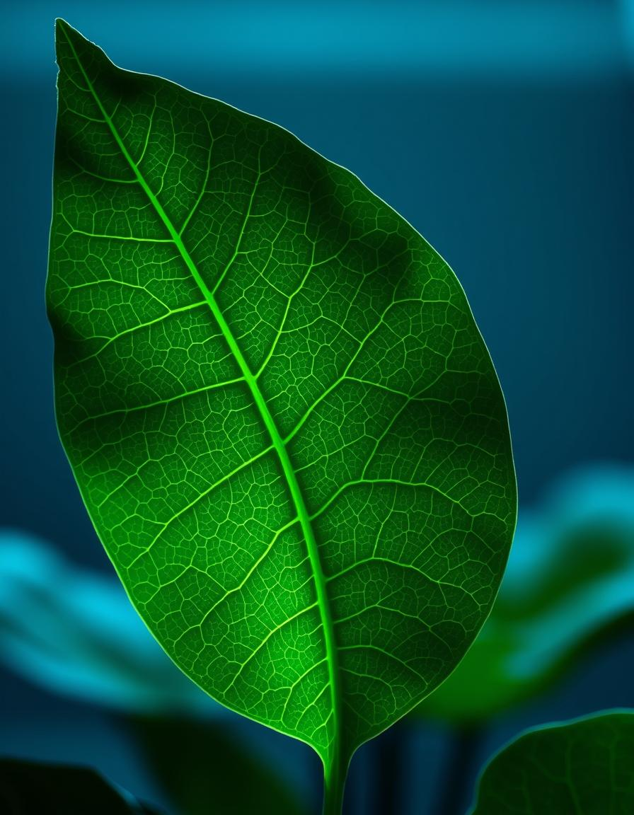
Problem Statement:
Many people, especially in rural or tribal areas, have access to medicinal plants but lack:
Proper identification tools
Knowledge of plant usage and dosage
Awareness of sustainable use

Slide 4
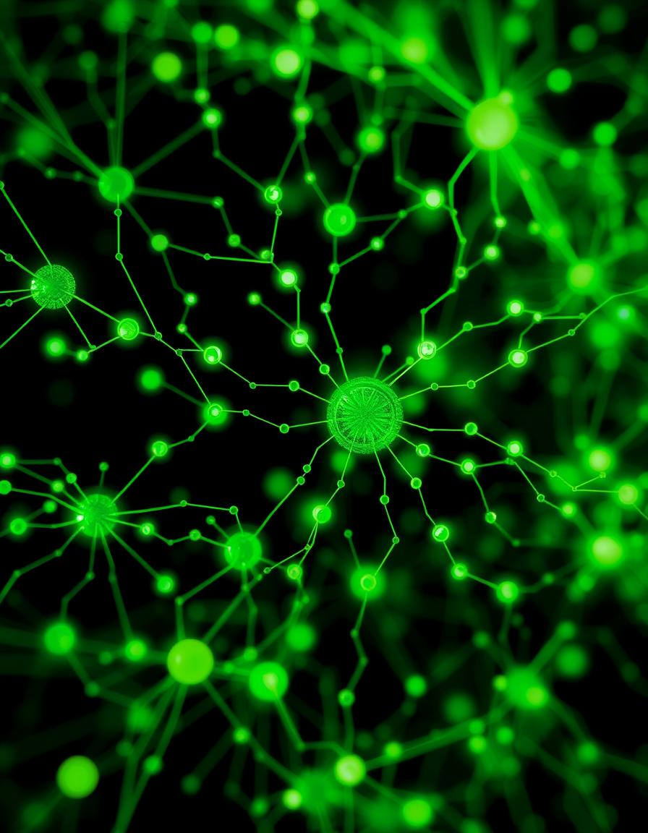
Our Solution:
🍃LeafSnap+
Instant plant identification using AI
Herbal remedy recommendations

Slide 5






Tools and Technology used
Frontend: Streamlit
AI/ML: TensorFlow, Keras (CNN model)
Languages: Python, HTML, CSS
Others: OpenCV

Slide 6
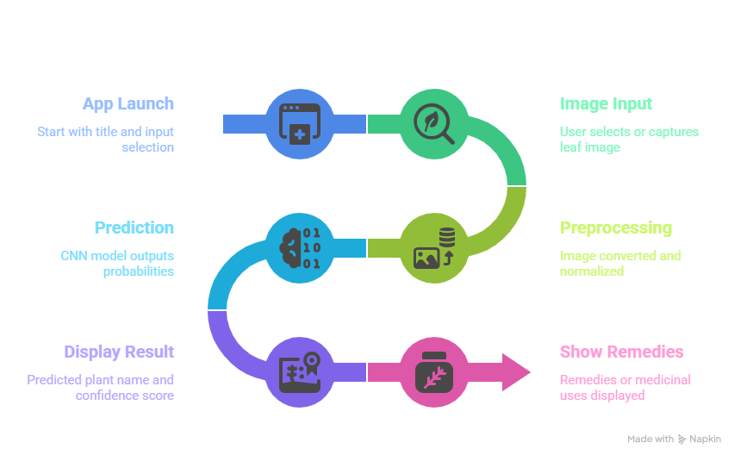
Methodology

Slide 7
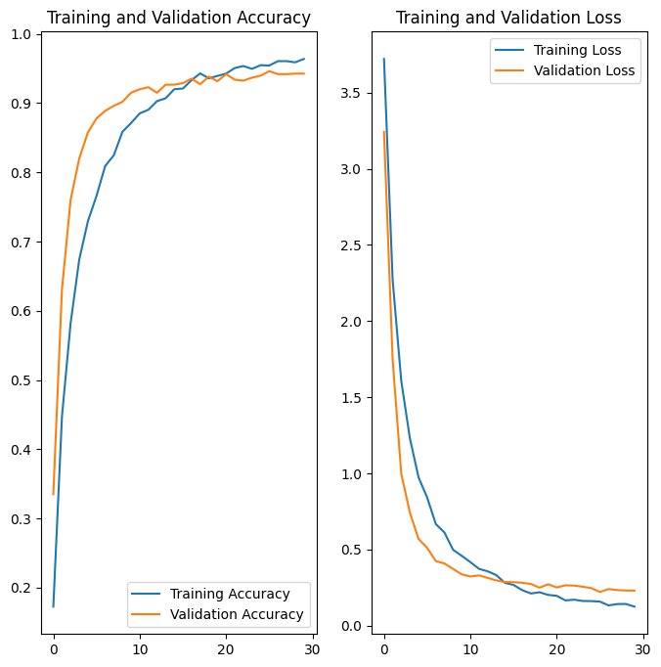
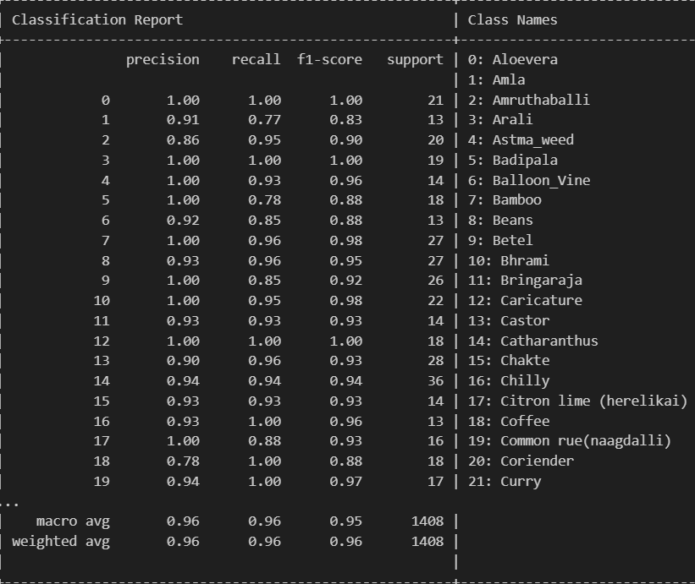
Screenshot of Output:

Slide 8
Conclusion:
LeafSnap+ leverages the power of Green AI to bridge healthcare and environmental awareness by enabling anyone with a phone to tap into nature’s pharmacy. With accessibility, sustainability, and tradition at its core, it’s a step toward smarter, greener villages.
Streamlit App: https://leafsnap-7g8ydx3wapsv2jvyedaafg.streamlit.app/
Github Link: https://github.com/Blaze-0903/LeafSnap

