Slide 1
Ping and Traceroute: Tools for Network Diagnostics
Anurag Gupta (BMC202309)
Networking Fundamentals
25-04-2025

Slide 2
Understanding Ping
Ping is a widely used network utility that tests the reachability of a host on an IP network. It is also employed to measure latency and detect network issues. The tool operates by sending Internet Control Message Protocol (ICMP) Echo Request packets to a target host and listening for ICMP Echo Reply messages.
Ping measures the round-trip time (RTT) between the source and the destination, and calculates packet loss. The output includes a summary showing minimum, maximum, and average RTTs, as well as packet loss percentages.

Slide 3
ICMP Protocol and Ping Packet Structure
Ping uses ICMP, a protocol designed to report errors and operational information.
An ICMP packet contains:
Type: ICMP message type (e.g., 8 for Echo Request, 0 for Echo Reply)
Code: Further classifies the message type
Checksum: Ensures data integrity
Identifier (ID) and Sequence Number: Used to match replies with requests
Ping packets can include payload data, which must be echoed back exactly in the reply. The identifier and sequence fields are especially useful for tracking multiple requests in sequence.

Slide 4
Echo Request and Echo Reply
An ICMP Echo Request is sent from the client to a remote host with the expectation that the same data will be returned in an Echo Reply. The behavior of these messages is defined as follows:
Echo Request (Type 8, Code 0): Initiated by the client. Contains a unique identifier and a sequence number for tracking, along with a payload of data.
Echo Reply (Type 0, Code 0): Sent by the recipient host. Must contain the exact same data as received in the request, including the same identifier and sequence number.
This exchange allows for the measurement of round-trip time and ensures the correctness and completeness of data transmission between the sender and receiver.

Slide 5
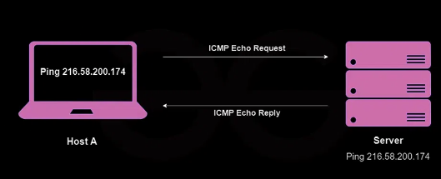

Slide 6
Traceroute and its Purpose
Traceroute is a network diagnostic utility that reveals the path taken by packets as they travel from a source to a destination. It helps in identifying where along the route delays or failures may be occurring. Network administrators use traceroute to examine routing behavior and to visualize the network’s topology between two hosts.
This tool is especially valuable in detecting misconfigurations, performance bottlenecks, and unreachable network segments.

Slide 7
How Traceroute works
Traceroute operates by sending ICMP Echo Request messages with incrementally increasing Time-To-Live (TTL) values. A packet with TTL = 1 is discarded by the first router, which then returns an ICMP Time Exceeded message (Type 11). With each subsequent packet, the TTL is increased, revealing the address of the next hop along the route.
Once the destination is reached, it responds with an ICMP Echo Reply (Type 0). Traceroute measures the round-trip time for each hop, making it possible to locate delays or packet loss at specific points in the network path.

Slide 8
ICMP Message Types in Traceroute
Traceroute uses specific ICMP message types to trace the path packets take across a network. It begins with ICMP Echo Requests (Type 8), which are sent to the destination with increasing TTL values. As each router along the path decrements the TTL, it eventually reaches zero and responds with an ICMP Time Exceeded message (Type 11), exposing its presence and IP address. When the packet finally reaches the destination, an ICMP Echo Reply (Type 0) is returned.
By observing these responses, traceroute reveals the sequence of routers between the source and destination. It also measures the round-trip time to each router, helping to identify where delays or packet loss occur. This detailed path analysis makes traceroute a critical tool for network diagnostics and performance monitoring.

Slide 9
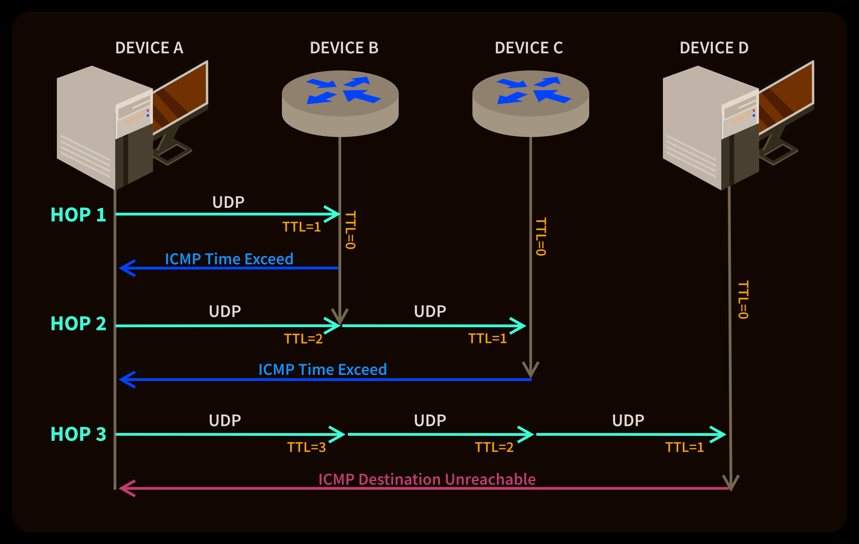

Slide 10
Summary
Ping and Traceroute are essential network diagnostic tools that leverage the Internet Control Message Protocol (ICMP) to test connectivity and analyze network behavior.
Ping checks whether a host is reachable and measures the round-trip time for messages sent from the source to the destination. It helps detect packet loss and latency issues, making it a tool for initial connectivity checks.
Traceroute traces the path that packets take through the network. By incrementing the Time-To-Live (TTL) field in successive packets, it identifies all intermediate routers and calculates delays at each hop.
Together, these tools helps troubleshoot problems, optimize performance, and understand how data travels across the internet.

