Slide 1
Active Noise Cancellation

Slide 2
Introduction
In this project we simulate how random white noise distorts original audio signal and how using anti-noise signal we can get the desired signal back.
The main algorithm used is LMS (Least Mean Squared) algorithm with some additional improvements.

Slide 3
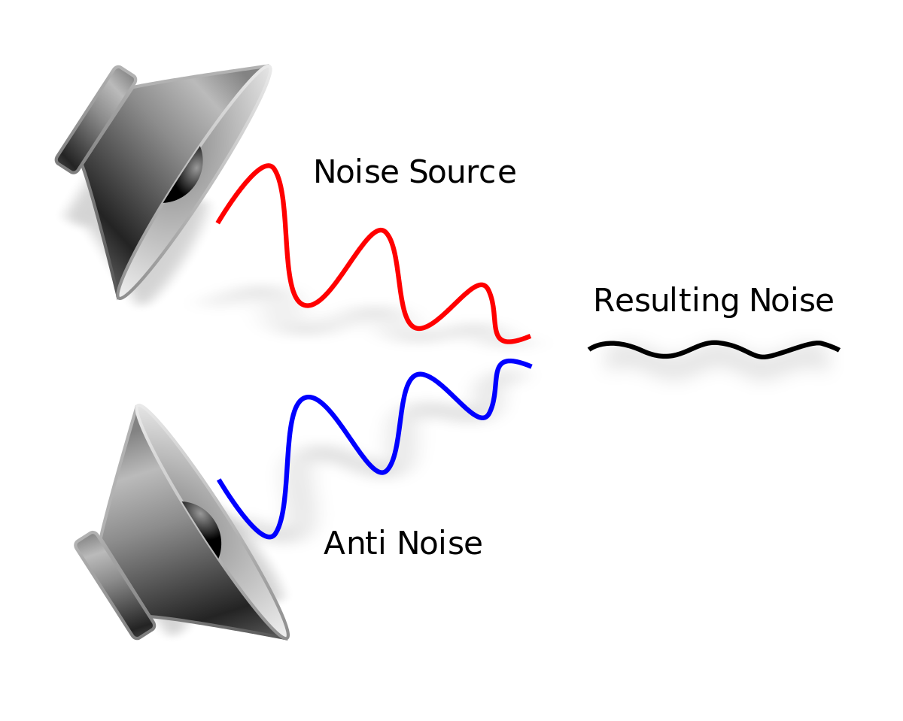
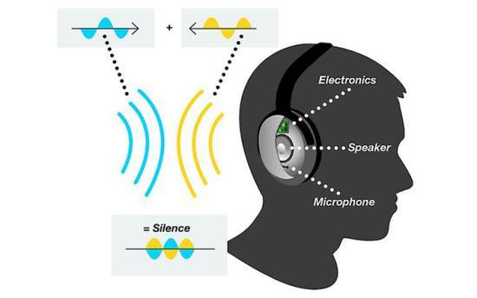
What is active noise cancellation?
Active Noise Control/Cancellation (ANC) is a noise cancellation method which works by adding an active anti-noise signal which mostly cancels out noise signals and improves quality of audio.

Slide 4
Adaptive Filters
An adaptive filter is a system with a linear filter that has a transfer function controlled by variable parameters.
Parameters are adjusted according to an optimization algorithm.
Unlike usual filters, the filter coefficients are not constant.
Used in mobile phones, digital cameras, camcorders, medical equipment etc.
Optimization algorithm used in this project: LMS algorithm.

Slide 5
The LMS Algorithm
Least mean squares (LMS) algorithms are a class of adaptive filter used to mimic a desired filter by finding the filter coefficients that relate to producing the least mean square of the error signal.
Invented in 1960 by Stanford University professor Bernard Widrow and Dr. Ted Hoff.
Provides meaningful measure of performance.
Practically realizable.
The idea is to use steepest descent to find filter coefficients h(n) to minimize the mean square error.

Slide 6
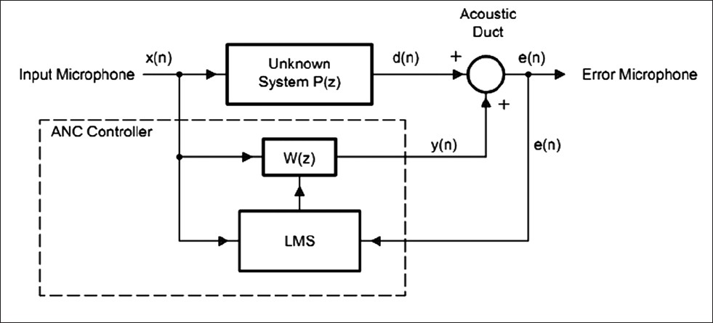
Schematic of an ANC System

Slide 7
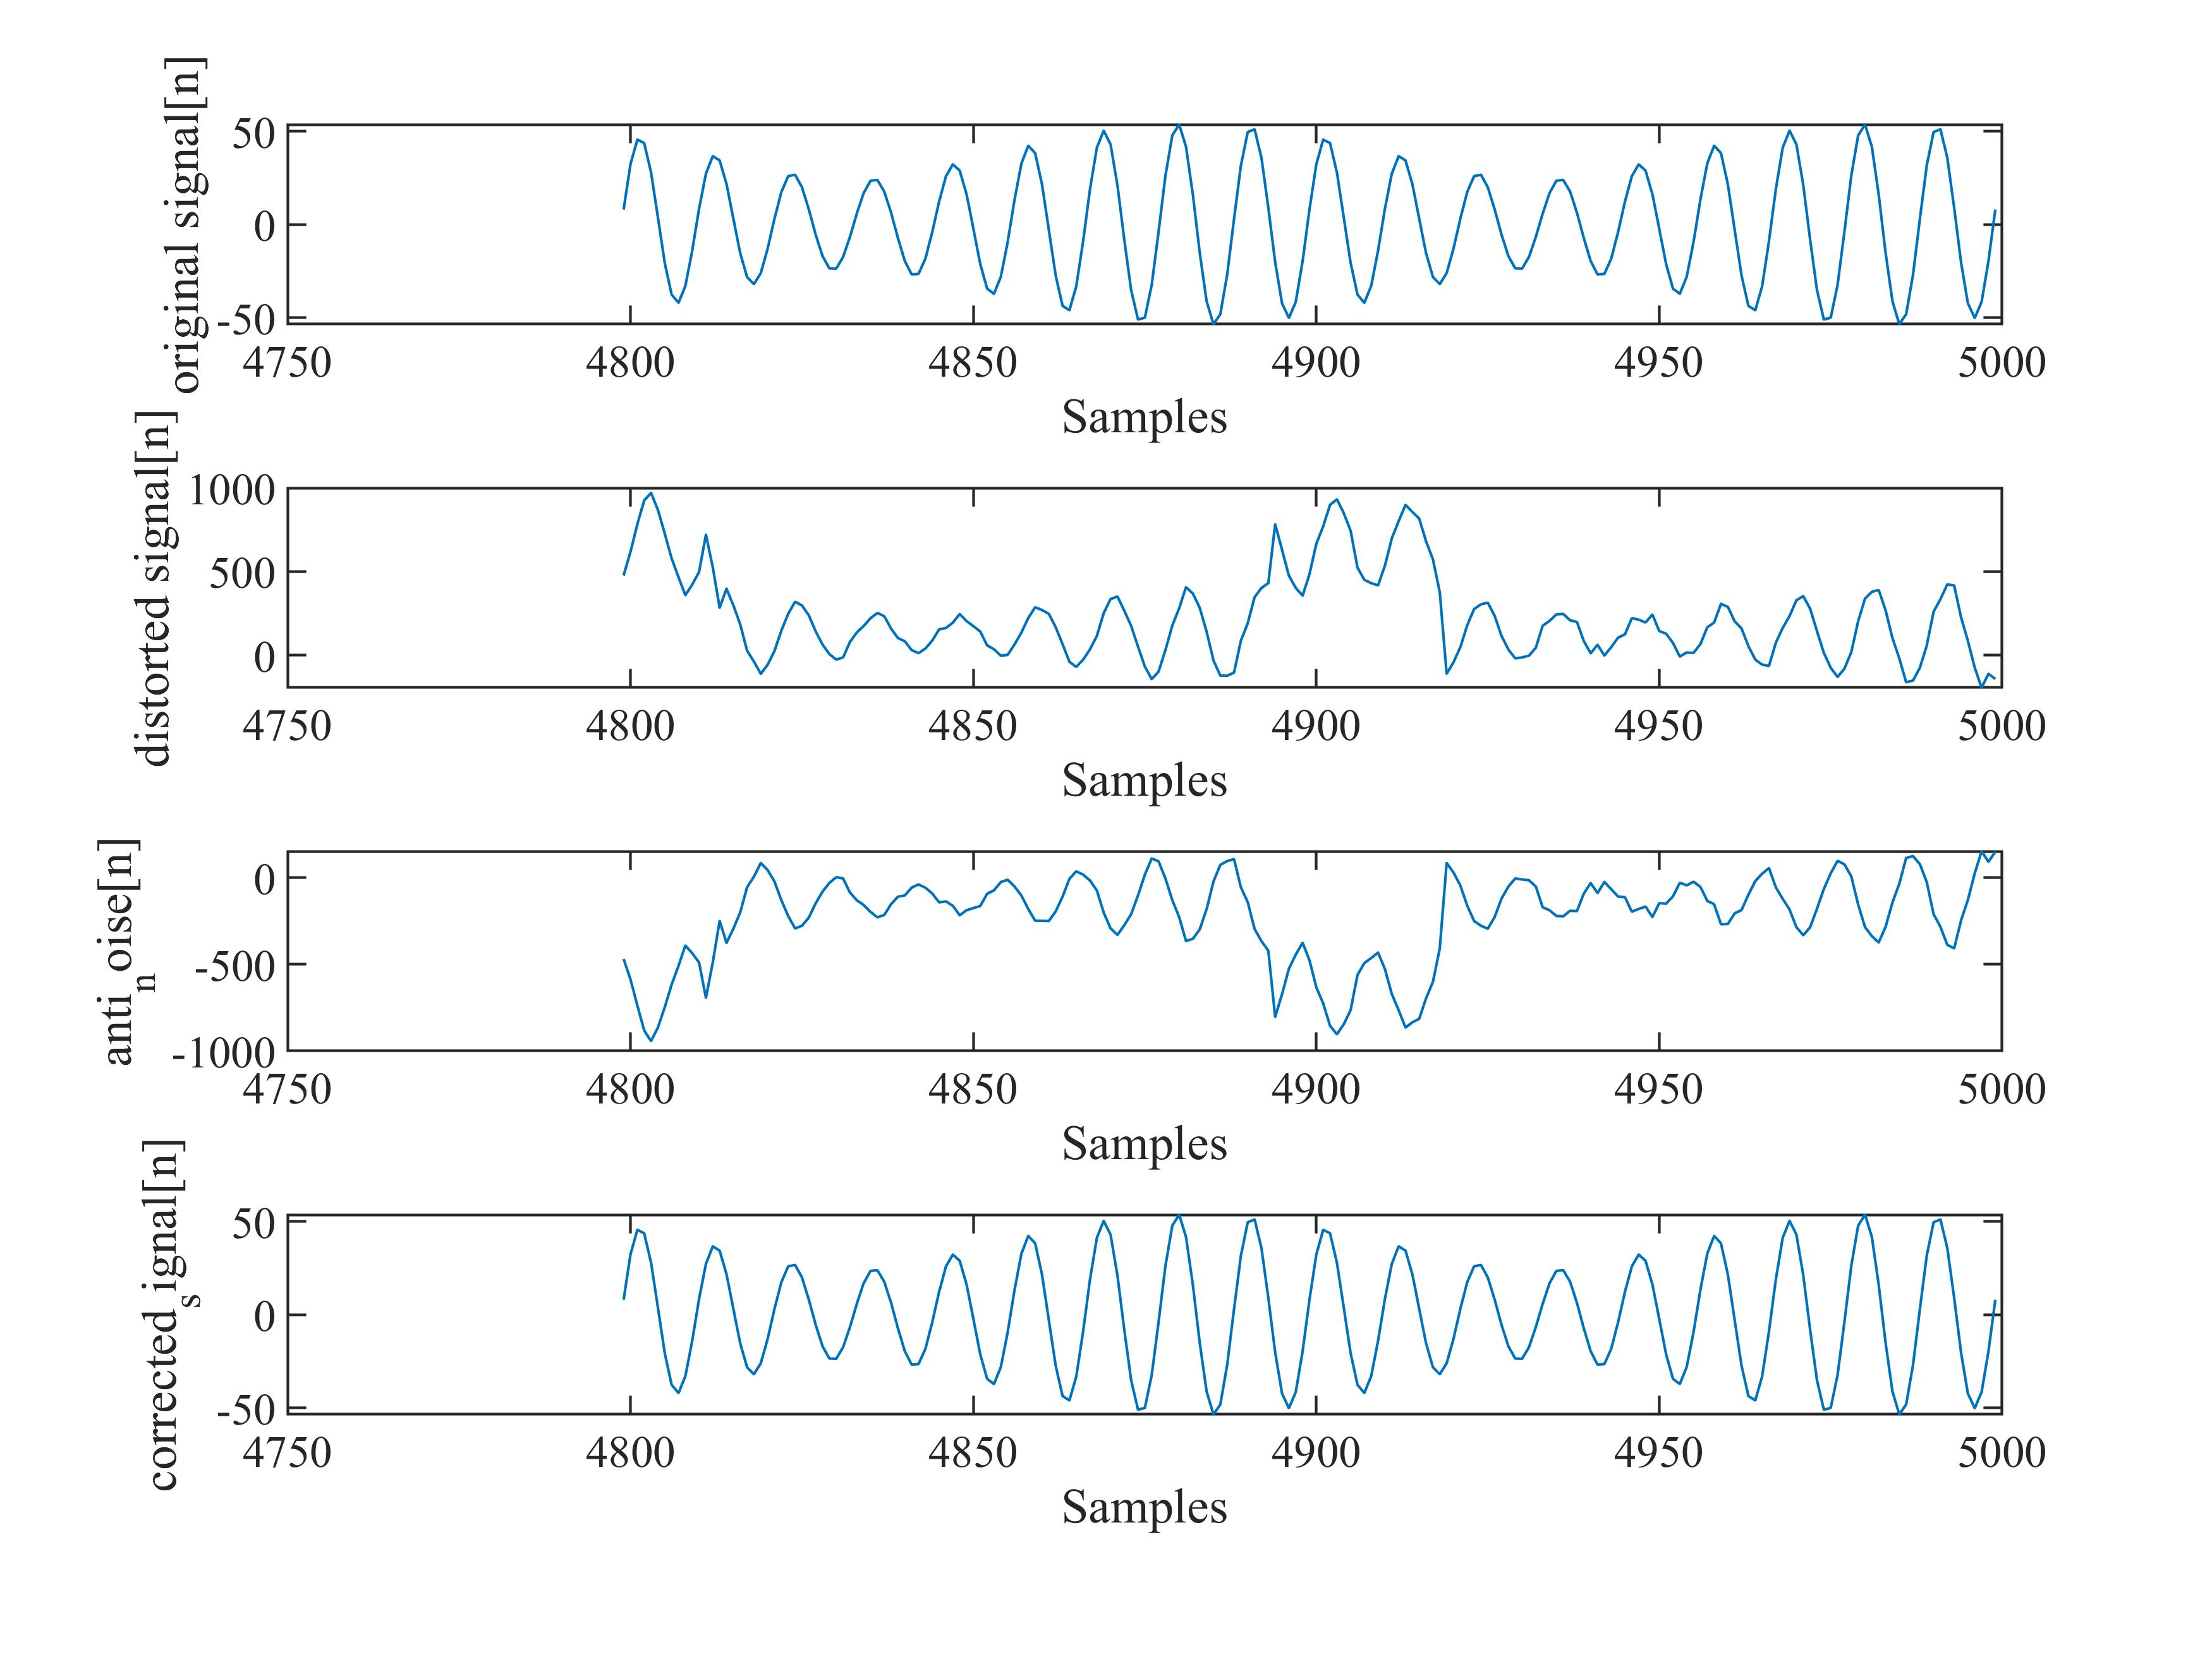
System Inputs and Output

Slide 8
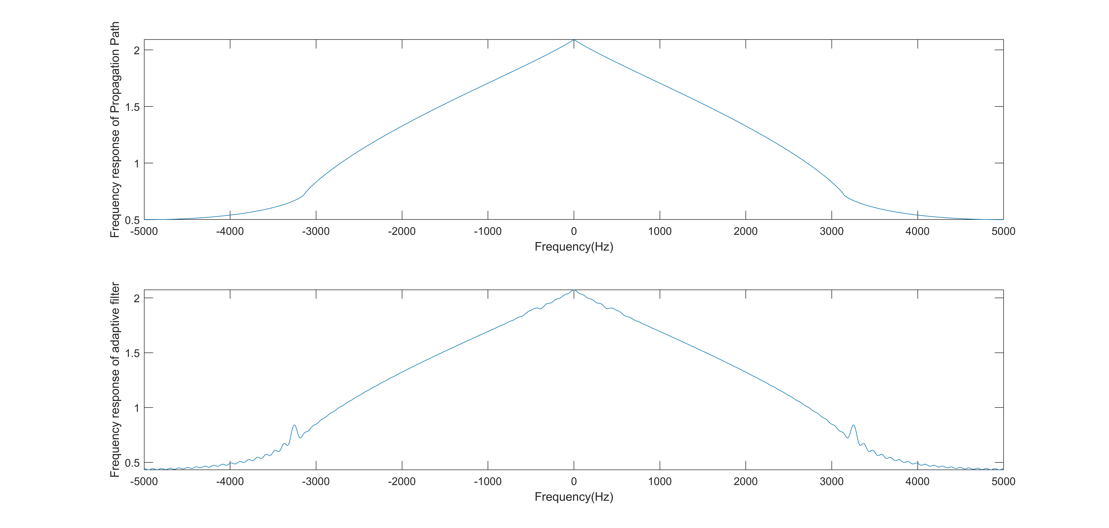
Frequency Response of Adaptive Filter

Slide 9
Advantages compared to PNC
In passive noise cancellation or PNC the noise source is physically separated from the subject (listener) so that sound waves travelling from the source to the subject get as much attenuated as possible.
PNC is very expensive and not practical for a lot of applications.
PNC cannot eliminate internally generated noise.
ANC can be used to create moveable/mobile devices but PNC is one place solution.

Slide 10
Applications
Headphones are earphones for media consumption and gaming.
Industrial machinery noise cancellation.
Noise cancellation inside aircraft cabins, car interiors or other vehicles.
Virtual Reality (VR) headsets for total immersion
Ultra-sensitive hearing aids especially made for hearing-impaired people.

Slide 11
Challenges
The wider the area the more difficult it is to implement the system.
Works better for cyclic/predictable noise such as the engine of a car.
non-periodic ambient noise having a multitude of frequencies and phase shifts are difficult to eliminate.
In 3-D space, a lot of error microphones, cancellation speakers and adaptive filters, sensors sometimes increase cost too much.
Useful sound may partially be cancelled by mistake due to error in complicated algorithms.

Slide 12
THANK YOU
Questions / Query

