Slide 1
DC MOTOR SPEED CONTROL WITH FPGA
Group 4

Slide 2
Objective
Control speed of motor by PWM through switches connected to FPGA
Display speed of motor in rpm in LCD display

Slide 3
Parts used:
Project setup:
Main Parts Used:
• FPGA (Cyclone 2 EP2C5T144C8)
• Arduino Uno
• Arduino Mega
• Motor driver L293D
• USB Blaster
• 12V DC motor 400rpm
• SDEC LCD Display
• IR sensor
• Battery - LIPO 2200mAH

Slide 4
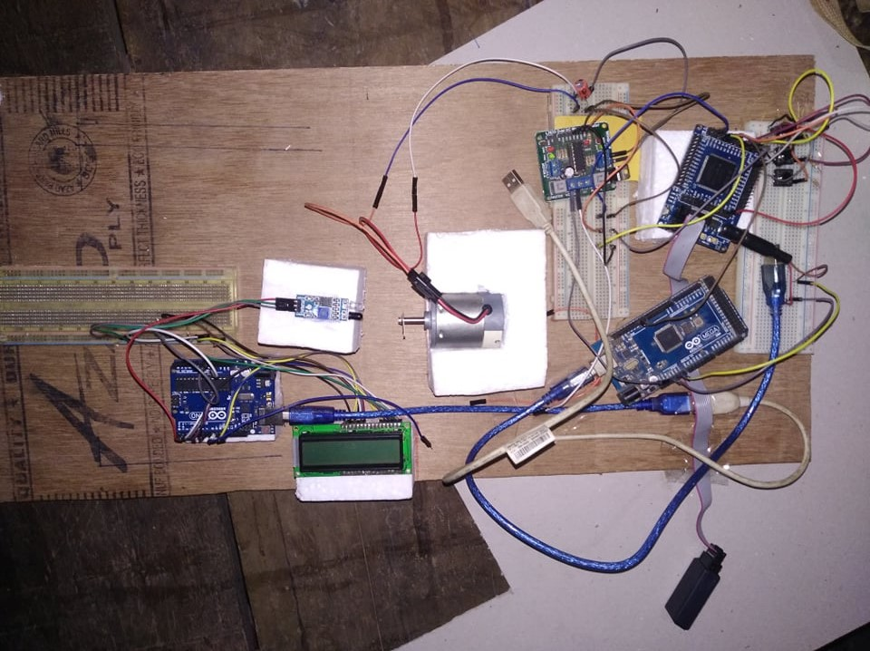
HOW IT WORKS?

Slide 5
HOW IT WORKS?

Slide 6
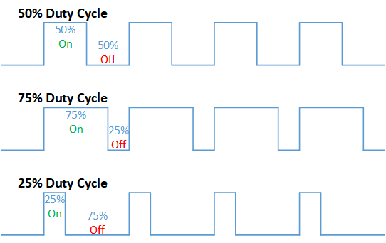
PWM

Slide 7
Applications
DC motors are suitable for many applications – including conveyors, turntables, and others for which adjustable speed and constant or low-speed torque are required. They also work well in dynamic braking and reversing applications, which are common in many industrial machines. Their quick acceleration, stopping and reversing along with their linear-speed torque curve make the DC motor a popular choice in many new designs, particularly for fractional high power applications.

Slide 8
Advantages and Disadvantages
FPGA is a very fast device, it consumes less power. Thus the loss at the speed control process is less than any other process which increases the efficiency.
Also, it is very light. Therefore it can be used in light weighted electric machines.
It gives us a wide range of torque speed and power.
Because FPGA’s are reprogrammable, they are reusable, making them flexible for faster prototyping and mistakes are not so costly.
BUT…
FPGA’s are not as flexible as micro-controllers
Verilog language used to program FPGA is complex
Very Low power

Slide 9
QUESTIONS??

