Slide 1
C like Compiler using Flex and Bison
Team7
Gogineni Ashrith Sai BL.EN.U4AIE20015
Konda Reddy Balaji Reddy BL.EN.U4AIE20029
Thanakanti Ganesh Madhav BL.EN.U4AIE20067
Evaluated by:
Dr. Meena Belwal.
Dept. Of CSE

Slide 2
Introduction
The language for which we are implementing is the simplified C.
This language will look a lot like the classic C
C Like Compiler Features:
Keywords: char, int, float, double, boolean.
Data Types: char, int, float, double, boolean.
Arrays & Pointers supported
No imports or external libraries
Simplified Lexical Analysis using regex
Simplified Syntax, no main function required
Static Semantic Rules, no runtime checks
Static Memory Allocation (no dynamic allocation)

Slide 3
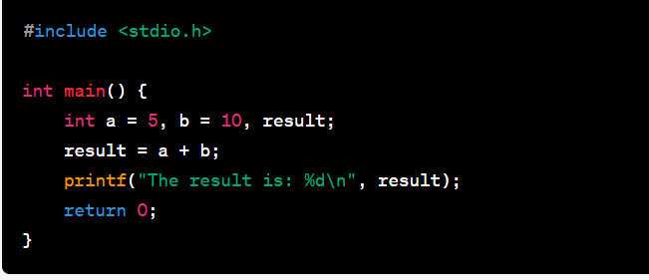
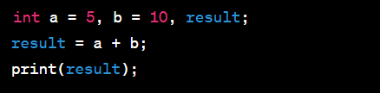
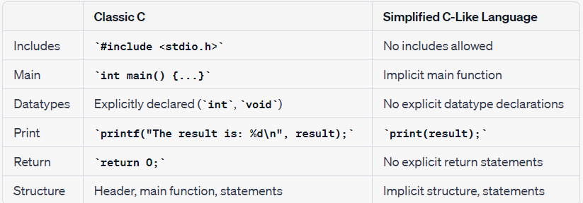
Comparing it with the Classic C
Classic C
Simplified C-Like Language:

Slide 4
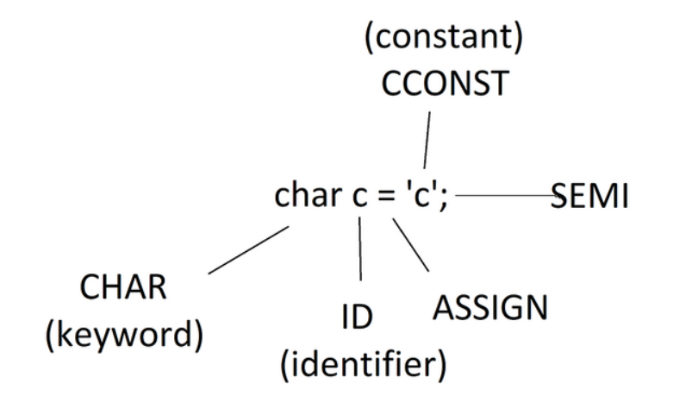
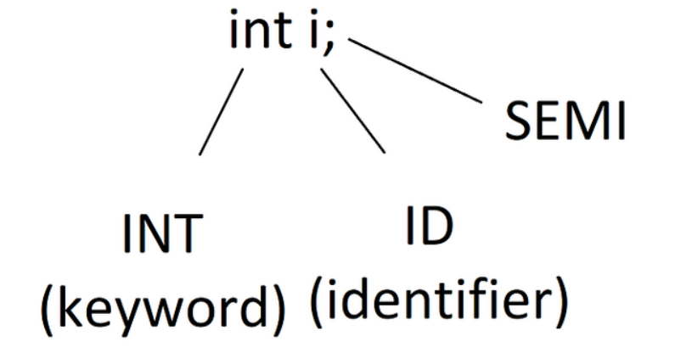
Declarations
Simple Declaration of one Variable
Simple Initialization of one variable:

Slide 5
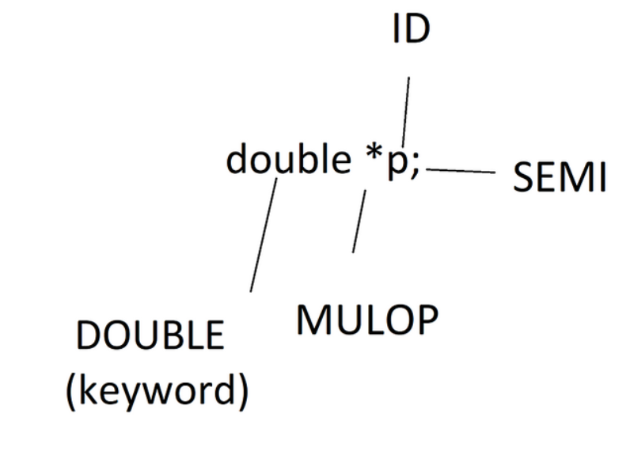
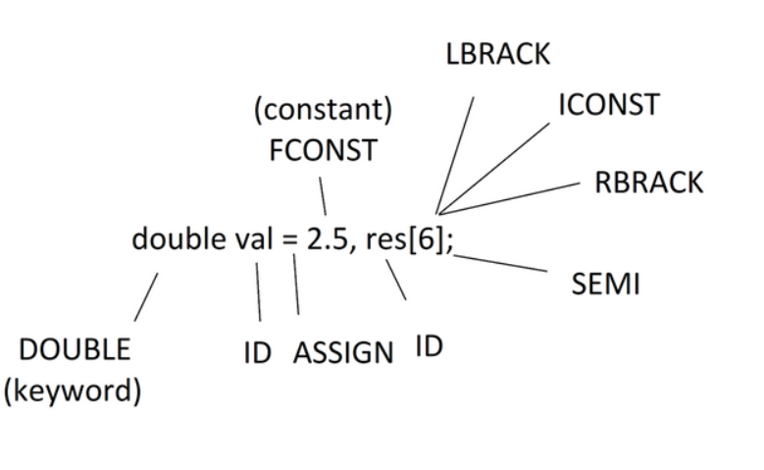
Declaring multiple variables:
Declaring a pointer variable:

Slide 6
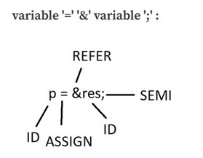
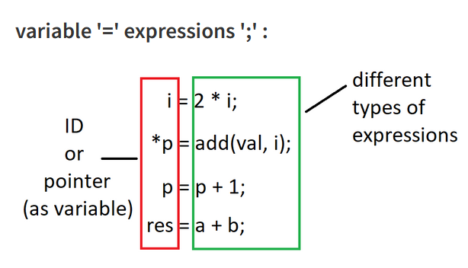
Variables

Slide 7
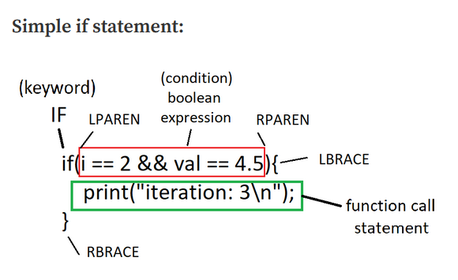
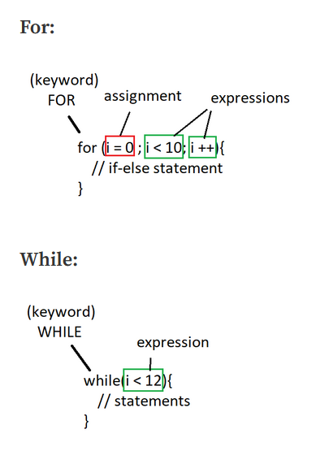
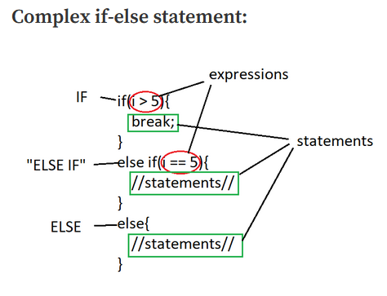
If-else
Loop statements

Slide 8
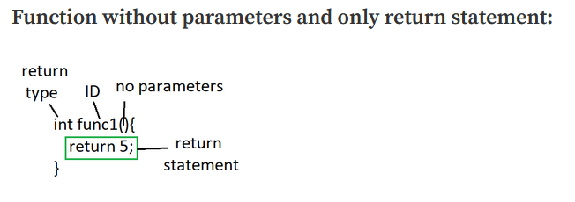
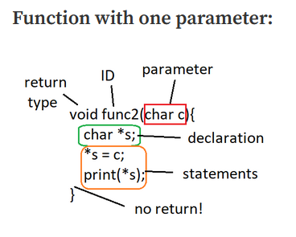
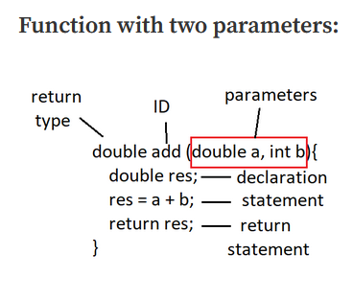
Functions

Slide 9
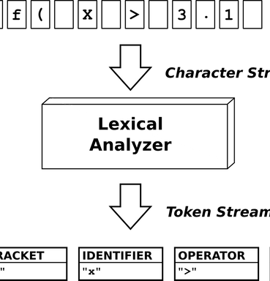
Lexical Analysis
Lexical analysis is the first phase of the compilation process, responsible for breaking the input source code into meaningful units called tokens.
It scans the source code character by character and groups them into tokens based on predefined rules and patterns.
Flex and Lexical Analysis:
Flex is a tool for generating lexical analysers in compiler construction.
It automatically generates lexer code in C based on defined rules.
Structure of a Flex program:
Statements/definitions section for options and declarations.
Rules section with regular expressions and associated actions.
User functions section (optional) for additional functions.
Regular expressions define patterns to match in the input source code.
Actions specify what to do when a pattern is found (e.g., printing, variable modification).
Flex generates a C file from the lexer file using the command "flex lexer.l".
The generated lexer code can be compiled using a C compiler like GCC.
The lexer performs lexical analysis by tokenizing the input source code.

Slide 10
Symbol Table
Symbol tables store information about identifiers that occur in the (source) program.
The symbol table in the compiler stores different types of identifiers and their associated information
Variables: Information like type, value, scope, and location is stored for variables.
Subprograms/Subroutines: Details such as parameters and return type are stored for subprograms.
Subroutine Parameters: Parameters of subprograms are stored separately from variables.
Instruction Labels: Labels for instructions are stored (not applicable in this compiler).
Constants: Constants are stored as Abstract Syntax Tree (AST) nodes.
Data Types: Support for data types like structs and unions will be added later.
The symbol table facilitates semantic analysis, type checking, and code generation.

Slide 11
Implementation of Symbol Table
A symbol table is typically implemented as a hashtable, which provides efficient operations for adding, searching, and managing identifiers.
The hash function plays a crucial role in ensuring a uniform distribution of identifiers in the hashtable.
The formula used for the hash function is hash(name) = Σascii mod k, where k is the size of the hashtable (preferably a prime number).
Insert: Adds a new identifier to the symbol table if it doesn't already exist. If the identifier already exists, its scope is checked to determine whether it should be added to the reference list or treated as a new entry.
Lookup: Searches for an identifier within the current or any specified scope and returns its symbol table entry. This operation is useful during syntax or semantic analysis.
Hide: Deactivates or hides the variables belonging to a specific scope, typically the current scope. This operation is performed when leaving a particular structural block or subroutine.

Slide 12
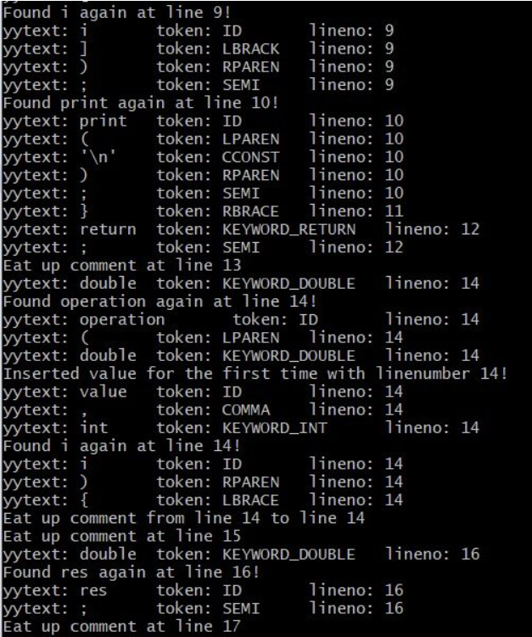
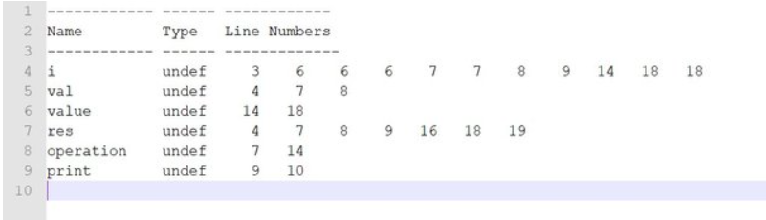
Combining Symbol Table with Lexer
Include the Symbol Table library in the Lexer using #include "symtab.c"
Define two external FILE variables in the Lexer:
extern FILE *yyin; for the input file (program)
extern FILE *yyout; for the output file of symtab_dump()
The output file "symtab_dump.out" contains all the symbol table entries.
The command-line now also contains messages for when an identifier is inserted into the Symbol Table for the first time or even Re-inserted (found again) another time and maybe on another line.
There is now also a new file in the folder. This file is the dump_file for the Symbol Table and shows us all the entries that the Symbol Table has

Slide 13
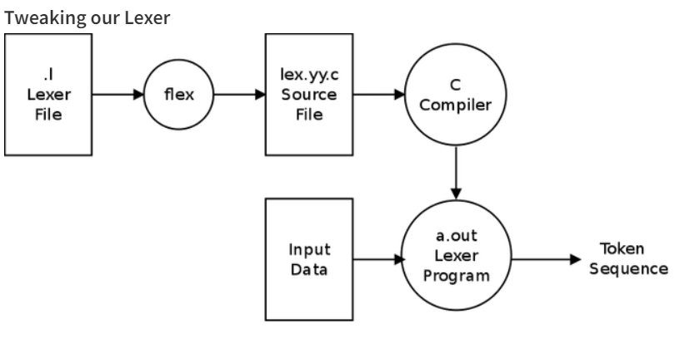
Creating Parser and integrating it with Flex
The parser code is written in Bison, which is a parser generator.
The parser code includes C code that includes libraries, defines functions, etc.
Token definitions are specified using the %token directive. These tokens are returned by the lexer (Flex) to the parser as integer codes.
The grammar rules are defined using Bison syntax. Some rules have been modified to use token names instead of character sequences.
The expression priorities and rules are defined, specifying the order of operations for expressions.
The error handling function yyerror() is defined to handle syntax errors in the parser.
The main() function is defined to perform parsing. The input file is opened, and the yyparse() function is called to initiate the parsing process.
The lexer (Flex) is integrated with the parser by including the generated parser.tab.h library.
The lexer returns tokens to the parser by returning the corresponding token IDs defined in the parser.
The symbol table and its initialization and dump methods are added to the main function of the parser.
After compiling the parser and lexer files using Bison and Flex, the compiler can be run by providing an input file containing the code to be parsed.

Slide 14
Semantic Analysis
Variable Declaration Semantics:
Check if the variable has already been declared in the current scope.
Main function variables are treated as global variables accessible to all functions.
Optional functions can have variables with the same name, but they are only accessible within their scope.
Scope Resolution of Variables:
Variables are resolved based on the current scope.
Scope values are incremented when entering a function and decremented when leaving a function.
Symbol table entries corresponding to a scope are removed when leaving that scope.
Declaration and Initialization of Variables:
For simple variables (IDs) and pointers without initialization, check if they have been declared.
For arrays, check that the initialization values are of the correct constant type.
The expression inside array brackets must evaluate to a positive integer constant value.

Slide 15
Integrating it with bison
Include the "semantics.h" and "semantics.c" files in the existing compiler code.
Ensure that the "semantics.c" file includes its corresponding header file, "semantics.h".
Include the "semantics.h" library in the "symtab.c" and "symtab.h" files, which contain the symbol table.
Incorporate the "semantics.h" header file in the lexer to use the "UNDEF" token type when inserting an identifier into the symbol table.
Include the "semantics.c" file in the parser to make the new functions available and ensure their compilation and inclusion in the final compiler executable.

Slide 16
Changes to be made in parser
Managing the "declare" variable:
The "declare" variable is used to track whether we are currently in a declaration or not.
It is set to 1 when entering a declaration (for variables or parameters) and set to 0 after leaving the declaration.
This helps in distinguishing between regular variable usage and variable declarations.
Entering and leaving a scope:
Scopes are entered and exited within the "function" rule.
Before processing the function head, the scope is incremented using the "incr_scope()" function.
After processing the function tail, the scope is hidden using the "hide_scope()" function to remove the entries of that scope.
Parser Rule Changes:
The "declaration" rule now sets "declare" to 1 before parsing the type and variable names, and sets it back to 0 after the SEMI token.
The "parameter" rule follows a similar pattern, setting "declare" to 1 before parsing the type and variable, and setting it back to 0.

Slide 17
Statement Semantics:
Increment/Decrement of ID: The identifier to increment/decrement must be of a numeric type.
If Statement: The condition inside the if statement must return a boolean value.
For Statement: The second part of the for statement must be an expression that returns a boolean value.
While Statement: The condition inside the while statement must return a valid boolean value.
Assignment Statement: Check the compatibility of the left-hand side variable and right-hand side expression types.
Function Call Statement: Check if the function has been declared and if the parameters are compatible.
Expression Semantics:
Mathematical Operations: Check compatibility of types for addition, subtraction, multiplication, and division.
Boolean, Relational, and Equality Operators: Check compatibility of types for logical and comparison operations.
Function Declaration Semantics:
Check if the function being used has been declared.
Check compatibility of formal and caller parameters.
Check if the return value (if any) matches the declared return type.

Slide 18
These functions contribute to managing function declarations, parameter definitions, and checking parameter compatibility during function calls in the compiler:
Parameter Definition: The def_param function creates and returns a structure called Param, representing a parameter in the compiler. It sets the parameter's type, name, and passing method.
Function Declaration: The func_declare function handles the declaration of functions. It sets the function's return type, number of parameters, and parameter details in the symbol table entry for that function.
Function Parameter Type Compatibility Checking: The func_param_check function checks the compatibility of function parameters between a function call and its declaration. It compares the number of parameters and checks each parameter's type compatibility using the get_result_type function.

Slide 19
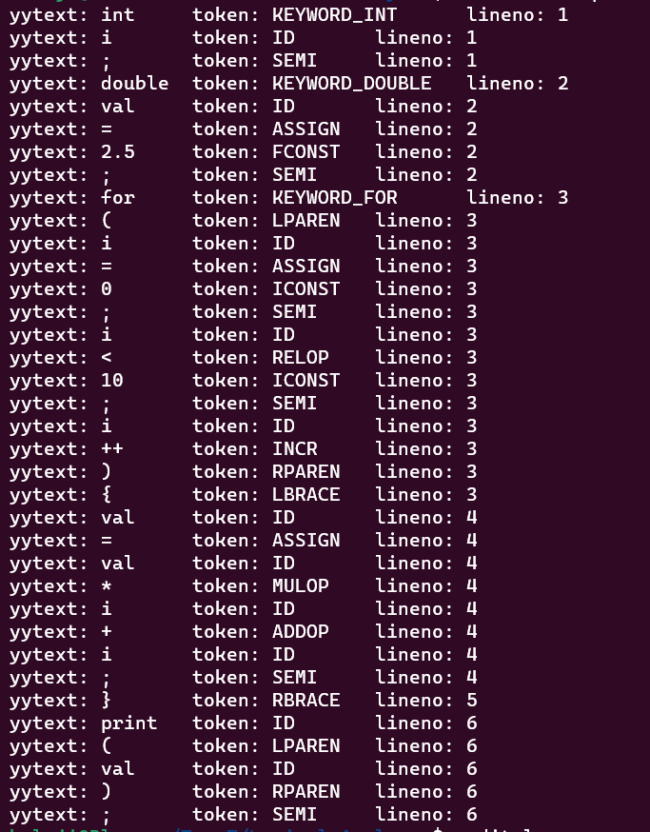
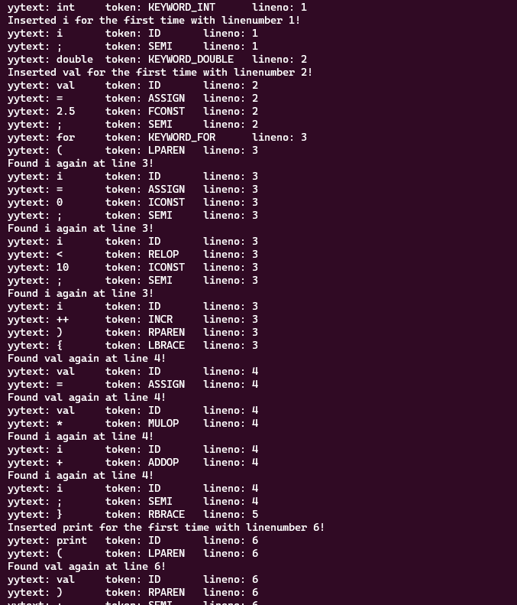
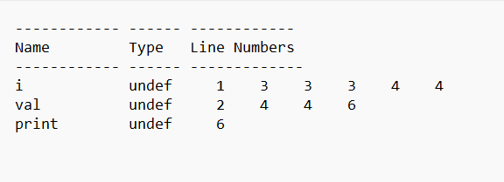
Lexical Analysis and Symbol Table

Slide 20
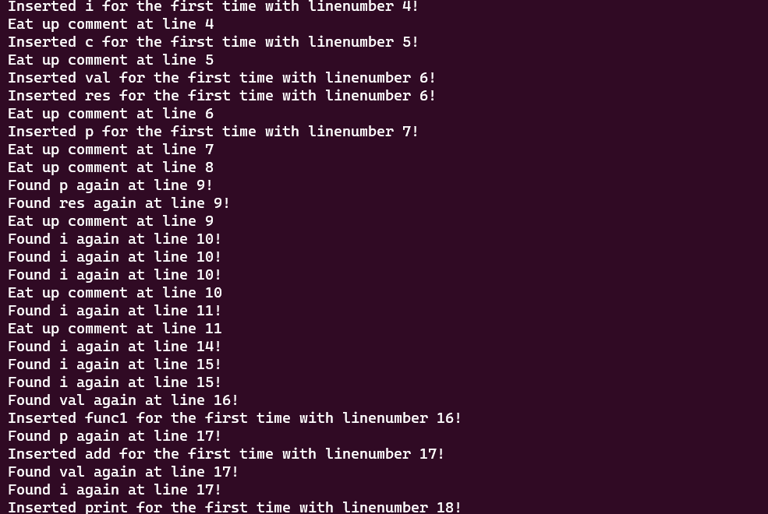
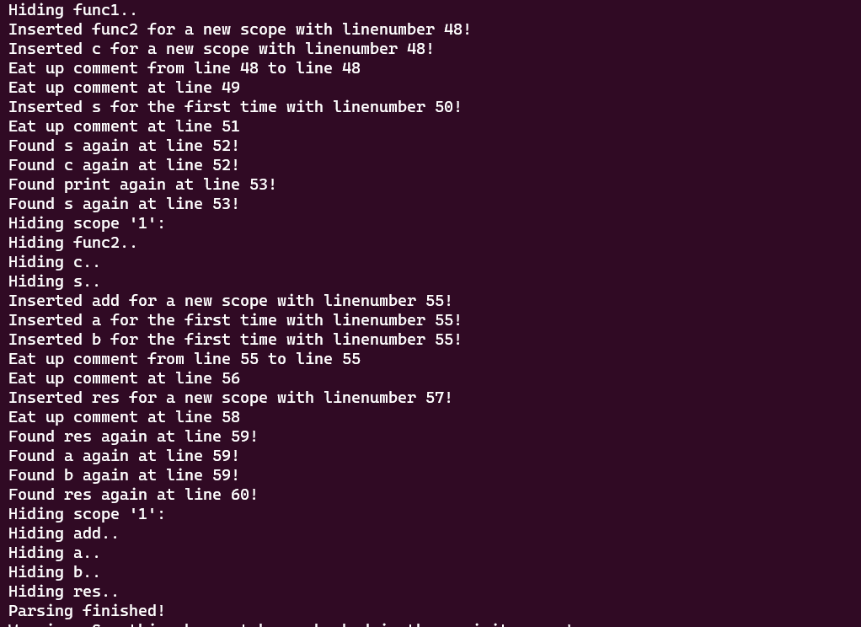
Functional Semantics and Parser

