Slide 1
Multiple Disease Prediction
INTELLIGENCE OF BIOLOGICAL SYSTEMS-4
19BIO211
TEAM 20

Slide 2



OUR TEAM
KOWSHIK
MANI PRAKASH
BALAJI
BL.EN.U4AIE20009
BL.EN.U4AIE20017
BL.EN.U4AIE20029

Slide 3
TABLE OF CONTENTS
01
02
Introduction
Litreature Survey
03
04
05
Implementation
Conclusion
References

Slide 4
INTRODUCTION
Machine Learning Algorithms and its approaches are generally helpful for healthcare and biomedical sectors for predicting the disease. For trivial symptoms, the difficulty is to meet the doctors at any time in the hospital. Thus, Machine Learning provides essential data regarding the diseases on the basis of the patient's symptoms. For several medical organizations, disease prediction is important for making the best feasible health care decisions.

Slide 5
Why Multiple Disease Prediction ?
Data in the healthcare industry consists of all the information related to patients.
So, we have designed a general architecture for predicting the disease in the healthcare Industry.
Many of the existing systems can predict only one disease at a time and that too with lower accuracy.
So, we have designed a Multiple Disease Prediction System which can predict multiple diseases at a time.
All the parameters which cause the disease is included so it is possible to detect the disease efficiently and more accurately.

Slide 6
PROBLEM SYSTEM
PROPOSED SYSTEM
Many of the existing machine learning models for health care analysis are concentrating on one disease per analysis.
For example, first is for liver analysis, one for cancer analysis, one for lung diseases like that. If a user wants to predict more than one disease, user should go through different sites.
When a company wants to analyze patient health information, they must use numerous models, which drives up the cost and time. Some of the current systems take extremely few parameters into account, which can lead to false results.
In multiple disease prediction, it is possible to predict more than one disease at a time.
So, the user doesn’t need to traverse different sites in order to predict the diseases.
To implement multiple disease, we have used machine learning algorithms and Stream lit.
When the user is accessing this API, the user should send the parameters of the disease along with the disease name

Slide 7
LITREATURE SURVEY
"Prediction of Heart Disease Using Machine Learning Algorithms," 2019
This paper aims to predict heart disease using different machine learning techniques
Multi Disease Prediction Model by using Machine Learning and Flask API," 2020
This Paper aims to predict all diseases at once using Machine Learning and developed a user interface using Flask API

Slide 8
REQUIREMENTS
Functional Requirement:
The system allows the patient to predict the disease
The user adds the input for the disease and based on the trained model of the user input the output will be displayed .
Non-Functional Requirement:
The website will provide a range of values when the disease is predicted.
The website should be reliable and consistent.

Slide 9

DESIGN
Input Dataset
Preprocessing
Splitting
Classification using algorithm
Training
Testing
Choice the more accurate model
Applied Knowledge

Slide 10
DATASETS USED
HEART
PARKINSON’S
KIDNEY
DIABETES

Slide 11
HEART
Heart Disease or in other words cardiovascular disease is the common health problem in most of countries these days
Causes of Heart Disease:
Physical inactivity and malnutrition, overweight and obesity, tobacco and substance abuse are amongst the leading causes for cardiovascular disease
Out of All Random Forest which yielded better results
This prediction of Heart Disease through machine learning will help us reduce the errors made by doctors in diagnosis of Heart Disease

Slide 12
KIDNEY
Chronic Kidney Disease(CKD) is a major issue worldwide which is a condition characterized by a gradual loss of kidney function over time.
Over 2 million people worldwide currently receive treatment with dialysis or a kidney transplant to stay alive.
Chronic kidney disease causes more deaths than breast cancer or prostate cancer
Out of all machine learning methods considered, logistic regression shown the highest accuracy and minimal bias to the attributes.

Slide 13
Parkinson’s Disease
Parkinson’s disease is a central nervous system disorder. Its symptoms occur because of low dopamine levels in the brain.
Four Primary symptoms are tremor, rigidity, slow movement and balance problems.
Till now no cure for Parkinson’s Disease is known, treatment aims to reduce the effects of the symptoms.
By Comparing Several ML algorithms for the prediction of Parkinson’s disease out of which we found DecisionTree as the most accurate model.
.

Slide 14
DIABETES
It is a kind of metabolic diseases in which patients suffer from blood glucose problems due to abnormal production and release of insulin.
Caused when there is inadequate production of insulin, or insulin resistance.
Symptoms of diabetes include frequent urination, excessive thirst or hunger, and weight changes.
For Diabetes, various machine learning algorithms are applied on the dataset and the classification has been done using various algorithms of which RandomForest gives highest accuracy of 95%

Slide 15
ABOUT THE INPUT PARAMETERS

Slide 16
DIABETES INPUT PARAMETERS
Select one or more of the patient's symptoms
Pregnancies
Glucose
Blood Pressure
SkinThickness
Insulin
BMI
Age
DiabetesPedigreeFunction

Slide 17
HEART INPUT PARAMETERS
Select one or more of the patient's symptoms
Age
Sex
Chest pain type
Resting blood pressure
Serum chol mg/dl
Fasting blood sugar
Maximum heart rate achieved
Exercise included angina
Resting electrocardiographic
results
Oldpeak
The slope of the peak
Number of major vessels colored by flouroscopy
thal

Slide 18
KIDNEY INPUT PARAMETERS
Select one or more of the patient's symptoms
Age
Blood Pressure
specific gravity
albumin
sugar
red blood cells
pus cell
pus cell clumps
bacteria

Slide 19
PARKINSON’S INPUT PARAMETERS
Select one or more of the patient's symptoms
Average vocal fundamental frequency
Maximum vocal fundamental frequency
Minimum vocal fundamental frequency
Several measures of variation in fundamental frequency
Several measures of variation in amplitude
NHR, HNR - Two measures of the ratio of noise to tonal components in the voice
RPDE, D2
DFA- Signal fractal scaling exponent
health status
spread1
spread2
PPE

Slide 20
COMPARISON
DISEASES | RandomForest | LogisticRegression | Decision Tree
HEART | 90.16% | 85.25% | 81.97%
KIDNEY | 89.831% | 97% | 96.25%
PARKINSONS’ | 90% | 81.5% | 99.52%
DIABETES | 95.7% | 77.73% | 77.87%

Slide 21
Logistic Regression
01
02
Random Forest
SVM
03
04
K means
DECISION TREE
05
06
NAÏVE BAIS
KNN
07

Slide 22
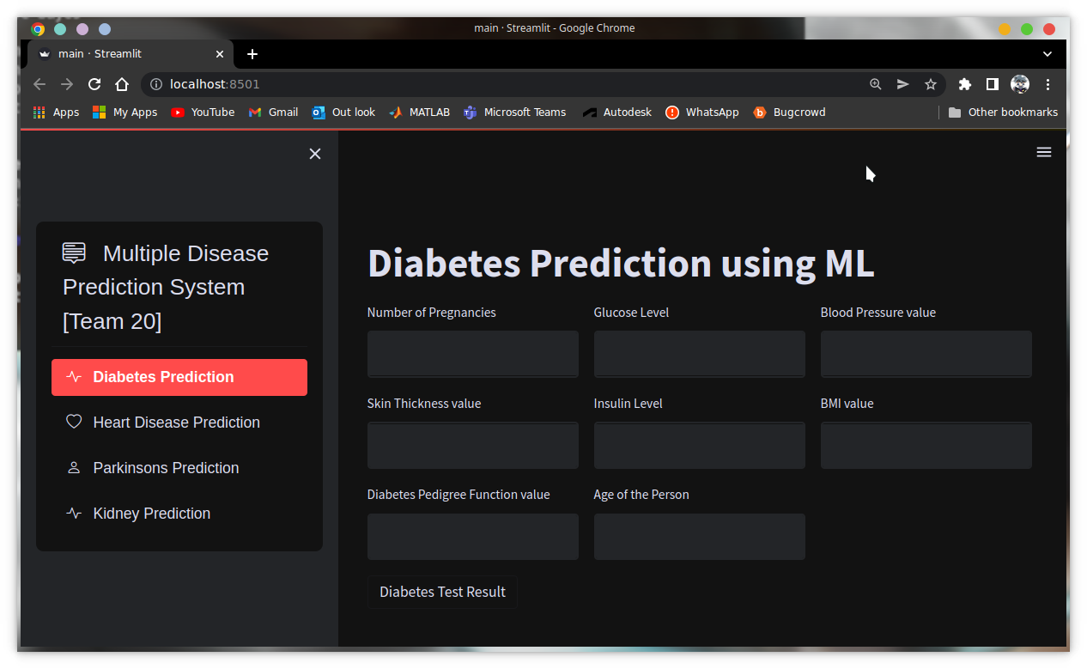
GUI AND MODULES USED
scikit-learn
Pandas
Pickle
Streamlit
Streamlit option menu

Slide 23
Demo + Code Walkthrough

Slide 24
CONCLUSION
Our Proposed System aims at bridging gap between Doctors and Patients which will help both classes of users in achieving their goals.
Diseases if predicted early can increase your life expectancy as well as save you from financial troubles.

Slide 25
REFERENCES
“Disease Prediction Using Machine Learning Over Big Data” (2018).
"Applying Machine learning methods in Diagnosing Heart disease for Diabetic Patients" International Journal of Applied Information Systems (IJAIS) – ISSN: 2249-0868 Foundation of Computer Science FCS, New York, USA Volume 3– No.7, August 2018
” DIABETES PREDICTION USING DIFFERENT MACHINE LEARNING APPROACHES”, 2019

Slide 26

THANKYOU
SUBMITTED TO:
DR.AMRITA THAKUR
DR.NIDHIN PRABHAKAR TV

