Slide 1
Bowling Game
Teodor Nikolov
Mihail Tsakov

Slide 2
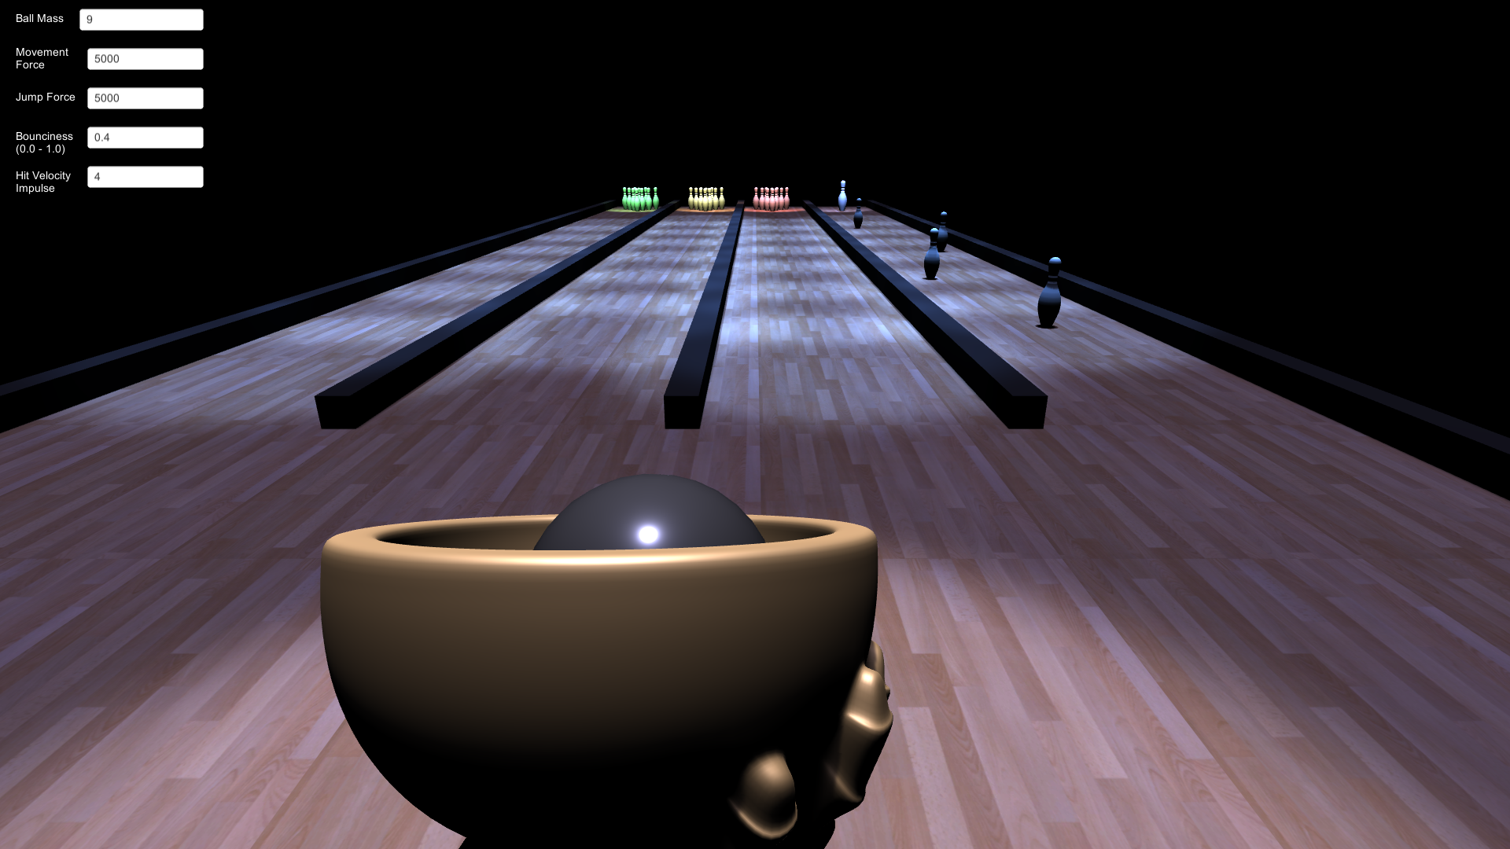
Scene
Movement and Jump
WASD and SPACE
Options:
Ball Mass
Acceleration Force
Jump Force
Bounciness
Impact Force
For spring-like pins

Slide 3
Physics
Unity Physics Engine (player input)
Force applied in four directions (forward, backward, left, right) each frame (movement)
Force applied once in the up direction (jump)
Bouncing
Dampened force applied in opposite direction of contact normal with static objects (walls, floor)
Pin Stretch (Hooke’s Law)
On impact with stationary springy pins

Slide 4
BOUNCE
Works only with static, non-rigid body objects (walls, floor)
n – contact normal
C – damp coefficient
Calculate impulse I
I = -n * ( v(t) • n )
Calculate bounce velocity v on impact (C – bounce or damp coefficient):
v(t) = v(t) + I + I * C

Slide 5
PIN STRETCH
With the help of Hooke’s Law
The pin bottom is fixed
The pin Y scale represents the displacement d + rest position
m = 1
K = 39.2N
C – varying damp coefficient
dt = 0.016s (simulation independent from Unity’s physics)
F = f(t + dt) = f(t) -9.8 – K * d(t)
D = d(t + dt) = d(t) + ( F – F * C ) / K * dt
Y = y(t + dt) = (1 + D) * y(0)

Slide 6
Live Demo

