Slide 1
Bowling Game
Teodor Nikolov
Mihail Tsakov

Slide 2
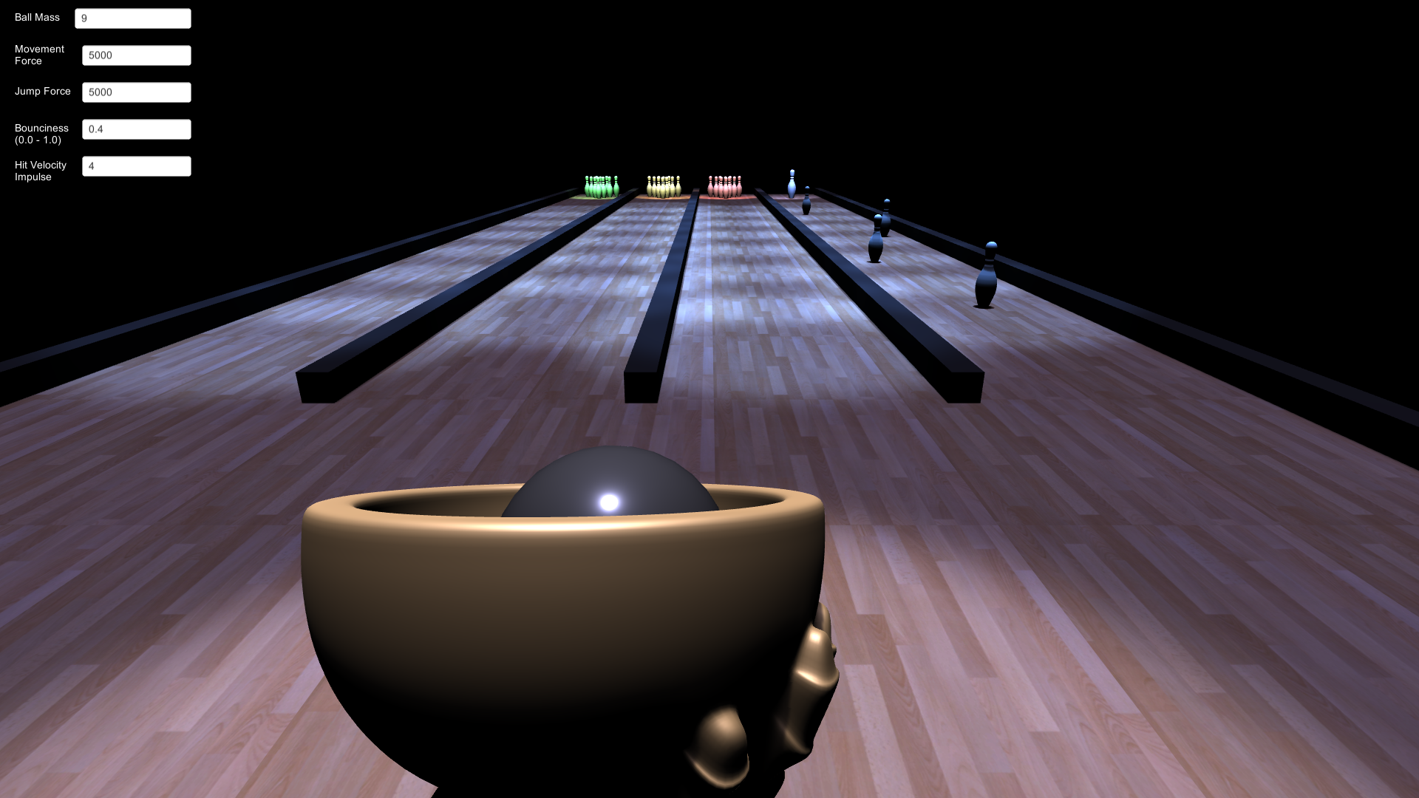
Scene
Movement – WASD and SPACE
Options:
Ball Mass
Acceleration Force
Jump Force
Bounciness
Impact Velocity
for stationary pins

Slide 3
Physics
Unity Physics Engine
Force is added when WASD keys are held down (movement)
Bouncing
Force applied in opposite direction of contact normal with walls
Stretching (Hooke’s Law)
On impact with stationary pins, velocity impulse is applied (to show spring stretch)

Slide 4
Live Demo

