Slide 1
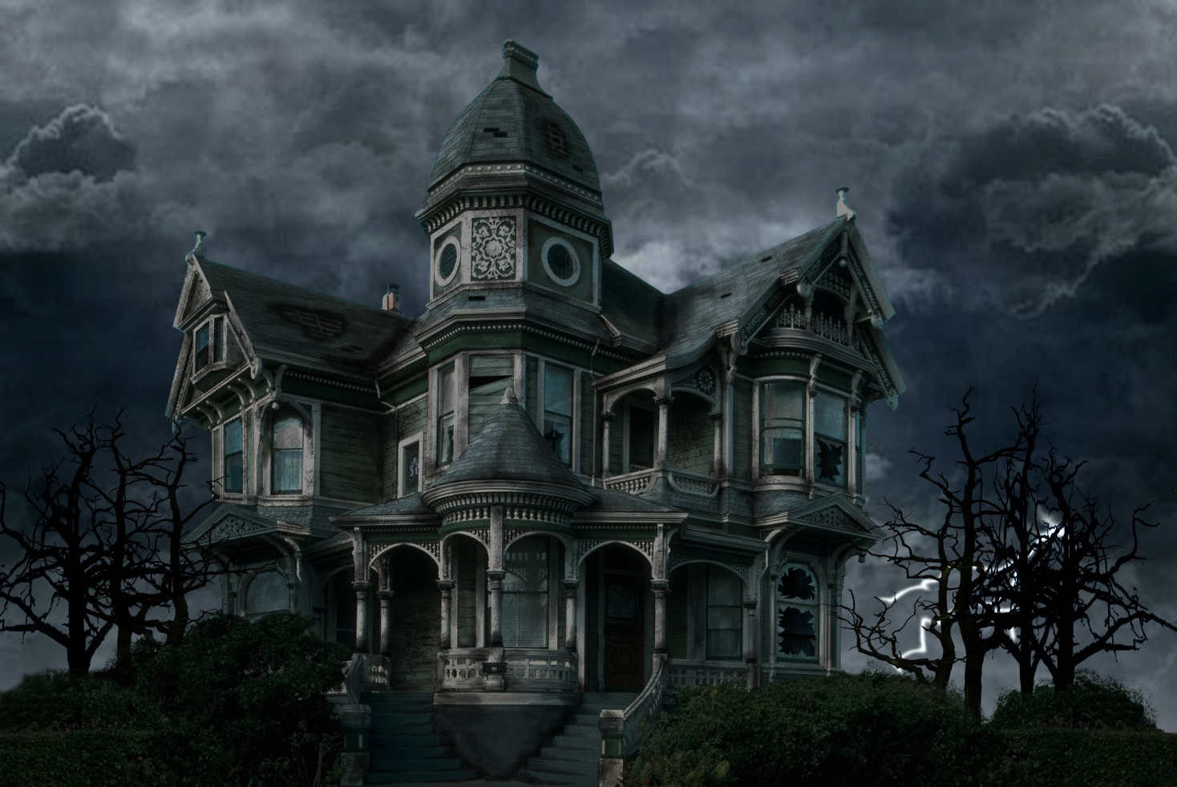
Haunted House
Done by: Group 9

Slide 2
Outline:
What is “Haunted House”?
The Functions of Inventory
The Movement of the Players
Features of the Haunted House:
Systems:
- Combat System
- Lighting System
The Keys & Locked Doors
Searchable objects
Secrets
Status Window
Live Show (Haunted House)
Future Developments

Slide 3
What is “Haunted House”?
Text based (adventure game)
Basement | Ground | First
Hallway | Hallway (E,W,C) | Hallway(E,W,N,S)
Storage | Dining (E,W) | Child’s bedroom
Pantry
Torture | Kitchen | Master bedroom
Work Shop | Office | Store room
Wine Cellar | Lounge (E,W) | bathroom
Story’s location:
-
Play with:
-4 different characters
It contain :
3 Floors & 25 rooms
Enemies occupy rooms, so you’ll need to kill them
Notes:
Text based adventure game
Story’s maps based arouund ?
Who I play with?
what exactly I have to be careful with?

Slide 4
The Functions of Inventory
-You now can view you inventory
-Allows you to:
use and item
drop an item
View items
-Keeps the display clear of clutter as you could carry lots of small items

Slide 5
The Movement of the Players
-Players can move using the directions
North
East
South
West
Up
Down
The Keys and locked Doors:
- You can unlock the doors to gain access to more areas
-You can’t move into a room if there is a locked door
-You’ll have to search for keys

Slide 6
Features of the Haunted House
Systems:
Combat System
- Fighting an enemy→ Spamming (button ”Keyboard”)→Acts (attack: opponent)
Fight or Flight
Running → drain “Mana”
Fighting → drain “Health”
Mob → drop “Items”
Lighting system
Lamp + torch
Lamp → see doors and searchable objects
Torch → adds the ability to see items on the floor

Slide 7
Features of the Haunted House
Searchable objects:
- they have different items that will help the player
- you can find keys and swords in there
Secrets:
-Secret room in the basement
-
Status Window:
allows curses → ended gracefully
shows player health, stats and inventory

Slide 8
Live Show
Haunted House

Slide 9
Future Developments
More enemies, players and a better combat system.
More potions with different effects.
More floors to increase the map size
Save/Load function.
Slots for gear on the player and items for the gear slots.
Adding spells and better mana usage. Quests.
More rooms with more interactions.
Locking doors(enemies chasing the player).
Longer game and choices that impact the game.
Different endings of the game.
Adding NPCs and more secrets.
Status window to show enemy health and stats.

Slide 10

Any Questions

