Slide 1
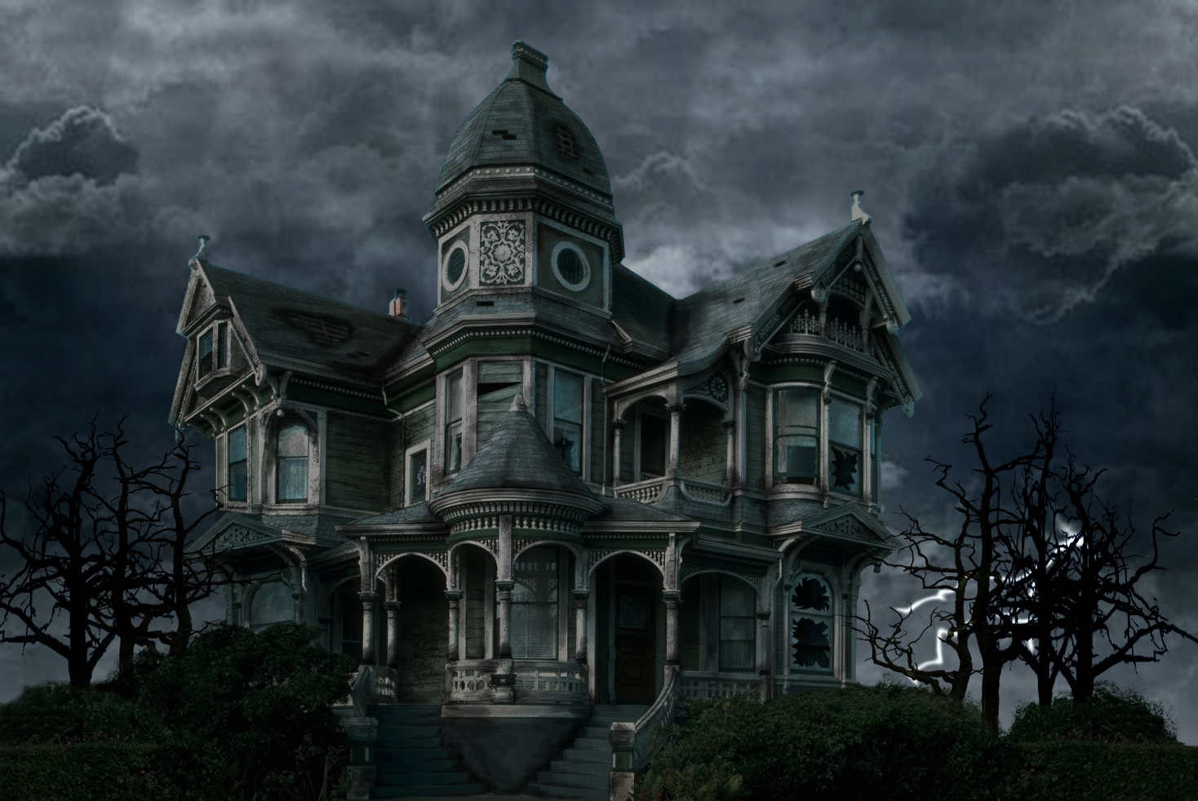
Haunted House
Done by: Group 9

Slide 2
Outline:
What is “Haunted House”?
The Functions of Inventory
The Movement of the Players
Features of the Haunted House:
Systems:
- Combat System
- Lighting System
The Keys & Locked Doors
Cabinets
Secrets & Shit
Statue Window
Live Show (Haunted House)
Future Developments

Slide 3
What is “Haunted House”?
Text based (adventure game)
Basement | Ground | First
Hallway | Hallway (E,W,C) | Hallway(E,W,N,S)
Storage | Dining (E,W) | Child’s bedroom
Pantry
Torture | Kitchen | Master bedroom
Work Shop | Office | Store room
Wine Cellar | Lounge (E,W) | bathroom
Story’s location:
-
Play with:
-
It contain :
3 Floors & 25 rooms
Be Careful about:
-
-
Notes:
Text based adventure game
Story’s maps based arouund ?
Who I play with?
what exactly I have to be careful with?

Slide 4
The Functions of Inventory
-
-
-
-

Slide 5
The Movement of the Players
-
-
-
-

Slide 6
Features of the Haunted House
Systems:
Combat System
- Fighting an enemy→ Spamming (button ”Keyboard”)→Acts (attack: opponent)
Fight or Flight
Running → drain “Mana”
Fighting → drain “Health”
Mob → drop “Items”
Lighting system
Helps → Vision “Dark rooms”
The Keys and locked Doors:
- You can unlock the doors to gain access to more areas

Slide 7
Features of the Haunted House
Cabinets:
- they have different items that will help the player
- you can find keys and swords in there
Secrets:
-
-
Status Window:
allows curses → ended gracefully
shows player health, stats and inventory

Slide 8
Live Show
Haunted House

Slide 9
Future Developments
More enemies, players and a better combat system.
More potions with different effects.
Save/Load function.
Slots for gear on the player and items for the gear slots.
Adding spells and better mana usage. Quests.
More rooms with more interactions.
Keys to lock doors(enemies chasing the player).
Longer game and choices that impact the game.
Different endings of the game.
Adding NPCs and more secrets.
Status window to show enemy health and stats.

Slide 10

Any Questions

