Slide 1



Bangalore Institute of Technology
K.R. Road, V.V. Pura, Bengaluru.-560004.
Department of Computer Science & Engineering
A Privacy-Preservation Framework based on Biometrics Blockchain in VANET
By:
20P10
1BI20CS160
SHIVANI
Under the Guidance
of
Dr. Hemavati P
Associate Professor
Dept. of CSE

Slide 2
Bangalore Institute of Technology
K.R. Road, V.V. Pura, Bengaluru.-560004.
Department of Computer Science & Engineering
Agenda
Introduction
Literature Survey
Problem Statement
Proposed System
Architecture
Methodology/Algorithm
Results
Application
Conclusion
References

Slide 3
Bangalore Institute of Technology
K.R. Road, V.V. Pura, Bengaluru.-560004.
Department of Computer Science & Engineering
INTRODUCTION
Vehicular Ad-hoc Network (VANET) is one of the core structure of intelligent vehicles.
VANET is an IoT system that enables wireless communication among vehicles, facilitating real-time data exchange between two vehicles (V2V) and between vehicles and infrastructure (V2I).
It enhances road safety and decreases traffic congestion.
The use of blockchain in VANET offers decentralized data storage, hence enhancing security and privacy.
A Biometrics Blockchain framework is presented to secure the data that is shared among vehicles in VANET. Statuary data is also retained in a trusted system.
The advantage of biometric is used to keep a record of genuine identity of the message sender and helps establish a trust between vehicles in VANET.

Slide 4
Bangalore Institute of Technology
K.R. Road, V.V. Pura, Bengaluru.-560004.
Department of Computer Science & Engineering
LITERATURE REVIEW
Sl.No | Title | Author | Year of Publication | Adopted Technique/ Methodology | Limitations
1 | A Blockchain-Based, Privacy Preserving Authentication Scheme for VANET | Z. Lu, Q. Wang, G. Qu, H. Zhang and Z. Liu | 2019 | Law enforcing authority, Certificate authority to generate unique keys. | With more vehicles, tracking and retrieving certificates becomes difficult.
2 | Privacy preservation in blockchain based IoT systems: Integration issues, prospects, challenges, and future research directions | Muneeb Ul Hassan, Mubashir Husain Rehmani, and Jinjun Chen | 2019 | Anonymization, encryption, mixing, and differential privacy | Encryption based privacy increases communication overhead. Susceptible to linking attack.

Slide 5
Bangalore Institute of Technology
K.R. Road, V.V. Pura, Bengaluru.-560004.
Department of Computer Science & Engineering
Sl.No | Title | Author | Year of Publication | Adopted Technique/ Methodology | Limitations
3 | A Traceable Blockchain-Based Access Authentication System With Privacy Preservation in VANETs | D. Zheng, C. Jing, R. Guo, S. Gao and L. Wang | 2019 | A traceable and decentralized Internet of Vehicle system framework for communication among vehicles by employing a secure access authentication scheme | Privacy is protected by using pseudonym addresses that do not necessarily have link with actual identities. Pseudonymity doesn’t provide full protection
4 | BPAS: Blockchain-Assisted Privacy-Preserving Authentication System for Vehicular Ad-Hoc Networks | Q. Feng, D. He, S. Zeadally, K. Liang | 2020 | Use of Fuzzy Extractor, Attribute Based Encryption (ABE), and Smart Contracts deployed on Blockchain, which satisfies security and privacy requirements of VANET. | Using cryptographic operation on resource-constrained OBUs, may result in more computational overhead

Slide 6
Bangalore Institute of Technology
K.R. Road, V.V. Pura, Bengaluru.-560004.
Department of Computer Science & Engineering
Sl.No | Title | Author | Year of Publication | Adopted Technique/ Methodology | Limitations
5 | Blockchain-based distributed management system for trust in VANET | Youssef Inedjaren, Mohamed Maachaoui, Besma Zeddini, and Jean-Pierre | 2021 | Optimize Link State Routing (OLSR) as a protocol to maintain information about neighbors, and FT-OLSR protocol to calculate the trust values. | OSLR requires more processing power than other protocols when discovering an alternate route.
6 | An Efficient Privacy-Preserving Authentication Model Based on Blockchain for VANETs | Xia Feng, Qichen Shi, Qingqing Xie, and Lu Liu | 2021 | Tackle the problem of high latency in blockchain while verifying the users membership by the use of asynchronous accumulator to extend the application of blockchain. | The model heavily relies on the RSMs and RSUs. If these entities face s compromise or failure, the system's reliability and security could be compromised

Slide 7
Bangalore Institute of Technology
K.R. Road, V.V. Pura, Bengaluru.-560004.
Department of Computer Science & Engineering
Sl.No | Title | Author | Year of Publication | Adopted Technique/ Methodology | Limitations
7 | Efficient Biometric-Based Identity Management on the Blockchain for Smart Industrial Applications | Neyire Deniz Sarier | 2021 | Biometric-based anonymous credential scheme, supporting selective disclosure, suspension and revocation of credentials. | The system reliance on Merkle trees and storage of authentication paths for each leaf in tree could lead to significant storage needs.
8 | Design of Blockchain-Based Lightweight V2I Handover Authentication Protocol for VANET | S. Son, J. Lee, Y. Park, Y. Park and A. K. Das | 2022 | A protocol where vehicles only perform lightweight computations in handover situations for efficiency of the network. BAN logic, ROR oracle model and AVISPA is used. | Handover technique from one RSU to another, and does not guarantee protection from Sybil attacks. Computation cost is high during handover.
Notes:
VANET is an IoT service , , including traffic information and weather conditions, for purposes like collision avoidance and intelligent routing.
Known as vehicular adhoc network, enables wireless communication among vehicles.
There is also a risk of user data leaks.
Use of blockchain makes it decentralized and secure
Biometrics would make it more secure.

Slide 8
Bangalore Institute of Technology
K.R. Road, V.V. Pura, Bengaluru.-560004.
Department of Computer Science & Engineering
Sl.No | Title | Author | Year of Publication | Adopted Technique/ Methodology | Limitations
9 | A Blockchain-Enabled, Trust and Location Dependent - Privacy Preserving System in VANET | Kiran Bala, Ramakant Upadhyay, Syed Rashid Anwar, and Gajendra Shrimal | 2023 | Location privacy is achieved through combination of algorithms like Anonymity set size, Entropy, k-Anonymity and Cloaking Granularity. Trust scores are used to evaluate the trustworthiness of vehicles and Road Side Units. | Only theoretical discussion about blockchain and its smart contracts. No provide experimental proof.

Slide 9
Bangalore Institute of Technology
K.R. Road, V.V. Pura, Bengaluru.-560004.
Department of Computer Science & Engineering
PROBLEM STATEMENT
“A framework that secures data sharing using biometrics-blockchain within VANETs to resist denial-of-service, replay attacks and Sybil attack, while maintaining trust and privacy “
Objectives:
1. Single registration whereby vehicles are only required to register once before being able to send messages.
2. To ensure that the received messages are credible.
3. The vehicles genuine identity must not be visible to others, and should not be possible for malicious actor to acquire identities.
4. Trusted authority should be able to trace the true identity incase of malicious behaviour.

Slide 10
Bangalore Institute of Technology
K.R. Road, V.V. Pura, Bengaluru.-560004.
Department of Computer Science & Engineering
PROPOSED SYSTEM
“A Privacy-Preservation Framework Based on Biometrics Blockchain (BBC) to Prevent Attacks in VANET", A. Alharthi, Q. Ni and R. Jiang, IEEE Access, vol. 9, pp. 87299-87309, 2021”
Biometrics blockchain (BBC) framework is proposed to make communication in VANET more secure.
The vehicles are employed with a public-private key pair provided by Trusted Authority to communicate with other parties.
Usually blockchain is used for crypto currency, but this blockchain handles safety event messages without use of cryptocurrency.
Safety event messages is employed as event messages. The blockchain will retain and manage event message history alongside each vehicle’s trust level reliably and it is immutable.

Slide 11
Bangalore Institute of Technology
K.R. Road, V.V. Pura, Bengaluru.-560004.
Department of Computer Science & Engineering
The biometrics feature is combined with blockchain to provide reliable transmission of data and tracking of data exchange along with the identification of vehicles that are responsible in case of false messages.
It involves collection of vehicle details and biometric detail like a fingerprint.
The performance of the framework is evaluated in terms of packet delivery rate, packet loss rate and computational cost.
Proposed methods utilizes modified discrete cosine transformation and hash function to achieve privacy.
Protocol Wireless Access in Vehicular Environment (WAVE) is a standard for Dedicated Short-Range Communication (DSRC).
Communication with nearby vehicles is achieved using On-Board Units(OBUs), together forming ad hoc networks.

Slide 12
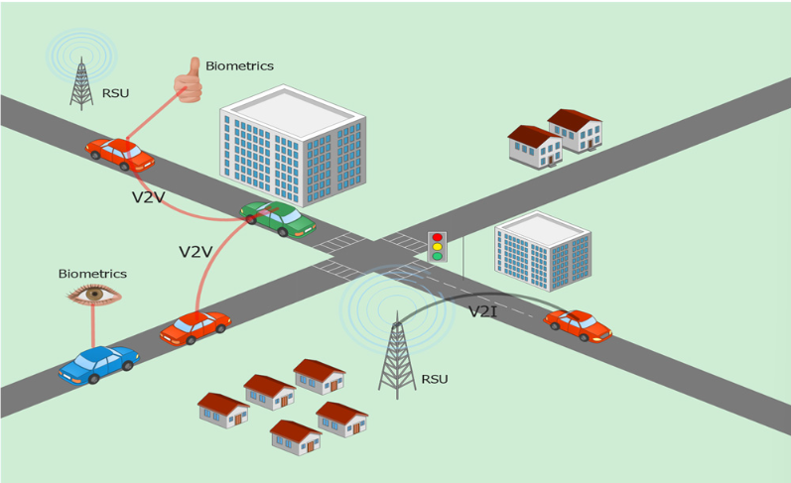
Bangalore Institute of Technology
K.R. Road, V.V. Pura, Bengaluru.-560004.
Department of Computer Science & Engineering
Figure 1. Proposed vehicular ad hoc network and architecture

Slide 13
Bangalore Institute of Technology
K.R. Road, V.V. Pura, Bengaluru.-560004.
Department of Computer Science & Engineering
ARCHITECTURE
1. Trusted Authority (TA):
The trusted authority (TA) simply means an entity that can be trusted by the public to not give false information.
It is responsible for initializing the system, deploying smart contracts, registering vehicles and revoking information.
It has significant computation and capacity. It is independent of other parties.
2. Motor Vehicle Department (MVD):
Its responsibilities includes vehicle registration, maintain vehicle records and authorize the TA to issue certificates and public keys to the vehicles after successful verification of the vehicle is done by the MVD.
MVD can be government or private organisation.

Slide 14
Bangalore Institute of Technology
K.R. Road, V.V. Pura, Bengaluru.-560004.
Department of Computer Science & Engineering
3. Vehicle:
The vehicle undertakes services for the driver and will carry an Onboard Unit (OBU)
OBUs help in communication with nearby vehicles, hence forming an ad hoc networks allowing for the distribution of communication. It achieves communication wirelessly.
4. Road Side Unit (RSU):
It is a roadside infrastructure which has the capability of communicating wirelessly with all vehicles within its range.
It receives instant messages from vehicles and it is capable of verifying them and passing them on to nearby vehicles or traffic management centre.
5. Blockchain:
It is responsible for secure handling of the transactions exchanged by vehicles across the network.

Slide 15
Bangalore Institute of Technology
K.R. Road, V.V. Pura, Bengaluru.-560004.
Department of Computer Science & Engineering
6. Messages:
Messages can be classified into two types – Beacon and Safety event messages.
Beacon messages are emitted at set intervals to give information to all vehicles in an area of current position, such as driving information to allow all vehicles in an area to cooperate, in order to manage traffic.
Safety event messages are emitted when critical events are occurring, such as hazards, traffic accidents, etc.

Slide 16
Bangalore Institute of Technology
K.R. Road, V.V. Pura, Bengaluru.-560004.
Department of Computer Science & Engineering
METHODOLOGY/ ALGORITHMS
Biometrics based authentication:
During the registration phase, the vehicle information and driver’s details will be passed on to the TA.
The driver details includes finger print. The OBU will contain a finger print scanner.
Modified Discrete Transformation (MDCT) is used to process the driver’s biometric and authenticate it.
MDCT generates a cancellable fingerprint template, which will be stored in the cancellable template database (CfT) within the TA and OBU.
The authentication follows two processes: enrolment and authentication.
During enrolment, the drivers biometric CaT is registered in database, and during authentication, the biometric is captured as Cf*T, which is compared against the reference template stored.
The Euclidean distance is used to match them. If it’s a match, the driver will be registered on the VANET.
MDCT feature vector Fv of dimension M x N is used. DCT is highly reversible, and MDCT is non-invertible.
Notes:
Every time vehicle on road, driver will be registered to current RSUs

Slide 17

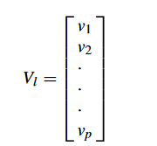
Bangalore Institute of Technology
K.R. Road, V.V. Pura, Bengaluru.-560004.
Department of Computer Science & Engineering
Relation mapped from R ∈ {x0, . . . xK −1} into ˆR = {X0, . . . XK −1} is given as:
Feature vector is given as:
The values in the vector Vl belongs to unique positive integers. Vl represents l number of transformation values. The column matrix is used to create sub-matrix R of size p x M.
Notes:
Every time vehicle on road, driver will be registered to current RSUs

Slide 18



Bangalore Institute of Technology
K.R. Road, V.V. Pura, Bengaluru.-560004.
Department of Computer Science & Engineering
Partial DCT is obtained on Fv using non-invertible CfT using following equation:
The matching process is done by using the following equations:
ED(CfT , Cf ∗T) is computed as follows: where g = CfT − Cf ∗T and Y transpose of a real vector/matrix.
Notes:
Every time vehicle on road, driver will be registered to current RSUs

Slide 19
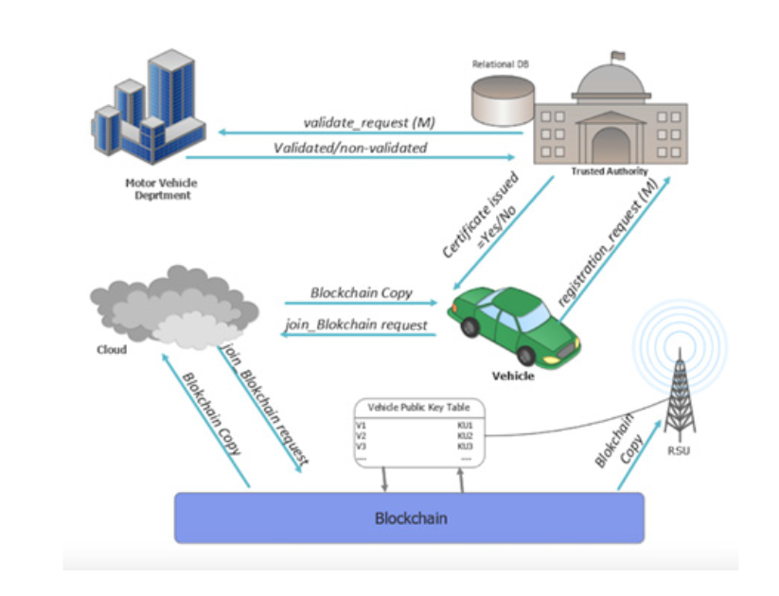
Bangalore Institute of Technology
K.R. Road, V.V. Pura, Bengaluru.-560004.
Department of Computer Science & Engineering
Partial DCT is obtained on Fv using non-invertible CfT using following equation:
The matching process is done by using the following equations:
ED(CfT , Cf ∗T) is computed as follows: where g = CfT − Cf ∗T and Y transpose of a real vector/matrix.
Notes:
Every time vehicle on road, driver will be registered to current RSUs

Slide 20
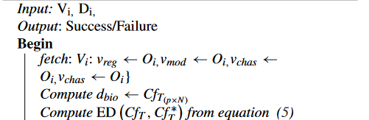
Bangalore Institute of Technology
K.R. Road, V.V. Pura, Bengaluru.-560004.
Department of Computer Science & Engineering
2. Vehicle Registration on BBC
When a vehicle joins for the first time, it registers with a TA. Biometric data of vehicle user is sent to the TA, which then returns a pair of keys.
The next time driver uses the vehicle, real identity is obtained from MVD and sent to TA. The TA verifies the existence and generates the certificate that includes a pair of keys according to vehicle ID.
Algorithm 1 Vehicle Registration Process
Notes:
Every time vehicle on road, driver will be registered to current RSUs

Slide 21
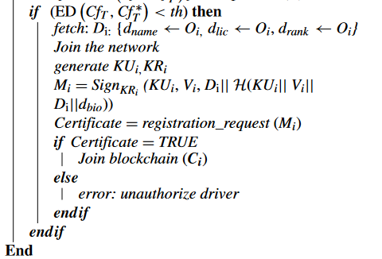
Bangalore Institute of Technology
K.R. Road, V.V. Pura, Bengaluru.-560004.
Department of Computer Science & Engineering
Notes:
Every time vehicle on road, driver will be registered to current RSUs

Slide 22
Bangalore Institute of Technology
K.R. Road, V.V. Pura, Bengaluru.-560004.
Department of Computer Science & Engineering
3. Join Blockchain
Once registered, the vehicle can join the blockchain, and get a copy of it. Vehicles can also append to the blockchain. The blockchain saves important historical data of vehicles along with safety messages.
Any vehicle that experiences a critical even, such as an accident, will broadcast the safety messages to neighbouring vehicles.
4. Message Reception
Vehicle is VANET will continuously receive message from the network. Based on the message type and priority, appropriate action will be taken.
5. Message Broadcast
All vehicles broadcast beacon messages to any proximate RSUs and vehicles. The message will be encrypted using the vehicle’s private key. The message may consist of details such as eventID, type, timestamp and location.
The receiving vehicle checks for freshness using the verification process. It compares the timestamp, reputation rate of the sender, verifies the message, and decrypts it using the sender’s public key.
Notes:
Every time vehicle on road, driver will be registered to current RSUs

Slide 23
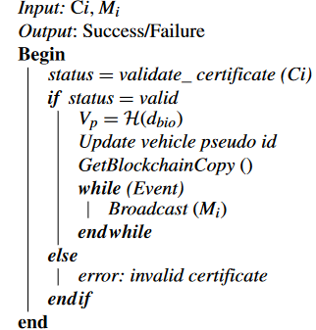
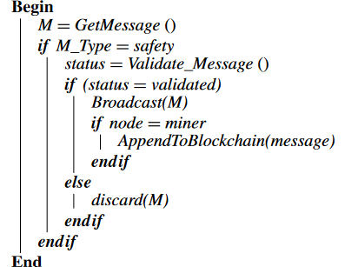
Bangalore Institute of Technology
K.R. Road, V.V. Pura, Bengaluru.-560004.
Department of Computer Science & Engineering
Algorithm 2 Vehicle Joining Process
Algorithm 3 Get Message Process
Notes:
Every time vehicle on road, driver will be registered to current RSUs

Slide 24

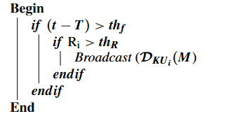
Bangalore Institute of Technology
K.R. Road, V.V. Pura, Bengaluru.-560004.
Department of Computer Science & Engineering
Algorithm 4 Broadcast Message Process
Algorithm 5 Verify Message
6. Update Blockchain
The message generated from the vehicle is added to blockchain in the form of transaction. Adding all messages leads to communication overhead, hence we only add safety messages that are validated.
7. De-Registration Process
The de-registration process is invoked by the registering authority or it may be invoked by the vehicle.
Notes:
Every time vehicle on road, driver will be registered to current RSUs

Slide 25
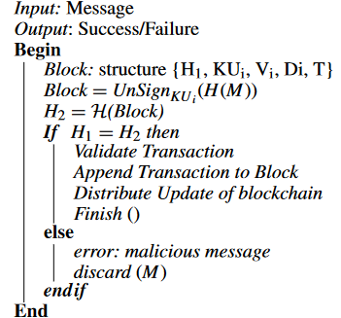
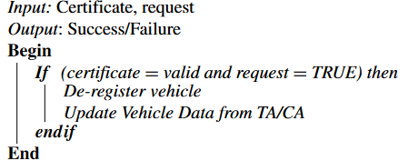
Bangalore Institute of Technology
K.R. Road, V.V. Pura, Bengaluru.-560004.
Department of Computer Science & Engineering
Algorithm 6 Blockchain Append Process
Algorithm 7 Vehicle De-Registration Process
Notes:
Every time vehicle on road, driver will be registered to current RSUs

Slide 26

Bangalore Institute of Technology
K.R. Road, V.V. Pura, Bengaluru.-560004.
Department of Computer Science & Engineering
RESULTS
The effectiveness of the proposed system is analysed with respect to the presence and absence of DoS.
A comparative analysis is also done with existing algorithm such as ASC, LAKAP, BC-VANET and it was found to be superior in terms of packet delivery, packet loss and computational cost.
The vehicle is assumed to use V2V and V2I model for communication for the simulation.
All the vehicles have OBUs, sensors and GPS device.
The model assumes multiple RSU and some of them are also play the role of malicious systems.
The simulation has been performed using OMNet++, Veins and SUMO to demonstrate the correctness of the proposed model using IEEE 802.11p/1609.4 protocols.
Packet Delivery Rate
Packet delivery rate refers to the proportion between the total packet sent and received in the network.

Slide 27
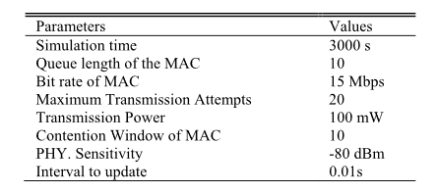
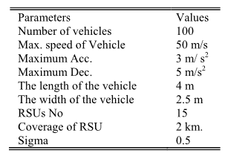
Bangalore Institute of Technology
K.R. Road, V.V. Pura, Bengaluru.-560004.
Department of Computer Science & Engineering
Table 1. OMNET simulation parameters.
Table 2. SUMO simulation parameters.
Figure 3 shows the impacts of PDR in the absence of an attacker in the network. Proposed system has PDR of 0.99. The average PDR of proposed model is 0.97 with 20 vehicles in the network.
Similarly in Figure 4 packet loss is lower when there are fewer vehicles in the network, and slightly increases when the number of vehicles increase.

Slide 28
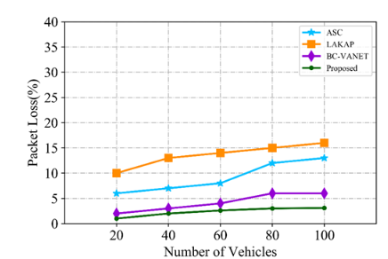
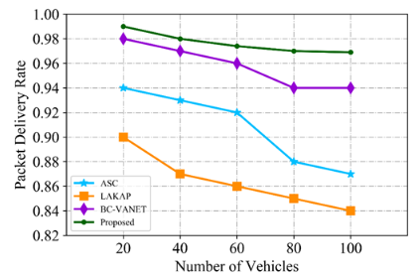
Bangalore Institute of Technology
K.R. Road, V.V. Pura, Bengaluru.-560004.
Department of Computer Science & Engineering
Figure 5 shows the effect on PDR when there is an attacker in the network. The proposed system has high PDR of 0.96, while, BC-VANET, ASC and LAKAP have PDRs of 0.94, 0.75, and 0.70 respectively.
This drops to 0.92 as the number of vehicles in the network increases. The proposed model has also the lowest packet loss rate.
Figure 3. PDR without DoS attack
Figure 4. Packet loss without DoS attack

Slide 29
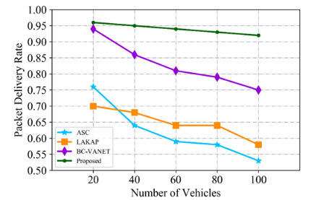
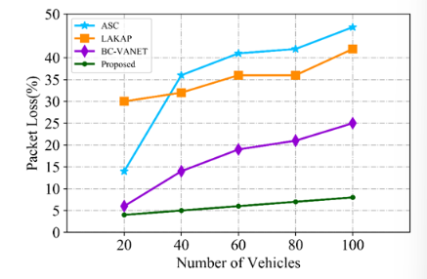
Bangalore Institute of Technology
K.R. Road, V.V. Pura, Bengaluru.-560004.
Department of Computer Science & Engineering
Figure 4. PDR with DoS attack
Figure 5. Packet loss with DoS attack

Slide 30
Bangalore Institute of Technology
K.R. Road, V.V. Pura, Bengaluru.-560004.
Department of Computer Science & Engineering
Similarly, the packet loss while it has an attacker as can be seen in figure 6 when the number of vehicles were less than the packet loss was low and slightly increased when the number of vehicles increases.
Computational Cost
Figure 7 shows that the proposed model has less computational cost of 0.1ms while other systems have 0.12, 2.8 and 4.0.
As number of vehicles increase from 20 to 100 time increases from 0.1ms to 0.3 ms.
Security Analysis
1) Secure Registration
Registration of vehicle ensures secure use of public and private keys. The keys are stored in the OBU which is tamper proof. The data is sent to network by signing with private key of the vehicle.
The length of the RSA signature key is 1024 bit long,

Slide 31
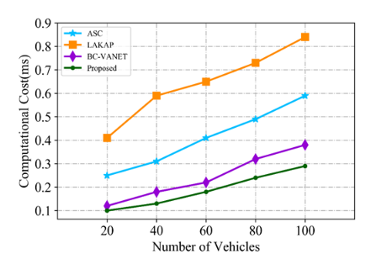
Bangalore Institute of Technology
K.R. Road, V.V. Pura, Bengaluru.-560004.
Department of Computer Science & Engineering
Figure 6. Computational cost of the proposed model

Slide 32

Bangalore Institute of Technology
K.R. Road, V.V. Pura, Bengaluru.-560004.
Department of Computer Science & Engineering
2) Data Integrity
Cost of authentication can be denoted as Ta which has H as hash function.
Ec represents the encryption cost and Thash can be evaluated using the hash function. The vehicle authentication process takes 2Thash and further time of is taken td to compare hash H1 and H2.
The cost involved in vehicle authentication for hashing will be 2H while the encryption cost can be derived by adding the hash cost as 1H + E. The TA cost may be derived by combining the decryption and verification cost. The total cost is expressed in equation
2H + E + D
3) Privacy Preservation and Traceability
Vehicle identity should not be revealed to anyone. Without detection by the RSU or drivers, the messages should be completely invisible. This is achieved by creating a unique id using biometrics and taking the hash.
Hence, every vehicle has a unique 512-bit pseudo identity. Real identity can be found by MVD and TD by looking at database stored in blockchain.

Slide 33
Bangalore Institute of Technology
K.R. Road, V.V. Pura, Bengaluru.-560004.
Department of Computer Science & Engineering
APPLICATIONS
1. Intelligent Transportation Systems (ITS): One of the primary applications of the BBC is in Intelligent Transportation Systems. The system's ability to ensure the integrity and security of data exchanged among vehicles allows for real-time traffic monitoring, congestion management, and efficient route planning.
2. Accident and Hazard Reporting: In VANETs, real-time safety is of paramount importance. The BBC provides the means for vehicles to broadcast safety event messages in the event of accidents, hazards, or other critical incidents.
3. Vehicle Insurance and Risk Assessment: Insurance companies can utilize the BBC to access accurate and tamper-proof data for risk assessment. By considering individual driving behaviour and environmental factors, insurers can provide more personalized policies.
4. Traffic Regulation and Enforcement: Law enforcement agencies can leverage the BBC to monitor traffic, enforce regulations, and identify traffic violations. The system can automatically generate alerts or citations based on real-time data, reducing the burden on human law enforcement officers and promoting compliance with traffic laws.
Notes:
Integrity and secure data exchange among vehicle- allow real time traffic monitor
- real time safety by broadcasting event messages in event accident
- insurance company utilize BBC to access accurate tamper proof data and it is personalized

Slide 34
Bangalore Institute of Technology
K.R. Road, V.V. Pura, Bengaluru.-560004.
Department of Computer Science & Engineering
5. Vehicle Tax and Toll Collection: Governments can use the framework for efficient vehicle tax collection and toll management. By securely tracking vehicle movements, the BBC enables automated billing, reducing congestion at toll booths and enhancing the overall user experience.
6. Privacy-Preserving Services: Beyond the immediate applications, the BBC safeguards user privacy. By anonymizing user identities while still providing traceability when needed, it balances privacy protection with security, making it suitable for a wide range of services where privacy is a concern, such as location-based services and user behavior analysis.

Slide 35
Bangalore Institute of Technology
K.R. Road, V.V. Pura, Bengaluru.-560004.
Department of Computer Science & Engineering
CONCLUSION
BBC framework can protect the security of messages within VANET in real-world scenarios.
The proposed framework provides security and trustworthiness of the communication between vehicles, and also keep anonymity without exposing the original identity of authorized users.
Additionally, biometric is combined with blockchain technology to provide reliable transmission of data, keep track of data being exchanged and identify the responsible vehicle in the case of false messages.
The simulation under the OMNET++, veins and SUMO is carried out to demonstrate the viability of the proposed framework.
The performance of the framework is evaluated in terms of packet delivery rate, packet loss rate and computational cost and proved to be superior in comparison with existing approaches.
As a part of future work, the model will be extended for computing ranking and reputation of vehicles and drivers using machine learning techniques.

Slide 36
Bangalore Institute of Technology
K.R. Road, V.V. Pura, Bengaluru.-560004.
Department of Computer Science & Engineering
REFERENCES
[1] Muneeb Ul Hassan, Mubashir Husain Rehmani, and Jinjun Chen, “Privacy preservation in blockchain based IoT systems: Integration issues, prospects, challenges, and future research directions,” in Future Generation Computer Systems, Volume 97, 2019, Pages 512-529.
[2] Z. Lu, Q. Wang, G. Qu, H. Zhang and Z. Liu, "A Blockchain-Based Privacy-Preserving Authentication Scheme for VANETs," in IEEE Transactions on Very Large Scale Integration (VLSI) Systems, vol. 27, no. 12, pp. 2792-2801, Dec. 2019.
[3] D. Zheng, C. Jing, R. Guo, S. Gao and L. Wang, "A Traceable Blockchain-Based Access Authentication System With Privacy Preservation in VANETs," in IEEE Access, vol. 7, pp. 117716-117726, 2019.
[4] Q. Feng, D. He, S. Zeadally and K. Liang, "BPAS: Blockchain-Assisted Privacy-Preserving Authentication System for Vehicular Ad Hoc Networks," in IEEE Transactions on Industrial Informatics, vol. 16, no. 6, pp. 4146-4155, June 2020.
[5] Neyire Deniz Sarier, “Efficient biometric-based identity management on the Blockchain for smart industrial applications,” in Pervasive and Mobile Computing, Volume 71, 2021.

Slide 37
Bangalore Institute of Technology
K.R. Road, V.V. Pura, Bengaluru.-560004.
Department of Computer Science & Engineering
[6] Youssef Inedjaren, Mohamed Maachaoui, Besma Zeddini, and Jean-Pierre Barbot, “Blockchain-based distributed management system for trust in VANET,” in Vehicular Communications, Volume 30, 2021.
[7] Xia Feng, Qichen Shi, Qingqing Xie, and Lu Liu, “An Efficient Privacy-preserving Authentication Model based on blockchain for VANETs,” in Journal of Systems Architecture, Volume 117, 2021.
[8] S. Son, J. Lee, Y. Park, Y. Park and A. K. Das, "Design of Blockchain-Based Lightweight V2I Handover Authentication Protocol for VANET," in IEEE Transactions on Network Science and Engineering, vol. 9, no. 3, pp. 1346-1358, 1 May-June 2022.
[9] Kiran Bala, Ramakant Upadhyay b, Syed Rashid Anwar c, and Gajendra Shrimal, “A blockchain-enabled, trust and location dependent - Privacy preserving system in VANET,” in Measurement:Sensors, vol. 30, 2023.

Slide 38
Bangalore Institute of Technology
K.R. Road, V.V. Pura, Bengaluru.-560004.
Department of Computer Science & Engineering
THANK YOU

