Slide 1
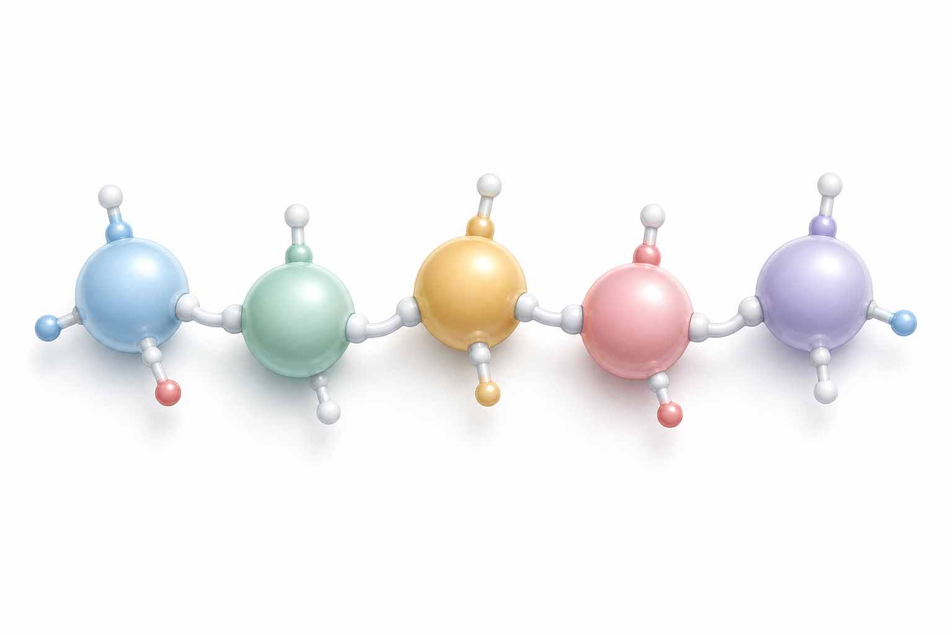
VIDEO ADDITIONS
Peptides: The Simple Mental Model
From “What is a Peptide? Explained Easy”
Short amino-acid chain
✉
Core analogy
↔
Teaching frame
✓
Safety frame
Peptides are short amino-acid chains that act like cellular text messages.
Peptides signal. Proteins build. Different roles, different expectations.
Signals need the right source, purity, timing, and context.
Source video: youtu.be/sTgx5HzZfQU • Beginner-friendly framing before deeper clinic discussion

Slide 2
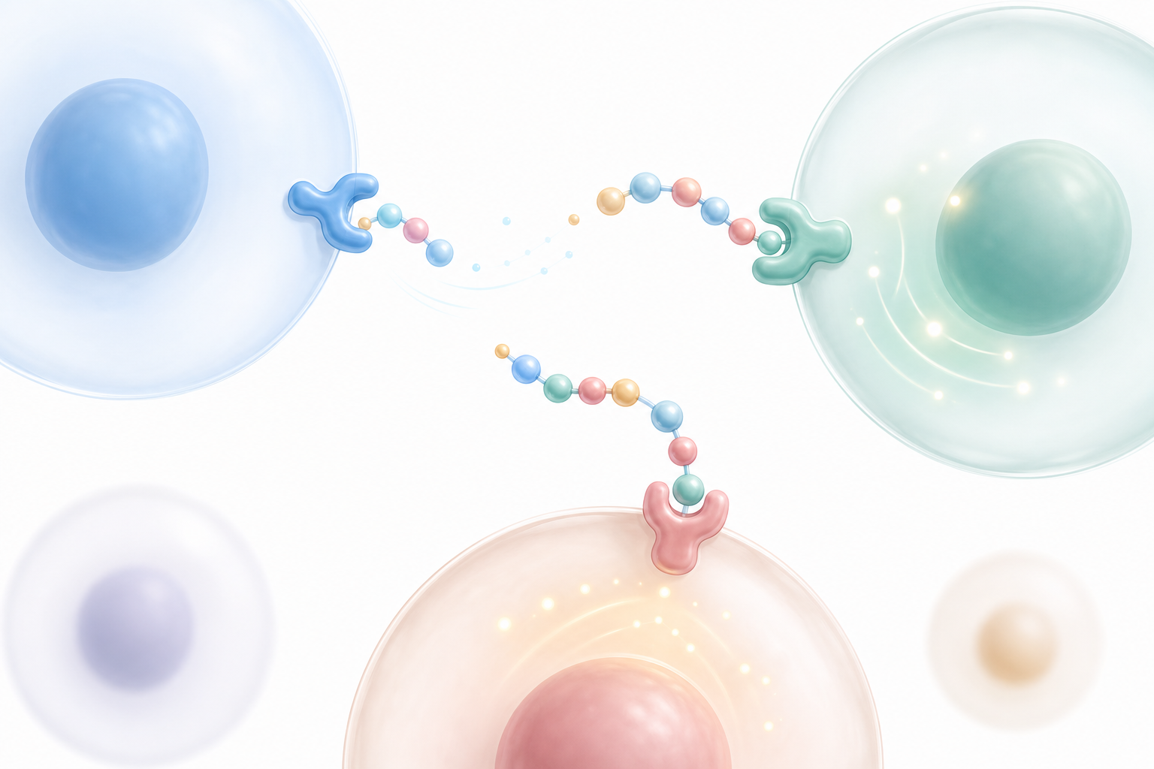
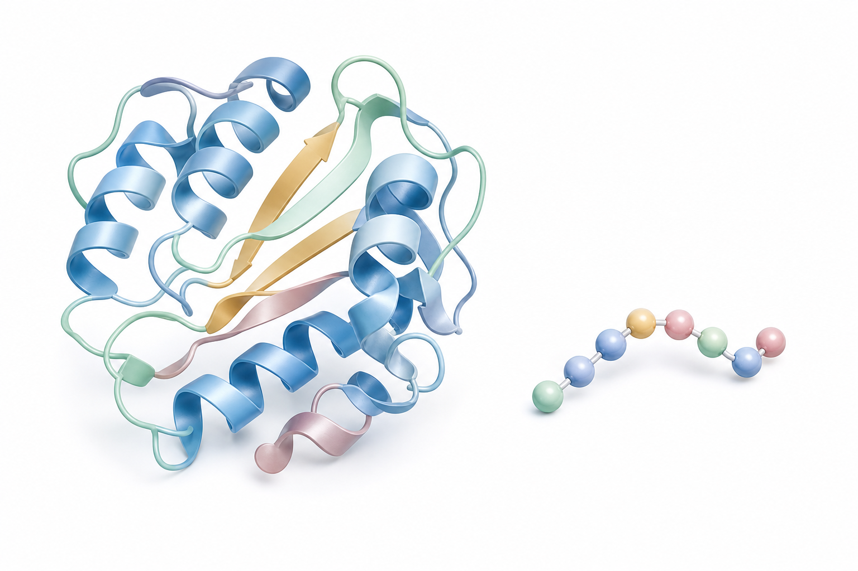
Peptides vs. Proteins
A simple way to explain the difference without overcomplicating the science
P
Peptides = short messages
B
Proteins = structure
Short chains of amino acids. Educational role: signaling — “tell this cell/pathway what to do.”
Longer amino-acid chains with structural and functional jobs — more like manuals than text messages.
Peptides = messages
Proteins = larger structures
Clinic line: “Food gives raw materials. Peptides are signals. You still need the baseline: training, sleep, nutrition, labs.”
CrossFit Blaze • Peptides & Biohacking Q&A • Educational only, not medical advice
2

Slide 3
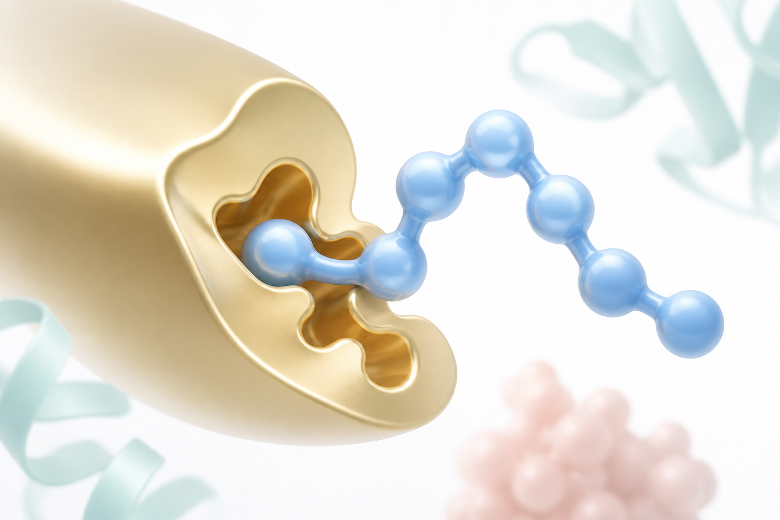

The 3-M Model
A quick filter before discussing any peptide
Message
Map
Moment
1
Message
2
Map
3
Moment
What signal is it sending? Repair? Release? Appetite? Sleep?
Where does the signal go? Which receptor/cell pathway?
When should it act? Timing, dose, and context matter.
Simple rule: if we can’t explain the Message, Map, and Moment in one sentence, we’re not ready to use or recommend it.
CrossFit Blaze • Peptides & Biohacking Q&A • Educational only, not medical advice
3

Slide 4
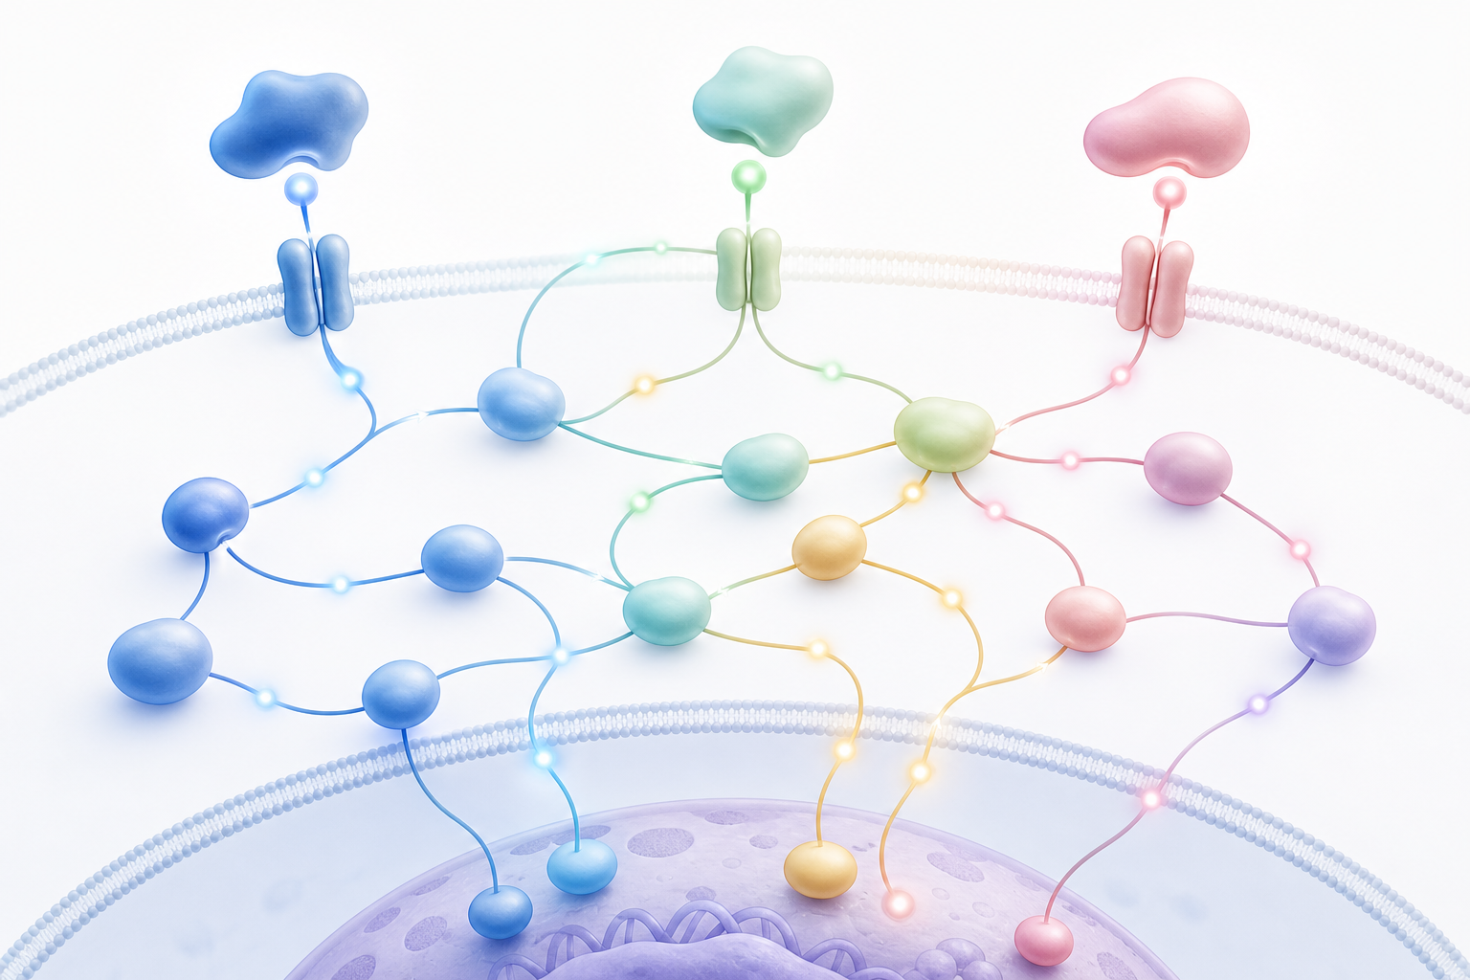
How Peptides Work
Conceptual mechanism — no dosing protocol implied
→
→
→
1
Peptide signal
2
Receptor fit
3
Pathway response
4
Outcome context
Short amino-acid chain
Key/lock style binding
Repair pathway or hormone release
Depends on labs, timing, health status
Important: More signal is not automatically better. Too much, too long, or poorly timed can become noise.
CrossFit Blaze • Peptides & Biohacking Q&A • Educational only, not medical advice
4

Slide 5


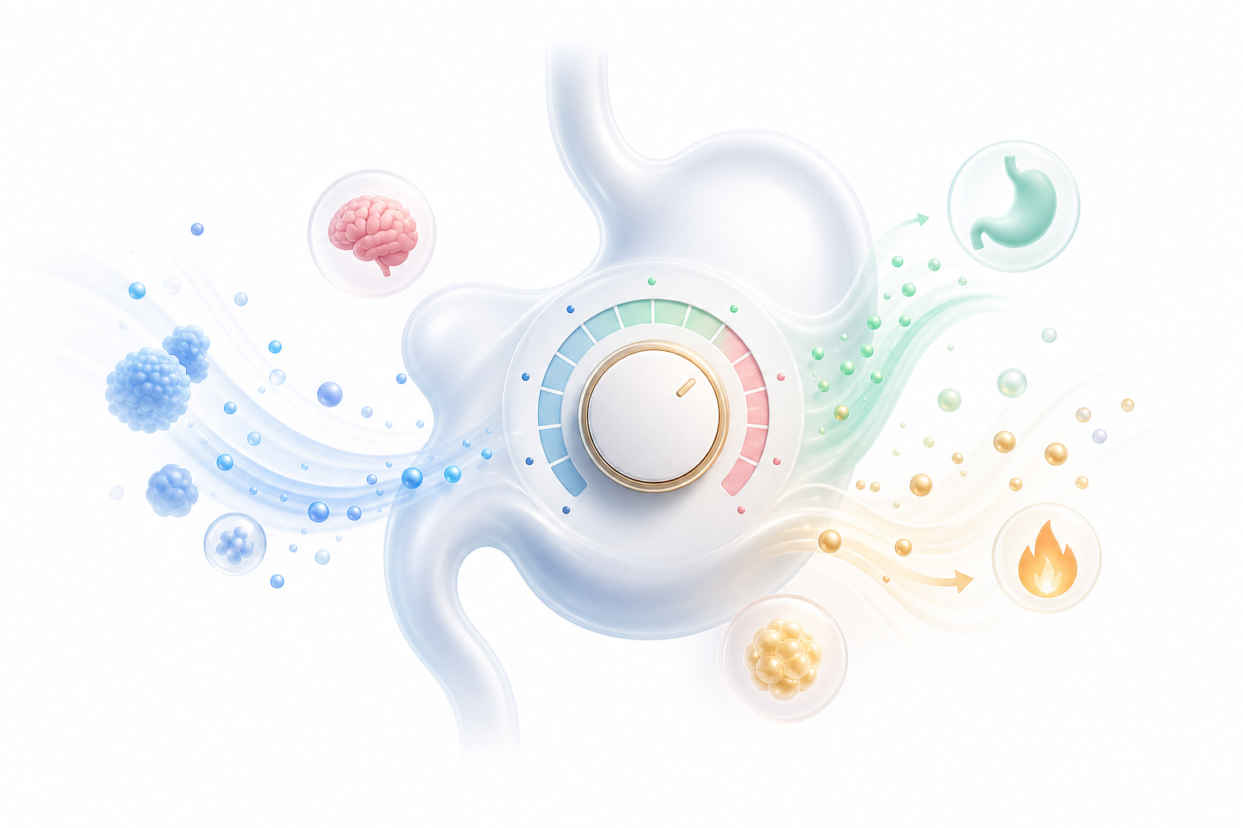
Quality + Safety Guardrails
Good clinic discussion should slow people down, not hype them up
Safety checklist first
Labs before protocols
Context changes the answer
Q
Source & purity
!
Regulatory context
✓
Professional oversight
Purity, storage, handling, heat, light, and contamination can degrade the message.
Rules vary by country, sport, and compound. Many peptides are not approved medicines.
Use labs, history, medications, contraindications, and qualified guidance.
Keep disclaimer visible: “Educational only — not medical advice. Individual assessment required.”
CrossFit Blaze • Peptides & Biohacking Q&A • Educational only, not medical advice
5

Slide 6

Slide Edits to Add to the Main Deck
Use these as inserts or speaker talking points
1
Add before peptide list
2
Add framework slide
Define peptides as cellular text messages; compare peptides vs. proteins.
Use the 3-M Model: Message, Map, Moment.
3
Edit safety slide
4
Edit labs section
Healing lane
Add: dose/timing matter; more is not better.
Tie labs to “Moment” — right signal, right person, right time.
5
Add quality note
6
Add closing check
Source, purity, storage, heat/light/contamination affect peptide integrity.
Ask: can we explain the peptide in one clear sentence before considering it?
Stacked signals
CrossFit Blaze • Peptides & Biohacking Q&A • Educational only, not medical advice
6

