Slide 1
HOSPITAL MANGAEMENT SYSTEM
Pavithra V D

Slide 2
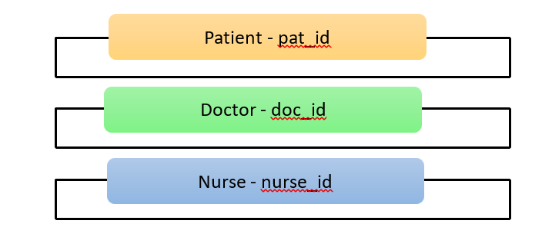
Table names and its primary keys

Slide 3
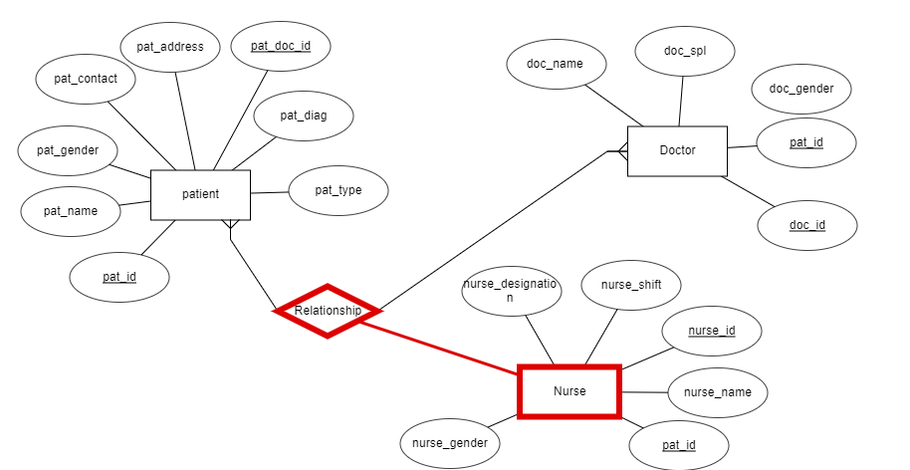
ER Diagram

Slide 4
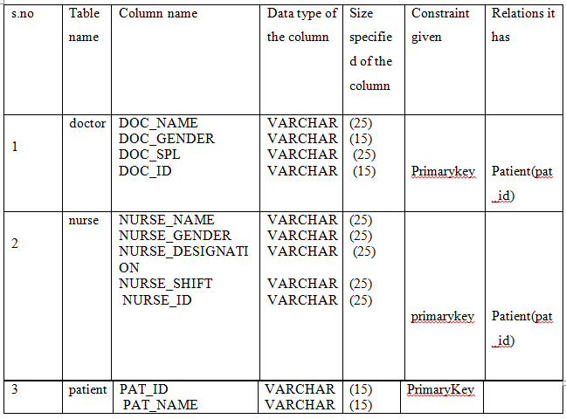
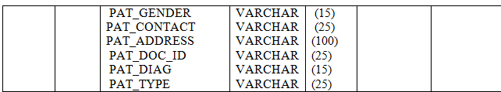
Table Structure

Slide 5
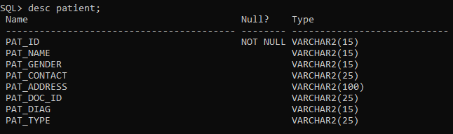
Patient table
Create :
Description of patient table:

Slide 6
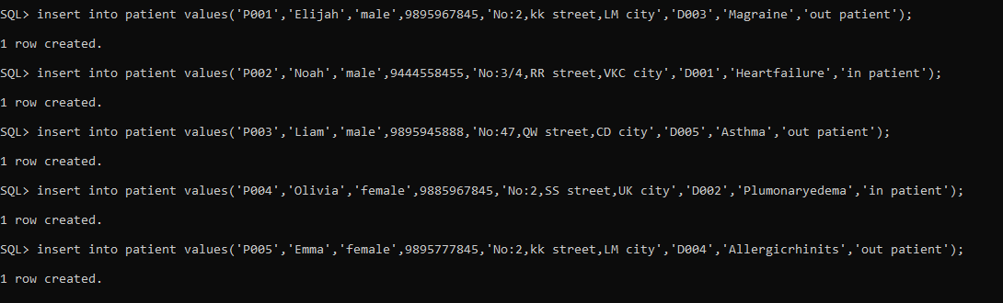
Insert values in patient table:

Slide 7
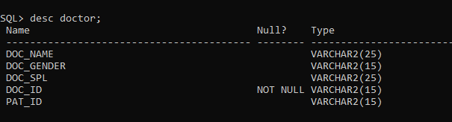
Doctor table
Create :
Description of Doctor table:

Slide 8
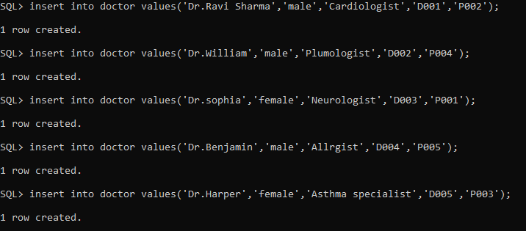
Insert values:

Slide 9
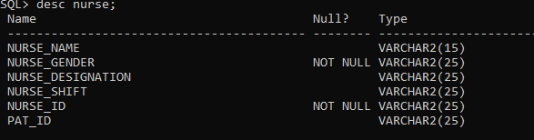
Nurse Table
Create :
Description of Doctor table:

Slide 10

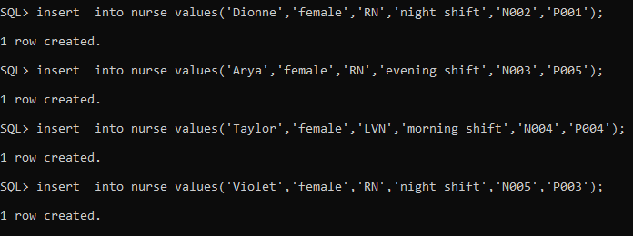
Insert values:

Slide 11
Constraints Violations
Check constraints
Not null constraints
Datatype Violation
Size violation

Slide 12
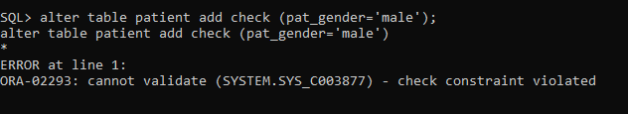
Check constraint violation
Not null violation

Slide 13
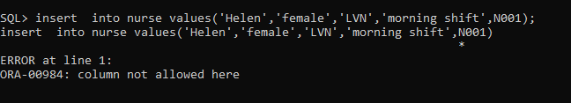
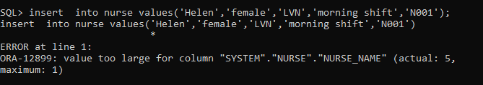
Datatype violation
Size violation

Slide 14
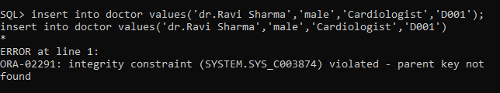
Primary and Foreign key constraint
Unique constraint
Integrity constraint

Slide 15
DDL COMMANDS
Select
Delete
Update
Alter

Slide 16
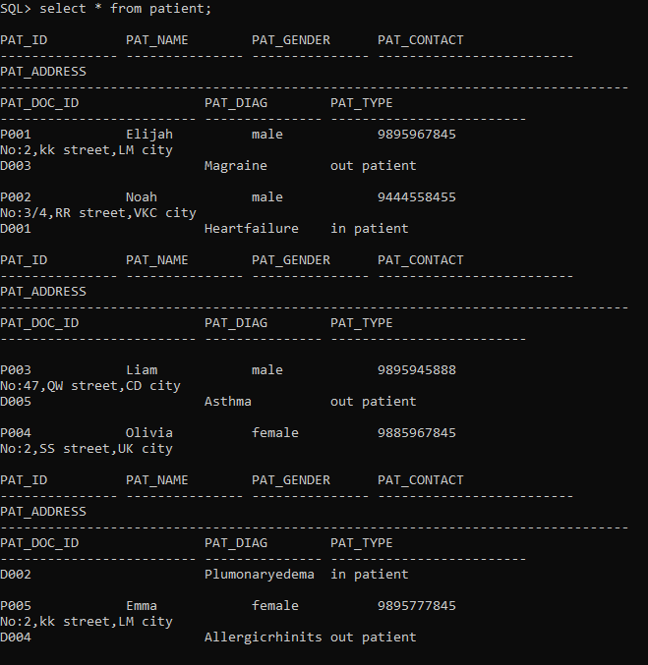
Select command
Patient

Slide 17
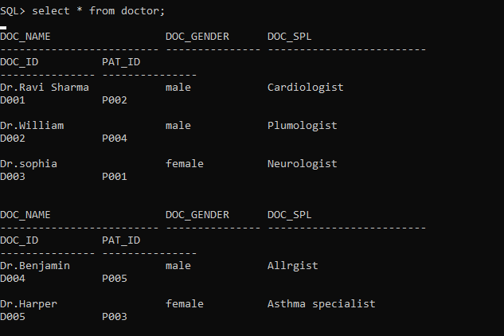
Select command
Doctor

Slide 18
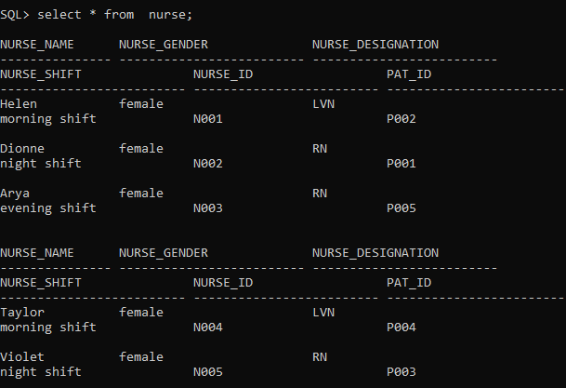
Select command
Nurse

Slide 19
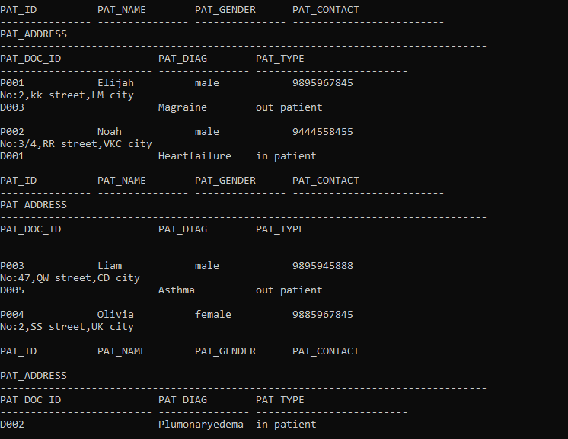

Delete command
Patient After delete
Before delete

Slide 20
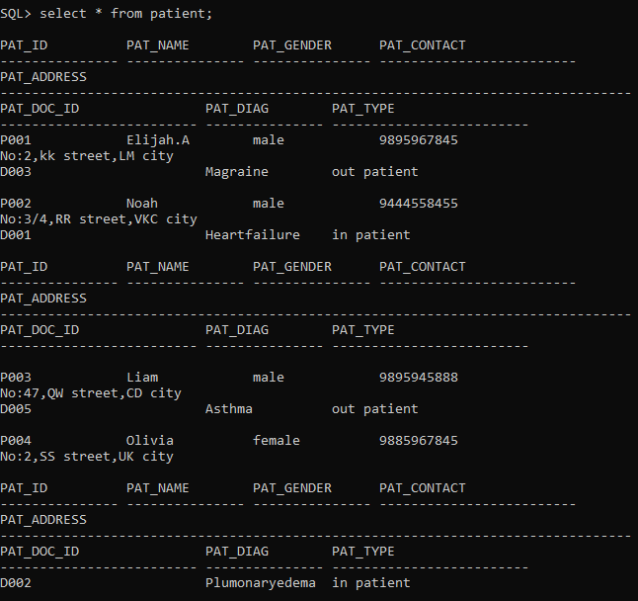

Update command
Patient After update
BeforeUpdate

Slide 21
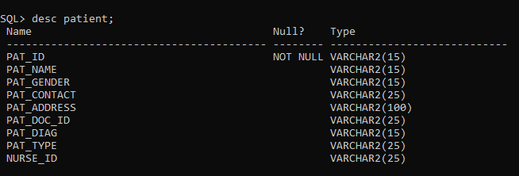

Alter command
Patient After alter
Before alter

Slide 22
Error code & its explanation
Error 1
After error correction
Error code is ORA-02291, integrity constraint is violated without giving any parent key . This error was corrected after inserting the parent key (pat_id).

Slide 23

Error code & its explanation
Error 2
After error correction
Error code is ORA-00928 : missing select keyword , it shows while we inserting the values using insert command “insert into table_name values(variable data type);” in this command we gave ‘value’ instead of ’ values’ so that we encountered such error.

Slide 24



