Slide 1
Fall 2017 WAF Data Challenge
Eric Zeng

Slide 2
Recommendation
Do not take LoanID 73622
Low employment/High unemployment
High crime rate
High delinquency rate
High percentage of free cash on payments
Pattern of rejection in neighborhood
Zip in question: 10466

Slide 3
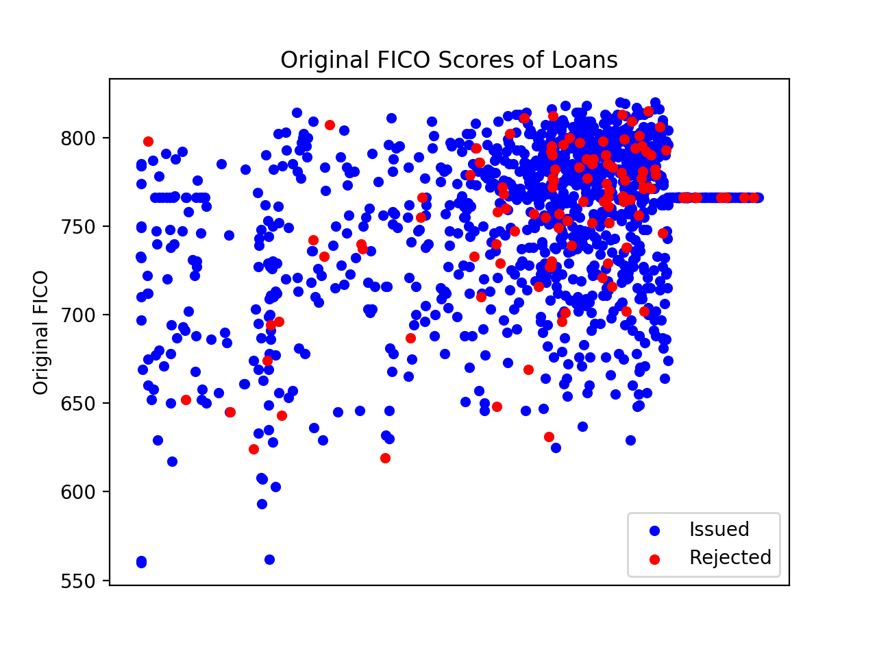
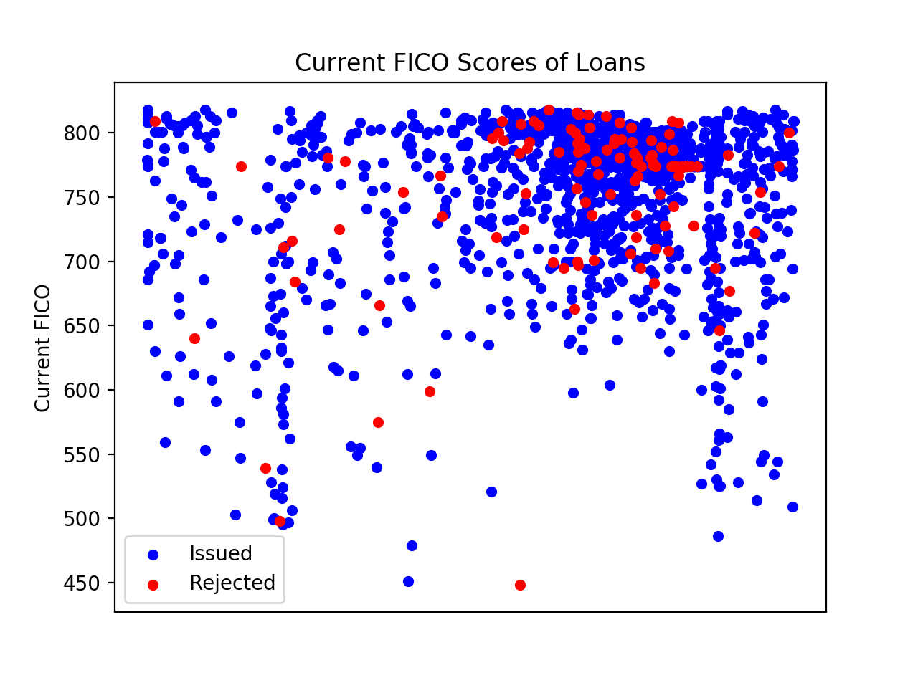
FICO Scores?
FICO scores seem to measure credit
But no correlation between issuing and FICO score

Slide 4
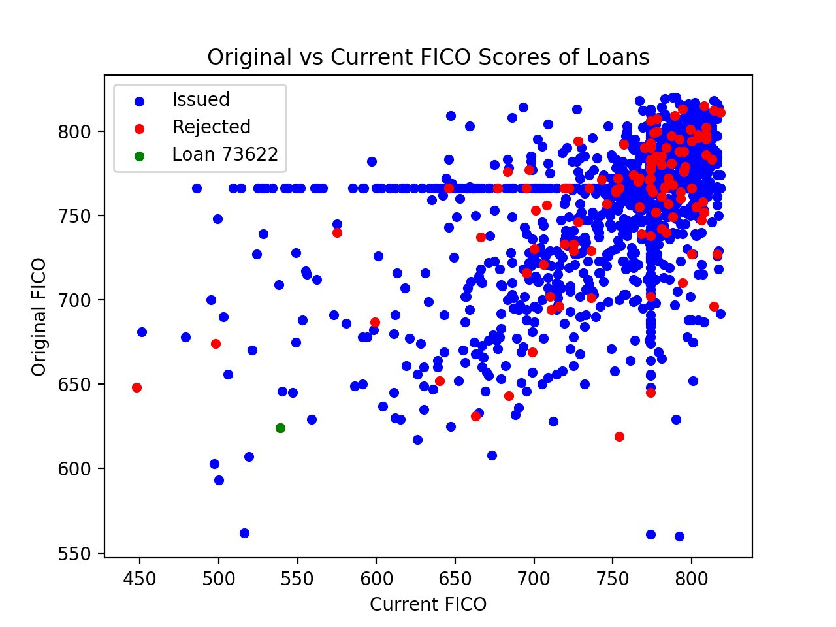
FICO Scores?
Change in FICO score
Separated by Issued/Rejected
Once again, no correlation
73622’s FICO decrease is NOT out of place…
’Lines’ maybe due to bad data?
Better metrics needed!

Slide 5
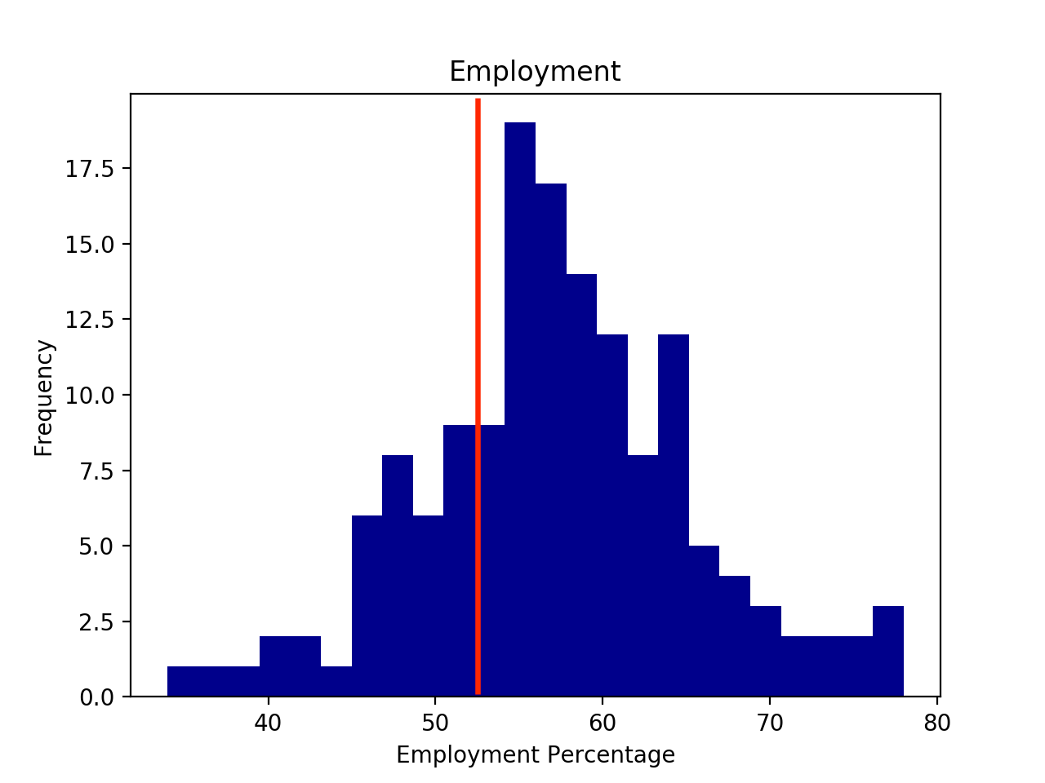
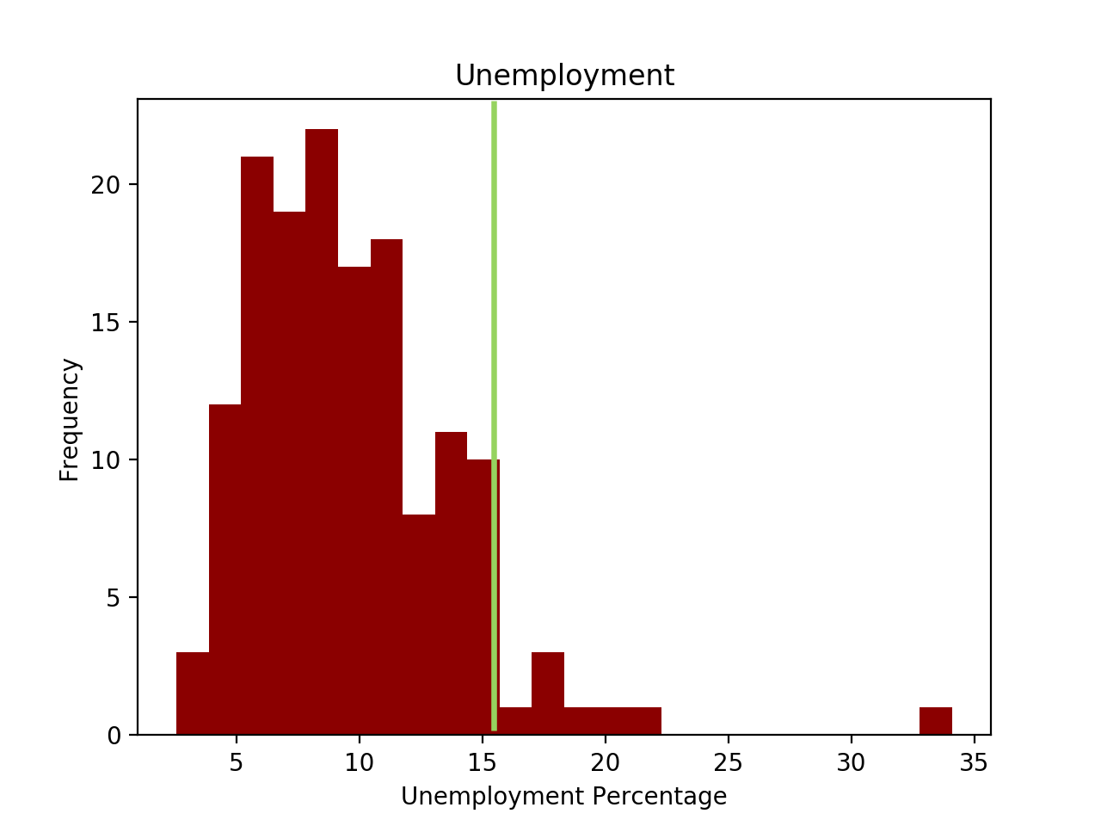
Employment / Unemployment
Employment: 52.2% | ~50 percentile
Unemployment: 15.2% | >75 percentile
Large unemployment may be a sign of economic stress

Slide 6
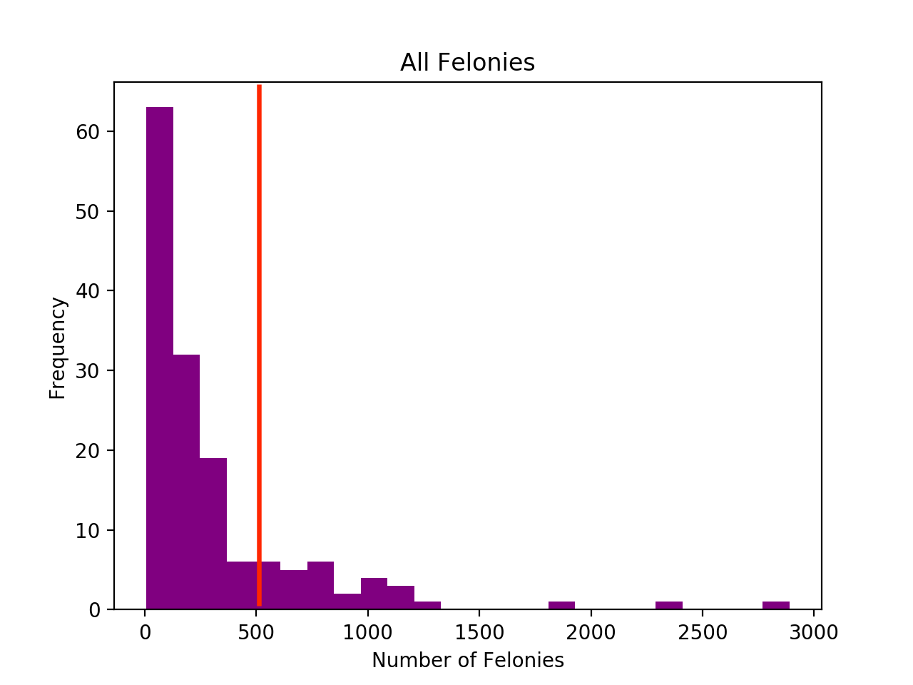
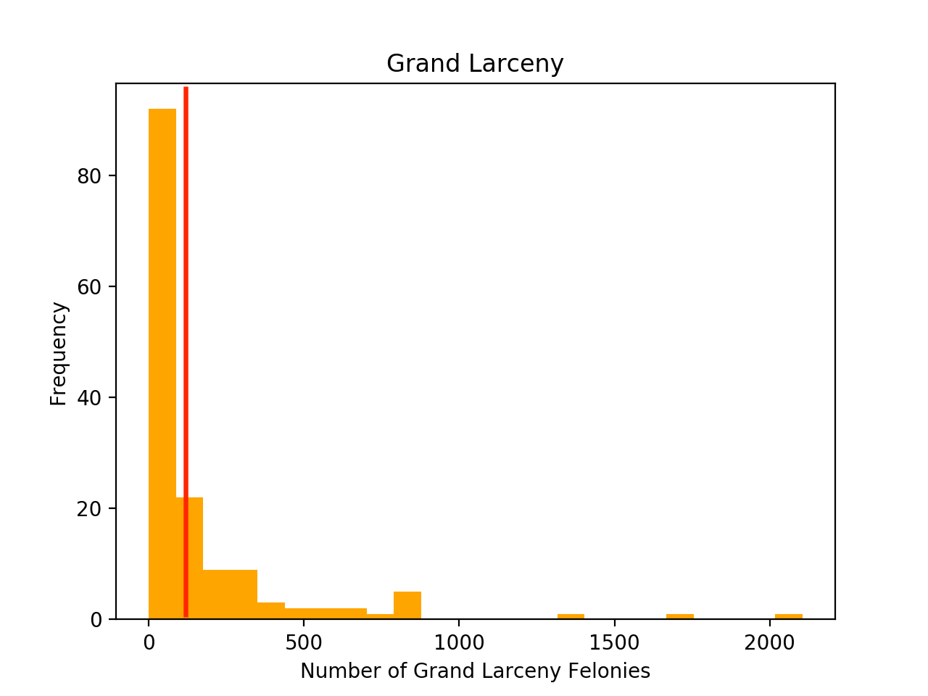
Crime (All Felonies and Grand Larceny)
All Felonies: 503 | >75 percentile
Grand Larceny: 135 | ~70 percentile
Theft crimes lead to more property damage/finanical burden

Slide 7
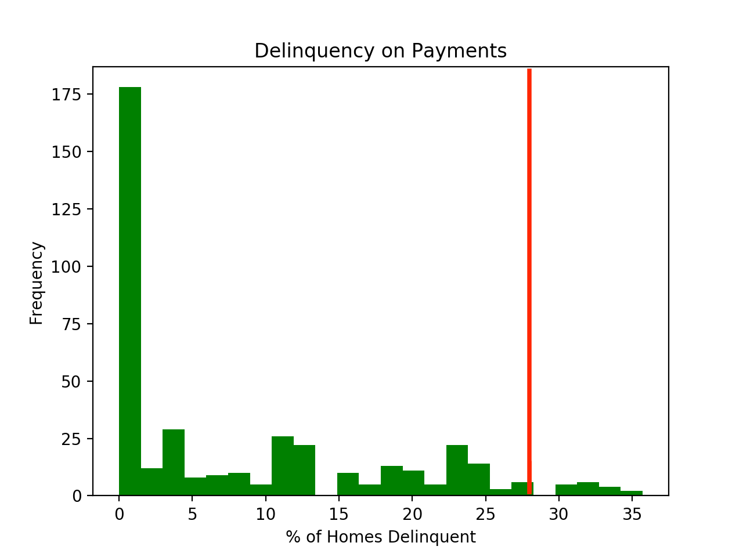
Delinquency on Payments
Late payment on monthly dues
27.7%
>75% percentile
Exposure to risk of default

Slide 8
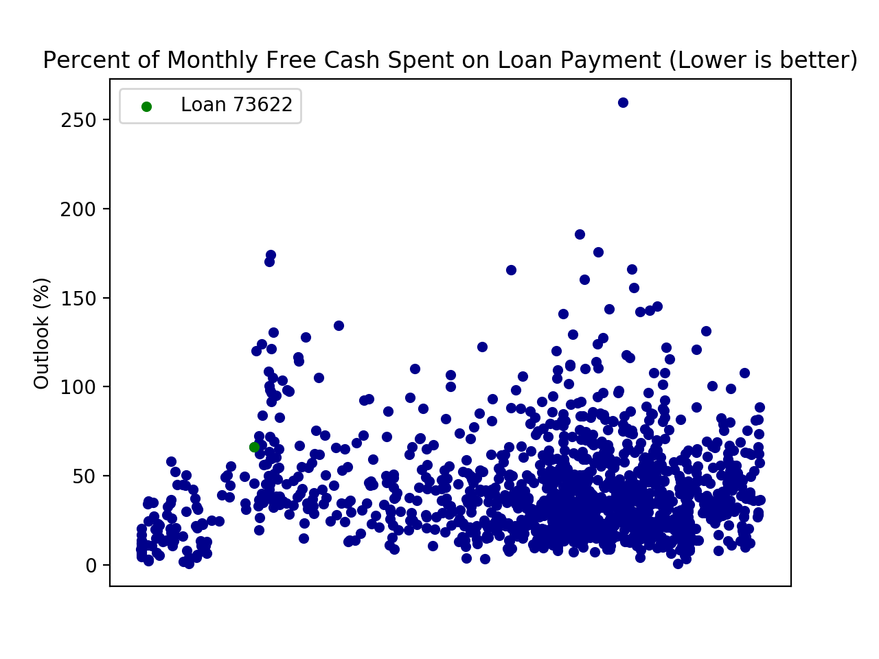
Percentage of Free Cash on Payments
Free cash found using median income and expenditure data by ZIP
Loan’s monthly payment based on balance, APR, and term length
73622 is at 66.2%
About 2/3 of median free cash will be spent on payments
Relatively high
>75 percentile

Slide 9
Concluding Thoughts
Due to the previous metrics
73622 is risky
FICO scores do not reflect real risk
Concerns regarding unemployment, crime, delinquency, and median free cash
Pattern of rejection in Eastchester neighborhood: 359878 and 312537 rejected

Slide 10
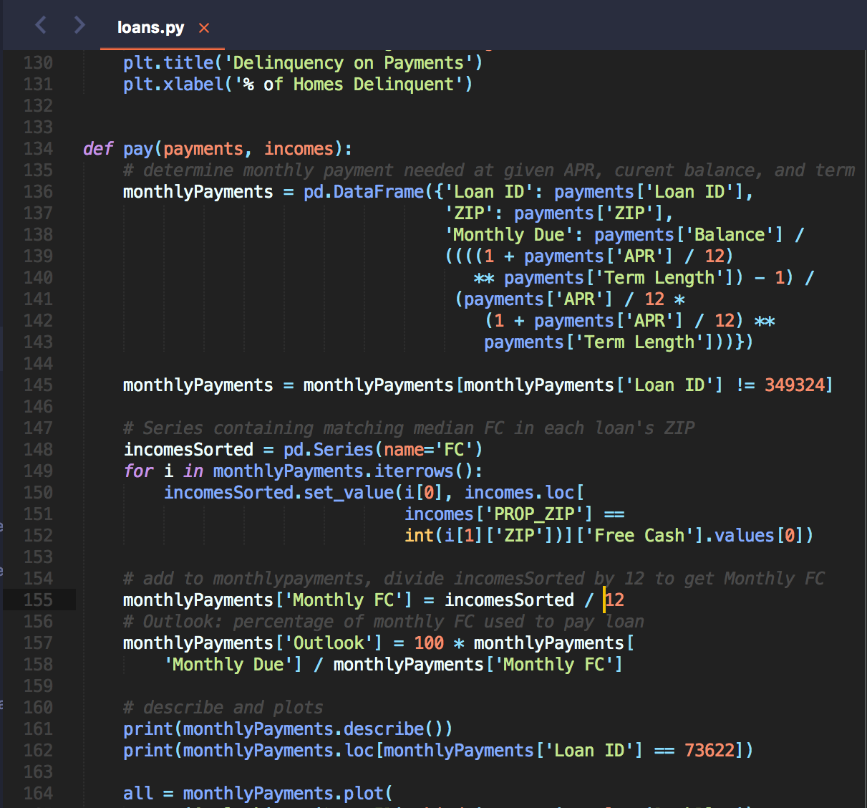

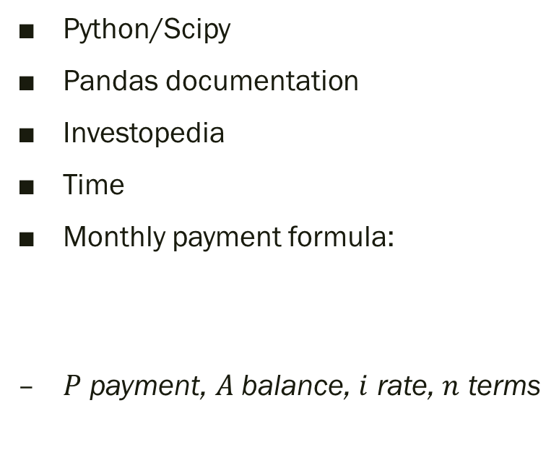
Resources
Python/Scipy
Pandas documentation
Investopedia
Time
Monthly payment formula:
$P$ payment, $A$balance, $i$ rate, $n$ terms
$$P=\frac{A}{{[(1+i)}^{n}−1]/[n{(1+i)}^{n}]}$$

