Slide 1
SIEMENS · SENIOR AI ENGINEER
Six bounded systems.
One evidence discipline.
Assignment baselines stay usable; business extensions remain explicit, tested, and reviewable.
Notes:
[Sources]
- README.md
- docs/adr/0007-business-extension-boundaries.md

Slide 2
SYSTEM MAP
The repository turns six requirements into auditable decisions
FIND
OPERATE
DECIDE
Task 1
Tasks 2–3
Tasks 4–6
Bounded research
and evidence
Durable API
and GCP reference
Calibrated, compatible,
leakage-safe extensions
Evidence moves forward; unsupported claims stop at the boundary.
02
Notes:
[Sources]
- docs/architecture.md
- docs/adr/0007-business-extension-boundaries.md

Slide 3
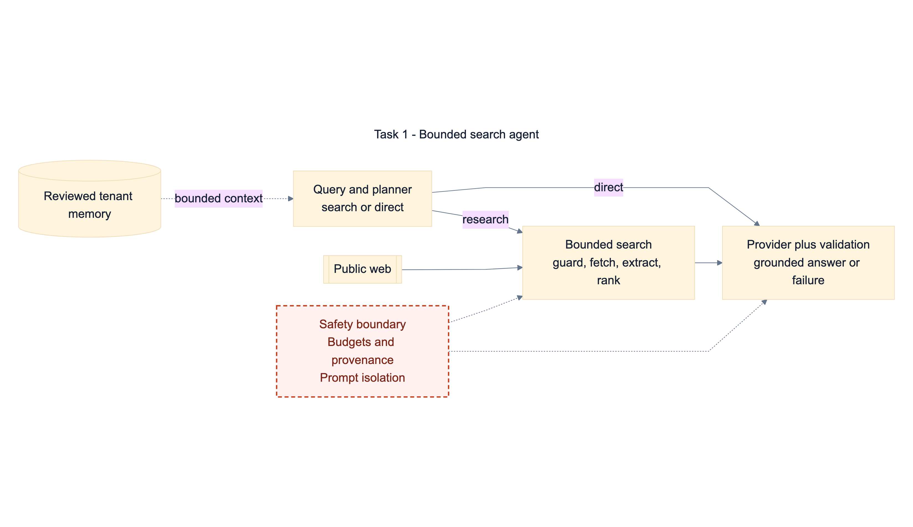
Committed evidence
4
candidate model configurations in a frozen protocol
FROZEN
protocol status
Synthetic fixture: synthetic; no live model selected.
03
Notes:
[Sources]
- task-01-search-agent/benchmarks/protocol.json
- task-01-search-agent/benchmarks/fixtures/synthetic-report.json
- docs/presentation/diagrams/task-01-search-agent.mmd

Slide 4
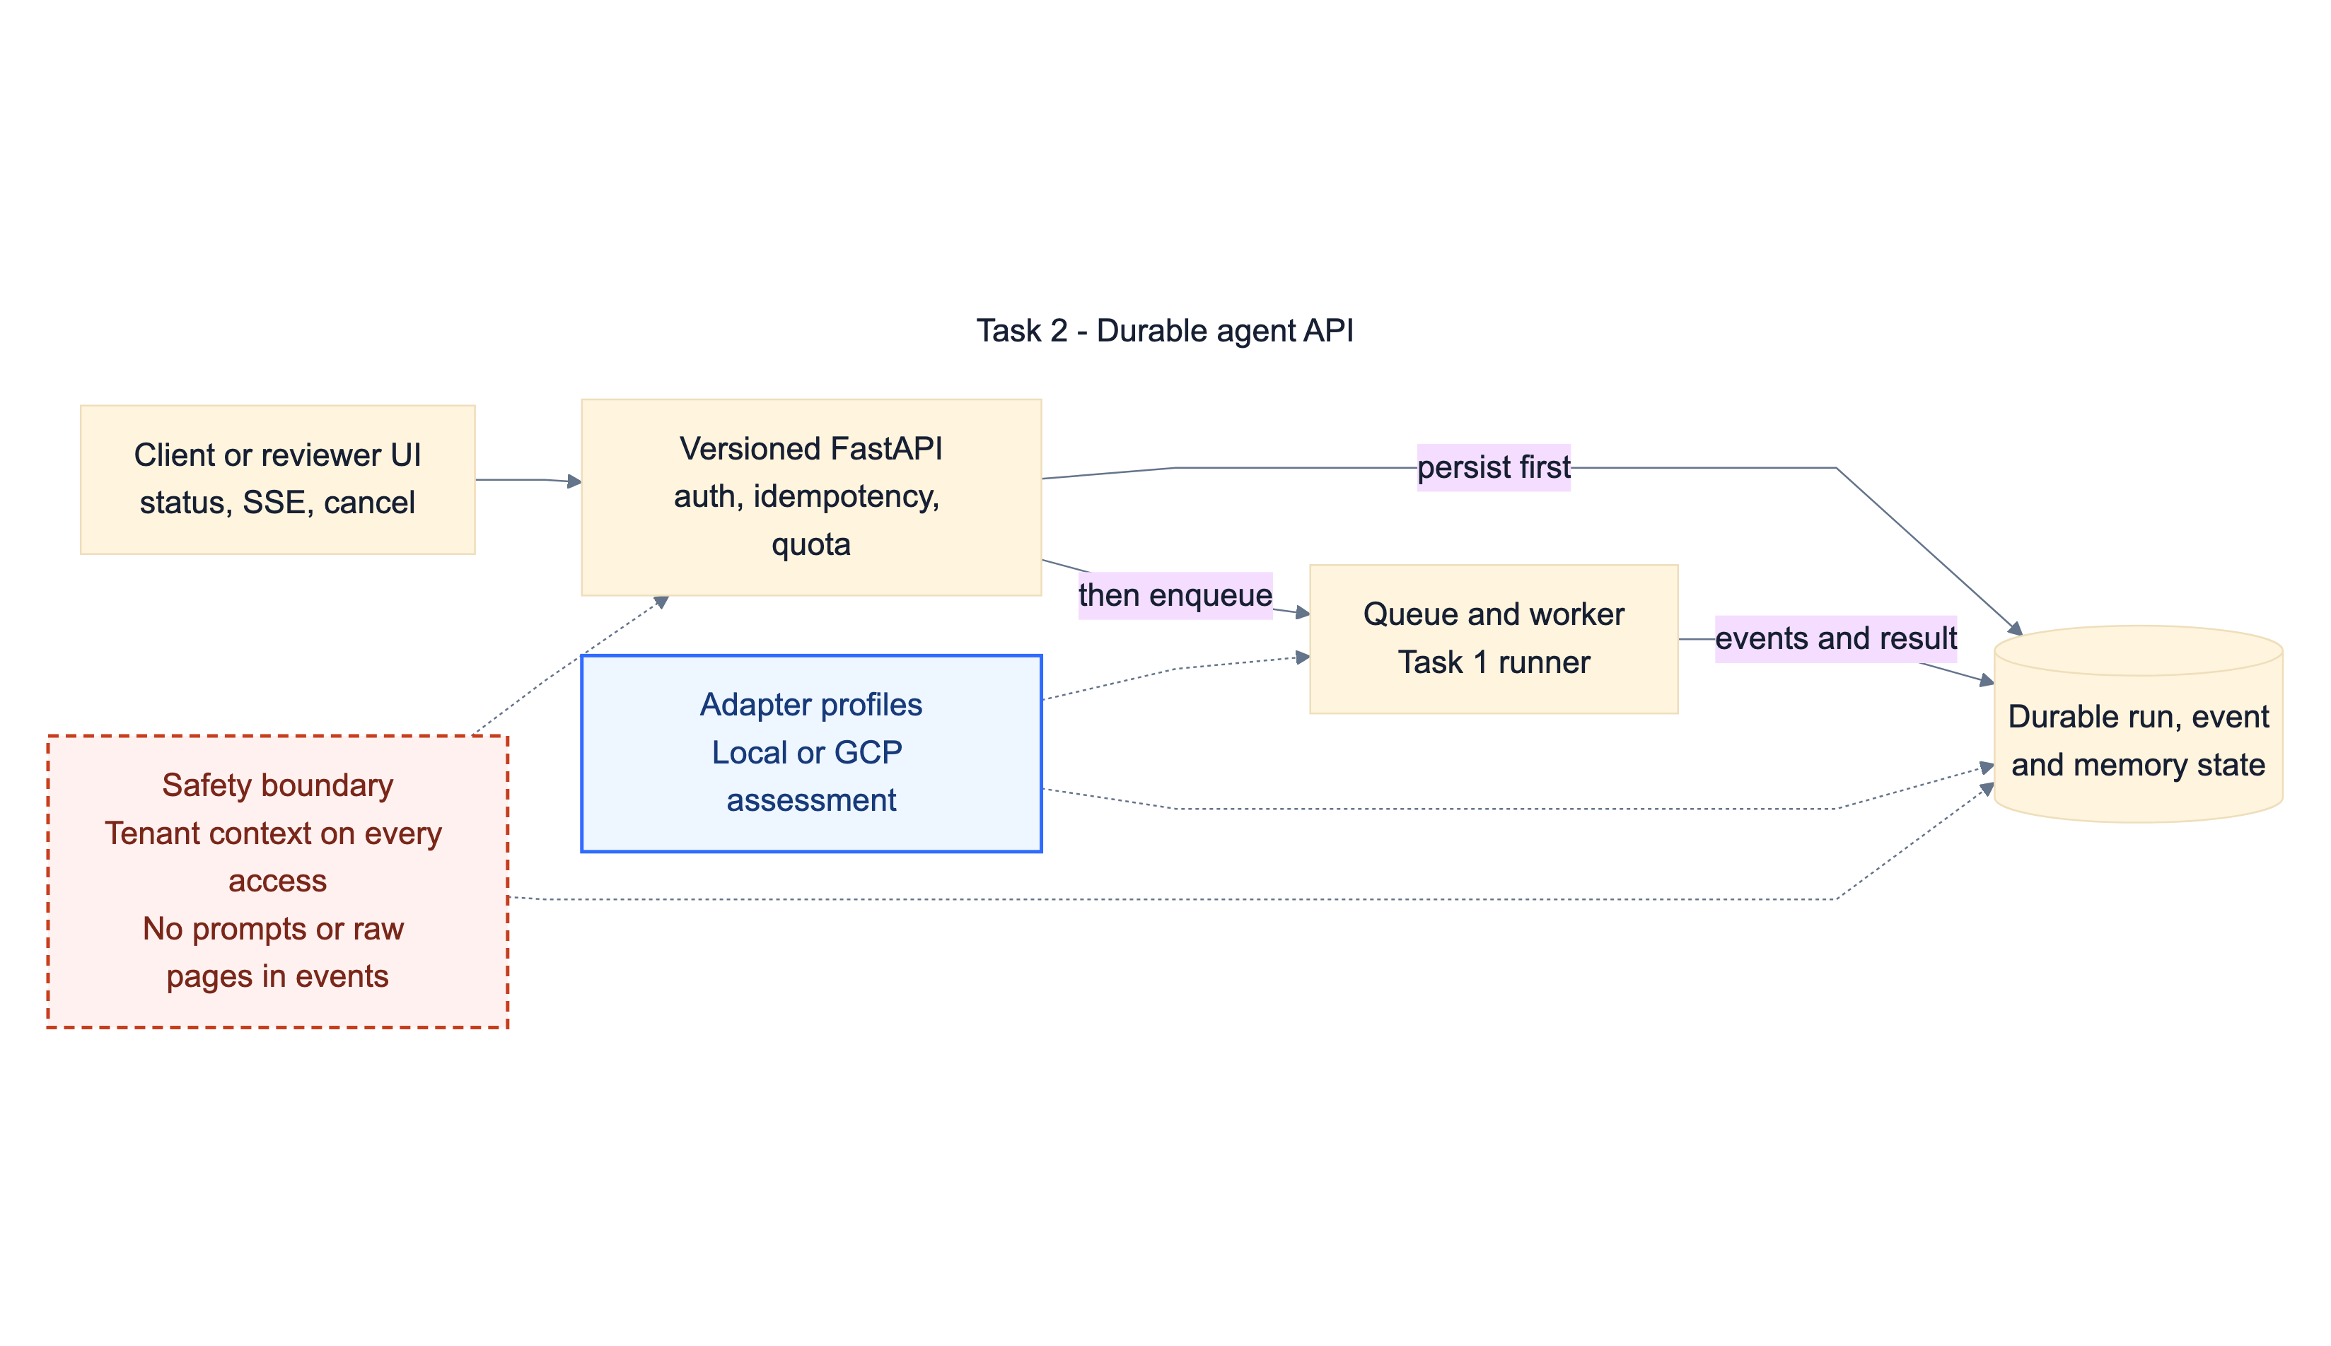
Versioned contract
9
API paths
11
HTTP operations
22
declared schemas
04
Notes:
[Sources]
- task-02-agent-api/tests/snapshots/openapi_contract.json
- task-02-agent-api/README.md
- docs/presentation/diagrams/task-02-agent-api.mmd

Slide 5
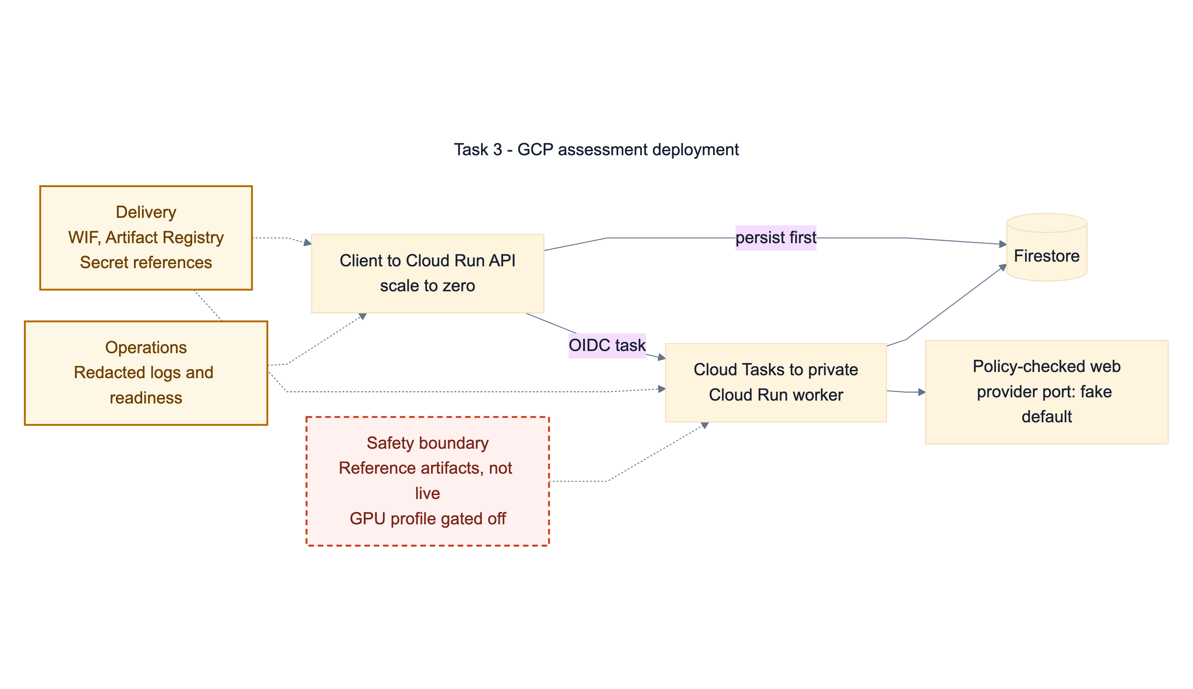
Local capacity proof
12
submitted jobs
8/12
accepted under the bounded envelope
264 ms
p95 first event — fake provider
Reference architecture and local proof — not a live production claim.
05
Notes:
[Sources]
- task-03-deployment-strategy/architecture/capacity-load-proof.sample.json
- task-03-deployment-strategy/architecture/strategy.md
- docs/presentation/diagrams/task-03-deployment-strategy.mmd

Slide 6
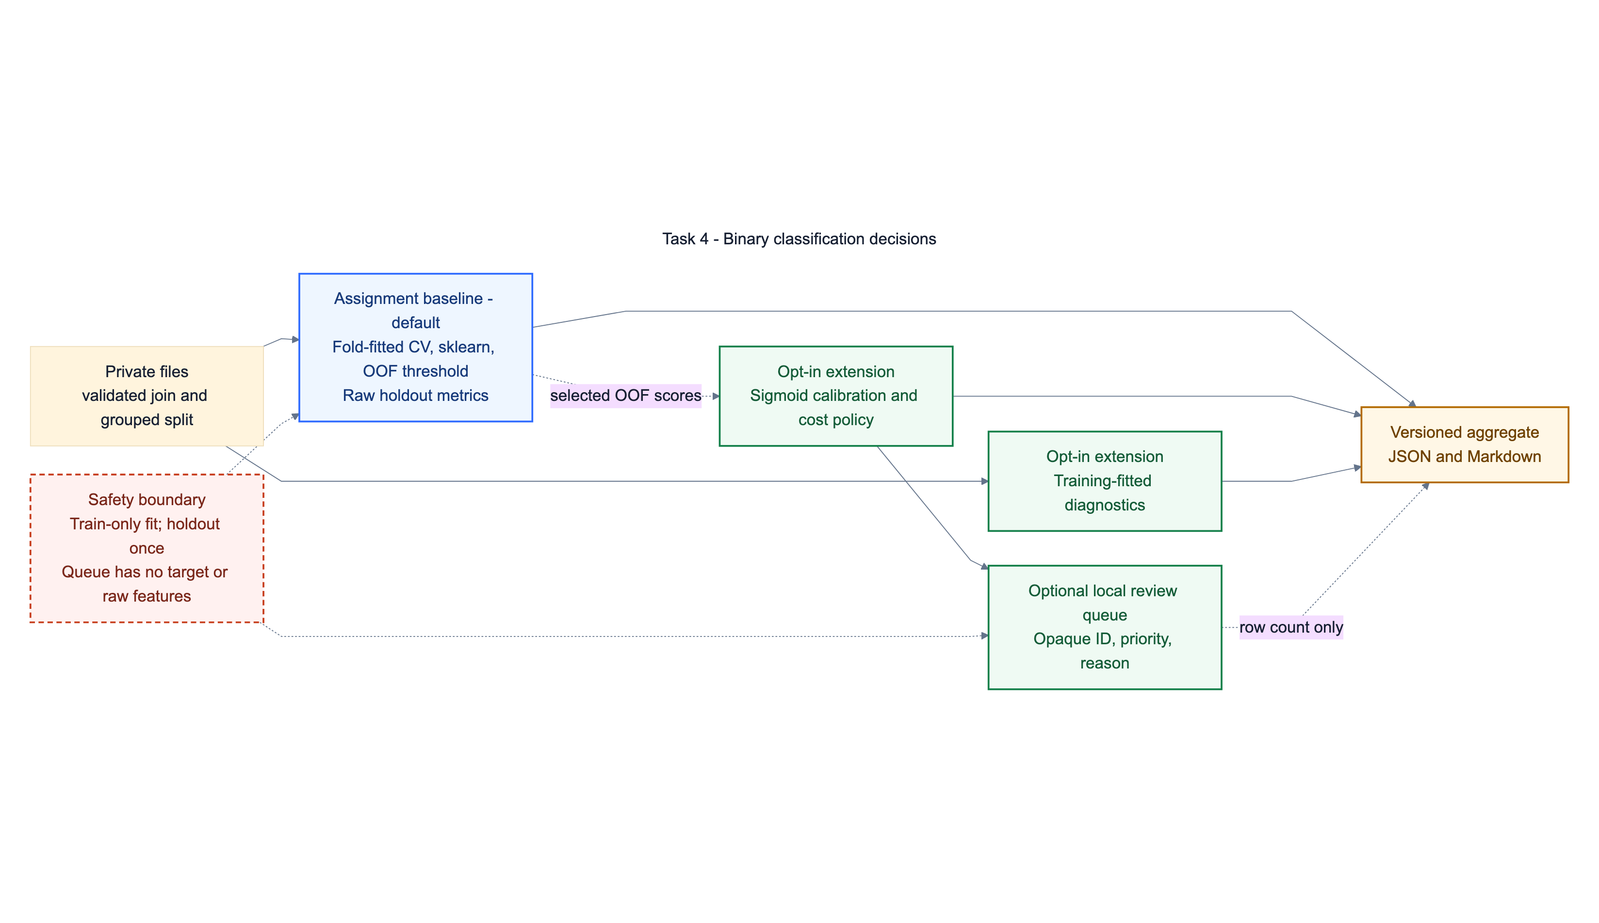
06
Notes:
[Sources]
- task-04-binary-classification/README.md
- docs/adr/0008-task4-calibrated-decision-layer.md
- docs/presentation/diagrams/task-04-binary-classification.mmd

Slide 7
TASK 4 · EVIDENCE
Calibration improves probability quality without rewriting the baseline
Brier score · lower is better
Recorded assignment baseline
0.303
0.3
3,700
0.423
0.2
joined entities
holdout PR-AUC
0.169
0.855
0.1
Selected: weighted logistic
holdout recall
0.0
Raw
Calibrated
Costs are example scenarios; class semantics and production costs require owner confirmation.
Sanitized extension fixture · 96 train / 24 holdout
07
Notes:
[Sources]
- task-04-binary-classification/reports/metrics.json
- task-04-binary-classification/reports/baseline-vs-extension.json

Slide 8
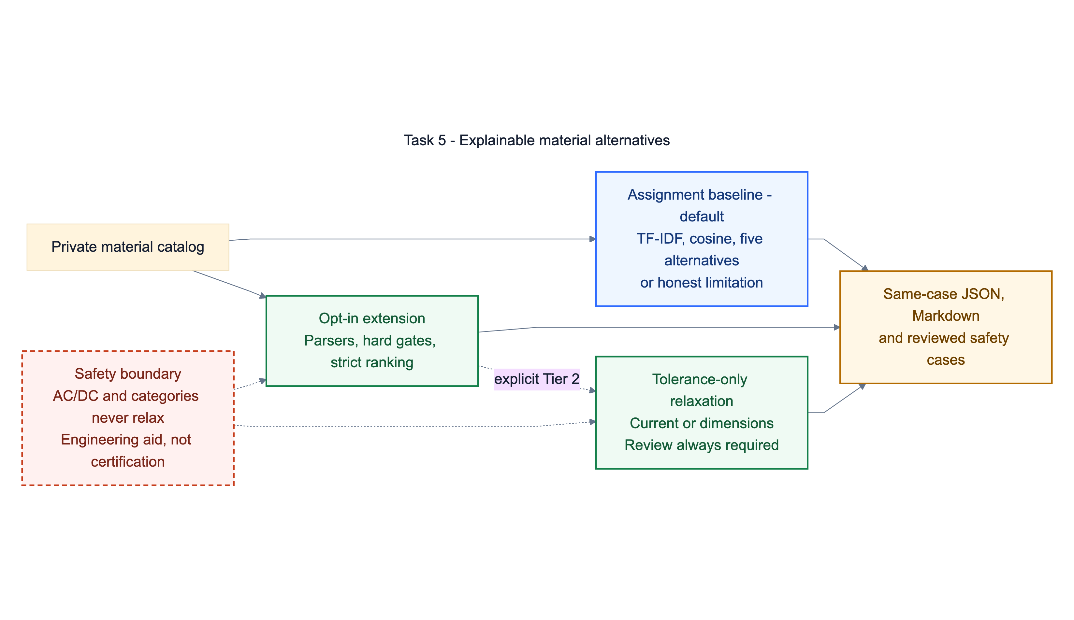
08
Notes:
[Sources]
- task-05-material-similarity/README.md
- docs/adr/0009-task5-compatibility-policy.md
- docs/presentation/diagrams/task-05-material-similarity.mmd

Slide 9
TASK 5 · EVIDENCE
Retrieval quality and engineering safety are measured on separate evidence
Recorded 998-row baseline
Sanitized extension fixture
0.847
0.875
20/20
0 → 1
NDCG@5
coverage
reviewed safety cases passed
strict → relaxed exactly-five coverage
25% word · 75% character TF-IDF
7 cases require review · 0 hard-negative rate
The relaxed result is an engineering review aid, never interchangeability certification.
09
Notes:
[Sources]
- task-05-material-similarity/reports/relevance-metrics.json
- task-05-material-similarity/reports/baseline-vs-extension.json

Slide 10
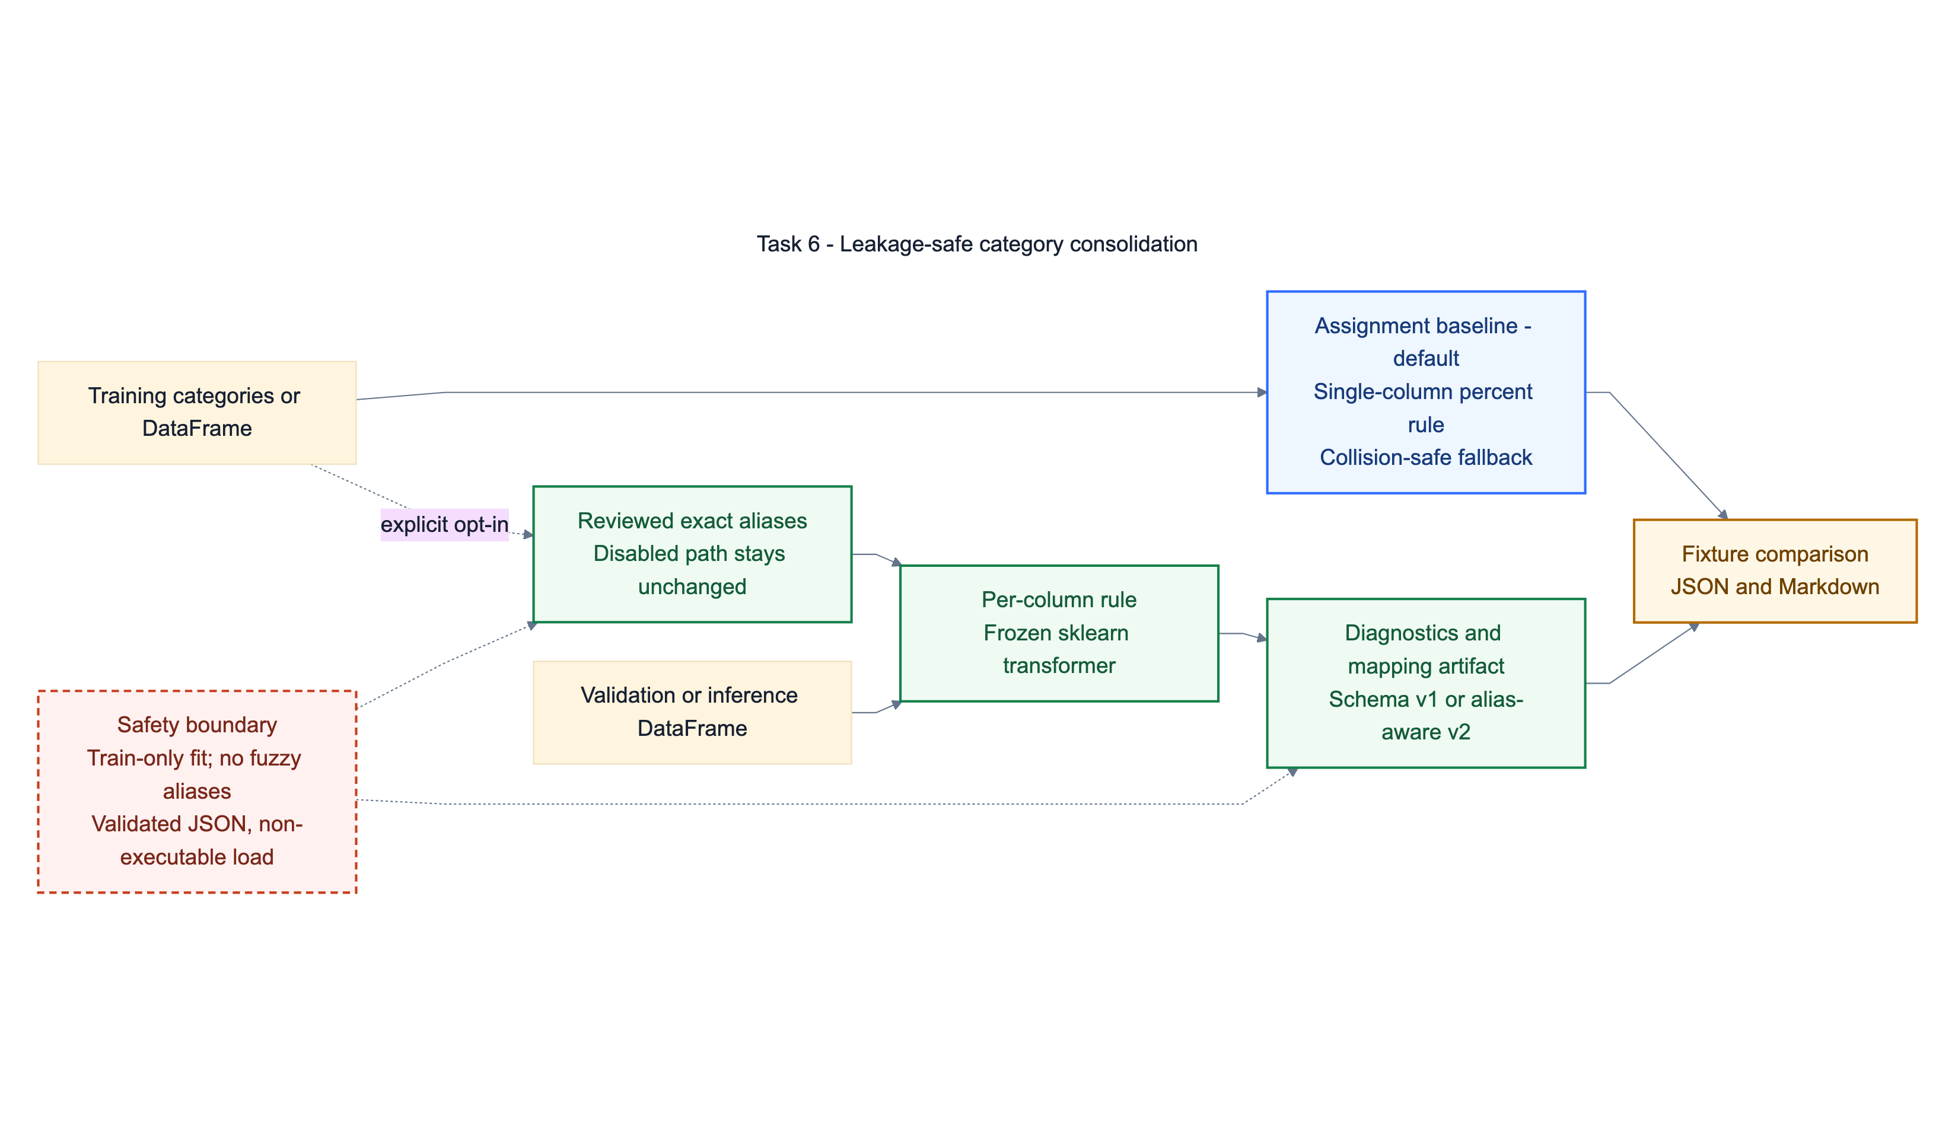
10
Notes:
[Sources]
- task-06-category-consolidation/README.md
- docs/adr/0010-task6-optional-sklearn-adapter.md
- docs/presentation/diagrams/task-06-category-consolidation.mmd

Slide 11
TASK 6 · RELEASE EVIDENCE
Default equivalence survives the reusable transformer and reviewed aliases
YES
8
v1 / v2
assignment output equivalent
sklearn integration checks
default artifact / alias-aware artifact
395
100%
100%
Tasks 4–6 deterministic tests passed
2,951 statements
812 branches
3 owner-private-data tests remain explicit acceptance handoffs.
11
Notes:
[Sources]
- task-06-category-consolidation/reports/baseline-vs-extension.json
- reports/test-coverage-baseline.md

Slide 12
RELEASE POSITION
Ready for owner evidence,
without overstating it.
Deterministic release
Owner acceptance
Tasks 4–6 code, reports, docs, and presentation evidence are locally reproducible.
Private datasets, second-computer setup, and live deployment remain explicit owner-run checks.
12
Notes:
[Sources]
- docs/owner-acceptance-checklist.md
- docs/reviewer-guide.md

