Slide 1

Sustainable Business Model Innovation
A Value Change for Survival
Pietro Mecca
gusmecpi@student.gu.se

Slide 2
Background
BUSINESS MODEL
Pacific in literature
Depicts the underlying logic of how a business makes profit
It is the conceptual architecture of how a business produces, delivers and captures value
It is a strategic asset for competitive advantage and performance (Afuah, 2003; Hamel, 2001; Magretta, 2002; Chesbrough, 2007)
Its components may vary, but value has a central role (Geissoderfer et al., 2018)
BUSINESS MODEL
BUSINESS MODEL INNOVATION
SUSTAINABLE BUSINESS MODEL
SUSTINABLE BUSINESS MODEL INNOVATION

Slide 3
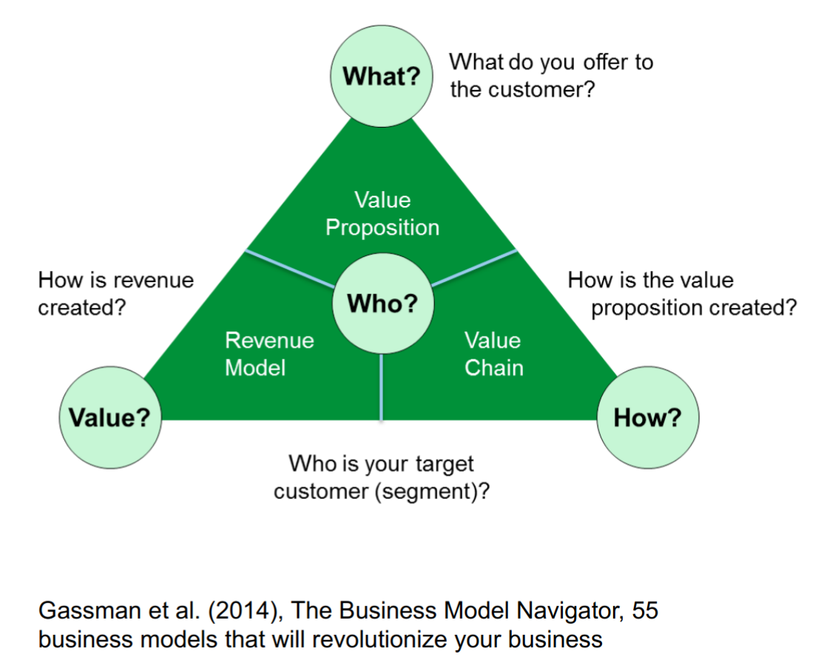
Background
BUSINESS MODEL
BUSINESS MODEL
BUSINESS MODEL INNOVATION
SUSTAINABLE BUSINESS MODEL
SUSTINABLE BUSINESS MODEL INNOVATION

Slide 4
Background
BUSINESS MODEL INNOVATION
The capability to innovate a business model is often necessary to capture value from innovation (Chesbrough & Rosenbloom, 2002)
Redesigning a BM is not only needed to capture the value generated by innovation, it can be the innovation by itself (Teece, 2010)
Not pacific, there are two main research stream:
Only a complete reinvention of a BM qualify as BMI (Geissdoerfer, 2018)
Incremental change and fine-tuning of a BM qualify as BMI (Girotra & Netessine, 2014)
BUSINESS MODEL
BUSINESS MODEL INNOVATION
SUSTAINABLE BUSINESS MODEL
SUSTINABLE BUSINESS MODEL INNOVATION

Slide 5
Background
SUSTAINABLE BUSINESS MODEL
Business model are source of sustainable advantage and of a company’s performance sustainability (Porter & Kramer, 2011)
Sustainable businesses are suspected to be more resilient (Choi & Wang, 2009)
SBM definitions are based on BM definitions with the addition of a long-term, non-monetary value creation for all stakeholders or sustainability oriented goals in one or more BM’s component (Geissdoerfer et al., 2018; Shakeel et al., 2020)
BUSINESS MODEL
BUSINESS MODEL INNOVATION
SUSTAINABLE BUSINESS MODEL
SUSTINABLE BUSINESS MODEL INNOVATION

Slide 6
Background
SUSTAINABLE BUSINESS MODEL INNOVATION
SBMI is BMI with a strong component of sustainability in the redesigning of value proposition, creation, delivery and the overall value network (Shakeel et al., 2020)
SBMI is the adaptation of an existing BM to overcome environmental issues (Boons & Lüdeke-Freund, 2013; Bocken et al., 2014)
There is no consensus on the SBMI concept (Shakeel et al., 2020)
BUSINESS MODEL
BUSINESS MODEL INNOVATION
SUSTAINABLE BUSINESS MODEL
SUSTINABLE BUSINESS MODEL INNOVATION

Slide 7
Problems
BUSINESS MODEL INNOVATION
There is no agreement on what qualify as BMI
Some scholars say you need to change a certain amount of components
Others to change specific
Others think any change qualify as BMI
BUSINESS MODEL
BUSINESS MODEL INNOVATION
Sustainability
SUSTAINABLE BUSINESS MODEL
SUSTINABLE BUSINESS MODEL INNOVATION

Slide 8
Problems
Sustainability
It is never explicitly defined in its meaning
Originally in strategic literature referred to strategic or competitive sustainability
Now often refers to environmental issues, but it does not have an explicit definition
BUSINESS MODEL
BUSINESS MODEL INNOVATION
Sustainability
SUSTAINABLE BUSINESS MODEL
SUSTINABLE BUSINESS MODEL INNOVATION

Slide 9
Problems
SUSTAINABLE BUSINESS MODEL
Being based on the addition of the concept of “sustainability” to the concept of BM, the SBM definition is vague and not well defined
To properly define a SBM it is required to defined what “sustainable” refers to
BUSINESS MODEL
BUSINESS MODEL INNOVATION
Sustainability
SUSTAINABLE BUSINESS MODEL
SUSTINABLE BUSINESS MODEL INNOVATION

Slide 10
Problems
SUSTAINABLE BUSINESS MODEL INNOVATION
It is based on two concepts that are yet to be defined (BMI and Sustainability)
Some scholars wonder if SBMI is an autonomous theoretical field or a BMI sub-field (Lüdeke-Freund & Dembek, 2017)
BUSINESS MODEL
BUSINESS MODEL INNOVATION
Sustainability
SUSTAINABLE BUSINESS MODEL
SUSTINABLE BUSINESS MODEL INNOVATION

Slide 11
Purpose
Research Questions
Is SBMI an autonomous theoretical field or a BMI sub-field?
What are the logic relations between BM, BMI, SBM, SBMI?
How is “sustainable” defined?
Is SBMI practised due to necessity hence just “adaptation” or is it innovation?
Clarification of the logic relations between BM, BMI, SBM and SBMI
Proposal of an unified view on the concept of BMI
Understanding of how to define “sustainable”

Slide 12
Methods
Assumptions
Interpretative epistemology
To understand humans’ actions empathy is required
Constructionism:
a social reality is made by its social actors interpretation and understanding of it
Reflexivity:
Interpretation as a requirement to understand a social reality
Assumptions
Strategy
Design
Sample

Slide 13
Methods
Strategy
Qualitative
Abduction
“dialect shuttling”: going back and forth from theory and empiric to highlight eventual mismatch
Iteration
Assumptions
Strategy
Design
Sample

Slide 14
Methods
Design
Multiple case study
Semi-structured interviews
Grounded theory analysis method
Assumptions
Strategy
Design
Sample

Slide 15
Methods
Sample
Founders of businesses born with an innovative business model which innovative component was based on some kind of sustainability focus (CAKE, PLANTAGON)
Managers from companies practising SBMI (Eriksson, Enel)
Managers helping clients practising the SBMI process (Baker Hughes, BDO)
Managers whose job is indirectly impacted by SBMI to gain a external viewpoint (Volvo, Azimut)
Assumptions
Strategy
Design
Sample

Slide 16
Findings
Sustainability
Deeply linked with ethics
The definition changes overtime
It’s an attitude
It starts with value
It improves a company performance over time
To be sustainable every aspect must to be considered and balanced (economic, financial, competitive, strategic, digital, environmental, social, governmental, ecological)
In the end it’s about its literal meaning of survival overtime
Sustainability
BM
BMI
SBM
SBMI

Slide 17
Findings
Business Model
It does not exist in real life for it is continuously changed through every action taken pursuing goals
When a BM change become a different one than before, but not necessarily a new one
A new BM is not necessarily sustainable
Sustainability
BM
BMI
SBM
SBMI

Slide 18
Findings
Business Model Innovation
Any tweak applied to a BM qualify as BMI
BMI has different configurations, for its effects on a BM can have different extents
Sustainability
BM
BMI
SBM
SBMI

Slide 19
Findings
Sustainable Business Model
It is a very specific configuration of BM, achieved through SBMI
To qualify as sustainable, sustainability has to be achieved in every component to the maximum extent possible given current ethics and technology and considering and balancing every sustainability aspect
Sustainability
BM
BMI
SBM
SBMI

Slide 20
Findings
Sustainable Business Model Innovation
It is a specific configuration of the concept of BMI, aimed at improving sustainability aspect in a BM
Any change applied to a BM pursuing a sustainability related goal qualify as SBMI
The process usually starts with the implementation of sustainability in the value proposition
Practising SBMI does not guarantee to achieve the SBM status
Sustainability
BM
BMI
SBM
SBMI

Slide 21
Purpose
Purpose fulfillment
BMI is pertinent to the BM nexus. SBM is a specific variation of plain BM, reached through SBMI, which in turn is a specific configuration of BMI aimed at pursuing sustainability related goals
A BM is proposed as a static image of a BM, while BMI is the dynamic image. This definition unify the existing definitions as different configurations of the same concept
Sustainability is defined over time by ethics and existing technology, but always consider every possible aspects. In the end results in its literal meaning of survival over-time
Clarification of the logic relations between BM, BMI, SBM and SBMI
Proposal of an unified view on the concept of BMI
Understanding of how to define “sustainable”

Slide 22
Last RQ
Purpose fulfillment
It is practised for different reasons, but the process stays the same. Hence the “commitment” or “compliance” is not a variable that define the different configurations of BMI
Is SBMI practised due to necessity hence just “adaptation” or is it innovation?

Slide 23
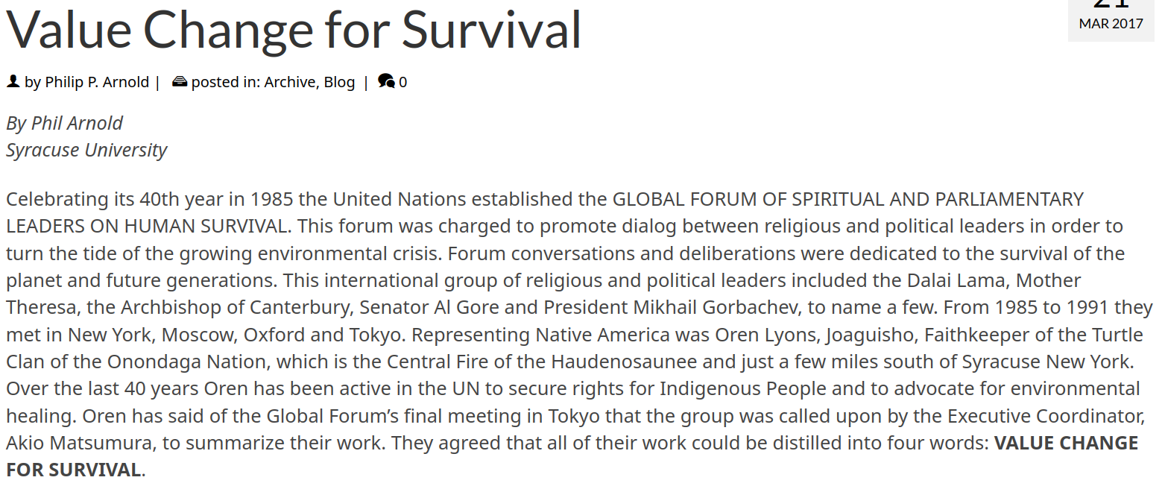
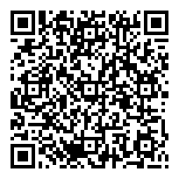
A interesting finding:
... hence Business Model Innovation for Sustainability is a value change for survival
SBMI is BMI aimed at improving Sustainability
Sustainability is deeply linked with ethics and within the business model context it usually starts with the value proposition
Several spiritual and political leaders after days of consultation concluded that sustainability is “a value change for survival”...
link here!

