Slide 1
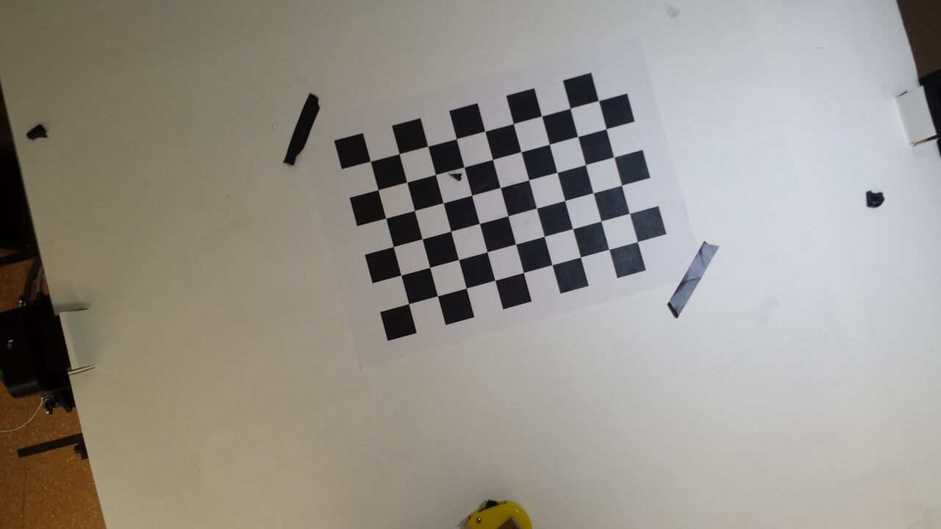
LLUM 1:
(-37.3,-12.5,-110)
v= (-0.107, -0.32, -0.94)
Y
LLUM 2: (9,4.2,-110) u= (0.038, 0.08,-0.99)
LLUM 3: (53,19,-110)
X

