Slide 1
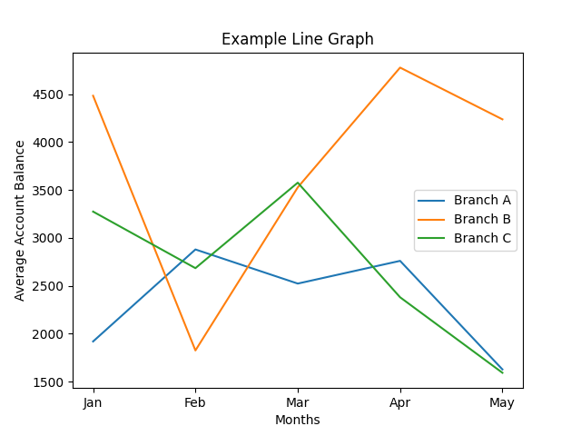
Line Graph
Ideal for showing trends over time. Examples:
- Average account balance over months
- Customer growth over years

