Slide 1
Visualization Types in Banking
Examples and Use Cases

Slide 2
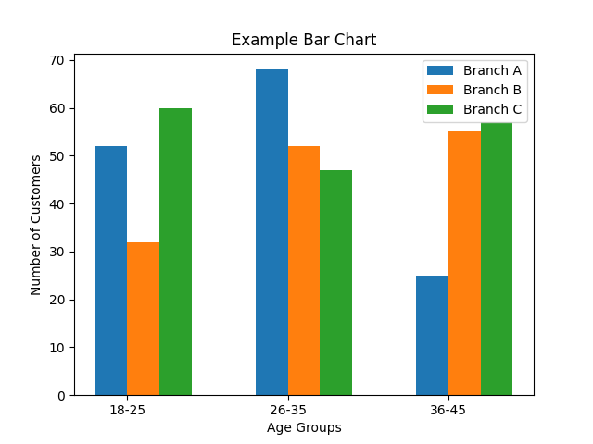
Bar Chart
Useful for comparing discrete categories. Examples:
- Age distribution by branch
- Loan types by branch

Slide 3
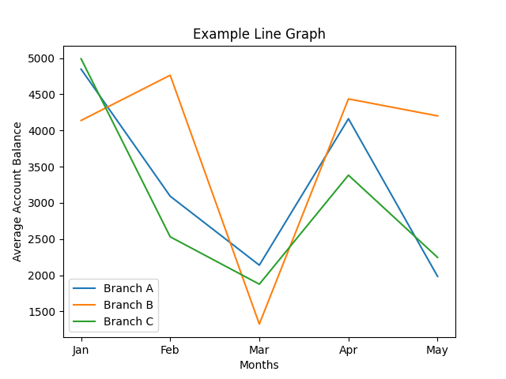
Line Graph
Ideal for showing trends over time. Examples:
- Average account balance over months
- Customer growth over years

