Slide 1
Visualization Types in Banking
Examples and Use Cases

Slide 2
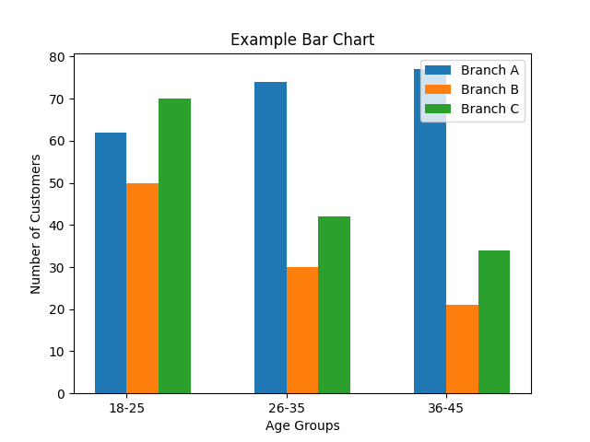
Bar Chart
Useful for comparing discrete categories. Examples:
- Age distribution by branch
- Loan types by branch

Slide 3
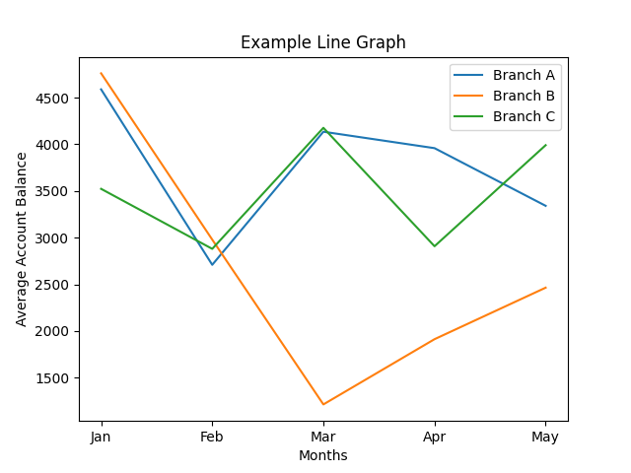
Line Graph
Ideal for showing trends over time. Examples:
- Average account balance over months
- Customer growth over years

Slide 4
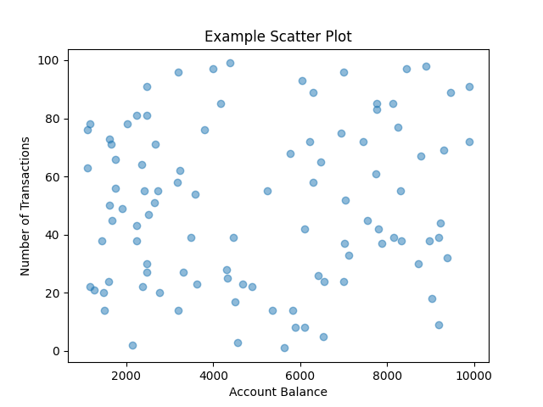
Scatter Plot
Used to visualize relationships between two variables. Examples:
- Account balance vs. number of transactions
- Age vs. income

Slide 5
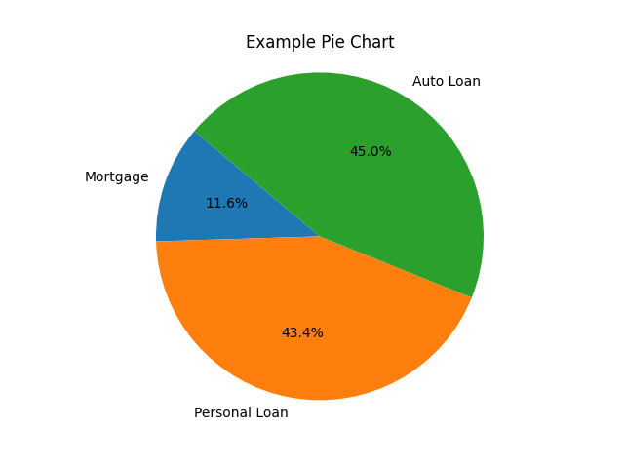
Pie Chart
Illustrates proportions of a whole. Examples:
- Loan types distribution within a branch
- Expenses breakdown by category

Slide 6
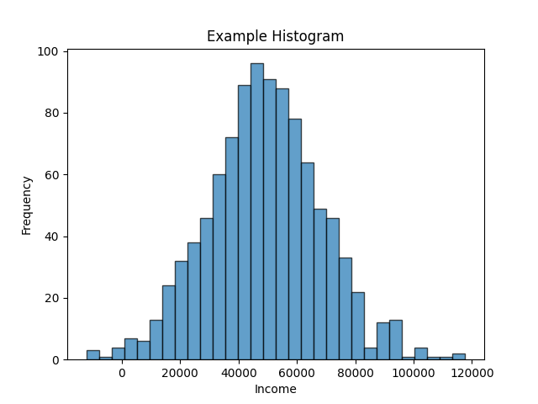
Histogram
Displays distribution of a continuous variable. Examples:
- Income distribution within an age group
- Transaction amounts distribution

Slide 7
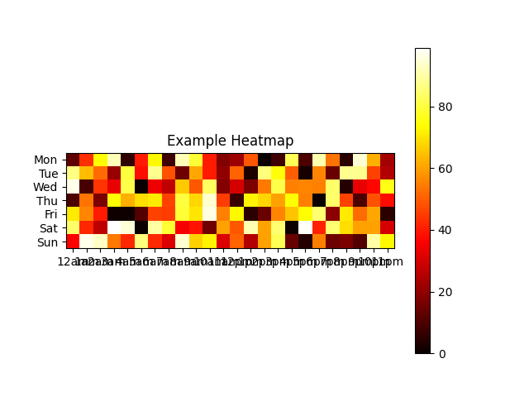
Heatmap
Effective for visualizing relationship between two categorical variables. Examples:
- ATM transactions frequency by time of day and day of week
- Loan approval rates by customer segment

Slide 8
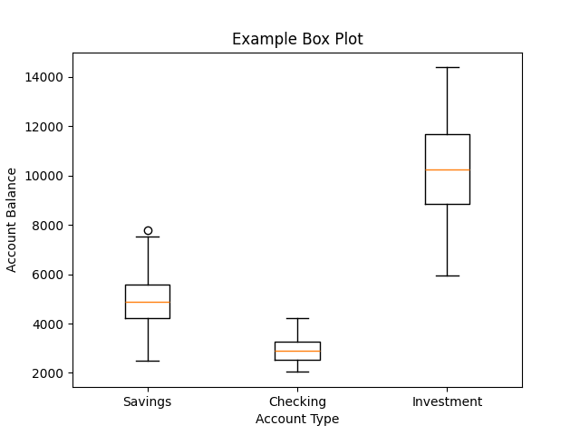
Box Plot
Displays distribution and outliers of a continuous variable. Examples:
- Account balance distribution by account type
- Loan amount distribution by loan type

