Slide 1

An introduction to the use of open repositories
Software engineering

Slide 2
Steps to start:
Create a GitHub account:
Sign up for GitHub
Create new Repository:
Click “Create Repository” and enter name for the new rep.
Create a file:
Open Terminal/Command Prompt, type:
Git (press Enter).
Mkdir Demo (Demo is directory name)
Echo “#Demo” >> README.md (creates a file called README)
Cat README.md (this shows inside README file)
Git init (initializes GitHub, and GitHub will be tracking any changes made in this file)
Git add README.md (this command will add README file to the repository)
Make a commit:
git commit –m “first commit” (it is the first commit into the repository and we have added a message “first commit” to it)
Connect your GitHub Repo with your PC:
git remote add origin https://github.com/<your_username>/Demo.git (this connects the computer to the GitHub)

Slide 3
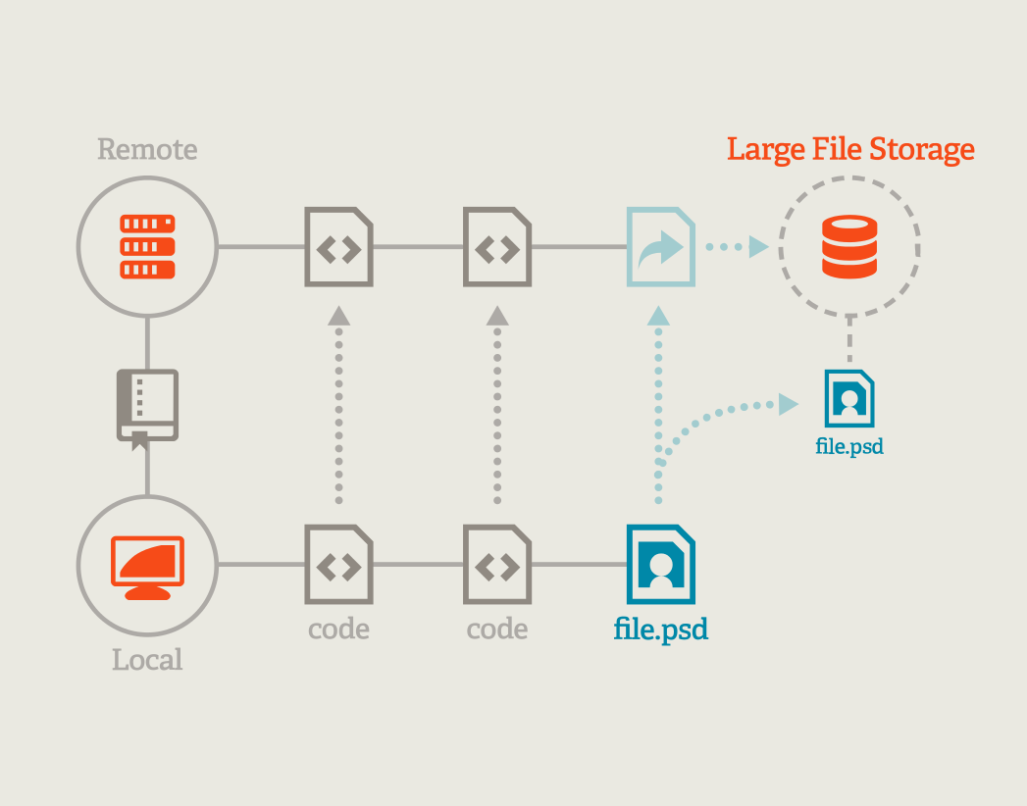
Places to store
When files are created via GitHub - Git compresses it and stores it into its own data structure. The compressed object will have a unique name, a hash, and will be stored under the object directory.
Local Git config file is stored inside the .git directory of the current in-work repository.

Slide 4
Benefit of using Git
Distributed model: It means your work is your own. You can let others see what is necessary. Additionally, it makes it possible to work offline and it is time efficient.
Branching and Merging: It means you can sandbox your features and ideas till they are ready for the mainstream.
Workflow is flexible: Compared to Centralized VCS, Git has the qualities that allows to choose your own workflow. It can be either as simple as centralized or just hierarchical.
Data Integrity is assured: Because Git uses SHA1 tree, data corruption due to external reasons can be easily detected.
Other benefits: it is faster than other DCVS, for local as well as network operations. Additionally, it is free, not everybody wants to pay over 400$ every year for repositories.

Slide 5
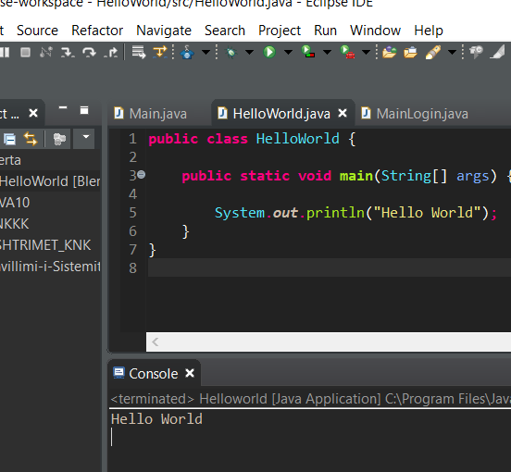
Our simple program “HelloWorld” -Open Eclipse -New Class -Class name HelloWorld

Slide 6
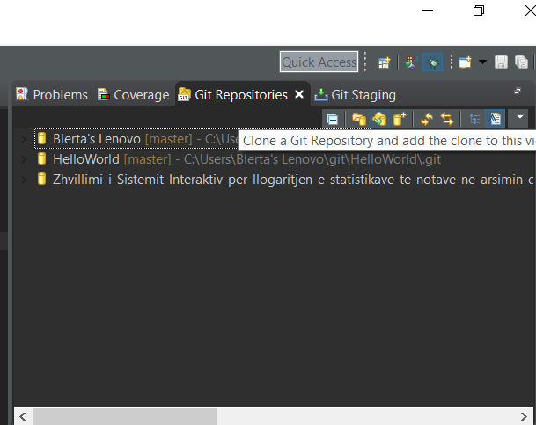
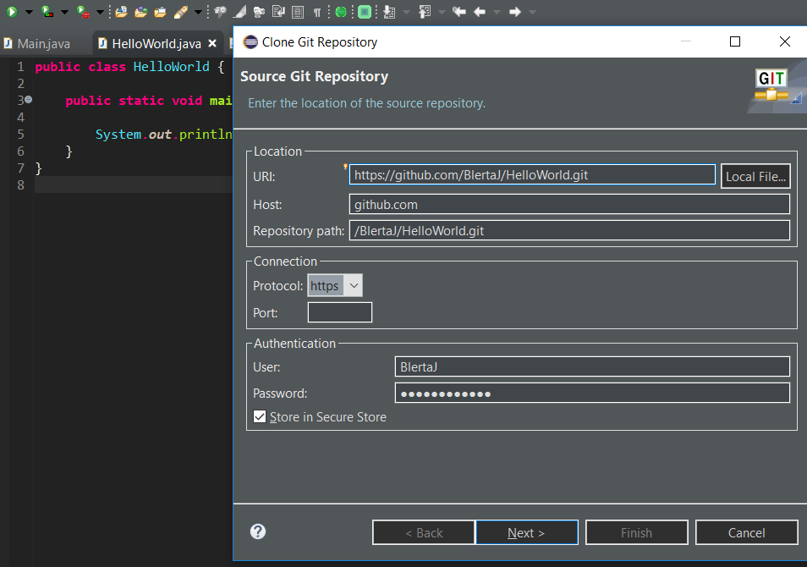
Using GitHub with Eclipse Projects
Clone repository in eclipse

Slide 7
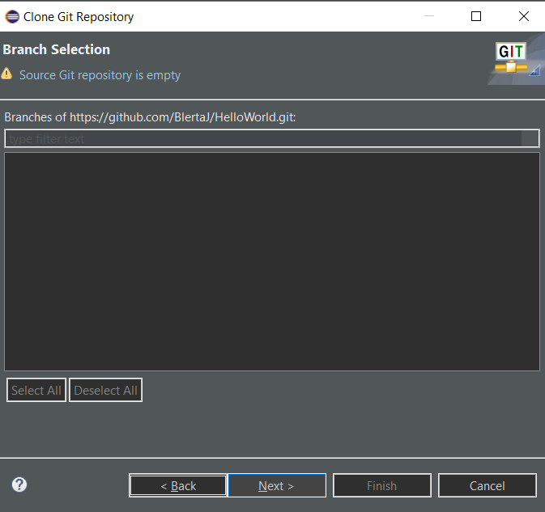
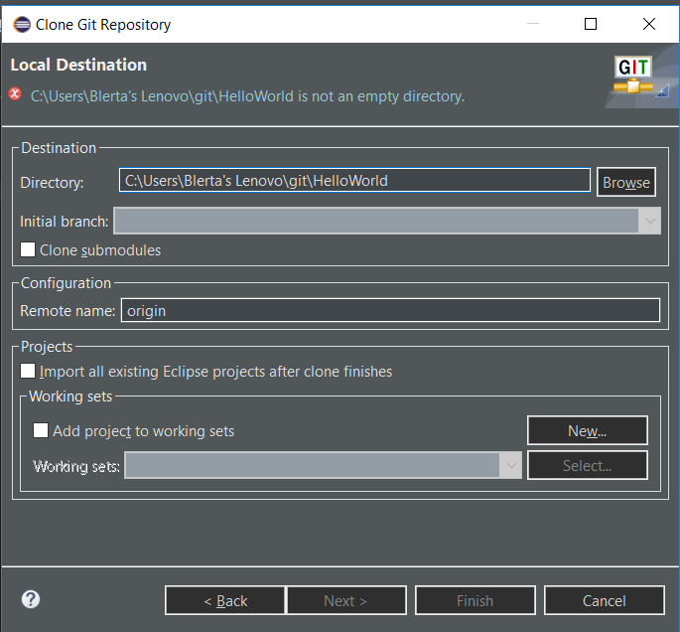
Go to Perspective -> Git Repositories and Click on Clone Git Repository

Slide 8
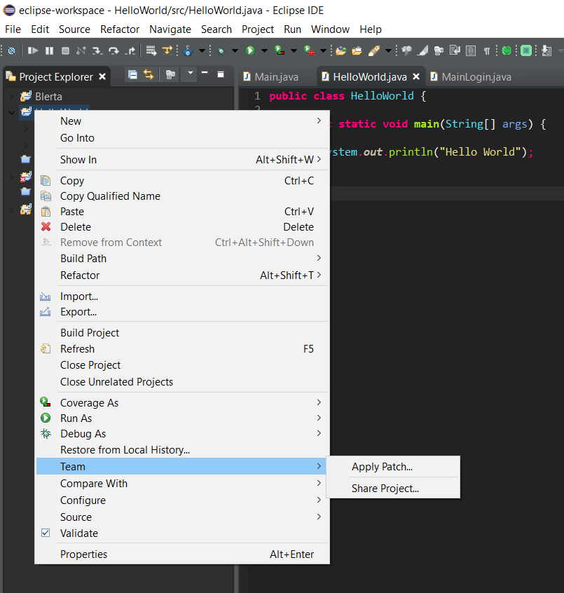
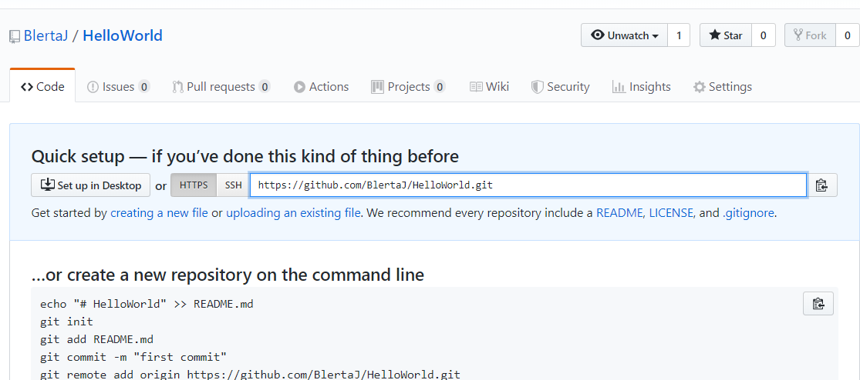
Do a right click on Project -> Team -> Share -> Add to git repo

Slide 9
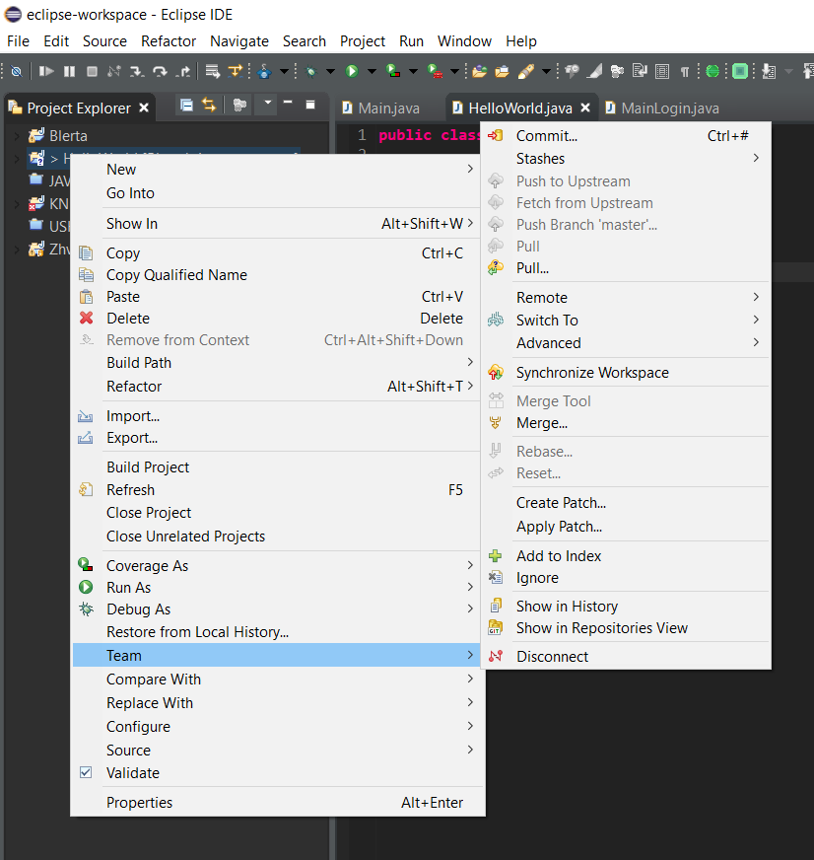
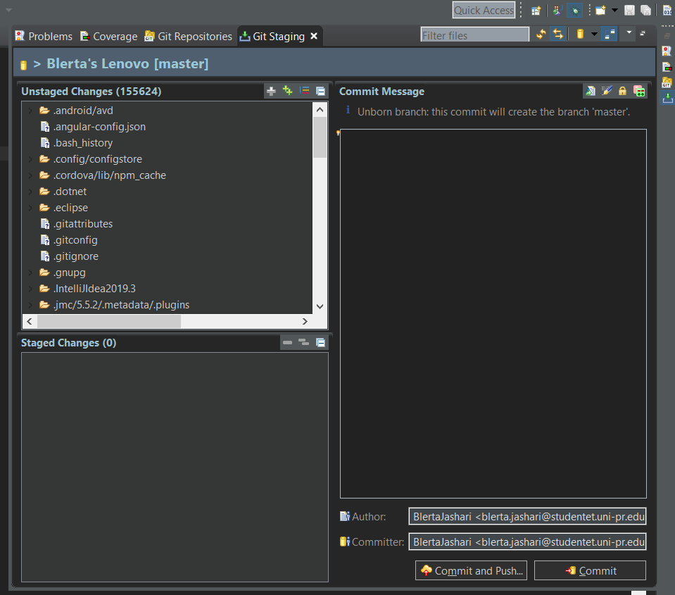
Commit Changes

Slide 10
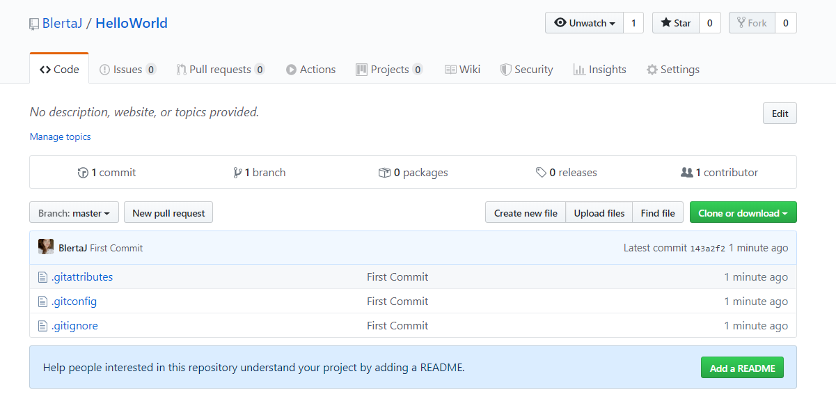
Tracking changes in git

Slide 11

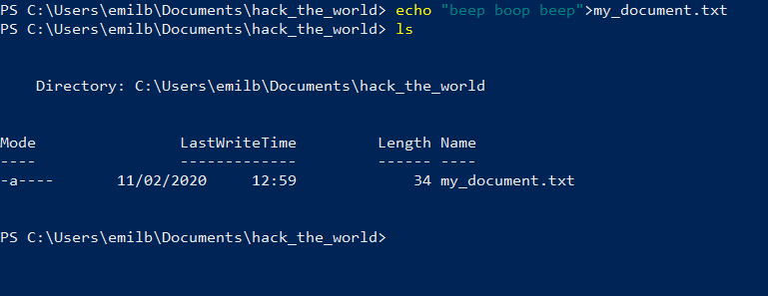
Doing git like a real programmer
initialize a repo
create a file

Slide 12
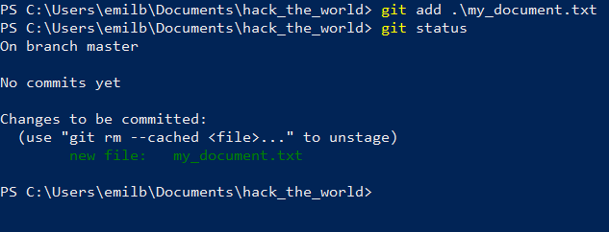
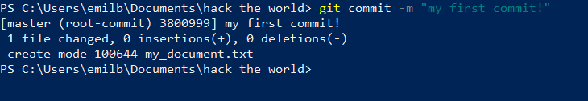
3. Add your changes
4. Make your first commit

Slide 13
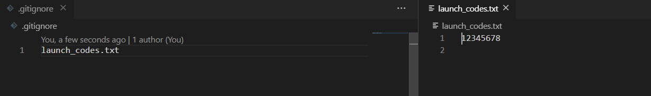
Hiding files
You can hide some files by adding their names to a file called .gitignore

Slide 14
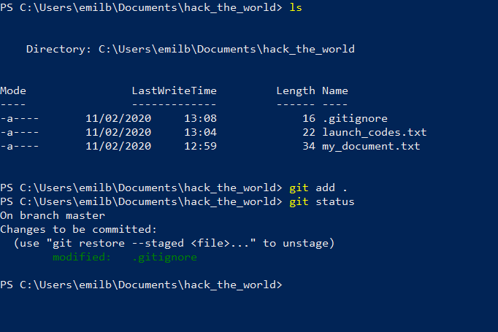
After that if you try to add all your files git will ignore the files listed in .gitignore ( my_document.txt doesn’t have any changes that is why it is not added )

Slide 15
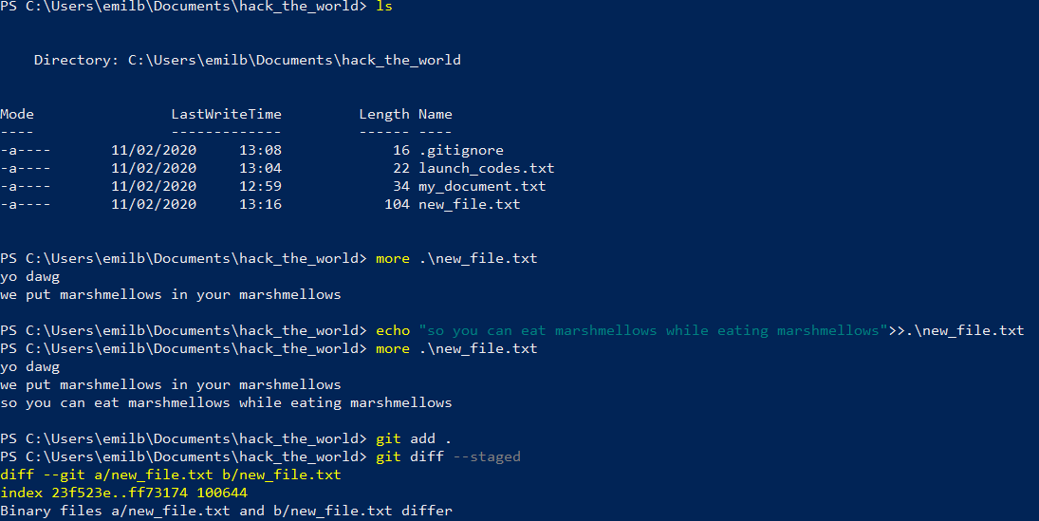
You can also see the changes made in current version of project compared to last version in the last commit using command git diff:

Slide 16
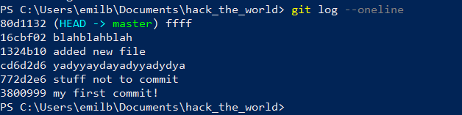
You can see list of all the commits using git log --oneline ( oneline makes output easier to read ):

Slide 17
How to learn all this stuff?
There is no actual “real programmer” way
You can use something with gui
If still want to learn, you just have to google stuff, not memorize the commands ( this is what my browser usually looks like if i don’t use git after 1 week of not using it):

Slide 18
Thank you
Blerta Jashari
Anvar Vakhobov
Emil Babazade
Gasim Mammadov
Ogtay Maharramov
Presentation was prepared by :

