Slide 1
Testing frameworks
Project:
The application for developing a system for high school platforms
The functions are described in details – not only pseudocode.
Blerta jashari

Slide 2
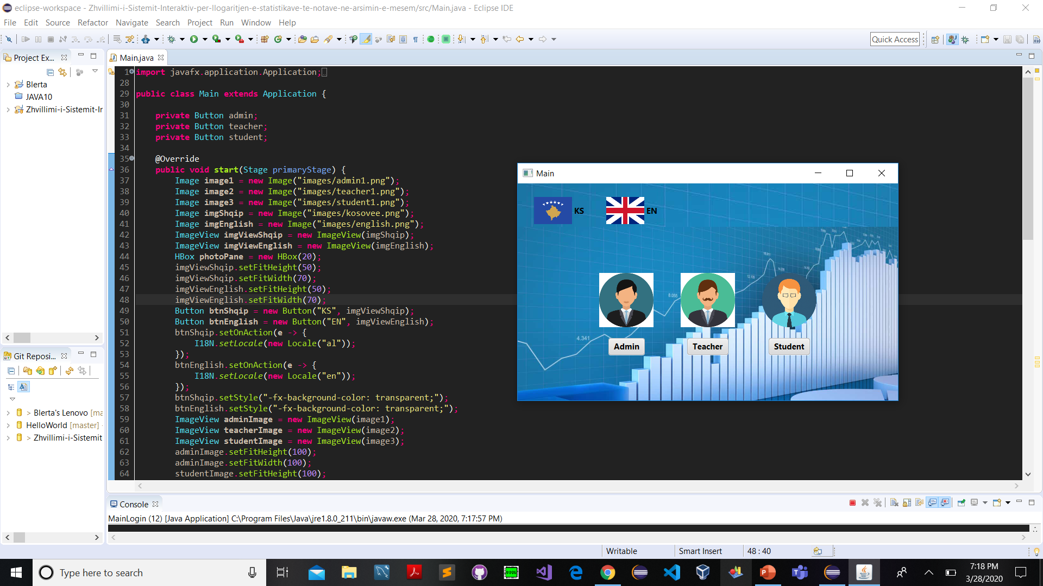
1st function – The start function
Every button has its own functionality, and when you start testing the admin, student and teacher should send you to the forms to login, where you should put the ids and password to login. These information are created by admin.
Two buttons ks and en are used to change the language of the application, by testing you can try it.

Slide 3
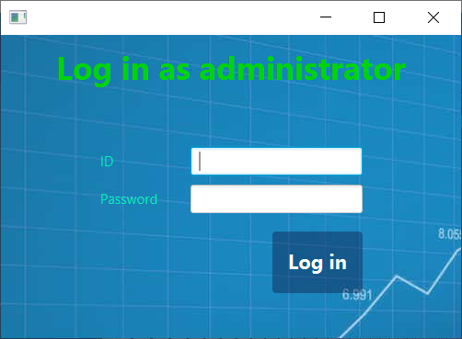

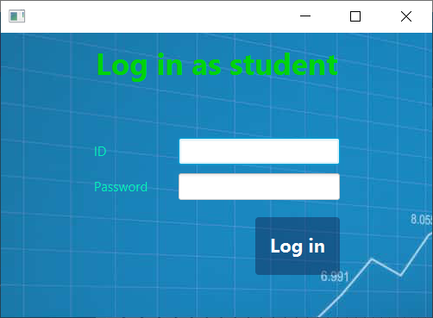
What will happen after clicking the buttons admin, student and professor?

Slide 4
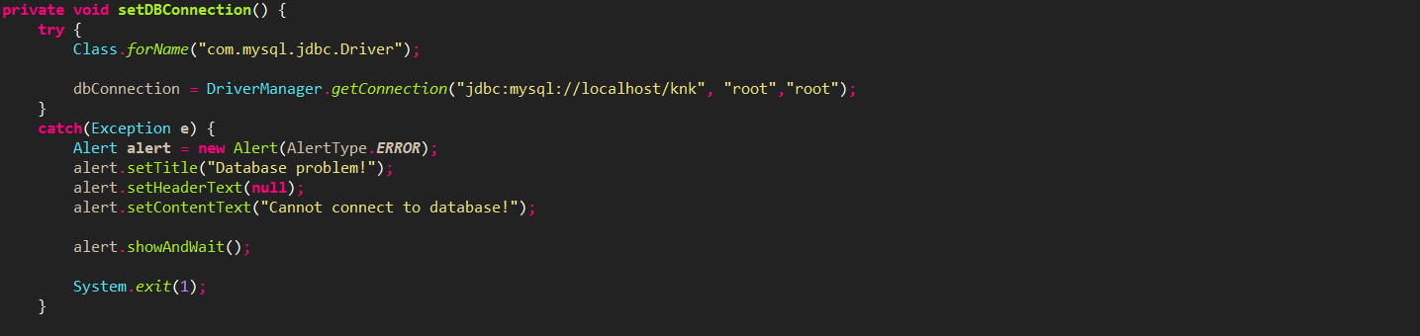
2nd function: setDBConnection
-The functionality of this function is everywhere, and I can say that without this function our application doesn’t have a meaning.
By using modular testing we can test if this function is working, and how it is working.
By logging in as a user(student, professor or admin) everything is done right in this function!

Slide 5
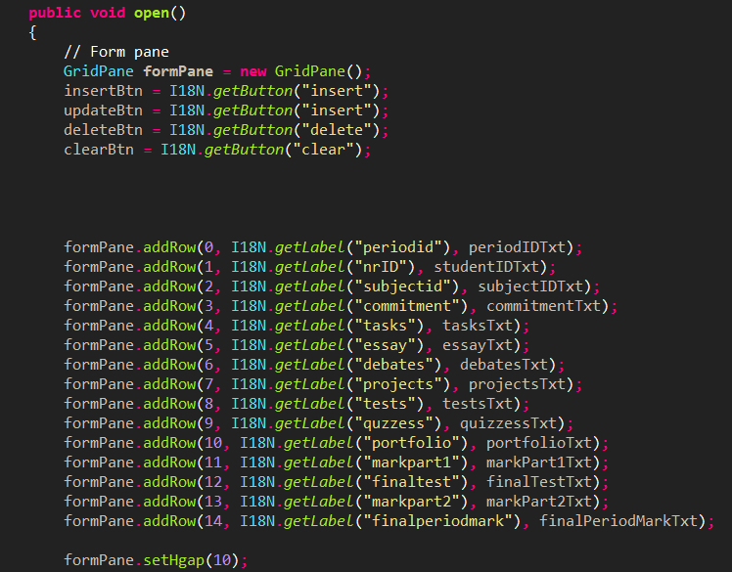
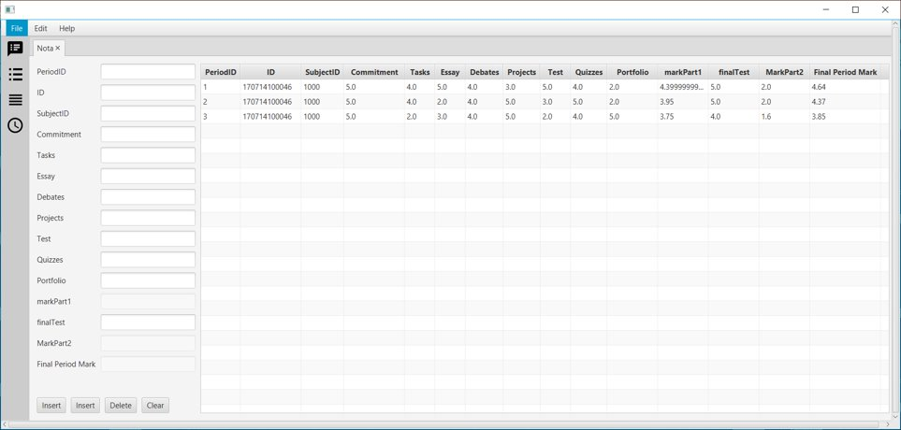
The third function - Open function:
By using this we open the teacher's panel with all the labels needed to add the data about a student, we can try filling the fields with data.

Slide 6
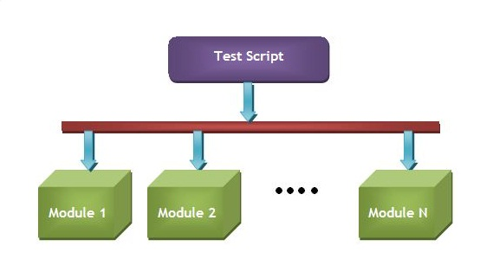
Modular testing framework
Modular frameworks divides the test scripts into small modules:
1st function for my opinion has 5 modules which are: Student, Professor, Admin btnEnglish, and btnShqip.
By doing the modular testing we will find the functionality of them all.
2nd function has all the modules for login, adding a new student, updating data for student and all the manipulations that are related to the database.
3rd function has the modules for inserting, updating, and deleting the data for students.

Slide 7
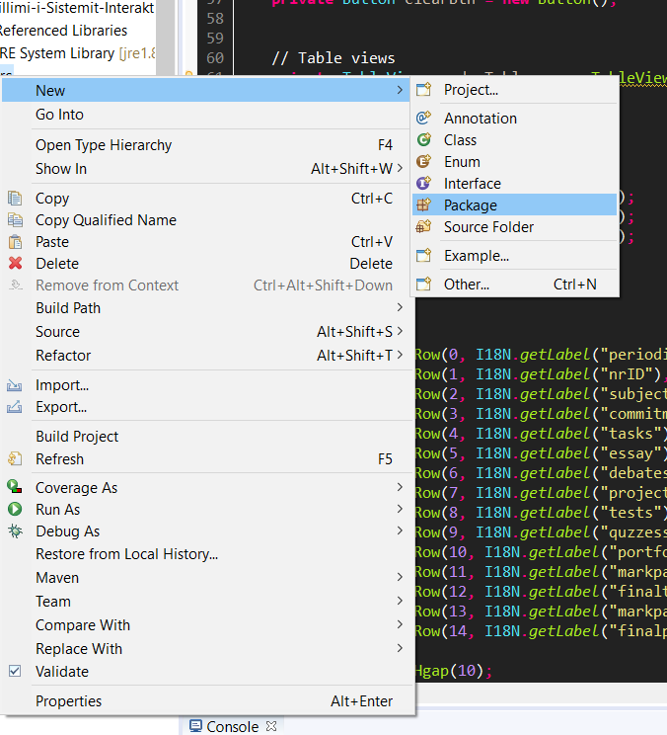
How to do this ?
We can do this by adding a new package with the name AppModule for example and then adding a class with a name how we want.
After that we go to the class and add the automation Framework where we can add the framework for testing and by this, we will test our application.

Slide 8
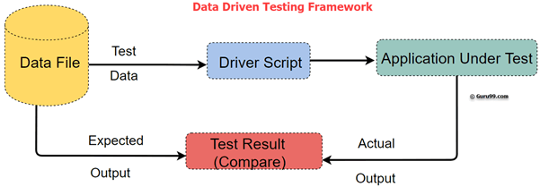
Data Driven Testing
Test automation framework that stores test data in a table or spreadsheet format.
1st function: We can add a non correct id , it means that isn’t in our database and try to login in any of our panels, the data will be stored to the table or spreadsheet, so this will be kind of one testing.
2nd function: Trying to add a non existing database to link with, or adding a fake password, or a fake database name.
3rd one: Adding data that we make a restriction that the user couldn’t add like a database query, or in place of id to put letters, or a blank field.

Slide 9
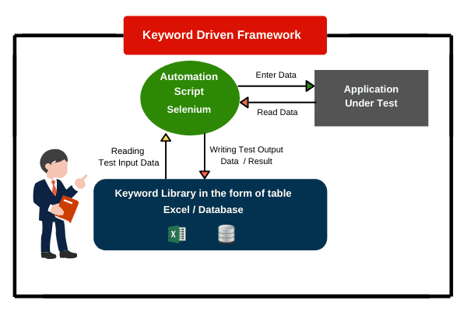
Keyword Driven Testing Framework
uses data files to contain the keywords related to the application being tested.
1st function: Keywords: login, teacher, admin, student, language, update, insert, delete.
2nd function: Keywords: database, query, password, username.
3rd function: Keywords: username, passwords, tasks, periodMark, grade, mark, finalGrade, projects, update, insert, delete.
To do this, we can use the tools:
HP QTP
Selenium

