Slide 1

Software Security
Blerta Jashari

Slide 2
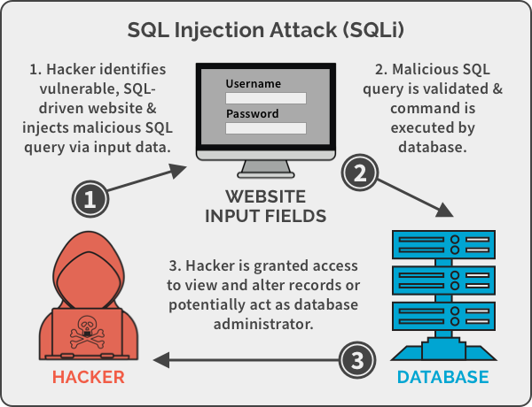
1st vulnerability :
Type : SQL injection
With SQL Injection the attacker insert a code, in which he/she can drop my database for the students or dump the database content.
I can prevent my database from the attacker with the code with using RegEx patterns.

Slide 3

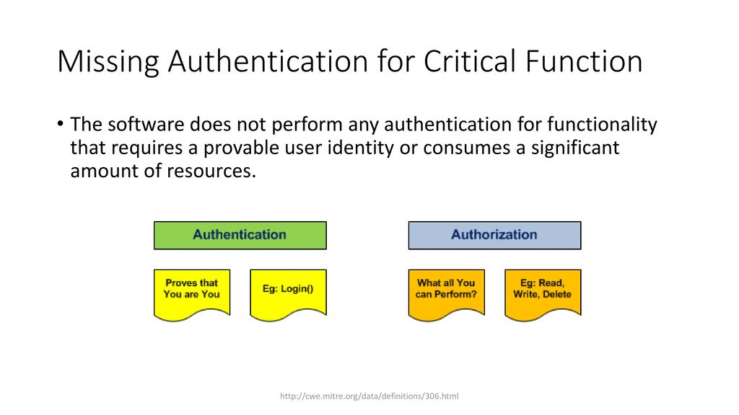
2nd vulnerability:
Type : Missing authentication for critical function
In my login form, the attackers can act like they are someone else and stole data.
We can prevent it by using the code for authentication, should look for the username and password if they match, or in another form with another character.

Slide 4
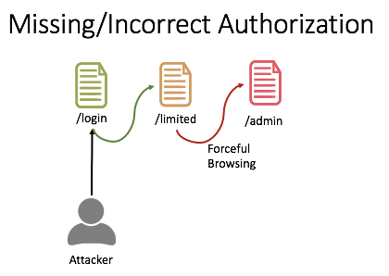
3rd vulnerability:
Type : Reliance on untrusted inputs in a security decision
Our data can be lost, by inputs that I have, username and passwords.
We should take care about the data type , or the input how it can be for my fields in my form.

Slide 5
Conclusions:
We should be so careful when using the forms, or the parts of our applications that contain a part for input, this because there are so many attackers that can try to drop or take our data.

