Slide 1


Appcelerator Titanium
January 6th, 2015
RVA.js
Bruce Pulley
Andrew Rumbley

Slide 2
Who are these guys?
Bruce Pulley (@pulleymb)
bruce@shockoe.com
Senior Mobile Applications Developer
Andrew Rumbley (@rumbleyam)
andrew@shockoe.com
Senior Mobile and Web Applications Developer
Shockoe.com LLC,
Taming the Mobile Monster

Slide 3
What are we talking about?
Appcelerator Titanium Basics
Titanium Alloy MVC Framework
Nuances associated with creating cross platform applications

Slide 4
How are Apps Developed?
Android:
-Java based SDK
-Compiles on Windows, Linux, and OSX
-Provides IntelliJ based IDE: Android Studio
iOS:
-Objective-C based SDK (or Swift…)
-Compiles on OSX only
-Provides Xcode IDE

Slide 5
Cross Platform Development
Two different development teams
Two different skill sets (Objective-C and Java)
No code reuse
Twice the development and maintenance effort

Slide 6
How can we make this manageable?

Slide 7
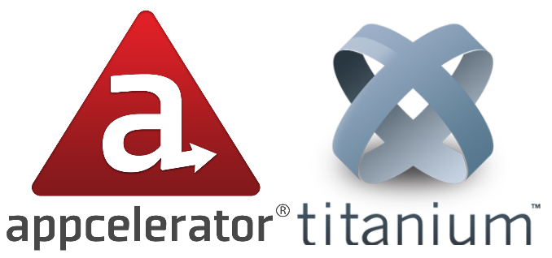

Slide 8
What is Appcelerator Titanium?
Cross Platform Mobile Applications Framework
Allows you to write your apps in JavaScript
Can compile for iOS and Android
Promotes code reuse
Provides an Eclipse based IDE

Slide 9
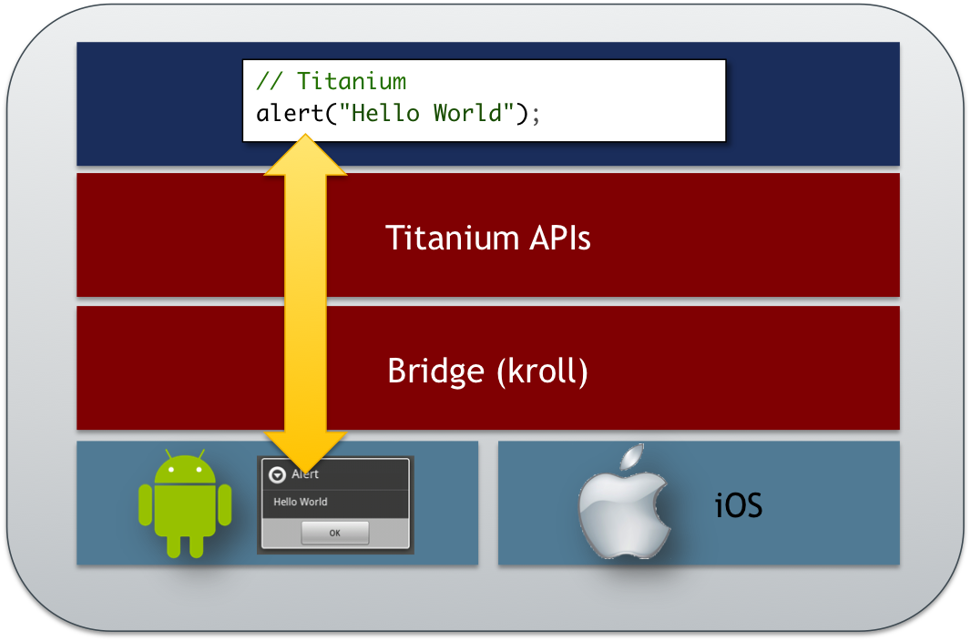
How does Titanium work?

Slide 10
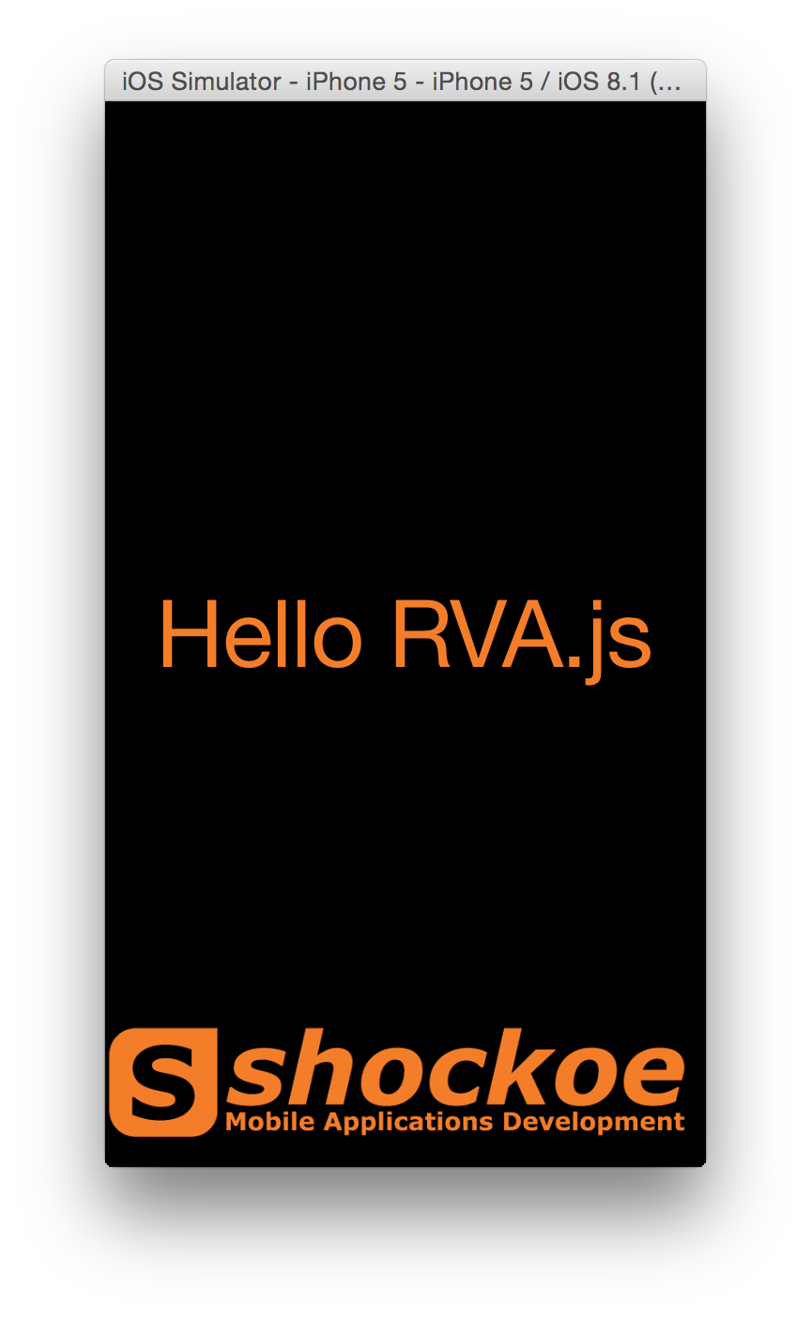
Sample Application
var win = Ti.UI.createWindow({
backgroundColor: '#000',
navBarHidden: true
});
var label = Ti.UI.createLabel({
text : 'Hello RVA.js',
color : '#F47D2A',
font : {
fontSize: 50
}
});
var logo = Ti.UI.createImageView({
image : 'shockoe.png',
bottom : 10,
right : 10
});
win.add(label);
win.add(logo);
win.open();

Slide 11
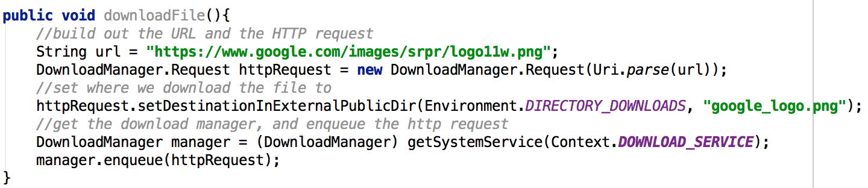
Example: Downloading a file (Android)

Slide 12
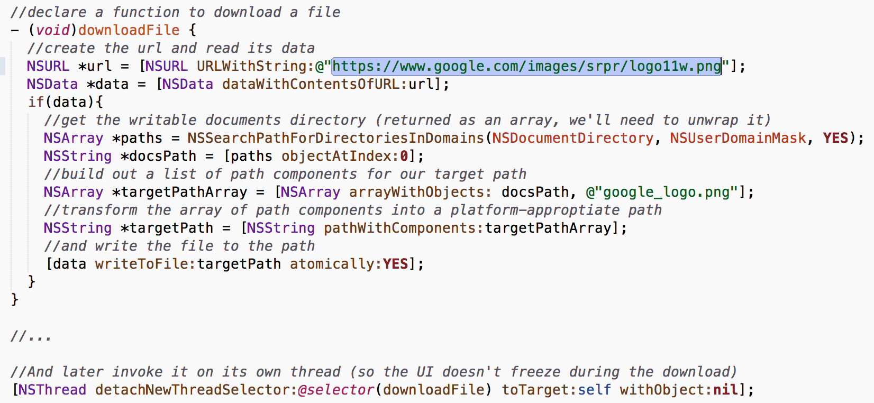
Example: Downloading a file (iOS)

Slide 13
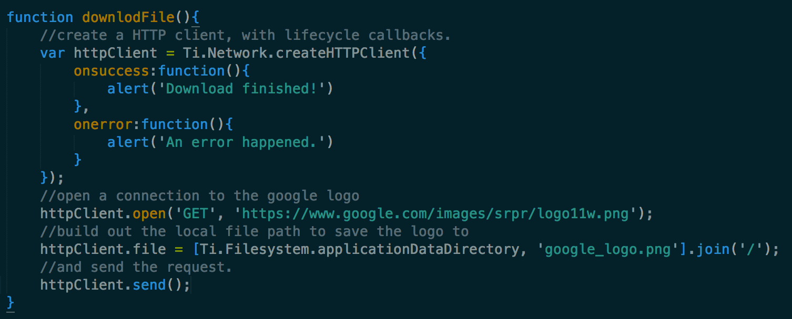
Example: Downloading a file (Ti)

Slide 14
What components are available to me?
API Documentation provided at:
http://docs.appcelerator.com/titanium/3.0/
UI Elements
Geolocation
Networking
Media Playback
Streams
Filesystem Access
Gesture Support
….

Slide 15
Example: UI Elements

Slide 16
Example: UI Animations

Slide 17
Example: Network Calls

Slide 18
Example: Media

Slide 19
Example: Geolocation

Slide 20
Adding structure with Titanium Alloy

Slide 21
What is MVC?
Software architectural pattern for implementing user interfaces.
Divides a given software application into three interconnected parts:
Model
View
Controller

Slide 22
Titanium Alloy Structure
The project is divided into three main folders
Views
Styles
Controllers

Slide 23
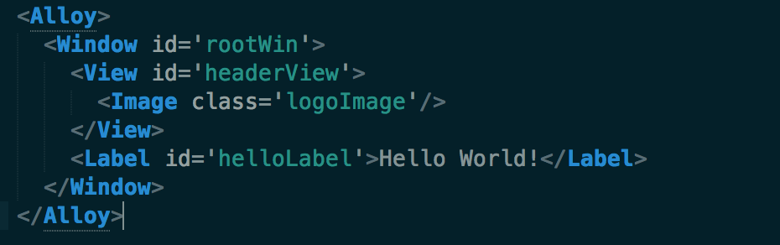
Views
XML
Describes the basic UI structure of an alloy project

Slide 24
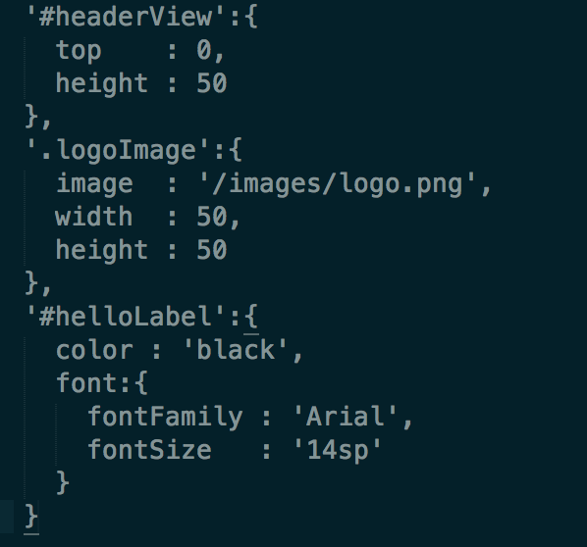
Styles
TSS (Titanium Style Sheets)
Defines the style of UI components
Like CSS, supports styling by id or class

Slide 25
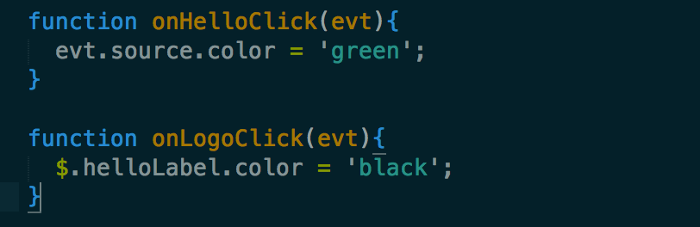
Controllers
Contains the business logic of the application
Used to manipulate the UI defined in the XML
Can create classic Titanium elements and add them to the View hierarchy

Slide 26
CommonJS Libraries
Existing JS libraries can be used with Titanium
Great for components that are used by multiple controllers
Alloy includes several built-ins:
-BackboneJS
-MomentJS
-UnderscoreJS

Slide 27
Widgets
Encourages code reuse
Use a component in multiple projects
Distribute your components for the benefit of others
Make use of components others have created

Slide 28
Themes
Allow you to create different UI for multiple applications that should behave the same way
Has a self-contained MVC structure
Will merge with base styles to create fully realized app-specific styles

Slide 29
Platform Specific Nuances

Slide 30
Why do platform specific code?
Android and iOS users expect different things.
Popovers (iOS)
Hardware back button (Android)
Pickers
Icons

Slide 31
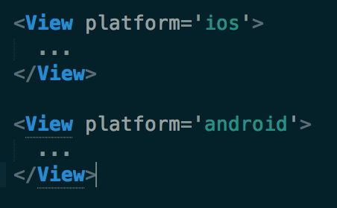
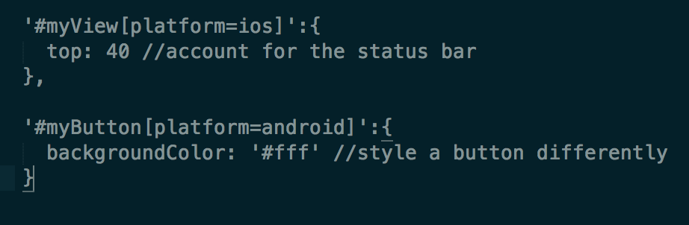
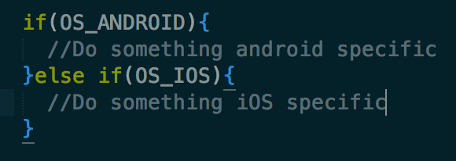
How?
XML
TSS
JS

Slide 32
Modules
Native code that can be used from your Titanium code
Advantages
Performance
Functionality
Disadvantages
Same as native development

Slide 33
Questions?

Slide 34
Who were those guys?
Bruce Pulley (@pulleymb)
bruce@shockoe.com
Senior Mobile Applications Developer
Andrew Rumbley (@rumbleyam)
andrew@shockoe.com
Senior Mobile and Web Applications Developer
Shockoe.com LLC,
Taming the Mobile Monster

