Slide 1

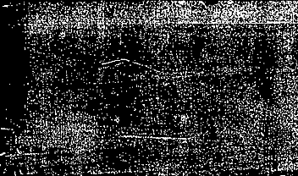
Development of a Novel Deep Learning Framework for Differentiating Functional Connectomes in Schizophrenia Using Resting-State Functional MRI
BLESSEN KOSHY SUJAN (23645007)
MSc Data Science
Department of Computing and Mathematics
Manchester Metropolitan University
September 2024

Slide 2

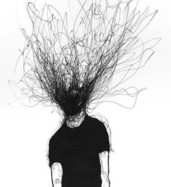
INTRODUCTION
Schizophrenia is a chronic and severe mental disorder that affects how a person thinks, feels, or behave.
About 1% of the world’s population is affected.
Current diagnostics rely on subjective clinical evaluations and misdiagnosis leads to delay in treatments.
fMRI and deep learning offer more objective insights.
Objective: Classify schizophrenia patients using functional connectivity from Rs-fMRI with a novel CNN-LSTM model.

Slide 3

Problem Definition & Aims
Problem: Misdiagnosis due to subjective evaluations and variability in brain activity.
Aims:
Develop a 2D CNN-LSTM framework to classify schizophrenia using the COBRE dataset.
Compare the model with existing techniques and improve diagnostic accuracy.
Use saliency maps for interpretability.

Slide 4
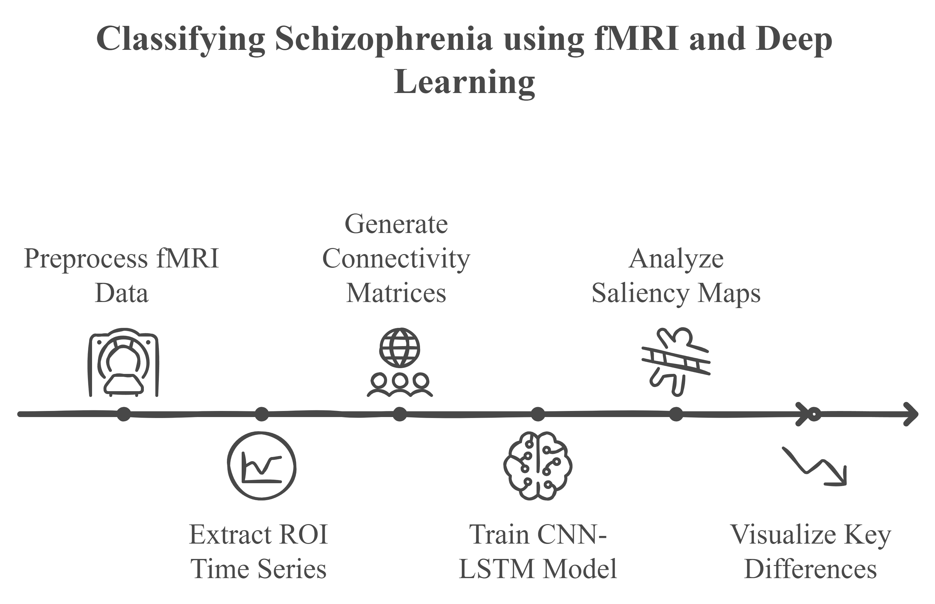
Dataset & Methodology
Dataset: COBRE pre-processed dataset with 146 subjects (72 schizophrenia, 74 healthy controls) from figshare.com
Preprocessing (Normalization, Motion Correction, Scrubbing).
Region of Interest (ROI) Extraction using AAL Atlas.
Generate Connectivity Matrices (Pearson Correlation).
Model training using 2D CNN-LSTM architecture.
Saliency Maps and Visualizations

Slide 5
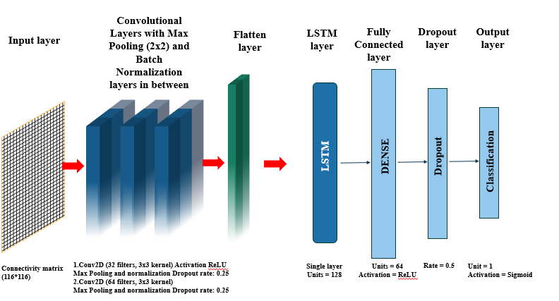
Model Design
CNN extracts spatial features from connectivity matrices.
LSTM captures temporal dependencies between brain regions.
Fully connected layers for final classification (Schizophrenia vs. Healthy).

Slide 6
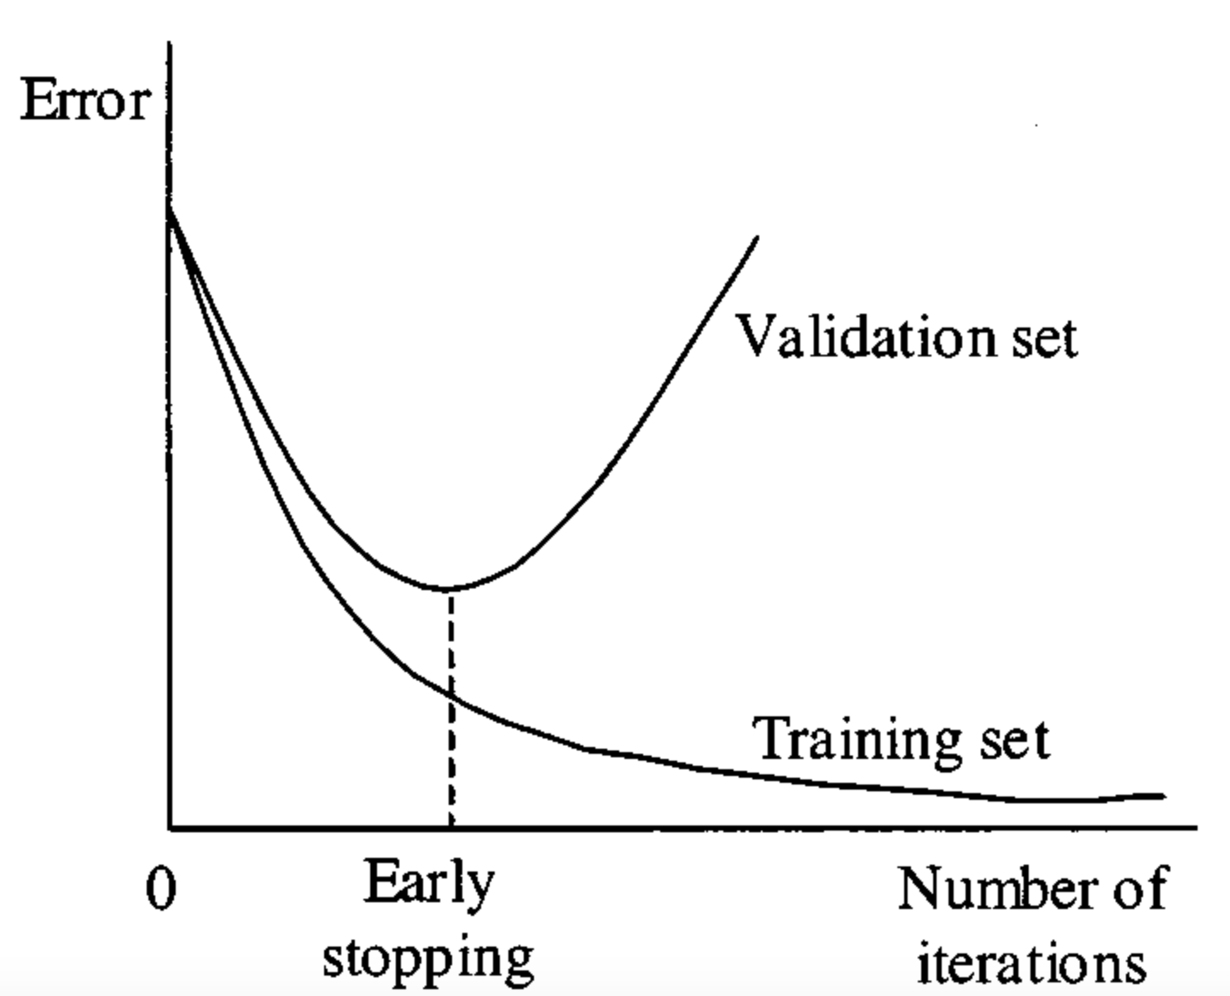

Model Training
To reduce overfitting regularization techniques were implemented:
Early Stopping with patience level of 5
ReduceLROnPlateau with factor 0.1 also at patience 5.
Optimizer: Adam
Loss Function: Binary Cross Entropy

Slide 7

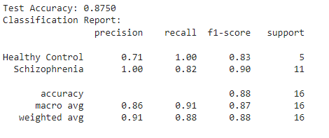
Model Performance
Accuracy: 87.5%
Precision: 71% for healthy controls, 100% for schizophrenia.
Recall: 100% for healthy controls, 82% for schizophrenia.
F1 Score: 0.83 for healthy and 0.90 for schizophrenia
AUC-ROC: 0.9818 (Excellent classification across thresholds).

Slide 8
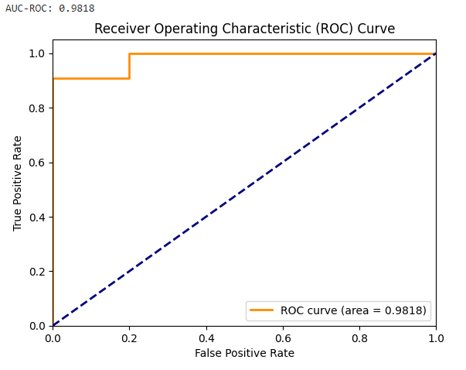
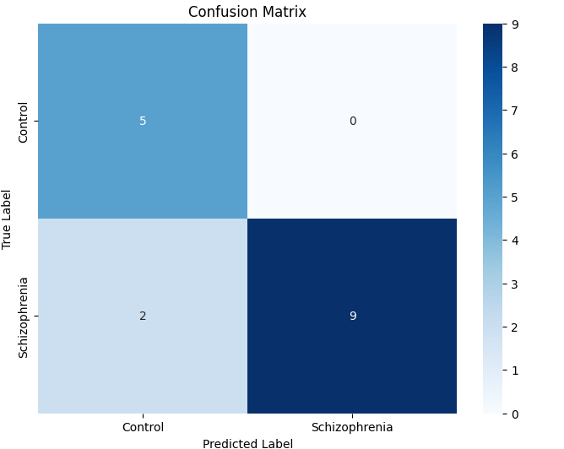
Confusion Matrix and auc-roc curve
No healthy individuals were misclassified as having schizophrenia (0 False Negatives).
The model incorrectly classified 2 schizophrenia patients as healthy (False Positives).
The closeness to 1.0 indicates the model was excellent in identifying and predicting SZ vs HC.

Slide 9
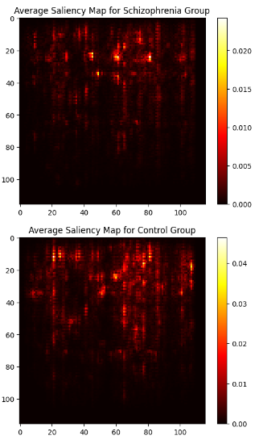
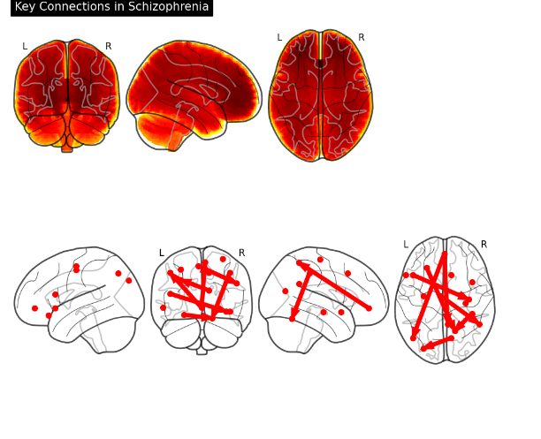
Saliency Maps for Interpretability
Saliency Maps: Highlight key brain regions contributing to classification.
Helps interpret model decisions by identifying the most affected regions in schizophrenia.

Slide 10
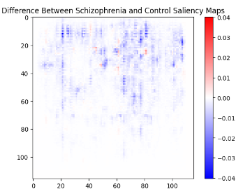
Saliency map as validation
Relevance to Previous Studies: Saliency maps highlight connections like Frontal_Inf_Oper_L to Hippocampus_R and Frontal_Inf_Tri_L to Temporal_Sup_R, confirming the role of the frontal regions and memory dysfunction in schizophrenia (Chatterjee et al., 2019).
Memory and Emotion Processing: Connections such as Frontal_Mid_Orb_R to Amygdala_R emphasize the importance of the hippocampus and amygdala in emotional and memory processing (Kim et al., 2019).
Auditory Processing Deficiencies: Involvement of the superior temporal gyrus and Heschl’s gyrus aligns with research on auditory processing issues and schizophrenia-related delusions (van Erp et al., 2018).
Focus on Cognition and Emotion: Key regions in the saliency maps (frontal, parietal, and hippocampal areas) emphasize cognitive, sensory, and emotional regulation, suggesting potential for novel studies on these underexplored areas.
Difference Maps: Highlight critical contributions of the frontal cortex, temporal lobe, and hippocampus, differentiating schizophrenia patients from healthy controls.

Slide 11
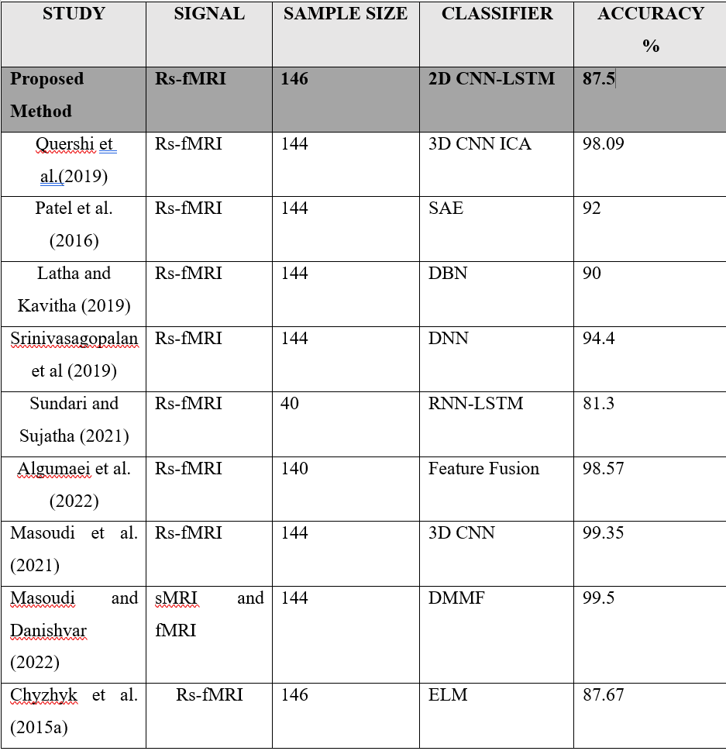
Model Comparison
Even though the proposed model has lower accuracy compared to prior studies, this is a novel approach in the domain to apply CNN-LSTM layers to rs-fMRI data, which will inspire others to do procced further work on this architecture in the domain. Additionally, many promising discoveries were obtained from the study.

Slide 12

Key Findings
CNN-LSTM Integration: Combines CNN for spatial pattern extraction and LSTM for capturing long-range temporal dependencies in brain connectivity.
ROI Extraction: Focuses on biologically meaningful brain regions using the AAL atlas, improving interpretability and reducing complexity.
Saliency Maps: Enhances model interpretability by highlighting key brain regions (e.g., prefrontal cortex, hippocampus) aligned with neuroscientific research.
Model Performance: Achieved strong accuracy, precision, recall, F1-score, and AUC-ROC through effective validation and regularization techniques.
Real-World Relevance: Focus on schizophrenia and functional connectivity mirrors clinical methods, with potential applications in diagnosis and treatment planning.

Slide 13
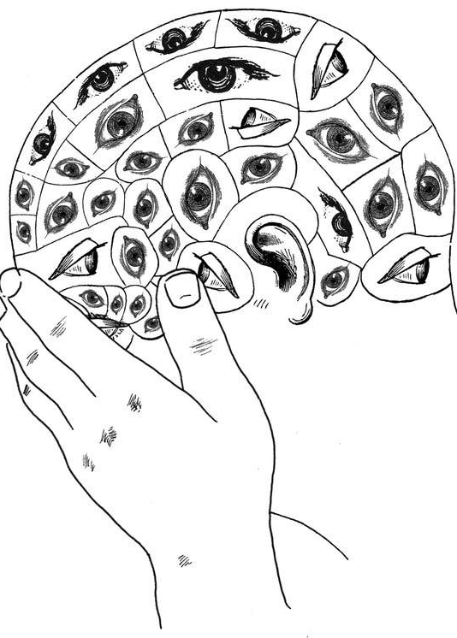
Challenges & Limitations
Small and Imbalanced Dataset: More schizophrenia cases than healthy controls may skew predictions.
Limited Sample Size: Reduced ability to capture variability in brain connectivity, affecting generalization.
Overfitting Issues: Despite Dropout and early stopping, the CNN-LSTM architecture required more data to prevent overfitting.
Interpretability of Saliency Maps: While useful, they did not always provide clear insights into the model’s decision-making.
Clinical Application Challenges: The need for clearer AI decision explanations for practical use in diagnostics.

Slide 14
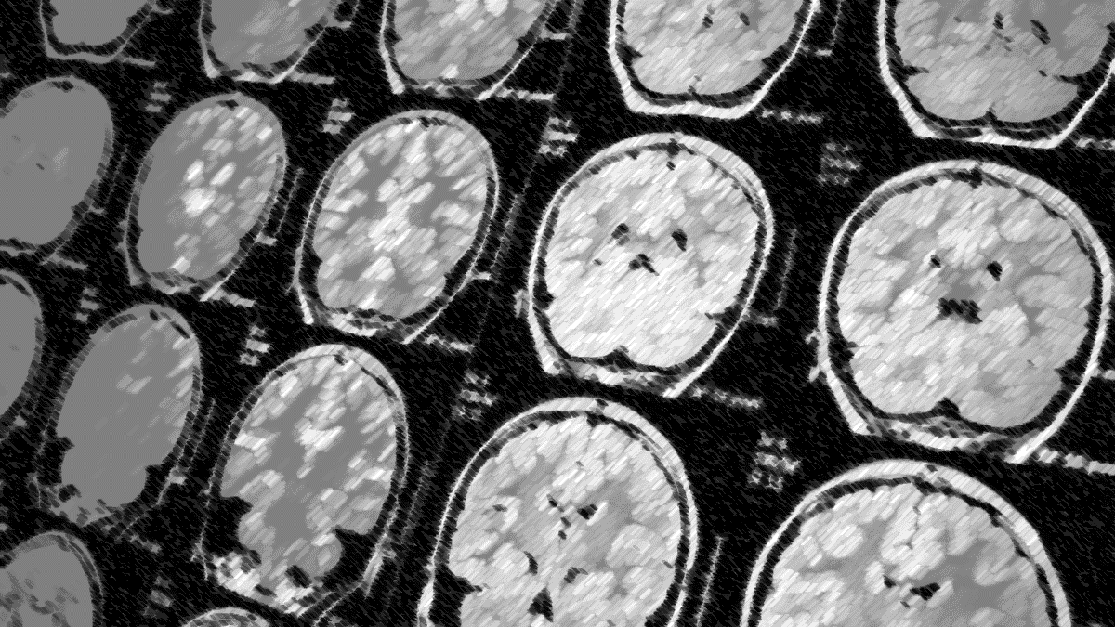
Future Work
Integrate Multi-Modal Data: Combine fMRI with structural MRI and EEG for comprehensive brain activity analysis.
Detailed Neurobiological Studies: Use saliency maps to explore the mechanisms of schizophrenia and other disorders.
Refine Model Architecture: Incorporate advanced techniques like attention mechanisms and graph neural networks.
Scale to Larger Datasets: Apply the model to diverse, multi-site datasets to improve generalizability.

Slide 15
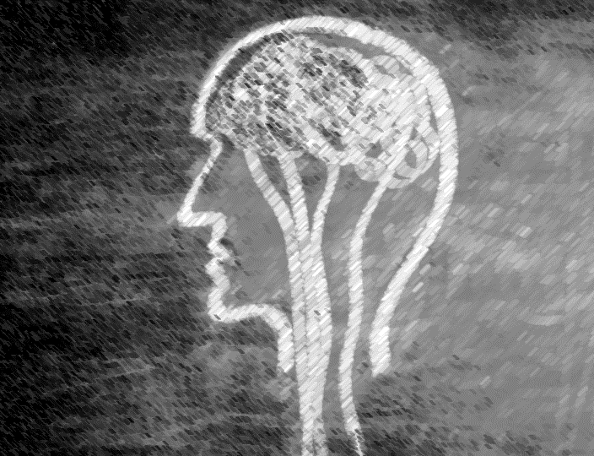
Conclusion
CNN-LSTM model achieved 87.5% accuracy.
Saliency maps add interpretability, aiding in identifying key brain regions.
Model shows promise for clinical applications in early schizophrenia diagnosis.

Slide 16

Acknowledgments
I would like to express my deepest gratitude to my supervisor, Dr. Indranath Chatterjee, for his invaluable guidance, support, and encouragement throughout this project. It was under his insightful supervision that I was introduced to the idea for this research, and his expertise and advice were crucial at every step. His suggestions and feedback have been instrumental in shaping this project and overcoming the challenges I encountered. I am truly grateful for his time, patience, and mentorship, which made this journey a rewarding experience.
I would also like to extend my sincere thanks to Manchester Metropolitan University for providing me with the resources and opportunity to carry out this research. A special thanks to my course leader, Dr. Luciano Gerber, for his continuous support and guidance throughout the course. His leadership and encouragement have been instrumental in helping me navigate the challenges of this project and complete it successfully.
Finally, I would like to thank my family for the constant support and trust.

Slide 17


Questions

