Slide 1
HACKATHON DATA ANALYSIS · ILO / WORLD BANK / UN SDG
Unravelling the Challenges
of Unemployment in Africa
A data-driven analysis of gender disparities, socioeconomic correlation,
and regional gap across 53 African countries | 2015 Snapshot
Blessing Chiagorom | Data Analyst Intern
Tool: Microsoft Excel · Power Query · Pivot Tables · VLOOKUP · CORREL · Conditional Formatting

Slide 2
Executive Summary
Unemployment is not evenly distributed across Africa, and the burden is disproportionately higher among women.
53
11.2%
8.2%
3.1pp
9.7%
Countries Analysed
Avg Female Unemployment
Avg Male Unemployment
Avg Gender Gap
Overall Avg Unemployment
Africa · 2015 snapshot
Continental baseline
Continental baseline
Female minus male
All 53 countries
Key Findings
Djibouti records the continent's highest average unemployment at 29.7% - 3× the continental average of the countries analyzed at 9.7%
Electricity correlation showed a strong positive relationship = 0.27 , which was an interesting fact cause it shouldn’t. The unexpected positive electricity relationship deserves deeper investigation rather than immediate policy conclusions.
Northern Africa female unemployment (21.4%) is more than double Sub-Saharan Africa (9.9%) - a regional structural divide
9 African countries show a reversed gender gap (men more unemployed than women, showing extreme values as outliers
Education correlation showed a weak negative relationship = 0.06 which means the effectiveness education may depend on factors beyond spending levels - such as education quality, skills alignment and economic structure

Slide 3
Introduction
Project Context
Unemployment is one of Africa's most critical socioeconomic challenges. This case study analyses gender disparities, policy maturity gaps and structural economic drivers across 53 African countries using 2015 data from six datasets.
The analysis was undertaken as part of a data analytics hackathon, producing evidence-grounded policy recommendations for governments and development stakeholders.
Six Datasets Used
01
Unemployment by Gender
53 African countries · 2015 · ILO modelled estimates
02
National Youth Employment Strategy
40 countries · 2019–2022 · UN SDG monitoring
Objectives
03
Education Government Expenditure
54 countries · 1980–2021 · % of govt spend
1
Understand the multi-dimensional nature of unemployment in Africa
04
Population with Electricity Access
2
Identify key factors contributing to high unemployment rates
54 countries · 1990–2020 · World Bank
3
Draw insights and correlations through data analysis and visualisation
05
Total Firms — LLC Historical Data
14 matched African countries · 2006–2020
4
Propose evidence-backed, implementable policy recommendations
Country Codes Reference
06
54 African countries · ISO 3166 · Region mapping

Slide 4
Tools & Methodology
01
Data Import via Power Query
02
Africa Filter via Left Outer Merge
03
Calculated Columns Added
Connected all 6 CSV/XLSX files using Get & Transform. Each dataset loaded as a named query with transformation recorded
Trim,
Remove Duplicates,
Renamed Columns,
Changed Type.
Country Codes (Dataset 6) used as reference table. Left Outer join on alpha-3 code column to bring Region/Sub-region into datasets with no geography column to my base dataset(Gender Unemployment)
Gender Gap (Female% − Male%), Average Labour Force Unemployment, Education_group (HIGH/Low via IF), Electricity_group (High/Low via IF), and Strategy_label (0–3 decoded).
04
Cross-Dataset VLOOKUP + CORREL
05
Pivot Tables & Conditional Formatting
06
DATA VISUALIZATION Dashboard
VLOOKUP pulled education spend and electricity access into the unemployment sheet by country code. CORREL computed r = −0.24 (education) and r = +0.52 (electricity).
Six pivot tables on the Africa 2015 Analysis sheet. Conditional formatting applied to Education Group and Electricity Group comparison tables.
GETPIVOTDATA formulas feed 5 KPI cards. 6 native Excel charts with consistent colour scheme. Dashboard sheet serves as the project deliverable.

Slide 5
Analysis 1: Gender Unemployment — Top 10 Average Unemployment
Female vs male unemployment rate (%)
36.6%
Djibouti female
unemployment - highest in Africa
23.2%
South Africa male
unemployment - highest male rate
3.1pp
Continental average
gender gap (female - male)

Slide 6
Analysis 2: Gender Gap & Regional Comparison
Top gender disparities and how unemployment splits between Northern and Sub-Saharan Africa

Slide 7
Analysis 4: Education vs Unemployment
Education expenditure shows a weak negative relationship with unemployment (R² ≈ 0.06), suggesting that education spending alone explains little of the variation in unemployment across the analyzed countries.

Slide 8
Analysis 5: Electricity vs Unemployment
Electricity access shows a strong positive association with unemployment. (R² ≈ 0.27). This relationship is observational and it not interpreted as evidence that electricity access increases unemployment, instead it raises questions about other structural factors.
Why is the relationship positive? Reasons might include;
1) 2015 cross-sectional sample may not capture infrastructure effects over time.
2) Countries with higher infrastructure may also have large urban population and more formal labor market pressures.
So the result should be treated as a signal for further investigation, not a policy conclusion.

Slide 9
Analysis 6: Cross-Dataset Analysis
Conditional formatting table (Excel) · Education Group & Electricity Group pivot results
Country | Avg Unemp % | Edu Spend % | Electricity % | Edu Group
Djibouti | 29.7% | 8.6% | 57.6% | Low Investment
South Africa | 25.4% | 18.7% | 85.3% | HIGH Investment
Lesotho | 24.0% | 14.0% | 31.7% | Low Investment
Gabon | 21.9% | 10.9% | 87.4% | Low Investment
Egypt | 17.0% | 11.9% | 99.3% | Low Investment
Cape Verde | 11.9% | 16.8% | 86.4% | HIGH Investment
Morocco | 9.8% | 4.7% | 97.3% | Low Investment
Ghana | 6.8% | 23.8% | 74.1% | HIGH Investment
Kenya | 2.8% | 16.7% | 41.6% | HIGH Investment
Ethiopia | 2.3% | 27.1% | 29.0% | HIGH Investment
Niger | 0.5% | 18.5% | 16.6% | HIGH Investment
Burundi | 1.6% | 27.5% | 8.4% | HIGH Investment
Conditional Formatting Key:
> 16% High risk
10–20% Moderate
< 10% Low

Slide 10
Analysis 7: Extreme Gender Gap
Conditional formatting table (Excel) · 9 Countries with extreme gender gap value (outliers) are number of men more unemployed than women
Country | Avg Unemp % Female | Avg Unemp % male | Gender Gap (pp)
Niger | 0.44 | 0.60 | -0.16
Ghana | 6.58 | 7.01 | -0.44
Guinea | 4.71 | 5.17 | -0.46
Liberia | 1.79 | 2.34 | -0.56
Chad | 0.70 | 1.33 | -0.64
Burundi | 1.19 | 2.04 | -0.86
Togo | 1.68 | 2.68 | -1.00
Democratic Republic of Congo | 3.67 | 5.19 | -1.52
Sierra Leone | 3.91 | 5.57 | -1.66
9 Countries with Reversed Gap — men more unemployed than women
Niger · Ghana · Guinea · Liberia · Chad · Burundi · Togo · DR Congo · Sierra Leone
Likely reflects female participation in informal/agricultural labour invisible to ILO formal measurement

Slide 11
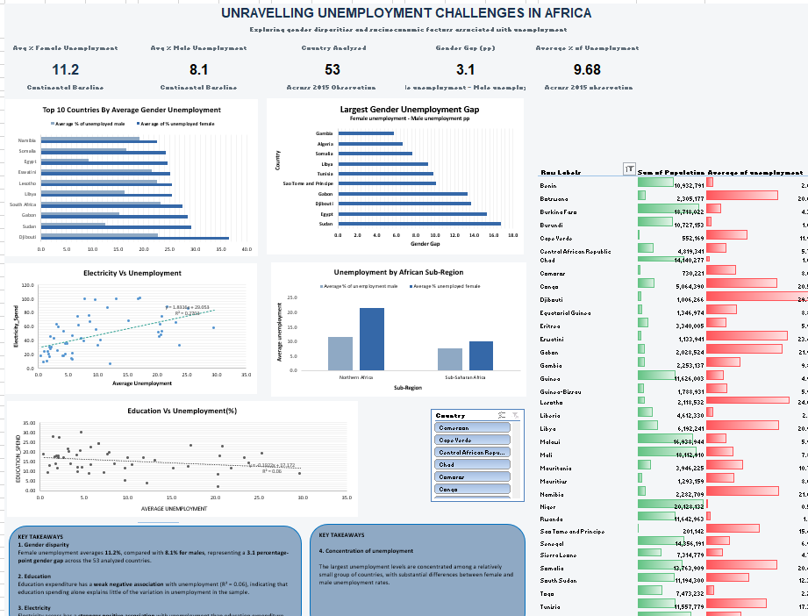
EXCEL DASHBOARD

Slide 12
Key Insights
Six evidence-grounded findings from the Africa 2015 analysis
Women bear a 3pp higher unemployment burden (11.2% female vs 8.2% male) across all 53 African countries in 2015.
Northern Africa female unemployment (21.4%) is more than 2× Sub-Saharan Africa (9.9%) - despite stronger youth strategy frameworks in the North.
1
4
Djibouti's average unemployment of 29.7% is 3× the continental baseline female at 36.6%, male at 22.8% - a structural crisis.
The effectiveness of education investment may depend on factors beyond spending levels - such as education quality, skills alignment, economic structure and the availability of jobs cause the relationship on the chart poses a weak evidence.
2
5
Sudan's gender gap of 16.7pp is Africa's widest. Egypt follows at 15.3pp, pointing to severe female formal employment barriers in Northern Africa.
Electricity access shows counterintuitive, high-access countries have larger formal economies where unemployment is formally measured and captured.
3
6

Slide 13
Recommendations
Four data-grounded policy recommendations for governments and development stakeholders
01
02
03
04
High-gap country governments
Ministries of Education
Govts & electricity access
Countries specific strategies
Target female employment barriers in highest gender-gap countries
Focus on education quality, not just expenditure
Invest in electricity access as employment infrastructure
Develop country-specific strategies
Because female unemployment is consistently higher than male unemployment, policymakers should investigate barriers affecting women's labor force participation, employment access and retention.
Sudan (16.7pp), Egypt (15.3pp) and Djibouti (13.7pp) require gender-responsive interventions: subsidised childcare, legal reforms removing employment restrictions, and vocational training for women entering formal work.
The weak education vs unemployment relationship suggests that spending levels alone may not translate into employment outcomes. Africa spends 15.4% of govt budgets on education matching the global average yet unemployment persists
Future analysis should examine:
vocational training
STEM participation
employability skills
education quality
school-to-work transition
The unexpected positive electricity relationship deserves deeper investigation rather than immediate policy conclusions.
Future analysis should incorporate:
GDP per capita
industrialization
urbanization
electricity reliability
manufacturing employment
labor-force participation
The large variation between countries means that a single unemployment intervention may not work equally well across Africa.
.

Slide 14
Limitations & Conclusion
Dataset Limitations
Conclusion
Single-year unemployment snapshot
This analysis of six datasets across 53 African countries confirms that Africa's unemployment challenge is heterogeneous.
Gender disparities are substantial, while socioeconomic factors such as education spending and electricity access show different and relatively limited explanatory relationships with unemployment.
This suggests that unemployment policy needs to consider country-specific labor markets, gender barriers, economic structure and the transition from investment to actual job creation.
Dataset 1 covers 2015 only, no trend analysis possible.
Missing and absent countries
8 countries missing from unemployment dataset which was my base dataset.
Year mismatches across datasets
Unemployment = 2015; Strategy = 2019–2022; Electricity = 1990–2020. Cross-dataset comparisons are approximate, not simultaneous.
Informal economy bias
ILO estimates capture only formal job seekers. Niger (0.5%) and Chad (1.0%) low rates reflect informality, not employment success.
Correlation does not equal causation
r = +0.52 and r = −0.24 describe relationships only.
LLC data - formal sector only
Firms dataset counts only registered LLCs. Significantly understates entrepreneurial activity in high-informality economies.
Thank you — ready to discuss findings, methodology and any panel questions.
10 / 10

