Slide 1
A data-driven approach to retail sales planning
ROSSMANN
STORES
01 Understand demand
SIX WEEKS AHEAD
02 Identify seasonality
A TIME SERIES ANALYSIS
CASE STUDY
03 Compare forecasting models
PRESENTED BY THE POD GROUP
04 Support business decisions
Store 800 • 942 daily records
January 2013 – July 2015
01 / 29
Notes:
Introduce the project. We focused on Rossmann Store 800 to develop a practical six-week daily sales forecast. Explain that the presentation follows the analysis from exploration through evaluation and recommendations.

Slide 2
1.1 Overview
Retail industry
Real-world data
Time series
Business value
Daily store-level demand
Observed sales and calendar flags
Trend, seasonality, and variability
Staffing and inventory planning
Purpose
Develop a reproducible six-week sales forecasting approach for Rossmann Store 800 and compare it against simple benchmarks.
ROSSMANN / STORE 800
POD GROUP
02 / 29
Notes:
Introduce the project. We focused on Rossmann Store 800 to develop a practical six-week daily sales forecast. Explain that the presentation follows the analysis from exploration through evaluation and recommendations.

Slide 3
1.2 Business Problem
Why accuracy matters
The challenge
Unpredictable sales create operational challenges: stock shortages, excess inventory, inefficient staffing and inconsistent planning.
Weekly cycles, promotions, holidays and store closures change daily sales.
The analytical response
Compare forecasting methods fairly and recommend a model only if it improves on a simple seasonal benchmark.
ROSSMANN / STORE 800
POD GROUP
03 / 29
Notes:
Explain why reliable sales forecasts matter. Inaccurate forecasts may cause stock shortages, excess inventory or inefficient staffing. We evaluate whether statistical forecasting adds value beyond simpler methods.

Slide 4
1.3 Project Objectives
01
Prepare and explore historical daily sales
02
Identify trends, weekly seasonality and calendar effects
03
Test stationarity; examine ACF and PACF
04
Develop and compare baseline and SARIMA forecasts
05
Evaluate MAE, RMSE, residuals and rolling backtests
06
Produce a six-week forecast and Interpretation of Findings
ROSSMANN / STORE 800
POD GROUP
04 / 29
Notes:
Explain why reliable sales forecasts matter. Inaccurate forecasts may cause stock shortages, excess inventory or inefficient staffing. We evaluate whether statistical forecasting adds value beyond simpler methods.

Slide 5
2.0 Data Overview
1,115
Data fields
Stores in source dataset
▸
Date and Sales
942
▸
Store operating status
Daily records — Store 800
▸
Promotions
2013–2015
▸
State and school holidays
Observation period
4,157,860
▸
Day of week
Total sales — Store 800
ROSSMANN / STORE 800
POD GROUP
05 / 29
Notes:
The original data covered many stores, but our analysis focuses on Store 800. We checked completeness, unique dates, and inconsistent holiday coding. We did not remove matching records simply because two different days had identical values.

Slide 6
2.1 Data Preparation
01 Clean
02 Format
Review missing and duplicate records
Convert dates and standardize categories
03 Order
04 Split
Sort observations chronologically
Preserve time order for evaluation
ROSSMANN / STORE 800
POD GROUP
06 / 29
Notes:
The original data covered many stores, but our analysis focuses on Store 800. We checked completeness, unique dates, and inconsistent holiday coding. We did not remove matching records simply because two different days had identical values.

Slide 7
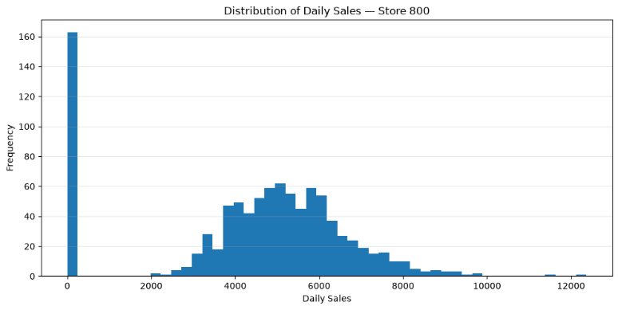
2.2 Sales Distribution and Outliers
Key observations
Average daily sales: 4,413.86
Zero-sales days: 163
Sales concentrate in the middle range, with occasional high spikes.
ROSSMANN / STORE 800
POD GROUP
07 / 29
Notes:
Discuss the histogram and box plot. Most daily sales are around 3,000 to 7,000. The zero-sales observations are legitimate closures, not errors. High-sales outliers should be examined in their business context.

Slide 8
2.3 Store Operations
Operating status
82.7% of days: open
17.3% of days: closed
Average sales on open days: 5,337.43
Closed days recorded zero sales.
ROSSMANN / STORE 800
POD GROUP
08 / 29
Notes:
The store generated all recorded sales on open days. Closure days are important when designing forecasts. The promotional association does not prove promotions caused higher sales.

Slide 9
2.3 Promotion Impact
Promotion effect
3,427.26
Average sales without promotion
6,008.87
Average sales with promotion
52.03% of sales occurred on promotional days.
ROSSMANN / STORE 800
POD GROUP
09 / 29
Notes:
Highlight the descriptive comparisons. These results show associations, not causal effects. Public, Easter and Christmas holiday categories had zero recorded sales in this store and often coincide with closure.

Slide 10
2.4 Holidays and Special Events
Holiday patterns
Public, Easter and Christmas holidays recorded zero sales in this store sample.
School-holiday days had higher average sales than other days.
Interpret associations cautiously.
ROSSMANN / STORE 800
POD GROUP
10 / 29
Notes:
Highlight the descriptive comparisons. These results show associations, not causal effects. Public, Easter and Christmas holiday categories had zero recorded sales in this store and often coincide with closure.

Slide 11
2.5 Sales Pattern by Day of Week
Weekly cycle
Monday has the highest average sales.
Sunday sales are zero.
This supports a seven-day seasonal pattern.
ROSSMANN / STORE 800
POD GROUP
11 / 29
Notes:
Walk through the weekday plot. Monday had the highest average recorded sales, while Sundays were closed. This repeating pattern motivates a seasonal forecasting approach with a seven-day period.

Slide 12
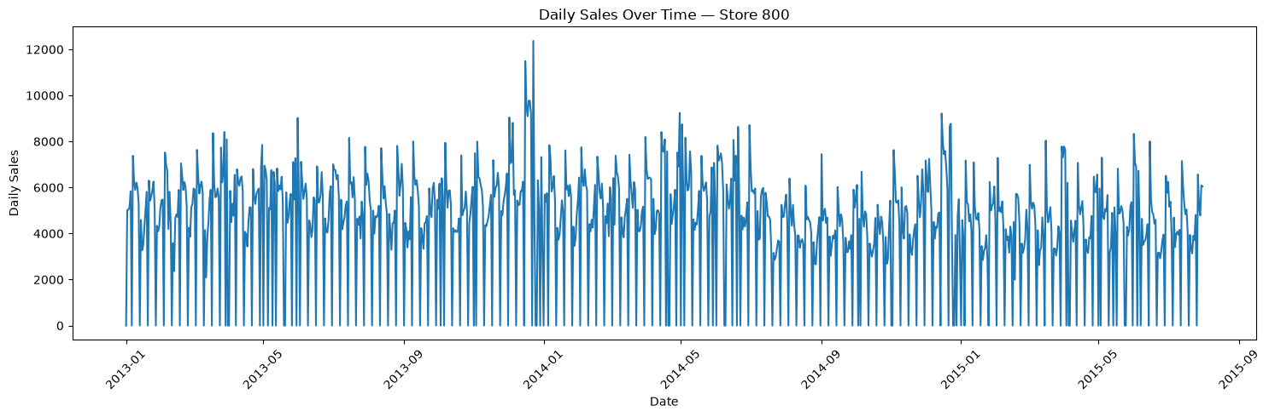
2.6 Trend and Seasonality
ROSSMANN / STORE 800
POD GROUP
12 / 29
Notes:
Explain the additive seven-day decomposition. It separates observed sales into trend, seasonal and residual components. Weekly seasonality is prominent, but there are also fluctuations that the decomposition does not explain.

Slide 13
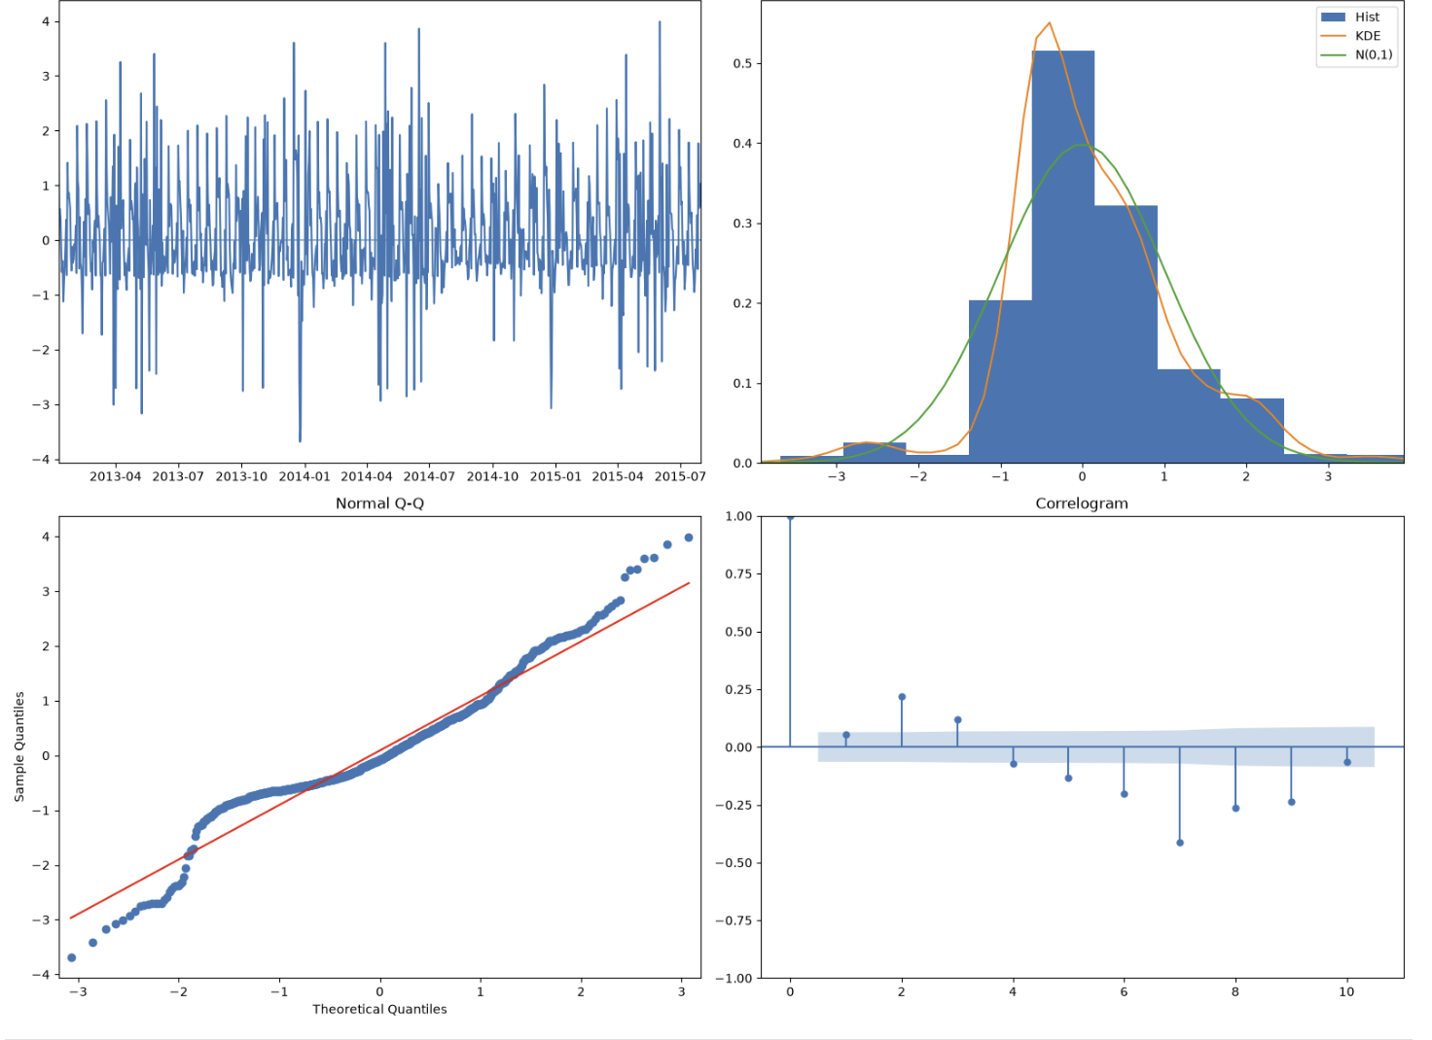
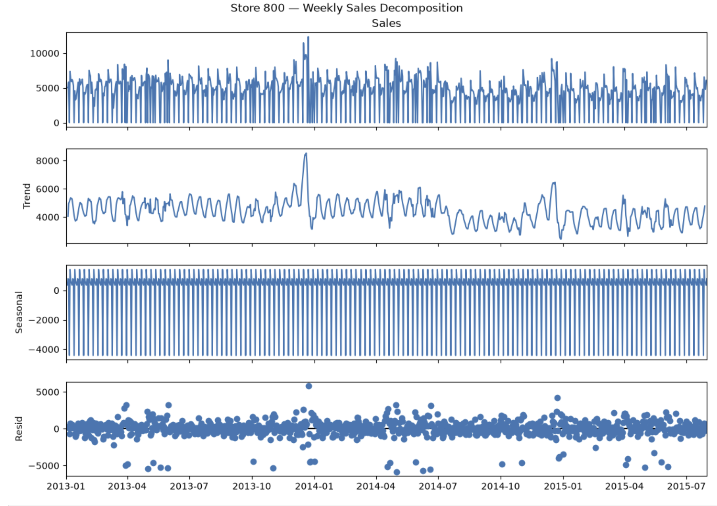
2.8 Detecting Stationarity and Time Series Diagnostics
STORE 800 DAILY SALES
ADF statistic
−3.6074
p-value
0.0056
Reject the unit-root null at 5%. Diagnostic plots also indicate non-normality and autocorrelation.
ROSSMANN / STORE 800
PRESENTED BY THE POD GROUP
13 / 29
Notes:
This slide reproduces Figure 2.8.1 from Section 2.8 of the uploaded Documentation(2).docx. The ADF test on Store 800 daily sales data reports statistic -3.6074 and p-value 0.0056. The report interprets this as evidence against a unit root. The associated diagnostic plots show standardized fluctuations around zero, non-normality and remaining autocorrelation.

Slide 14
2.9 Baseline Forecasting Results and Interpretation
MODEL
MAE
RMSE
Seasonal Naive
1,004.83
1,479.89
Naive
1,449.17
1,976.13
Drift
1,450.92
1,993.41
Moving Average
1,471.68
2,019.25
Key finding: Seasonal Naive had the lowest MAE and RMSE among all four baseline models.
ROSSMANN / STORE 800
POD GROUP
14 / 29
Notes:
This slide compares four baseline approaches on the same 42-day test period. Seasonal Naive was the strongest baseline, with MAE of 1,004.83 and RMSE of 1,479.89. It uses the value from the corresponding weekday one week earlier, so it captures the strong weekly operating cycle. Naive, Drift and Moving Average all had higher errors. This baseline is an important benchmark when judging whether the added complexity of SARIMA is worthwhile. On the single holdout, Seasonal Naive had lower MAE than SARIMA, while SARIMA had lower RMSE. The separate rolling-origin evaluation favored SARIMA on both metrics.

Slide 15
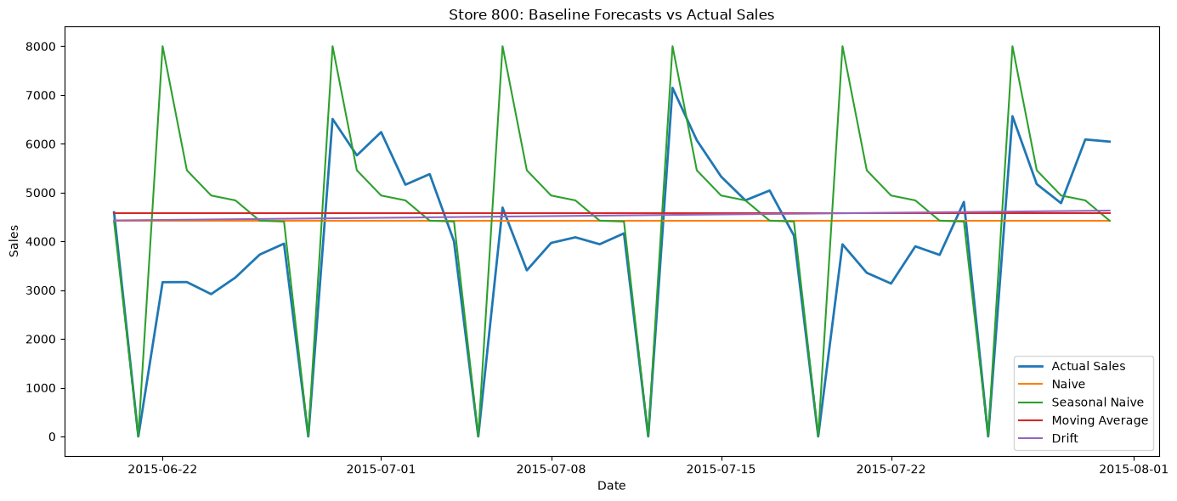
2.9 Actual Sales vs. Baseline Forecasts
Store 800 — Naive, Seasonal Naive, Moving Average and Drift forecasts against actual daily sales
ROSSMANN / STORE 800
PRESENTED BY THE POD GROUP
15 / 29
Notes:
This chart is reproduced from the project documentation. Four simple forecasting methods were tested on the same 42-day holdout. Seasonal Naive had the lowest MAE (1,004.83) and RMSE (1,479.89) among the four baselines. It captures the strong seven-day operating cycle, including Sunday closures.

Slide 16
3.1 Training and Testing Data
01 PREPARE
02 TRAIN
03 VALIDATE
Clean and sort Store 800 daily observations.
Use first 900 days for model fitting.
Hold out final 42 days; do not shuffle dates.
04 COMPARE
05 CHECK
06 FORECAST
Evaluate simple baselines against SARIMA.
Inspect residuals and rolling-origin results.
Generate historical 42-day forecast; set Sundays to zero.
ROSSMANN / STORE 800
PRESENTED BY THE POD GROUP
16 / 29
Notes:
We retained chronological order, using 900 observations for training and the final 42 days for testing. This avoids future information leaking into training. We compare baselines with SARIMA, then inspect diagnostics and rolling-origin performance before preparing the final historical six-week forecast.

Slide 17
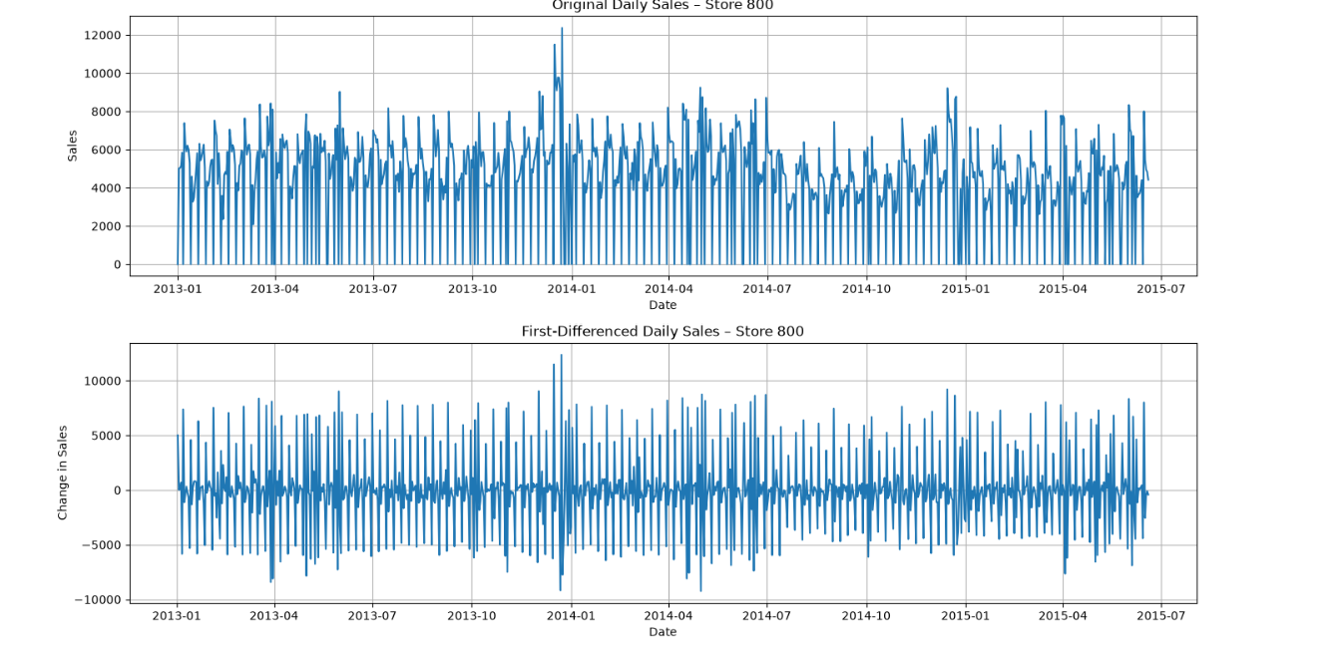
3.1 Training and Testing Data — Differencing
TRAINING-SERIES ADF
Original
p = 0.003323
First difference
p = 9.27 × 10⁻²²
Auto-ARIMA selected d = 1 although differencing tests suggested d = 0.
ROSSMANN / STORE 800
PRESENTED BY THE POD GROUP
17 / 29
Notes:
Training-series ADF test: original ADF statistic -3.7618, p=0.003323; first-differenced statistic -11.8023, p=9.27 × 10^-22. Both reject the unit-root null at 5%. pmdarima differencing tests suggested d=0 and D=0, while Auto-ARIMA selected SARIMA(5,1,0)(2,0,0)[7] with d=1 using its model-selection procedure. This does not mean the original series definitely required differencing. Distinguish these training-series results from Section 2.8 Store 800 overall-data ADF statistic -3.6074, p=0.0056.

Slide 18

3.2 ACF and PACF Analysis
Model selection
ACF peaks at multiples of 7.
Selected SARIMA:
(5,1,0)(2,0,0)[7]
AIC: 16,006.271
ROSSMANN / STORE 800
POD GROUP
18 / 29
Notes:
Explain that the ACF/PACF helped identify weekly seasonal structure. Auto ARIMA compared model candidates using AIC. Lower AIC favors fit relative to complexity, but does not guarantee better out-of-sample forecasts.

Slide 19
3.3 Model Identification and Alternative Models
SELECTED MODEL
WHAT THE PARAMETERS MEAN
SARIMA (5,1,0)(2,0,0)[7]
AIC: 16,006.271
The seasonal period of 7 reflects the weekly sales cycle.
p=5, d=1, q=0; seasonal P=2, D=0, Q=0; m=7.
WHY d=1?
The original ADF test rejects a unit root (p=0.003323). Auto-ARIMA still selected d=1 through its model-selection process; ADF and model selection answer different questions.
ROSSMANN / STORE 800
PRESENTED BY THE POD GROUP
19 / 29
Notes:
Auto-ARIMA selected SARIMA (5,1,0)(2,0,0) with weekly seasonality and AIC 16,006.271. The original training ADF p-value of 0.003323 rejects a unit root, so do not claim differencing was required by the ADF test. Auto-ARIMA nevertheless selected d=1 as part of its search. AIC is a model-selection criterion, not proof of forecasting superiority.

Slide 20
3.5 Forecast Evaluation — MAE and RMSE
MAE | Mean Absolute Error
RMSE | Root Mean Squared Error
Average absolute distance between predicted and actual sales.
Easy to interpret in daily sales units.
Less sensitive to large individual errors.
Squares errors before averaging and taking the square root.
Penalizes unusually large forecast misses more heavily.
Models can rank differently on MAE and RMSE.
Lower is better for both metrics. Always compare on the same test window.
ROSSMANN / STORE 800
PRESENTED BY THE POD GROUP
20 / 29
Notes:
MAE summarizes the average size of forecast errors. RMSE puts more weight on large misses. On the 42-day holdout, Seasonal Naive has lower MAE, while SARIMA has lower RMSE. Both are useful and neither metric should be ignored.

Slide 21
3.5.1 Interpreting Model Performance
Different tests, different winners
42-day holdout vs. seven-day rolling-origin windows
SARIMA
MAE 1,109.17
RMSE 1,397.67
Seasonal Naive
MAE 1,463.90
RMSE 1,994.23
Neither model won every test. Compare the same forecast horizon and metric before selecting a winner.
ROSSMANN / STORE 800
POD GROUP
21 / 29
Notes:
Rolling-origin validation used nine seven-day windows, stepped 28 days apart. SARIMA average MAE 1109.17 and RMSE 1397.67; Seasonal Naive average MAE 1463.90 and RMSE 1994.23. These results are separate from the single 42-day holdout; do not mix the two evaluation designs.

Slide 22
3.5.1 SARIMA vs. Baseline Models — 42-Day Holdout
Model
MAE
RMSE
Seasonal Naive
1,004.83
1,479.89
SARIMA
1,187.07
1,431.29
Naive
1,449.17
1,976.13
Drift
1,450.92
1,993.41
Moving Average
1,471.68
2,019.25
NO UNANIMOUS WINNER: Seasonal Naive leads holdout MAE; SARIMA leads holdout RMSE and rolling averages.
ROSSMANN / STORE 800
PRESENTED BY THE POD GROUP
22 / 29
Notes:
Neither model won every evaluation. On the 42-day holdout, Seasonal Naive had lower MAE (1004.83 vs SARIMA 1187.07), but SARIMA had lower RMSE (1431.29 vs 1479.89). Across nine rolling seven-day windows, SARIMA had better average MAE and RMSE. This mixed result is a central project finding, and is why we retain the simple benchmark.

Slide 23
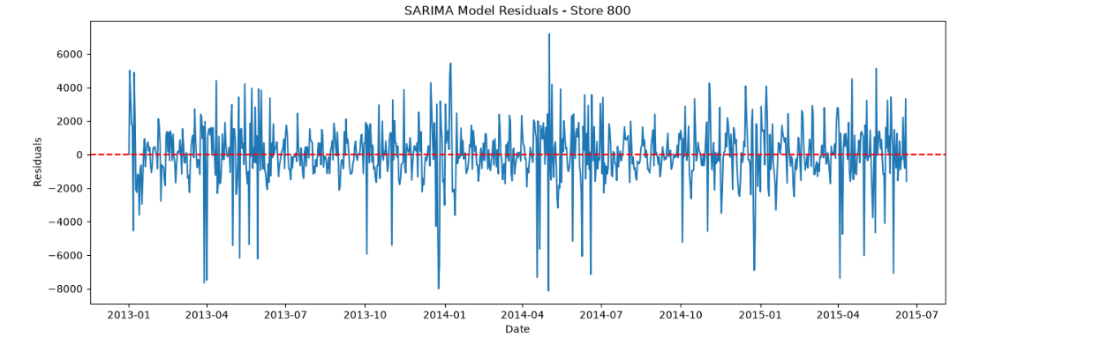
3.5.2 SARIMA Residual Diagnostic Analysis
Residuals fluctuate around zero with noticeable positive and negative deviations. Ljung–Box p-values at lags 7, 14, 21 and 28 were all below 0.05, indicating remaining residual autocorrelation.
ROSSMANN / STORE 800
PRESENTED BY THE POD GROUP
23 / 29
Notes:
This is Figure 3.5.2.1, SARIMA Model Residuals Over Time for Rossmann Store 800 (2013–2015), reproduced from the uploaded documentation. The residuals fluctuate around zero with noticeable positive and negative deviations. The report also documents Ljung–Box tests at lags 7, 14, 21 and 28, all with p-values below 0.05. This indicates remaining autocorrelation and patterns not fully captured by the SARIMA model. The next slide shows the original Q-Q plot.

Slide 24
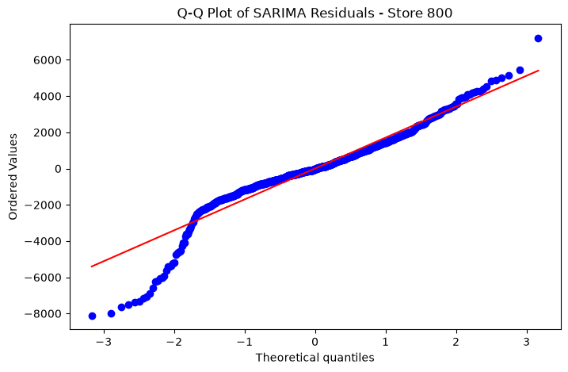
3.5.2 Q–Q Plot of SARIMA Model Residuals
WHAT THE PLOT SHOWS
The residuals deviate from the expected normal distribution.
The Q–Q plot therefore indicates that the residuals were not perfectly normally distributed.
ROSSMANN / STORE 800
PRESENTED BY THE POD GROUP
24 / 29
Notes:
This is the original Q-Q plot from the uploaded Rossmann Store 800 documentation, Figure 4.5.2.2. The report states that the residuals deviate from the expected normal distribution. The model captures important sales patterns, but the residual distribution is not perfectly normal. This slide reports the documented result rather than adding new statistical claims.

Slide 25
3.5.3 Rolling-Origin Backtesting
BACKTEST DESIGN
SARIMA
700
Average MAE: 1,109.17
Average RMSE: 1,397.67
starting observations
9 windows • 7 days each
SEASONAL NAIVE
Move forward 28 days between forecast windows. Both models were evaluated over the same periods.
Average MAE: 1,463.90
Average RMSE: 1,994.23
SARIMA had lower average errors across the nine backtests.
ROSSMANN / STORE 800
PRESENTED BY THE POD GROUP
25 / 29
Notes:
The document Section 3.5.3 reports rolling-origin backtesting with an initial 700 observations, seven-day forecasts, and a 28-day step. This produced nine evaluation windows. SARIMA average MAE was 1,109.17 and average RMSE was 1,397.67. Seasonal Naive average MAE was 1,463.90 and RMSE was 1,994.23. SARIMA performed better on both averages here. These seven-day backtests differ from the single 42-day holdout and should not be described as identical evaluations.

Slide 26
3.5.4 Sunday Closure Adjustment
OBSERVED STORE PATTERN
INITIAL SARIMA FORECAST
134 Sundays
Some Sundays had positive predicted sales.
All 134 recorded Sundays had zero sales.
FINAL FORECAST ADJUSTMENT
The dataset had 163 zero-sales days in total, including other closure days.
Sunday forecasts were set to zero to reflect the observed store closure pattern.
Applied after forecasting; no accuracy gain was established.
ROSSMANN / STORE 800
PRESENTED BY THE POD GROUP
26 / 29
Notes:
The original report says all 134 observed Sundays had zero sales and that the initial forecast predicted positive sales on some Sundays. We therefore replaced the Sunday predictions with zero to match the observed closure pattern. The total of 163 zero-sales days also includes other closure days. This was an adjustment after forecasting; the report does not demonstrate a recalculated accuracy improvement.

Slide 27
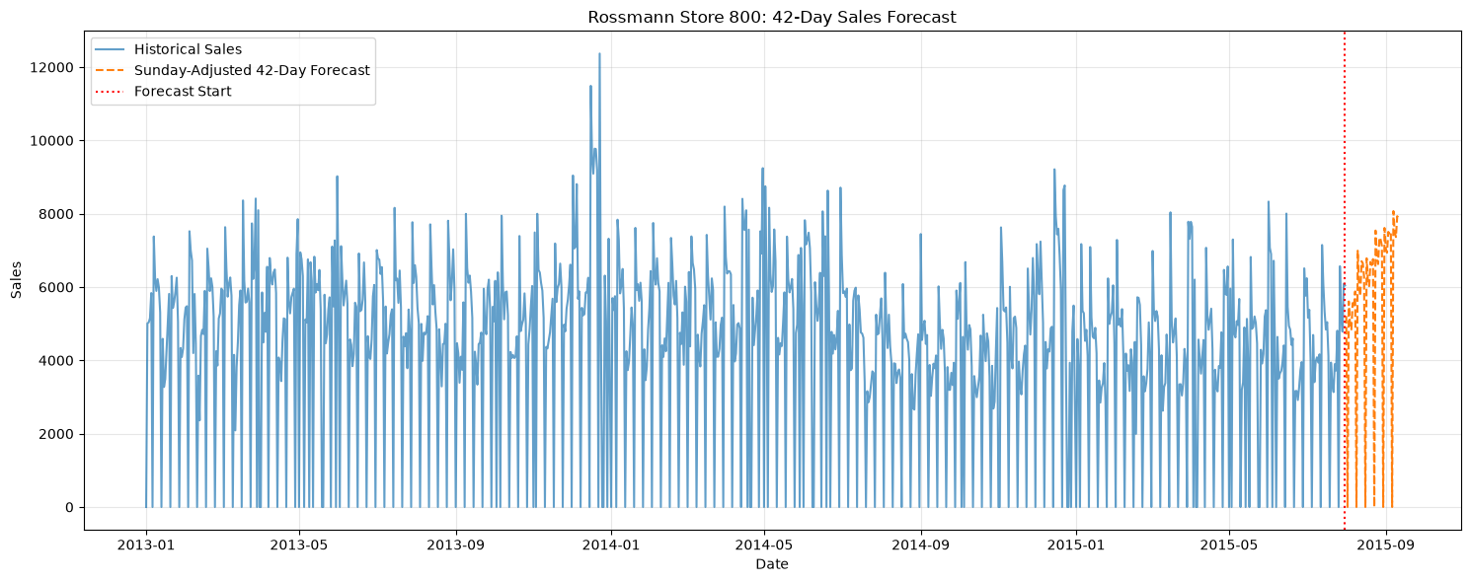
3.5.4 Historical Sales and 42-Day Forecast
Historical demonstration: Aug 1–Sep 11, 2015 | Sunday predictions set to 0; not a current forecast.
ROSSMANN / STORE 800
PRESENTED BY THE POD GROUP
27 / 29
Notes:
This plot shows observed historical sales and a 42-day model forecast for August 1 to September 11, 2015, with Sunday predictions set to zero by an explicit business rule. This is a historical demonstration of a forecasting workflow, not a current sales forecast for Rossmann.

Slide 28
3.5.4 Final Six-Week Sales Forecast
FORECAST PERIOD
HOW TO READ THE OUTPUT
1 August – 11 September 2015
• Forecast values represent expected daily sales, not guaranteed results.
• A seven-day cycle is important for this store.
• Sunday values were set to zero after forecasting, using the observed closure rule.
• The Sunday correction was not separately proven to improve accuracy.
42 days ahead
A historical demonstration of the forecasting workflow—not a forecast of current Rossmann sales.
ROSSMANN / STORE 800
PRESENTED BY THE POD GROUP
28 / 29
Notes:
The final six-week forecast covers August 1 through September 11, 2015. This is a historical example. The forecasting model produced daily predictions; afterward, the Sunday values were replaced with zero because Sundays were consistently closed in the observed data. This is a business-rule adjustment, not an automatically learned SARIMA feature. No accuracy improvement is claimed without recomputing evaluation metrics.

Slide 29
4.3 Conclusion
No single model won every test: SARIMA led rolling backtests and holdout RMSE; Seasonal Naive led holdout MAE.
Weekly seasonality
Model evidence
Diagnostic findings
Seven-day sales cycles and Sunday closures are central to Store 800 demand.
SARIMA beat Seasonal Naive on average in rolling backtests; holdout metrics were mixed.
Ljung–Box tests indicated remaining autocorrelation, and the Q–Q plot showed departures from normality.
Historical six-week forecast (Aug–Sep 2015): useful workflow demonstration, not a current sales prediction.
ROSSMANN / STORE 800
POD GROUP
29 / 29
Notes:
To conclude, this project demonstrates a historical six-week forecasting workflow for Rossmann Store 800. Weekly seasonality and store closures are essential to interpreting daily sales. Neither forecasting approach was best in every evaluation: Seasonal Naive achieved the lower holdout MAE, while SARIMA achieved the lower holdout RMSE and better average rolling-origin performance. The Ljung–Box and Q–Q diagnostics show limitations, so the findings should be interpreted with appropriate caution. The final August 1 to September 11, 2015 forecast includes a post-model Sunday closure adjustment, not an automatically learned SARIMA behavior or a prediction of present-day sales.

