Slide 1

Web Application Development
COMP-229
Fall 2023

Slide 2
RAG Architecture with Llama Index
Retrieval-Augmented Generation (RAG) is a widely used application pattern for Large Language Models (LLMs). It uses information retrieval systems to give LLMs extra context, which aids in answering user queries not covered in the LLM's training data and helps to prevent hallucinations.

Slide 3
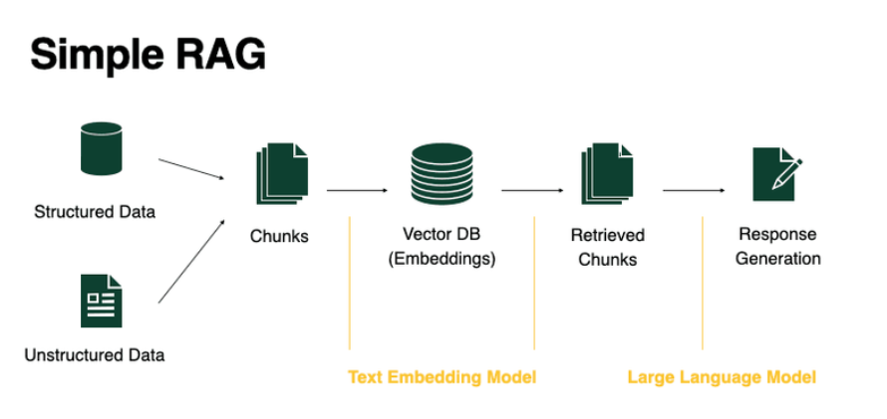
Simple RAG system
A simple RAG system consists of 5 stages:

Slide 4
Chunking: RAG begins with turning your structured or unstructured dataset into text documents, and breaking down text into small pieces (chunks).
Embed documents: A text embedding model steps in, turning each chunk into vectors representing their semantic meaning.
VectorDB: These embeddings are then stored in a vector database, serving as the foundation for data retrieval.
Retrieval: Upon receiving a user query, the vector database helps retrieve chunks relevant to the user's request.
Response Generation: With context, an LLM synthesizes these pieces to generate a coherent and informative response.

Slide 5
Creating a Simple Llama Index Node.js server
Creating a Node.js server to handle text queries the llamaindex tslibrary. This step-by-step tutorial will guide you through setting up an Express server that utilizes this library along with CORS (Cross-Origin Resource Sharing) support. The server will respond to POST requests with text queries and utilize a set of documents to return a relevant response.

Slide 6
Step 1: Initialize Your Project
Open your terminal or command prompt.
Create a new directory for your project and navigate into it:
mkdir my-query-server cd my-query-server
Initialize a new Node.js project:
npm init -y
Add "type": "module",
to the package.json so we can use ES6 Import statements
Install the required dependencies:
npm install express cors dotenv llamaindex

Slide 7
Step 2: Create a folder called data in the root folder File
Upload or move the mamatiakala highway accident file into it.

Slide 8
Step 3: Create Your Server File
In your project directory, create a file named server.js.
Open server.js in your IDE or text editor.

Slide 9
Step 3: Set Up Your Server
Copy the following code into your server.js file. This is your starting point, including importing necessary modules and setting up a basic server structure.

Slide 10
Server.js
import "dotenv/config";
import express from "express";
import cors from "cors";
import { Document, VectorStoreIndex, SimpleDirectoryReader } from "llamaindex";
const app = express();
const port = process.env.PORT || 3000;
app.use(cors());
// Middleware to use JSON body parsing

Slide 11
Server.js contd.
app.use(express.json());
const keys = process.env.OPENAI_API_KEY;
if (!keys) {
throw new Error("No OpenAI API key provided");
}
async function initializeIndex() {
const documents = await new SimpleDirectoryReader().loadData({
directoryPath: "./data",
});

Slide 12
Server.js contd.
return await VectorStoreIndex.fromDocuments(documents);
}
app.post("/query", async (req, res) => {
try {
const index = await initializeIndex();
const queryEngine = index.asQueryEngine();
// Expecting a query in the JSON body

Slide 13
Server.js contd.
const query = req.body.query;
if (!query) {
return res.status(400).send({ error: "Query not provided" });
}
const response = await queryEngine.query({ query });
res.send({ response: response.toString() });
} catch (error) {
console.error(error);
res

Slide 14
Server.js contd.
.status(500)
.send({ error: "An error occurred while processing the query." });
}
});
app.listen(port, () => {
console.log(`Server running on port ${port}`);
});

Slide 15
Remember to create an openAI account.
Log into OpenAI to get our keys.
Enter or create your account, and then go to the OpenAI key creation page and create a key.
Copy the key
OPENAI_API_KEY=your_key
Instead of “your_key,” enter the key you copied from OpenAI and save the file.

Slide 16
Step 7: Running Your Server
In your terminal, run the server with the following command:
node server.js
Your server is now running on http://localhost:3000 (or another port if you’ve configured it differently).

Slide 17
Step 8: Testing Your Server
To test your server, you can use a tool like Postman or a simple curl command in the terminal:
curl -X POST http://localhost:3000/query -H "Content-Type: application/json" -d "{\"query\":\"What did the author do in college?\"}"
Postman:
URL POST: http://localhost:3000/query. Body: JSON { “query”: “What did the author do in college?” }

Slide 18
You’ve now created a basic server capable of handling text queries against a set of documents, utilizing the Express framework and handling CORS requests. This setup is quite flexible and can be adapted to various applications, such as a search engine or a FAQ bot.

Slide 19
Creating the React Web App – Frontend.
Here is a simple react web app using this server to answer questions based on the doc in the server.
Spin up the React application using vite using the following command:
yarn create vite client --template react # For yarn
OR npm create vite@latest client --template react # For npm
cd client
npm install
yarn dev or npm run dev

Slide 20
Src/App.jsx
Update the app,jsx with the following code:
import React, { useState } from "react";
const App = () => {
const [query, setQuery] = useState("");
const [answer, setAnswer] = useState("");
const handleSubmit = async (e) => {
e.preventDefault();
setAnswer("Thinking...");
try {
const response = await fetch("http://localhost:3000/query", {
method: "POST",
headers: {
Accept: "*/*",
"Content-Type": "application/json",
},
body: JSON.stringify({ query }),
});

Slide 21
Src/App.jsx contd.
const data = await response.json();
console.log("Response from the server:", data);
setAnswer(data.response);
} catch (error) {
console.error("Error:", error);
setAnswer("Error: " + error);
setQuery("");
}
};
// Function to update the state with the input value
const handleChange = (e) => {
setQuery(e.target.value);
};
return (
<div
style={{
backgroundColor: "#f5f5f5",
height: "100vh",
flex: 1,
display: "flex",
justifyContent: "center",
alignItems: "center",
padding: "20px",
fontFamily: "Arial, sans-serif",
}}
>

Slide 22
Src/App.jsx contd.
<div
style={{
backgroundColor: "#fff",
padding: "20px",
borderRadius: "8px",
boxShadow: "0 2px 4px rgba(0, 0, 0, 0.1)",
minWidth: "200px",
maxWidth: "500px",
width: "100%",
}}
>
<h1 style={{ color: "#333", textAlign: "center" }}>Ask a question</h1>
<form onSubmit={handleSubmit}>
<input
id="query"
type="text"
placeholder="Enter your question"
value={query}
style={{
width: "100%",
padding: "10px",
margin: "10px 0",
border: "1px solid #ddd",
borderRadius: "4px",
boxSizing: "border-box",
}}
onChange={handleChange}
/>

Slide 23
Src/App.jsx contd.
<button
type="submit"
style={{
backgroundColor: "#007bff",
color: "white",
padding: "10px 20px",
border: "none",
borderRadius: "4px",
cursor: "pointer",
width: "100%",
}}
>
Query
</button>
</form>
<div id="answer" style={{ marginTop: "20px" }}>
{answer}
</div>
</div>
</div>
);
};
export default App;

Slide 24
Updated main.jsx
import React from "react";
import ReactDOM from "react-dom/client";
import App from "./App.jsx";
ReactDOM.createRoot(document.getElementById("root")).render(
<React.StrictMode>
<App />
</React.StrictMode>
);

Slide 25
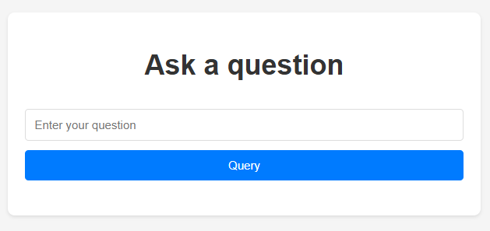
Output in the browser when you run the client
Cd client
Yarn dev or npm run dev

Slide 26
Sample question. How many people died in the accident.

Slide 27
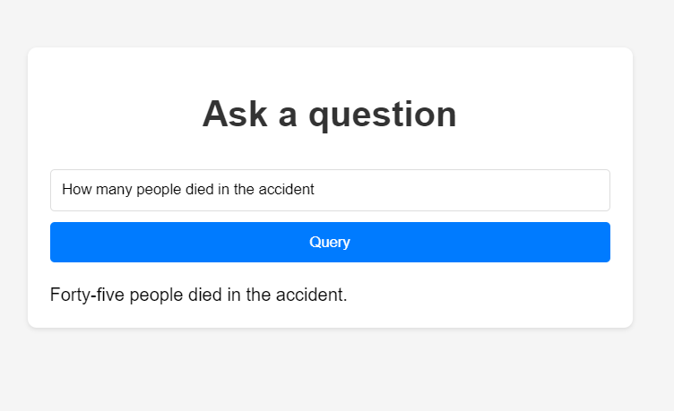
Output

Slide 28
OpenAI – Billing plan link
https://platform.openai.com/settings/organization/billing/overview
OpenAI – checking your account - https://platform.openai.com/settings/organization/limits

Slide 29
https://medium.com/@sisongqolosi/creating-a-simple-llama-index-node-js-server-19295cfa6c2d

