Slide 1
National Rural Employment Guarantee Act (NREGA) ANALYSIS
NREGA Analysis with Power BI
BY BLESSING ENE OTACHE
BATCH NAME: MIP-DA-09

Slide 2
Introduction Objective Problem Statement Dataset Overview Visualization Conclusion
TABLE OF CONTENT

Slide 3
INTRODUCTION
Abstract
This project delves into the analysis of data related to the National Rural Employment Guarantee Act (NREGA), a transformative government scheme aimed at providing rural households with guaranteed wage employment opportunities. The dataset used for this analysis encompasses a wide range of parameters, including the number of job cards issued, the workforce engaged, budget allocation, work completion statistics, and much more. Through the application of data analytics techniques, we aim to gain valuable insights into the implementation and impact of NREGA across different states and districts in India.

Slide 4
Objective
This project aims to analyze and visualize the NREGA dataset to extract meaningful insights, identify patterns, trends, and disparities in NREGA implementation.

Slide 5
PROBLEM STATEMENT
NREGA is a vital initiative to alleviate rural unemployment and poverty. This project seeks to address several key questions and challenges associated with NREGA:
● How effective is NREGA in providing employment opportunities to rural households?
● Are there regional disparities in the implementation and outcomes of the scheme?
● What is the utilization of the allocated budget, and how does it correlate with employment generation?
● What are the key factors contributing to the completion of NREGA works, and are there any roadblocks to its success?
● Can data-driven insights guide policymakers and administrators in optimizing the scheme's impact?

Slide 6
DATASET OVERVIEW
The dataset used for this analysis is sourced from official government records and contains information related to NREGA implementation across various states and districts in India. It comprises 740 rows, 28 columns, encompassing data on job cards, worker details, budget allocation, work completion statistics, expenditure, and more. This dataset offers a comprehensive view of the progress and challenges faced by the NREGA program.

Slide 7
DATA VISUALIZATION USING POWER BI

Slide 8
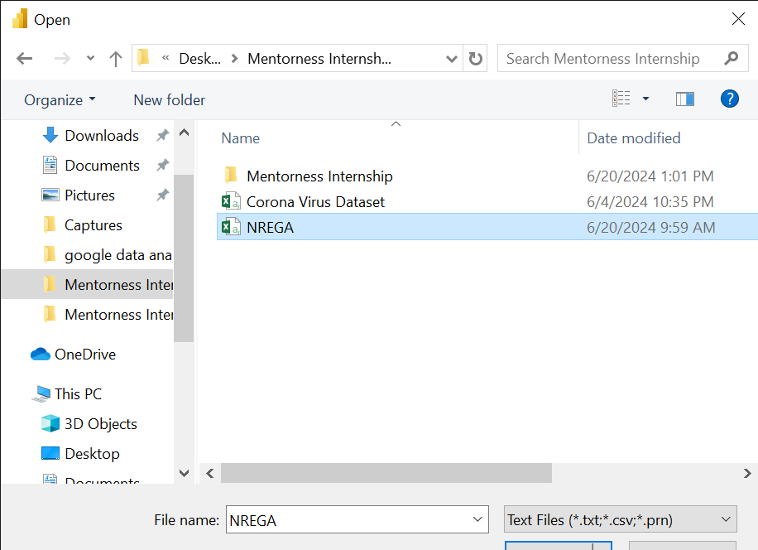
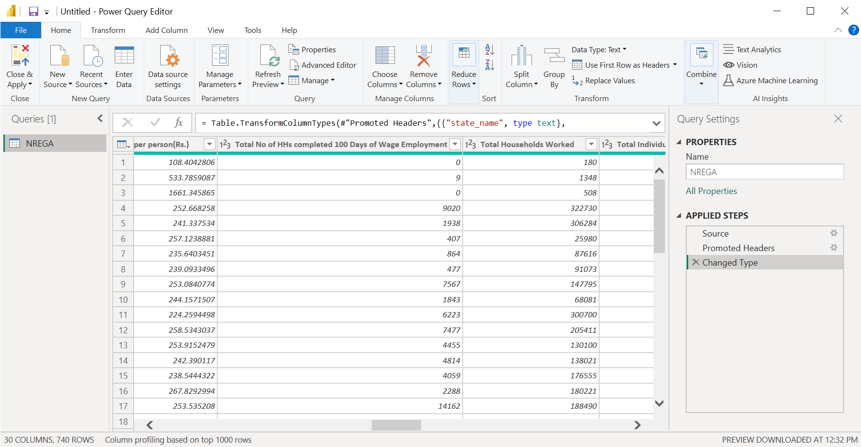
Import NREGA Dataset, transform to clean, apply and close

Slide 9
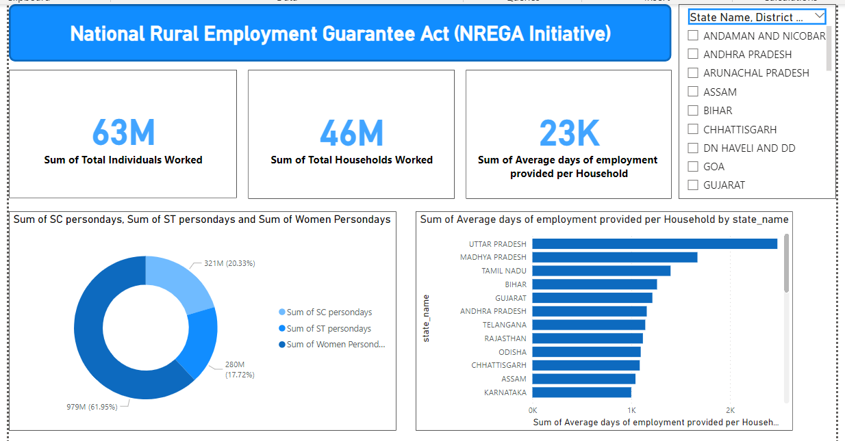
How effective is NREGA in providing employment opportunities to rural households?
The NREGA initiative is effective in providing employment opportunities to rural households with 23k sum average days of employment provided per household.
The sum of total households involved in NREGA works is 46million and sum of total individuals worked is 63million.
Persondays of employment provided to Scheduled Caste workers is 20.33%, Persondays of employment provided to Scheduled Tribe workers is 17.72% and Persondays of employment provided to women is the highest with 61.95%

Slide 10
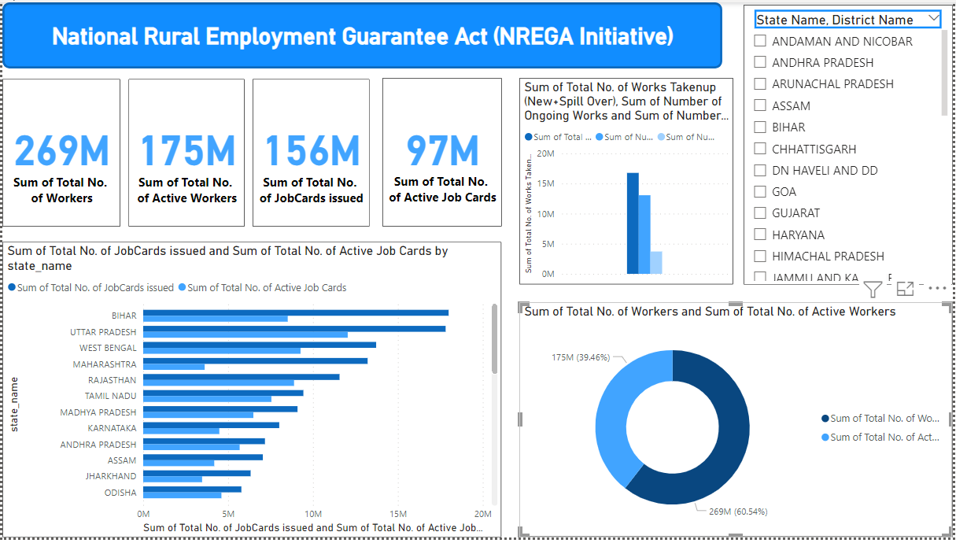
Are there regional disparities in the implementation and outcomes of the scheme?
The total number of job cards issued is 156million while the total number of active job cards is 97million.
The total number of workers registered under NREGA is 269million and the total number of active workers is 175million.
The total number of works initiated is 16million, Number of Ongoing Works is 13million and Number of Completed Works is 3million.

Slide 11
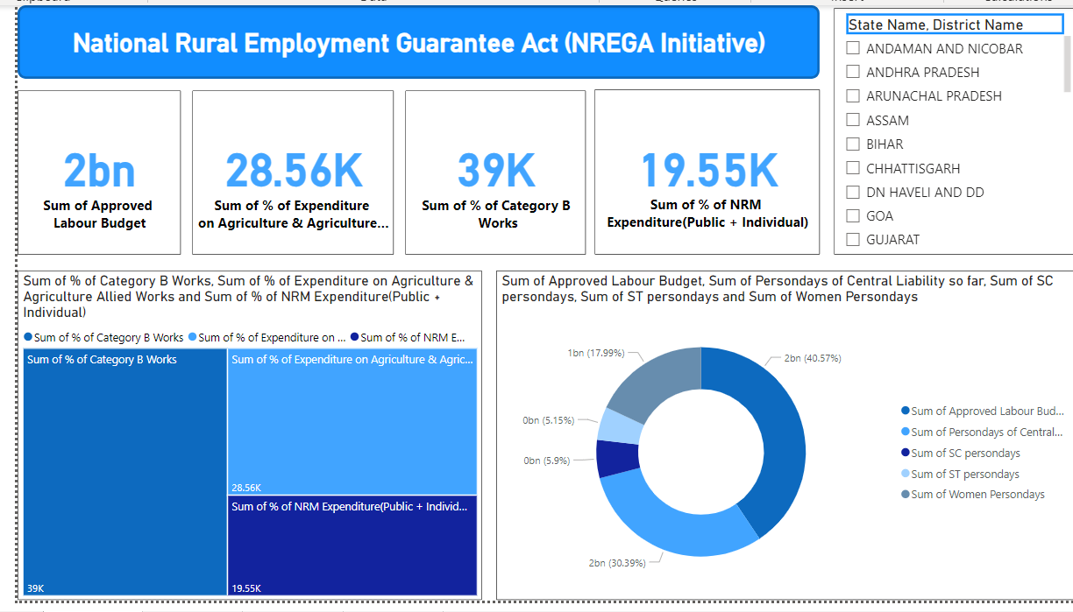
What is the utilization of the allocated budget, and how does it correlate with employment generation?
Approved Labour Budget is 2billion, Persondays of Central Liability is 1.6billion, SC persondays is 321million, ST persondays is 279million and Women Persondays is 978million
% of NRM Expenditure(Public + Individual) is 19,000 % of Category B Works is 39,000 % of Expenditure on Agriculture & Agriculture Allied Works is 28,000

Slide 12
CONCLUSION
The key factors contributing to the completion of NREGA works are;
Persondays of employment provided to women. Average daily wage rate per NREGA worker in Indian Rupees, and The number of households completing 100 days of wage employment. There are no roadblocks to its success.
Sum average days of employment provided per household should be increase. This will encourage workers and help in optimizing the scheme's impact.

Slide 13
THANK YOU

