Slide 1
Stock Price Analysis & Indicator-Based Modeling
Using Python (ML) & Power BI
Tools:
Python (Pandas, Scikit-learn), Power BI, DAX
Blesson Biju
UMID – UMID27112571779
Dec 1st Batch

Slide 2
Problem Statement & Objective
Stock price data contains complex patterns influenced by trading activity and technical indicators.
Objectives
Perform Exploratory Data Analysis (EDA)
Engineer technical indicators (MA, Volatility, Returns)
Build a machine learning model
Validate feature behavior visually using Power BI

Slide 3
Dataset Overview
Key Features:
Open, High, Low, Close
Volume
Dividends
Stock Splits
Engineered Features:
20-day Moving Average (MA_20)
50-day Moving Average (MA_50)
Daily Return
Volatility

Slide 4
Exploratory Data Analysis (EDA)
Price distribution patterns
Volume behavior
Rolling indicator behavior
Null value handling
Data type corrections

Slide 5
Feature Engineering
Moving Averages smooth short-term fluctuations
Daily Return captures percentage change
Volatility measures price dispersion
Why important?
Improves model input quality
Helps understand price stability vs risk

Slide 6
Machine Learning Approach
Target variable (Close price)
Model used (e.g., Linear Regression / Random Forest / etc.)
Train-test split
Evaluation metric (R² / MAE / RMSE)

Slide 7
Power BI Dashboard Overview
The Power BI dashboard was built using the cleaned dataset to visually validate relationships between:
Closing Price Distribution
Volume vs Closing Price
MA_20 vs Closing Price
Volatility vs Closing Price

Slide 8
Key Insights from Dashboard
Closing prices show clustered distribution
Higher trading volume does not always imply higher price
MA_20 closely follows closing price patterns
Volatility varies across price ranges

Slide 9
Conclusion & Learnings
What I Learned
Importance of proper data cleaning
Feature engineering impact on ML
Visual validation improves interpretability
Power BI complements ML analysis

Slide 10
Tools & Technologies
Python (Pandas, NumPy, Scikit-learn)
Power BI & DAX
CSV-based analytics dataset
Jupyter Notebook

Slide 11
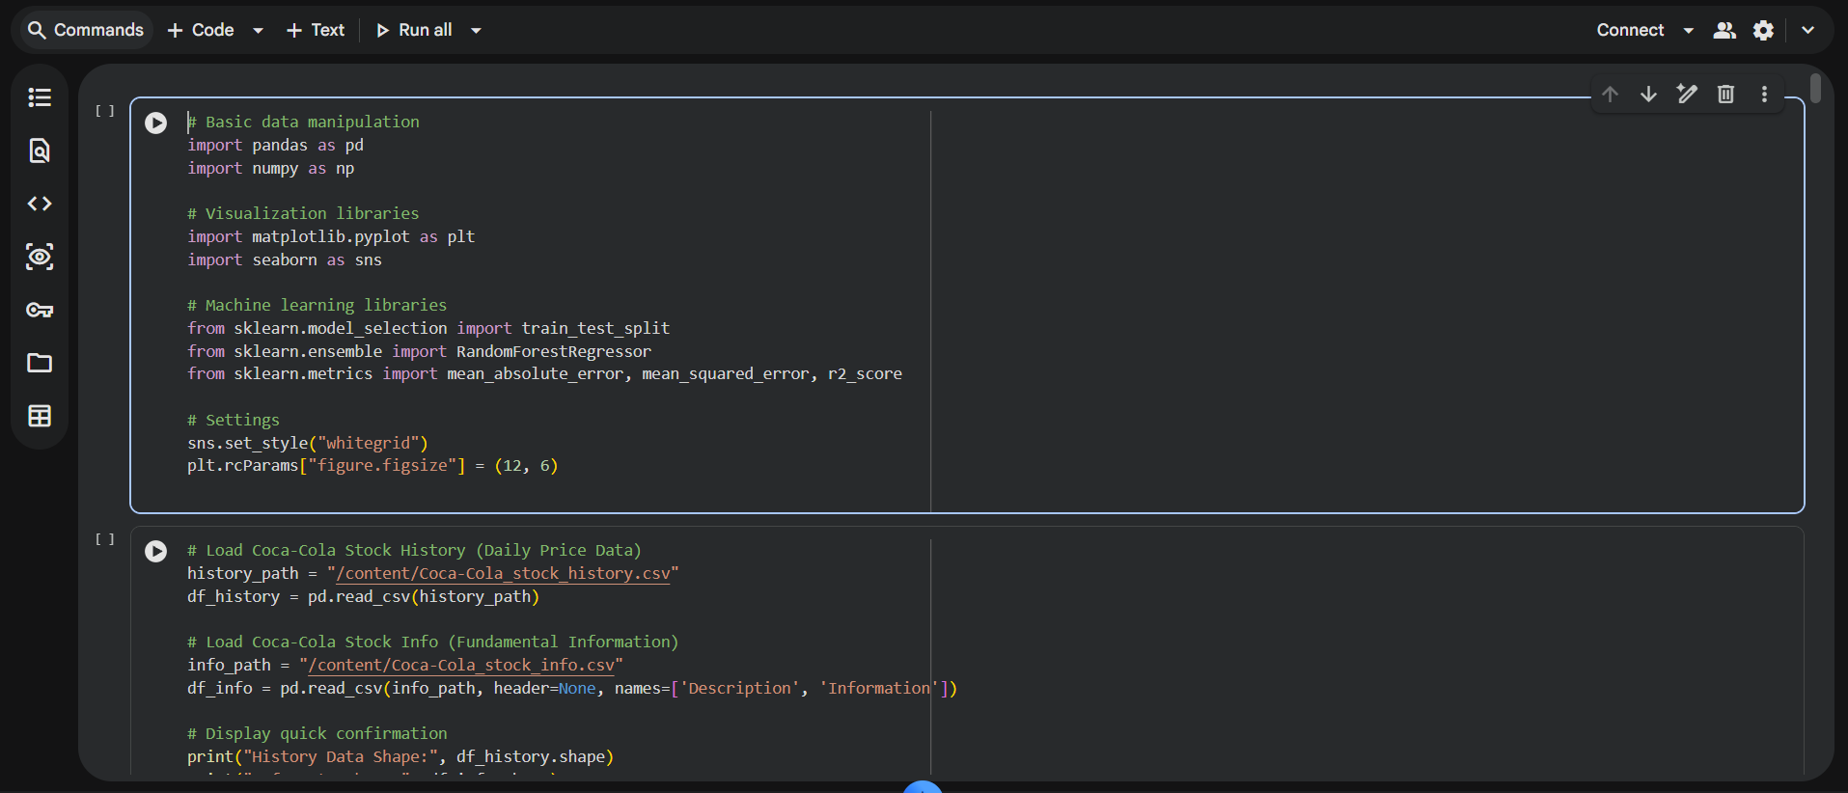

Slide 12
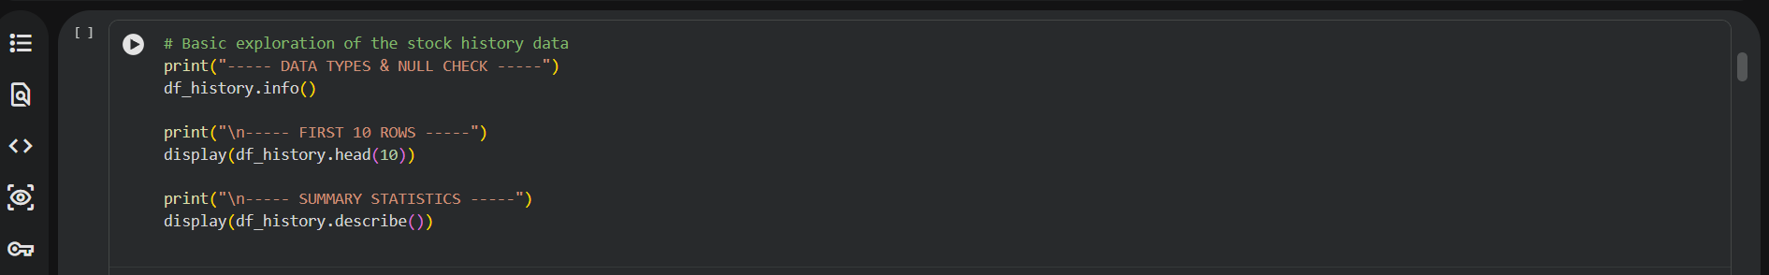
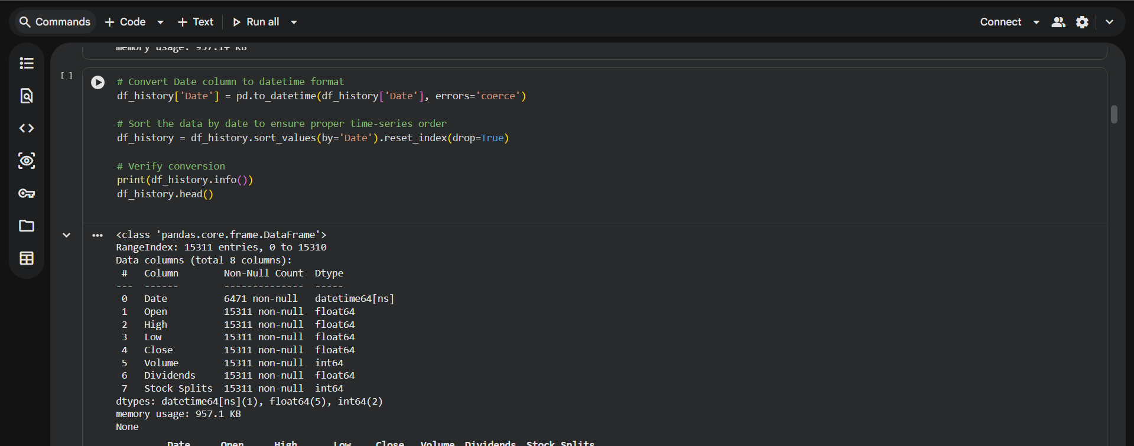

Slide 13
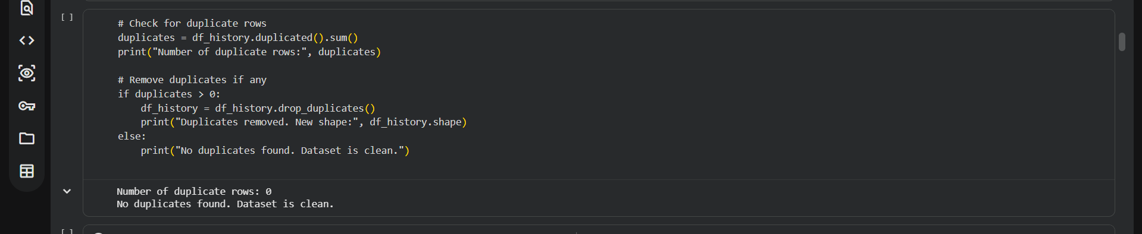
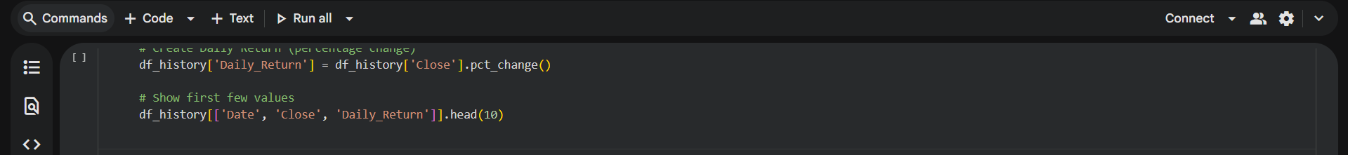
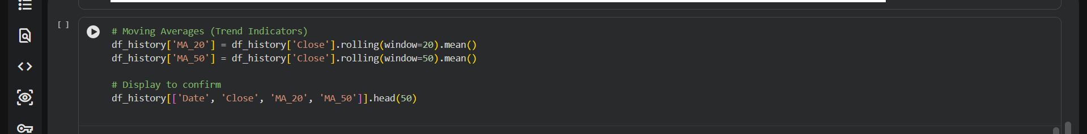
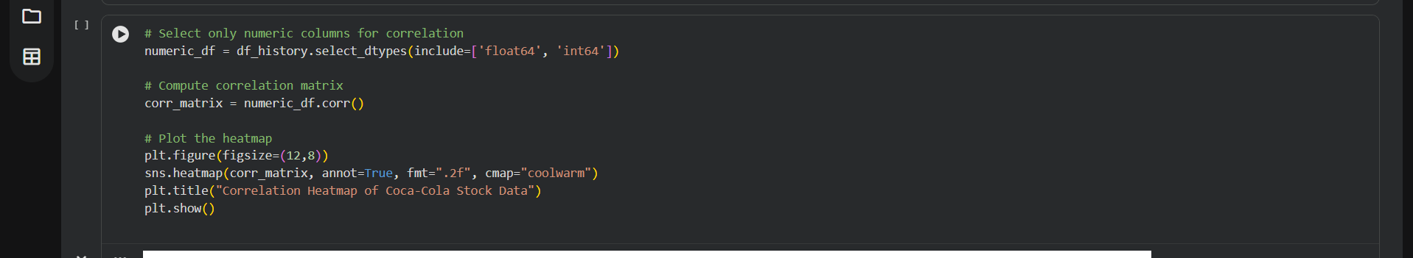

Slide 14
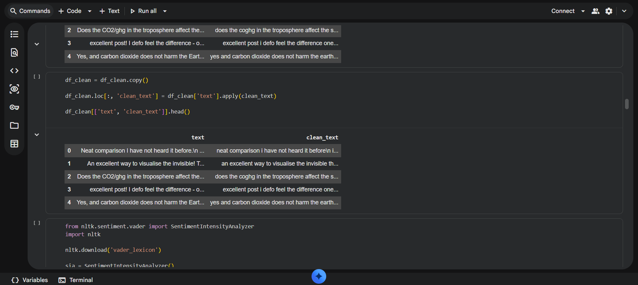

Slide 15
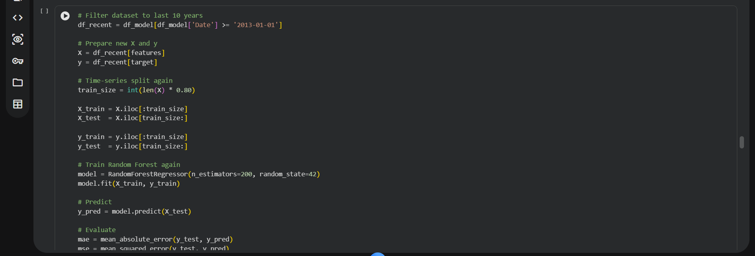
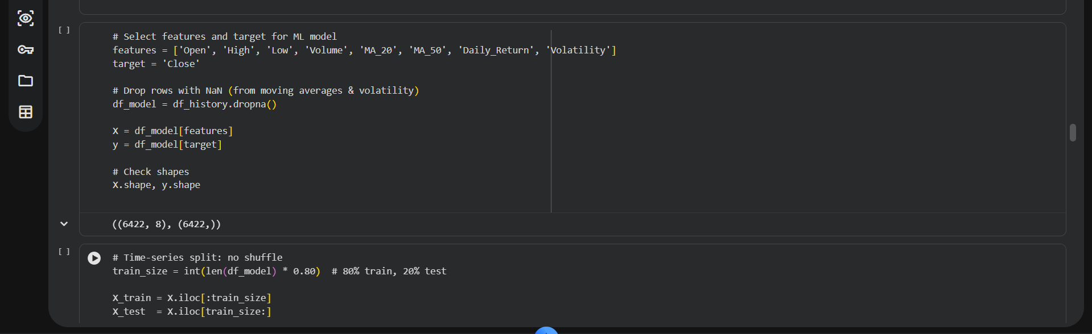
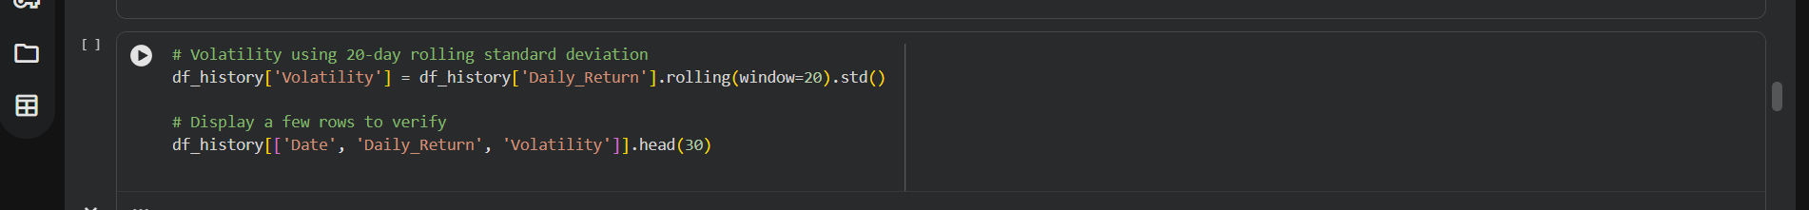

Slide 16
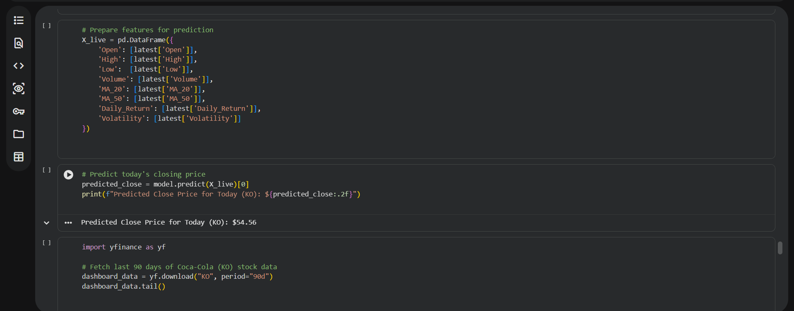
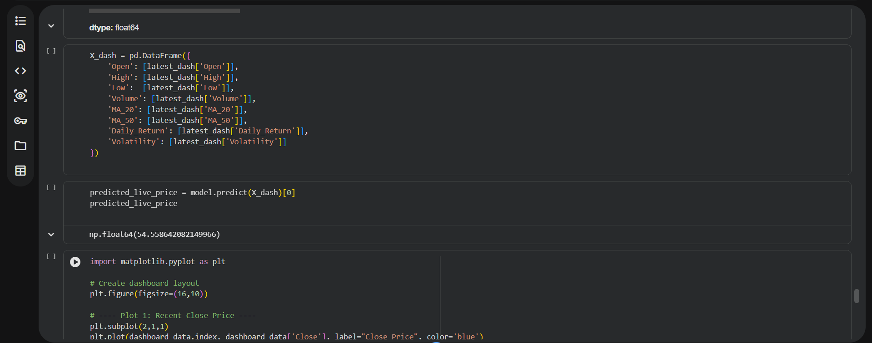

Slide 17
