Slide 1
Used Bike Price Analysis & Prediction
Machine Learning + Data Visualization Approach
Tools:
Python (Pandas, Scikit-learn), Power BI, DAX
Blesson Biju
UMID – UMID27112571779
Dec 1st Batch

Slide 2
Problem Statement
Content:
  The used bike market lacks transparent pricing standards.
  Price varies based on multiple factors:
    Model year
    Kilometers driven
    Engine power
    Brand
    Ownership history
Objective:
  Perform data cleaning & feature engineering
  Analyze price influencing factors
  Build a machine learning model to predict resale price
  Create an interactive Power BI dashboard for insights

Slide 3
Dataset Overview
Key Columns:
  model_name
  model_year
  kms_driven
  owner
  location
  mileage
  power
  price
Content:
  Total Records: 7,857
  Features: 8
  Source: Used bike listings

Slide 4
Data Preprocessing & Feature Engineering
Extracted brand from model_name
Extracted engine capacity (CC)
Converted mileage to numeric
Standardized power to bhp
Cleaned kms_driven column
Created new feature: bike_age
Handled missing values
Removed inconsistencies

Slide 5
Exploratory Data Analysis (EDA)
Newer bikes have higher resale value
Higher kms_driven → lower price trend
Premium brands retain value better
First-owner bikes are priced higher
Price distribution is positively skewed

Slide 6
Price Prediction Model
Content:
  Target Variable: Price
  Feature Encoding: One-Hot Encoding for categorical variables
  Train-Test Split: 80:20
Algorithms Tested:
  Linear Regression
  Ridge / Lasso (if used)
  Random Forest (if used)
Evaluation Metrics:
  R² Score
  MAE
  RMSE

Slide 7
Model Performance & Evaluation
  R² Score - 95431.32146192799
  MAE - 33718.28359508728
  RMSE - 0.5723596412758851
Model explains __% of price variance
Error margin indicates reasonable prediction accuracy
Key influencing features:
  Bike Age
  Brand
  Kms Driven

Slide 8
Interactive Dashboard (Power BI)
Price by Brand (Bar Chart)
Price by Model Year (Line Chart)
Owner Type Distribution (Pie Chart)
Mileage vs Price (Scatter Plot)
Location-based Filtering
KPI Cards (Avg Price, Total Listings)
Dashboard allows dynamic filtering and comparative analysis.

Slide 9
Conclusion & Future Scope
Conclusion:
  Successfully cleaned raw real-world dataset
  Identified key price-driving factors
  Built ML model for resale prediction
  Developed interactive business dashboard
Future Improvements:
  Hyperparameter tuning
  Advanced models (XGBoost)
  Deployment as web app
  Real-time market data integration

Slide 10
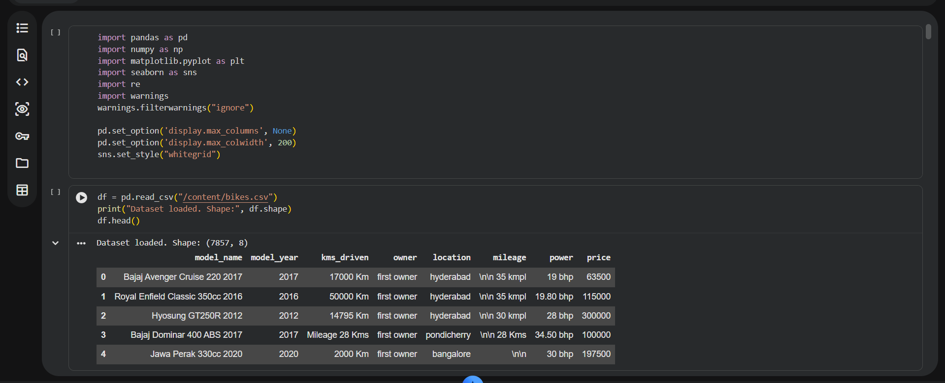

Slide 11
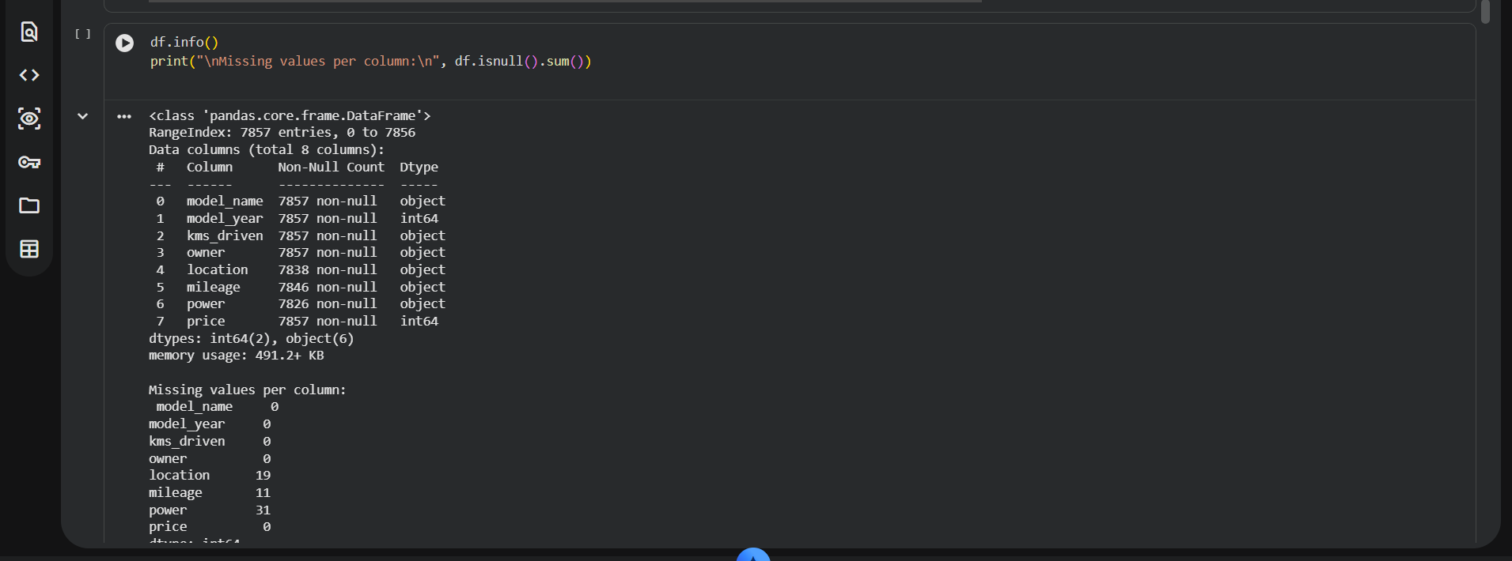
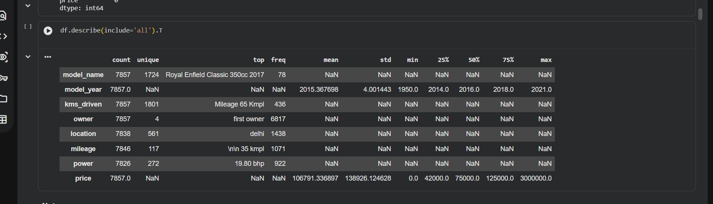

Slide 12
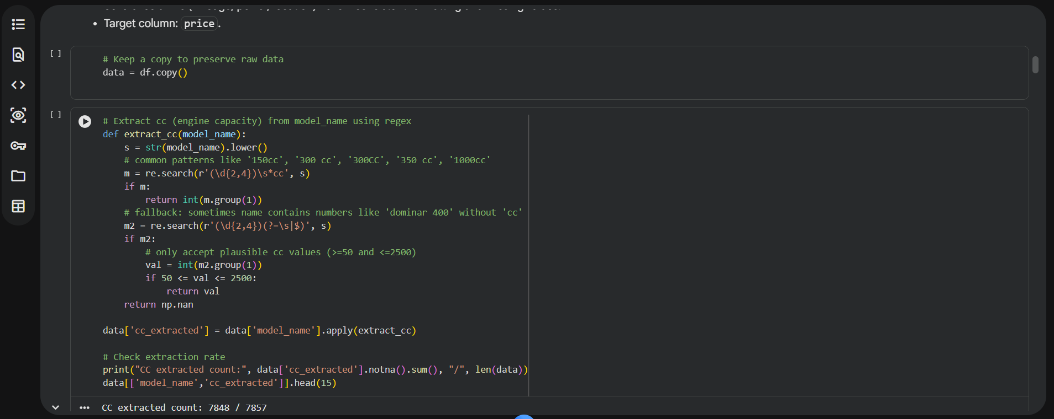
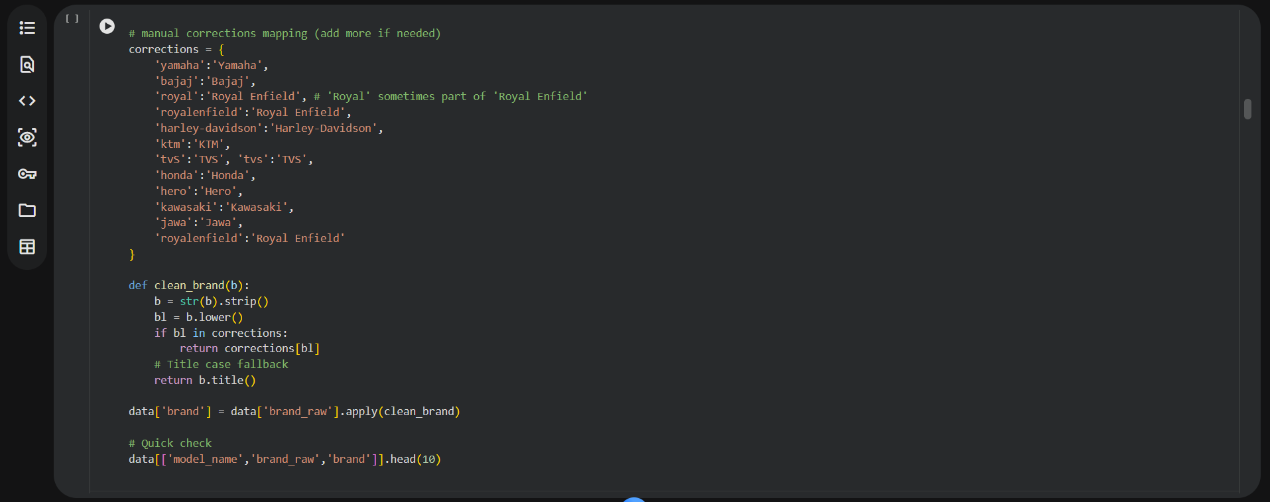

Slide 13
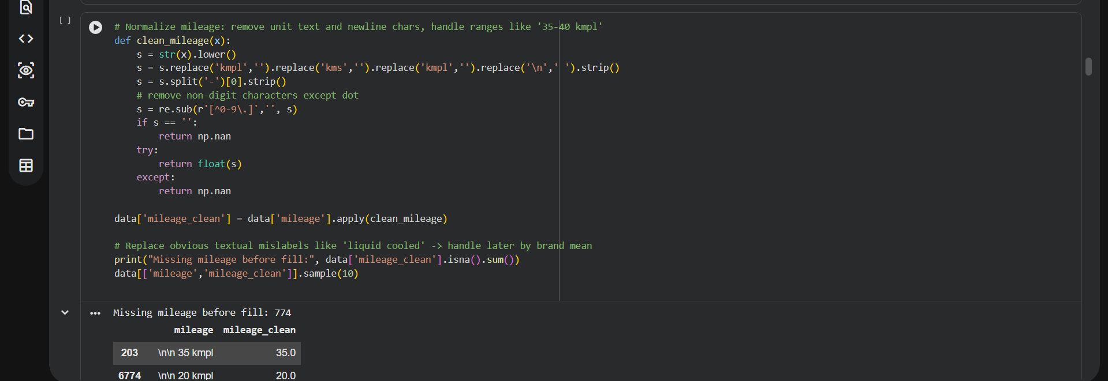
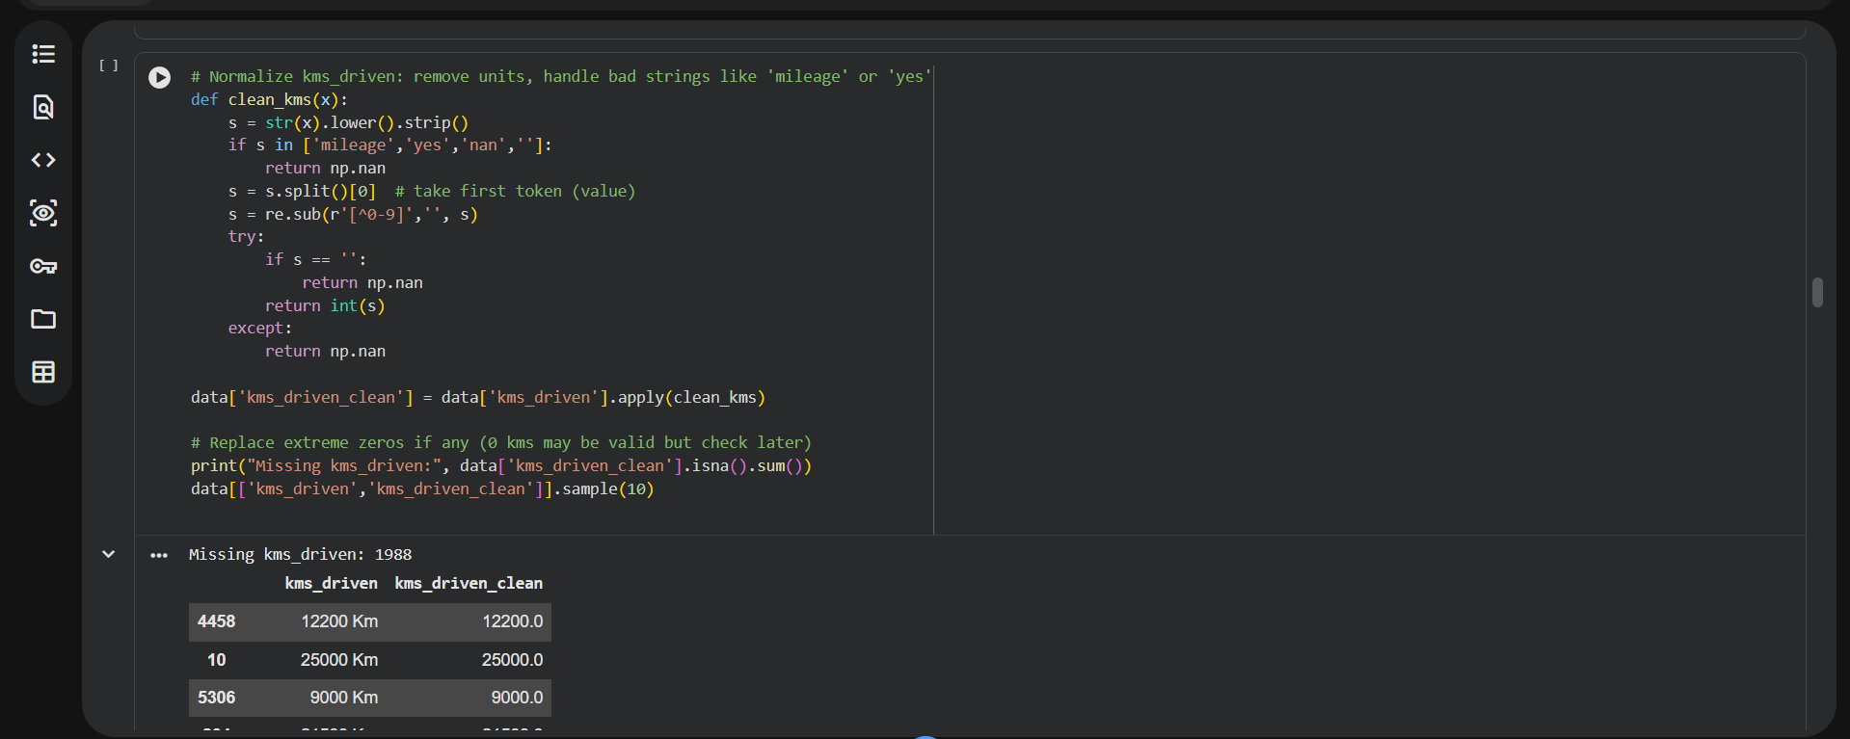

Slide 14
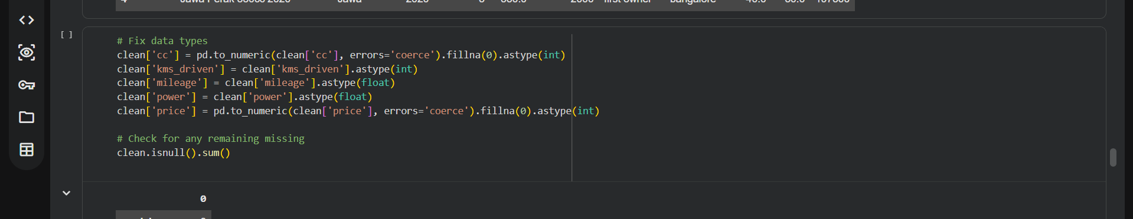
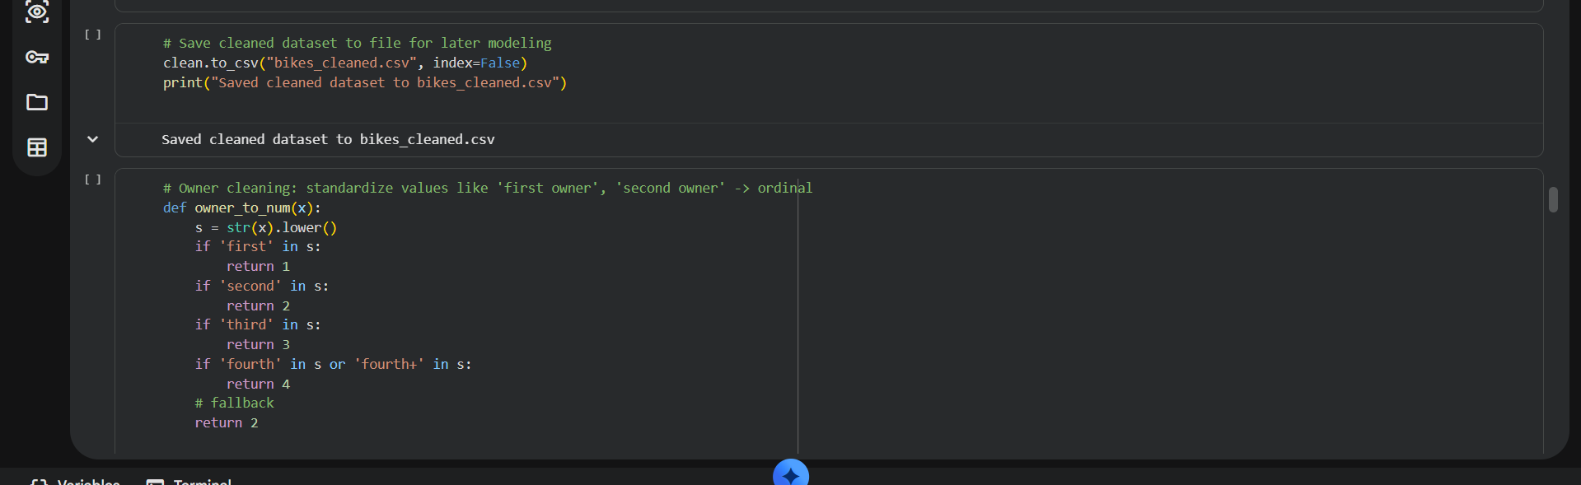


Slide 15
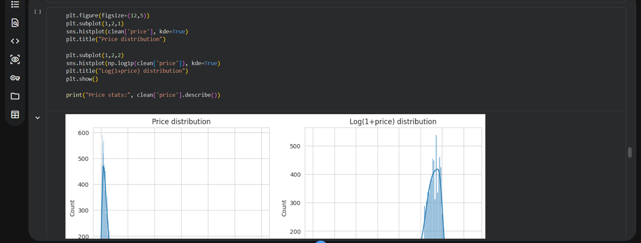
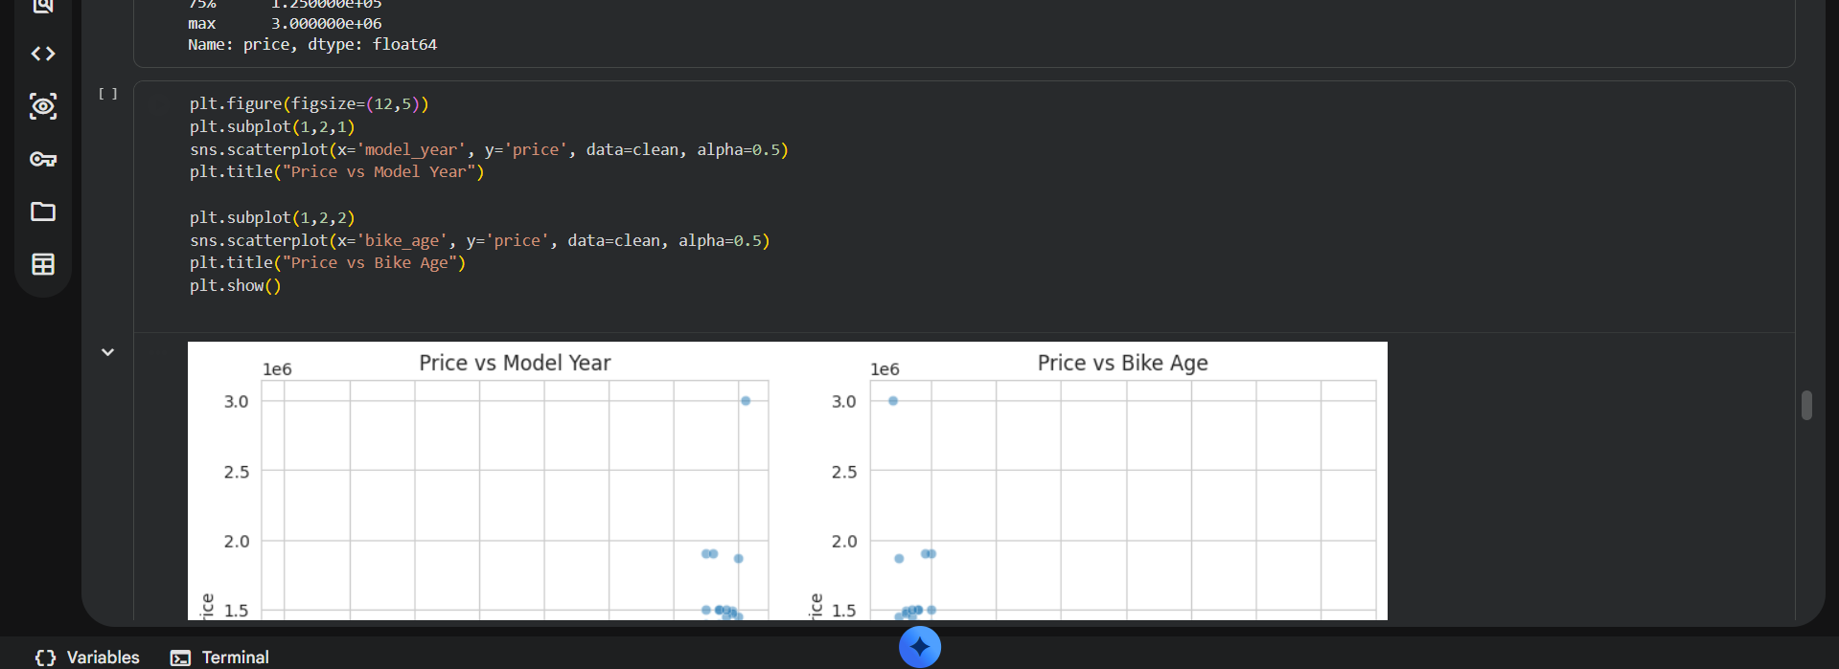

Slide 16
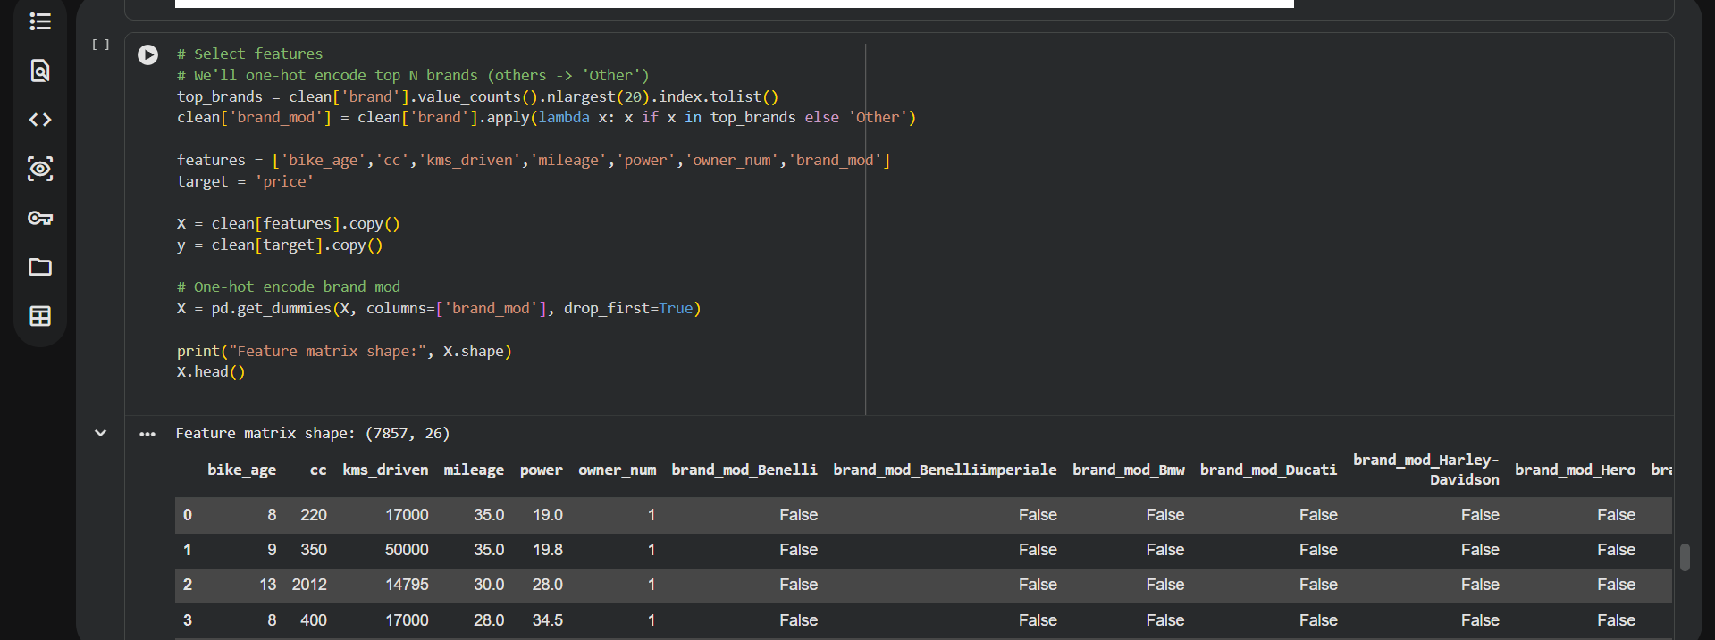
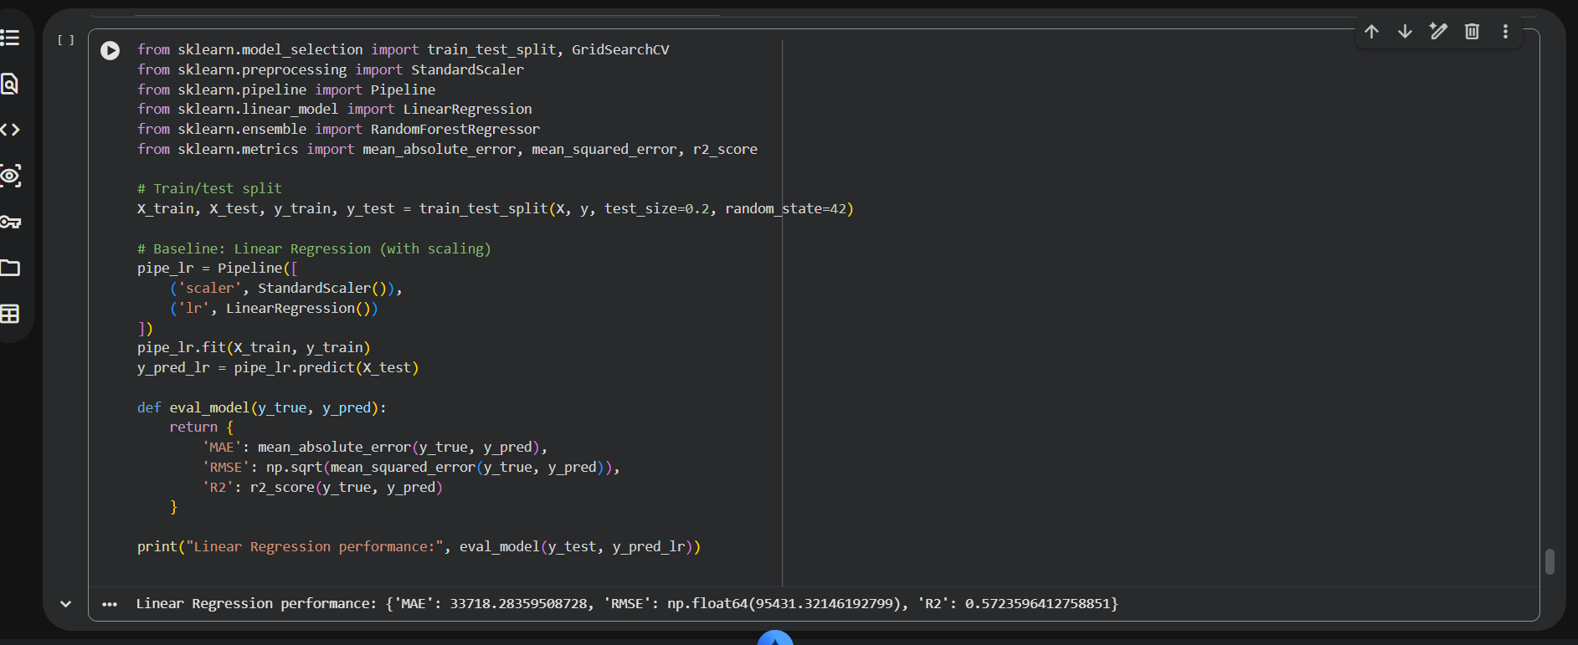

Slide 17
