Slide 1
Machine Learning Analysis of YouTube Revenue & Engagement
An ML-driven study using per-video, per-day YouTube Analytics data with Power BI for insight visualization
Tools:
Python (Pandas, Scikit-learn), Power BI, DAX
Blesson Biju
UMID – UMID27112571779
Dec 1st Batch

Slide 2
Problem Statement
High YouTube views do not always result in high revenue
Content creators and analysts need to understand what truly drives monetization
Traditional dashboards focus on vanity metrics like views and subscribers
This project aims to go beyond dashboards using machine learning

Slide 3
Project Objectives
Analyze YouTube performance using machine learning techniques
Identify key factors influencing revenue and engagement
Predict revenue patterns using regression models
Validate and communicate ML insights using Power BI visualizations

Slide 4
Dataset Overview
Source: YouTube Analytics (exported data)
Granularity: Per-video, per-day
Total records: 364
Each video appears across multiple days
Requires aggregation and careful feature engineering

Slide 5
Key Features Used
Views
Estimated Revenue (USD)
Revenue per 1000 Views (RPM)
Engagement Rate
Likes, Comments, Shares
Watch Time
Temporal features (Day, Month, Year, Days Since Publish)

Slide 6
Data Preprocessing & EDA
Removed irrelevant and redundant columns
Handled correct data types for numeric and date features
Performed exploratory data analysis to:
  Understand distributions
  Detect revenue concentration
  Analyze correlation between views, engagement, and revenue

Slide 7
Feature Engineering
Created efficiency-based metrics:
  Revenue per View
  Engagement efficiency
Aggregated per-video performance across days
Extracted temporal features to capture publishing patterns
Focused on features that improve interpretability and prediction

Slide 8
Machine Learning Methodology
Framed revenue prediction as a regression problem
Models used:
  Linear Regression (baseline)
  Tree-based regression models
Evaluation metrics:
  RMSE
  R² Score
Emphasis on explainability rather than overfitting

Slide 9
Key Insights from ML Analysis
Views alone are a weak predictor of revenue
RPM and engagement rate are stronger monetization drivers
Revenue distribution follows a power-law:
  A small number of videos generate most revenue
Higher reach often leads to lower engagement efficiency

Slide 10
Role of Power BI
Power BI used as a supporting visualization layer
Visualized:
  Top-performing videos by revenue and views
  RPM and engagement efficiency comparisons
  Views, revenue, and engagement trends
Helped validate and communicate ML findings to non-technical users

Slide 11
Conclusion
Machine learning provides deeper insight than dashboards alone
Revenue is driven by engagement quality and RPM, not just traffic
Power BI enhances interpretability of ML-driven insights
Project demonstrates an end-to-end data science workflow

Slide 12
Tools & Technologies
Python (Pandas, NumPy, Scikit-learn)
Power BI & DAX
CSV-based analytics dataset
Jupyter Notebook

Slide 13
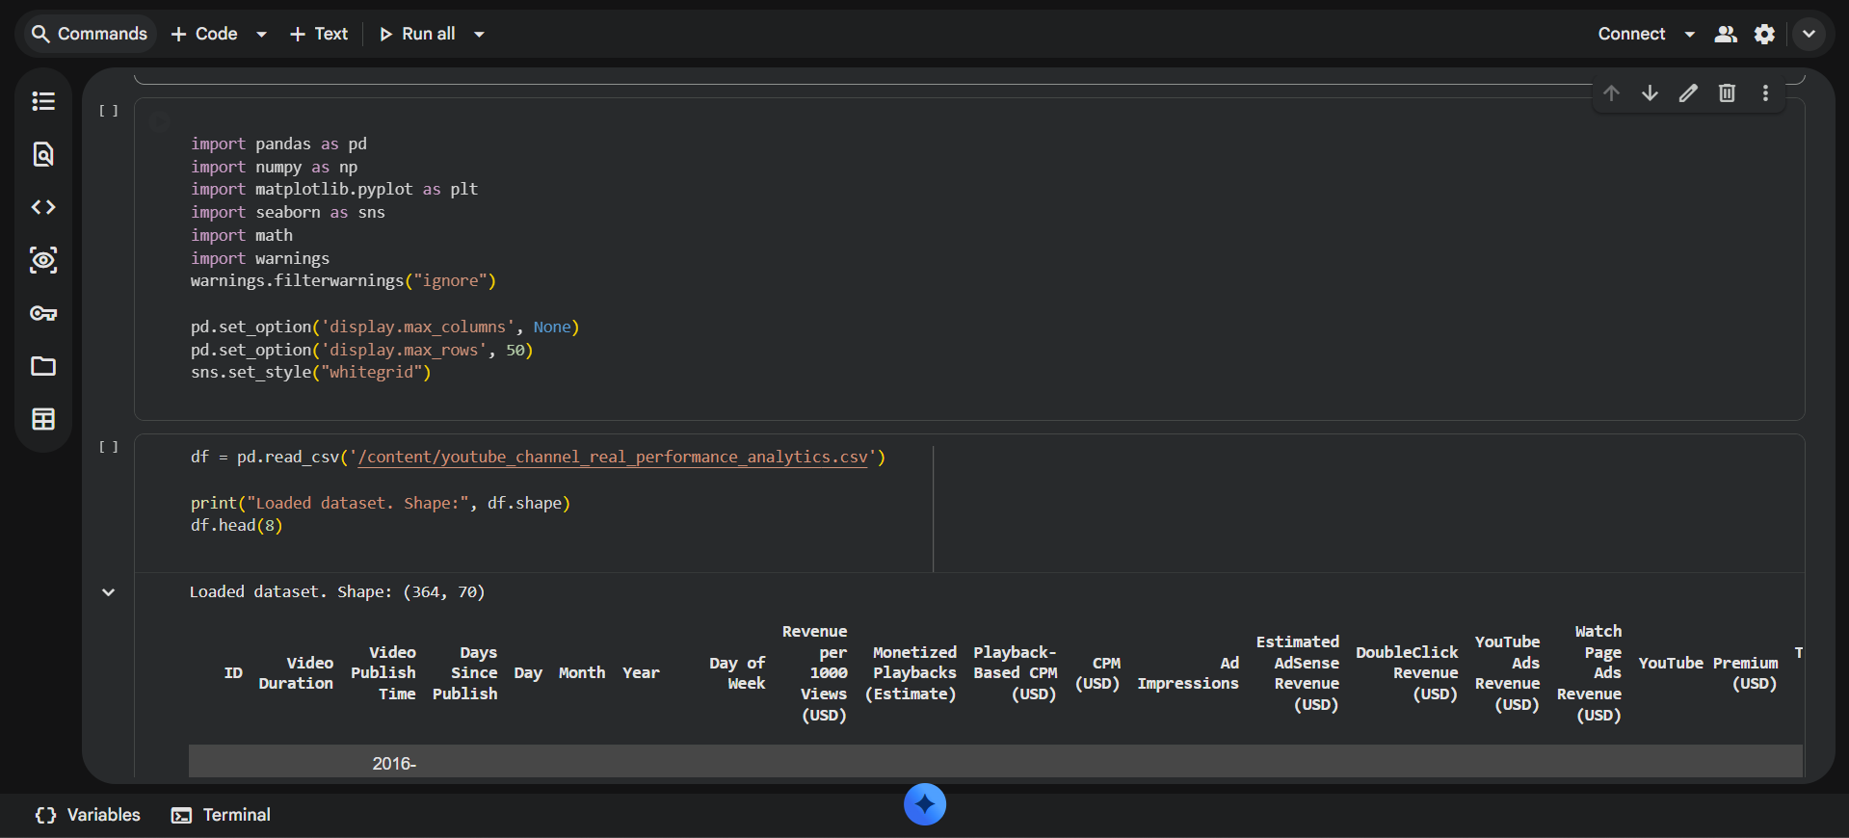

Slide 14
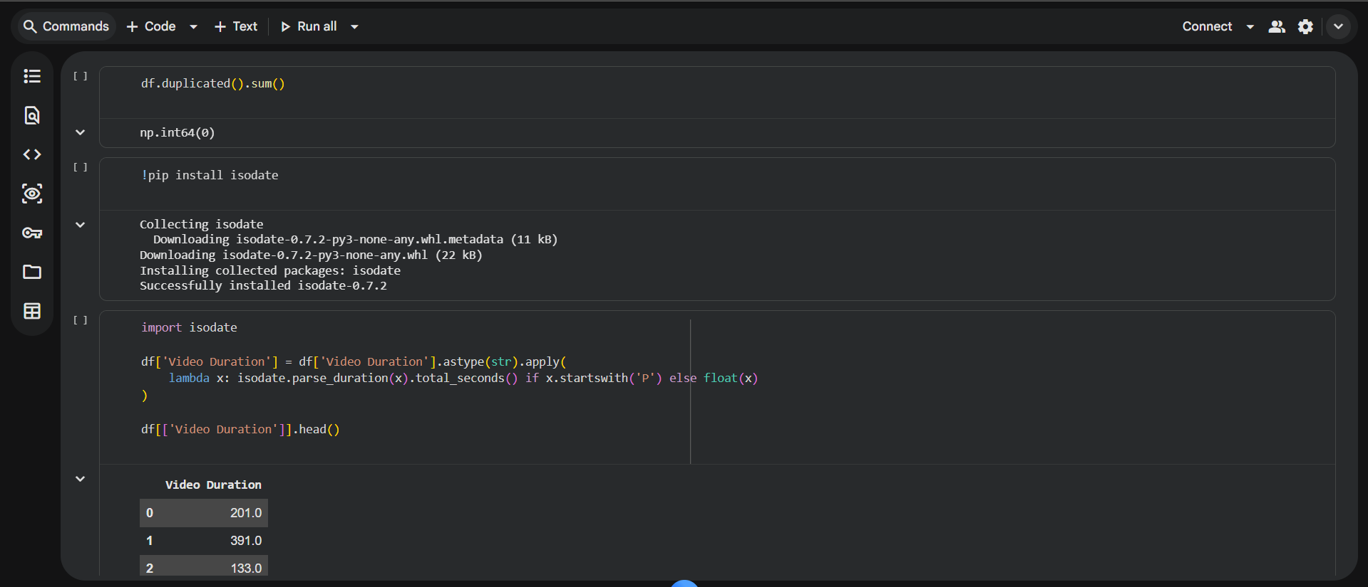
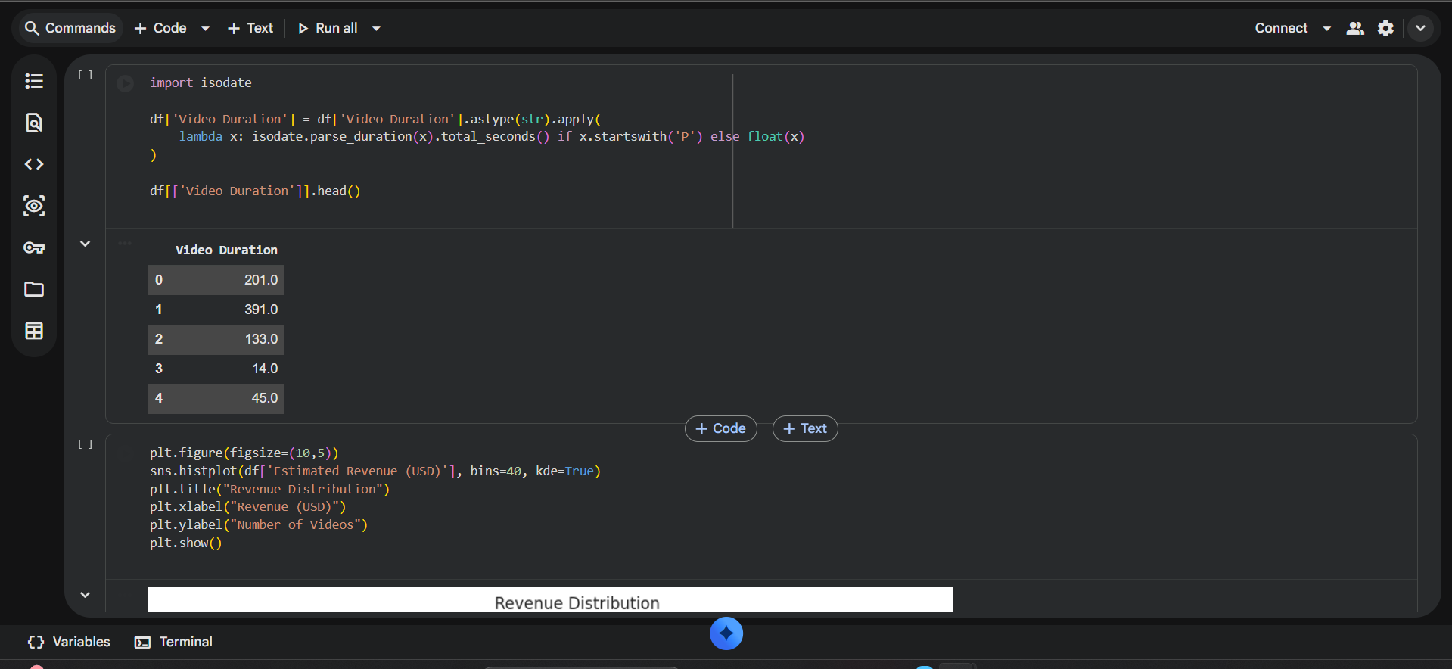

Slide 15
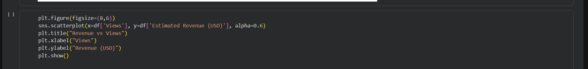
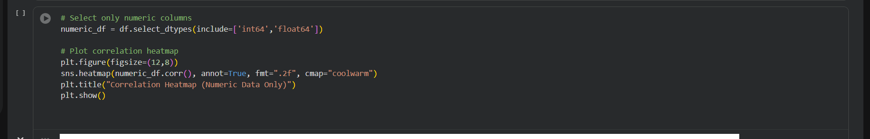
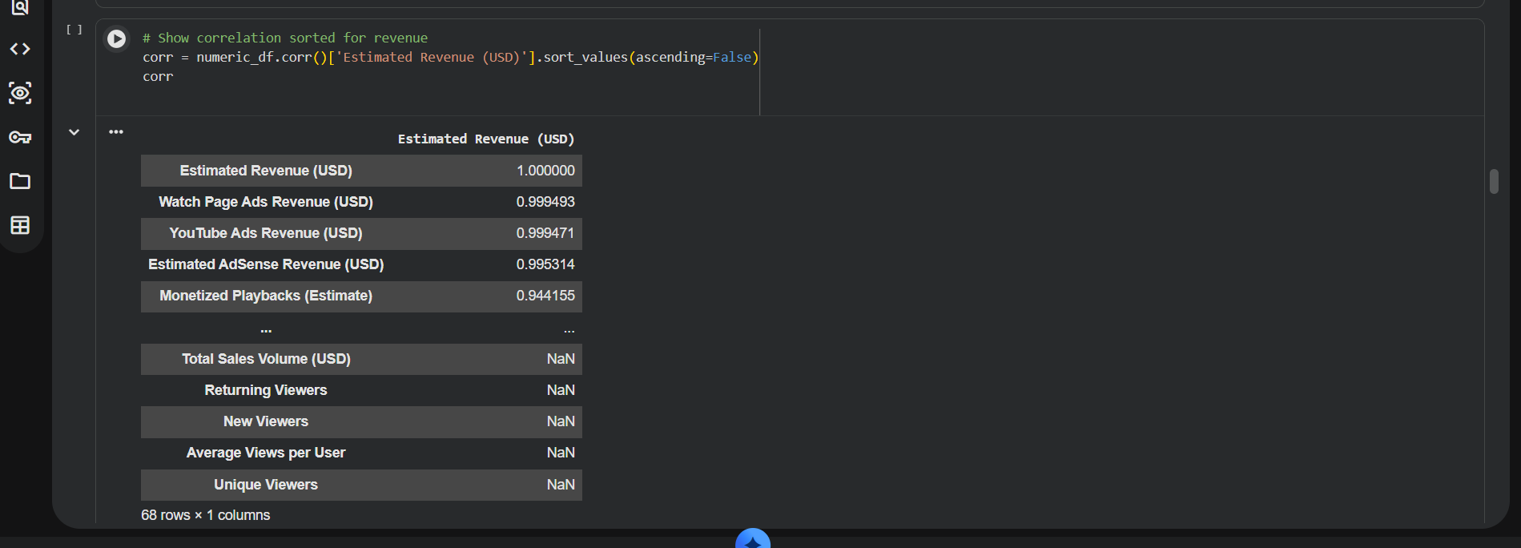

Slide 16
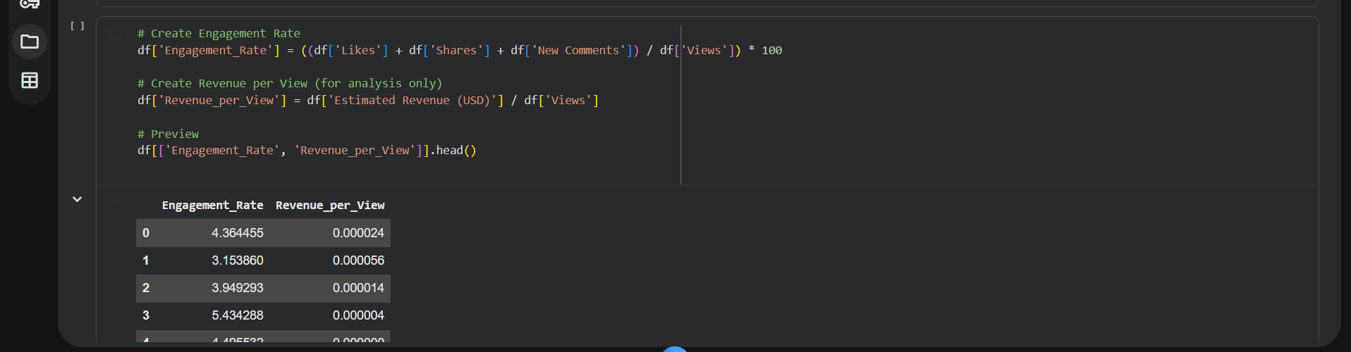
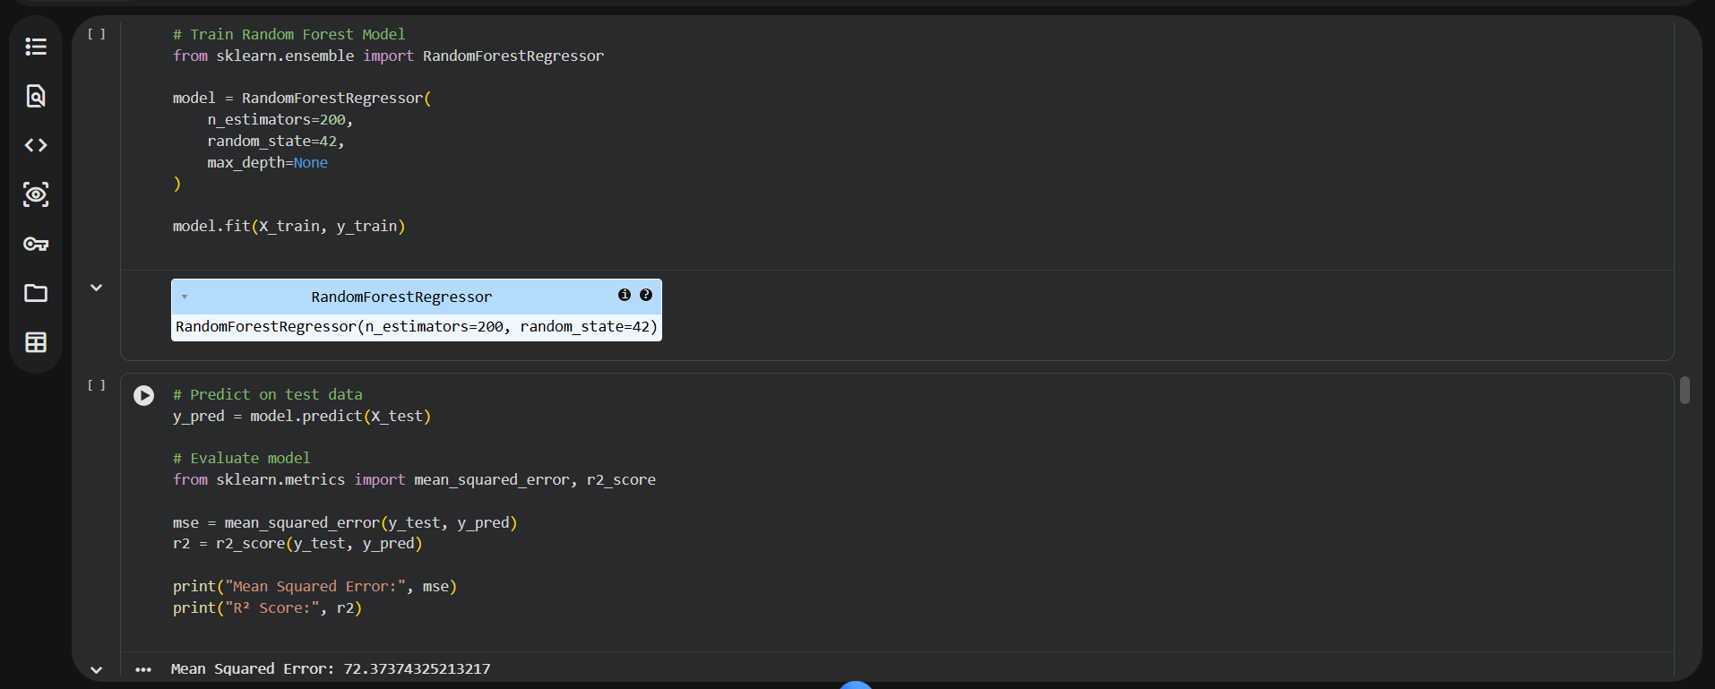

Slide 17
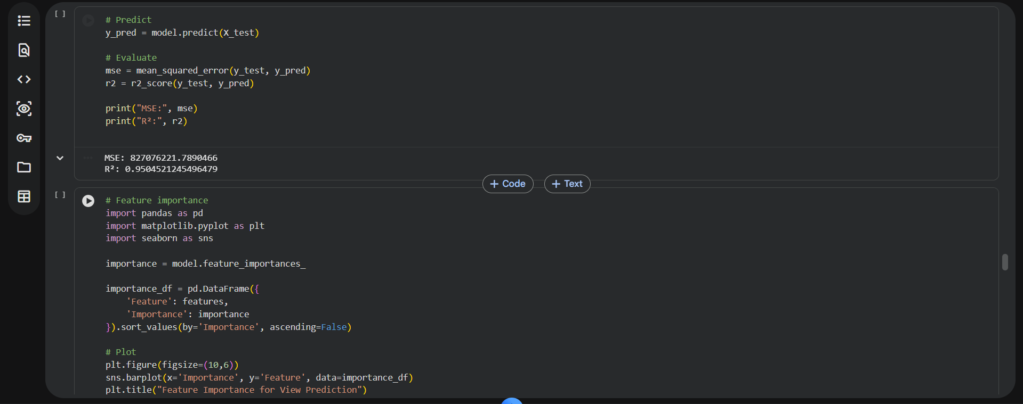

Slide 18
