Slide 1
Identifying Locality Types in Toronto

Slide 2
Why?
New businesses face tough competition from existing businesses
Identify opportunities (in the form of locations) where new business may be the pioneers would ensure profit
This will also help the local residents who have had to travel far until now to enjoy such luxuries

Slide 3
Data acquistion
Foursquare API
Geocoder package

Slide 4
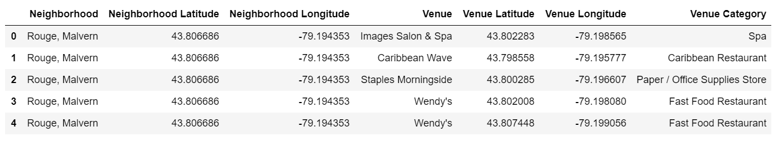
The dataset

Slide 5
Data Transformation
Data was transformed to include only restaurant venues
One hot encoding technique was used to transform textual data to numerical values

Slide 6
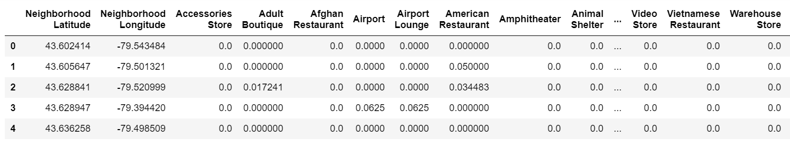
After transformation

Slide 7
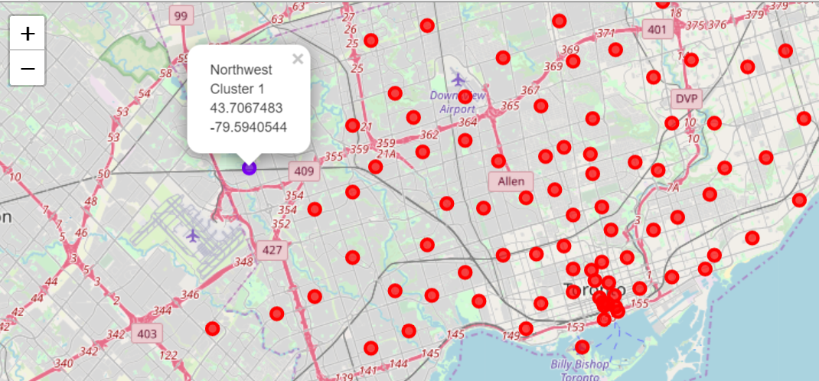
Clustering and visualisation

Slide 8
Conclusion
A locality with business opportunity for new restauranteurs has been identified through this clustering process
However, this result needs to be taken with a grain of salt, since we have relied on a single data source for venue details and as mentioned in the discussion section, there could be restaurants in the locality that weren’t captured in data sources for numerous reasons.

Slide 9
Thank you

