Slide 1
Ultrasound Pretreatment and Vacuum Drying Kinetics of Soursop (Annona muricata) Slabs
Grace Bill Uro
20/EG/FE/580
Supervisor: Dr. Ayobami Olayemi Oladejo
Department of Agricultural and Food Engineering
Faculty of Engineering, University of Uyo

Slide 2
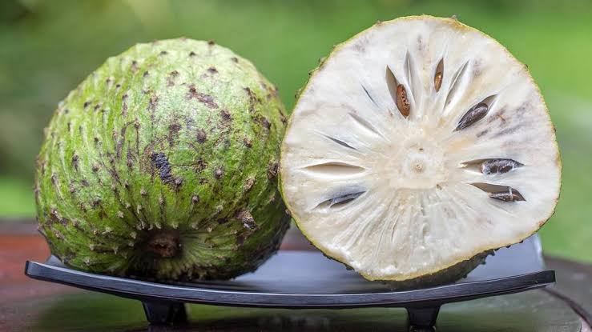
Background of the Study
Soursop is a high-moisture tropical fruit that softens and deteriorates quickly after harvest.
Hot-air drying extends shelf life but can destroy vitamin C and carotenoids and cause case hardening.
Vacuum drying works at lower temperature with little oxygen, but it is slow.
Ultrasound pretreatment creates micro-channels in the tissue (the “sponge effect”) and has cut drying time in other crops:
  carrot 41–53% (Chen et al., 2016); yellow cassava 35% (Oladejo et al., 2021); roselle 47% (Oladejo et al., 2023)
There is little information on combining ultrasound with vacuum drying for soursop.
Soursop fruit (Fig. 1.1)
Grace Bill Uro · Ultrasound pretreatment and vacuum drying of soursop
2

Slide 3
Aim and Objectives
Aim: to investigate the effects of ultrasound immersion pretreatment on the drying kinetics, modelling, moisture diffusivity and activation energy of soursop slabs during vacuum drying.
Objectives
Determine the effect of ultrasound time (0, 5, 10, 15 min) on mass gain of the slabs.
Evaluate vacuum drying kinetics at 50, 60 and 70 °C.
Fit eight thin-layer drying models and select the most suitable.
Determine the effective moisture diffusivity (Deff) and activation energy (Ea).
Test the effects with two-way ANOVA and post-hoc tests (LSD, DMRT, Tukey).
Grace Bill Uro · Ultrasound pretreatment and vacuum drying of soursop
3

Slide 4
Materials and Methods
Samples: fresh soursop from Akpan Andem Market, Uyo; peeled and cut into 3 mm slabs of about 3 g.
Ultrasound: 20 kHz, 600 W probe in 500 mL distilled water for 0, 5, 10 and 15 min.
Vacuum drying: 10 kPa absolute pressure at 50, 60 and 70 °C; mass recorded to 0.001 g.
Design: 4 × 3 full factorial, 12 treatments, three slabs each (36 units).
Analysis: moisture ratio, drying rate, eight thin-layer models (R², RMSE, χ²), Deff from Fick’s law, Ea from the Arrhenius equation, two-way ANOVA.
Grace Bill Uro · Ultrasound pretreatment and vacuum drying of soursop
4

Slide 5
Result 1: Mass Gain after Ultrasound
Mass gain increased with ultrasound time (F(2, 21) = 21.51, p < 0.001).
The 10 and 15 min gains were not significantly different.
The slabs absorbed water during sonication, which then had to be removed during drying.
Grace Bill Uro · Ultrasound pretreatment and vacuum drying of soursop
5

Slide 6
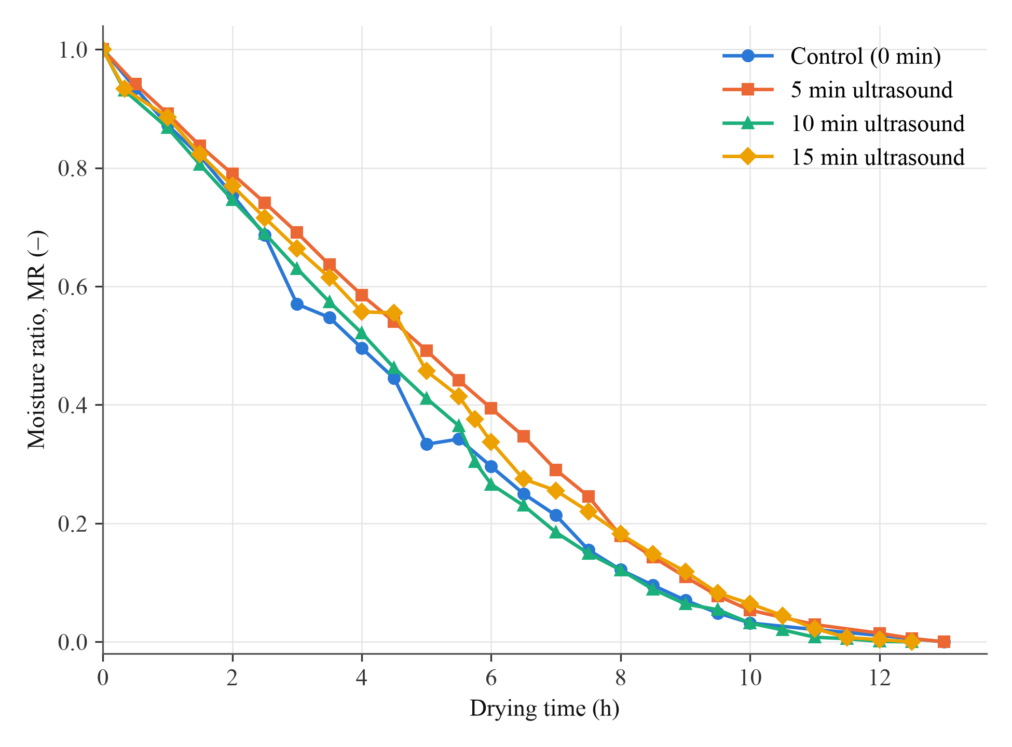
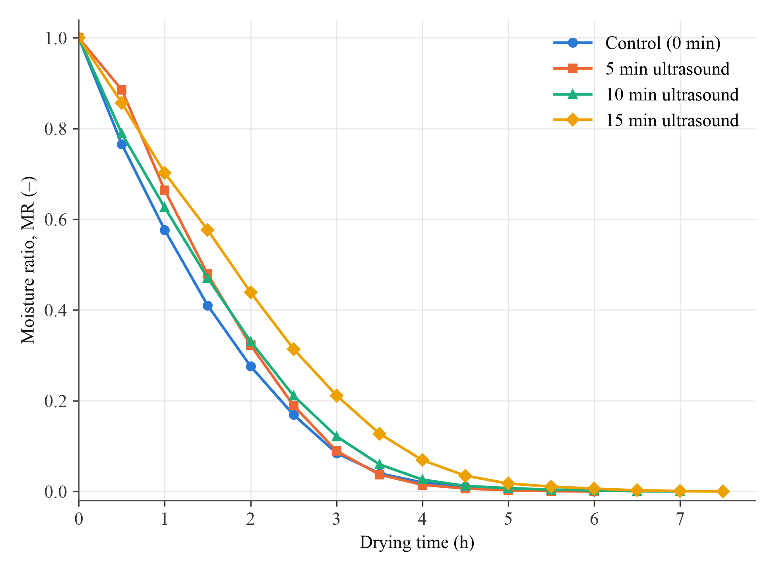
Result 2: Drying Curves
Fig. 4.1: 50 °C
Fig. 4.3: 70 °C
Raising temperature from 50 to 70 °C cut drying time of the control from 13.0 h to 6.0 h (54%).
Ultrasound did not shorten drying time at any temperature.
Grace Bill Uro · Ultrasound pretreatment and vacuum drying of soursop
6

Slide 7
Result 3: Thin-Layer Model Fitting
Model (60 °C, control) | R² | RMSE
Lewis (Newton) | 0.9835 | 0.0402
Page | 0.9975 | 0.0155
Modified Page | 0.9975 | 0.0155
Henderson and Pabis | 0.9865 | 0.0363
Logarithmic | 0.9958 | 0.0202
Two-term | 0.9865 | 0.0363
Wang and Singh | 0.9968 | 0.0177
Midilli et al. | 0.9987 | 0.0112
Midilli et al. model gave the best fit in 9 of the 12 runs.
Wang and Singh model fitted best in the other 3 runs (ultrasound runs at 60 °C).
Best-fit R² = 0.9962 to 0.9993; RMSE = 0.0089 to 0.0199.
Grace Bill Uro · Ultrasound pretreatment and vacuum drying of soursop
7

Slide 8
Result 4: Moisture Diffusivity and Activation Energy
Treatment | Deff 50 °C | Deff 60 °C | Deff 70 °C | Ea (kJ/mol)
Control | 0.987 | 1.921 | 2.851 | 48.99
5 min US | 0.901 | 1.960 | 3.293 | 59.85
10 min US | 1.129 | 1.900 | 2.826 | 42.35
15 min US | 1.002 | 1.701 | 2.544 | 43.00
Deff values are × 10⁻¹⁰ m²/s (mean, n = 3)
Deff increased with drying temperature and followed the Arrhenius relationship (R² = 0.9834 to 0.9963).
Activation energy ranged from 42.35 to 59.85 kJ/mol; 10 and 15 min ultrasound gave lower values than the control.
Grace Bill Uro · Ultrasound pretreatment and vacuum drying of soursop
8

Slide 9
Result 5: Analysis of Variance
Source | df | F | p
Temperature (T) | 2 | 460.60 | < 0.001
Ultrasound time (US) | 3 | 6.22 | 0.003
T × US | 6 | 4.62 | 0.003
Error | 24 | – | –
Drying temperature was the main factor (92.9% of the total sum of squares).
Ultrasound time and the interaction were significant, but ultrasound did not change Deff at 50 or 60 °C.
The Modified Page rate constant k (0.171 to 0.634 h⁻¹) showed the same pattern; 15 min ultrasound dried slower than the control at 60 and 70 °C.
Two-way ANOVA for Deff
Grace Bill Uro · Ultrasound pretreatment and vacuum drying of soursop
9

Slide 10
Conclusions
Ultrasound increased slab mass by 9.74% to 28.27% through water uptake.
Drying at 60 and 70 °C occurred mainly in the falling-rate period.
Raising temperature from 50 to 70 °C reduced drying time by 54%; ultrasound did not shorten drying.
The Midilli et al. model best described the drying curves.
Deff ranged from 0.901 to 3.293 × 10⁻¹⁰ m²/s and Ea from 42.35 to 59.85 kJ/mol.
Drying temperature, not ultrasound, was the main factor controlling vacuum drying of soursop.
Grace Bill Uro · Ultrasound pretreatment and vacuum drying of soursop
10

Slide 11
Recommendations
Vacuum dry soursop slabs at 70 °C and 10 kPa for the shortest drying time (about 6 h); ultrasound immersion is not recommended for shortening drying.
Measure retention of vitamin C, phenolics, flavonoids and antioxidant capacity in the dried slabs.
Carry out energy and exergy analyses of ultrasound-assisted vacuum drying.
Include a water-soaked control and test pulsed, multi-frequency and airborne ultrasound in future work.
Grace Bill Uro · Ultrasound pretreatment and vacuum drying of soursop
11

Slide 12
Thank You
Questions and comments are welcome.

