Slide 1
The Effect of Pretreatment on the Oil Yield of African Star Apple
Udedeh, Wisdom Aniefiok
20/EG/AE/705
Agricultural Engineering
Supervisor: Dr. Elijah G. Ikrang
Department of Agricultural and Food Engineering
Faculty of Engineering, University of Uyo

Slide 2
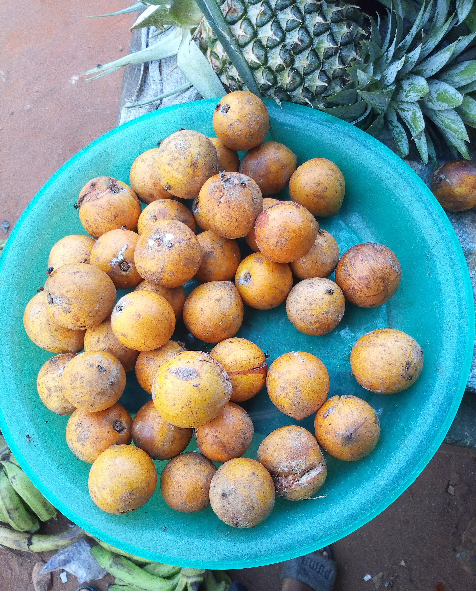
Background and Problem
African star apple (Chrysophyllum albidum) seeds are usually thrown away after the fruit is eaten.
The seed oil can be used for soaps, cosmetics, lubricants and biodiesel.
The seed is low in oil (about 10–24%), so recovery must be improved.
Heat pretreatment can break seed cells and improve oil flow, but too much heat lowers yield and quality.
No validated oven temperature and time exist for these seeds.
African star apple fruits (Fig. 1.1)
Udedeh, Wisdom Aniefiok · Effect of pretreatment on the oil yield of African star apple
2

Slide 3
Aim and Objectives
Aim: to determine and optimise the effects of oven pretreatment temperature and duration on oil yield from African star apple seeds using Response Surface Methodology (RSM).
Objectives
Prepare the seeds to uniform particle size and determine initial moisture content.
Pretreat the seeds at selected temperature–time combinations and extract the oil by Soxhlet.
Determine the linear, interaction and quadratic effects of temperature and time on oil yield.
Develop a second-order model, find the optimum and validate it.
Determine the physicochemical properties of the oil.
Udedeh, Wisdom Aniefiok · Effect of pretreatment on the oil yield of African star apple
3

Slide 4
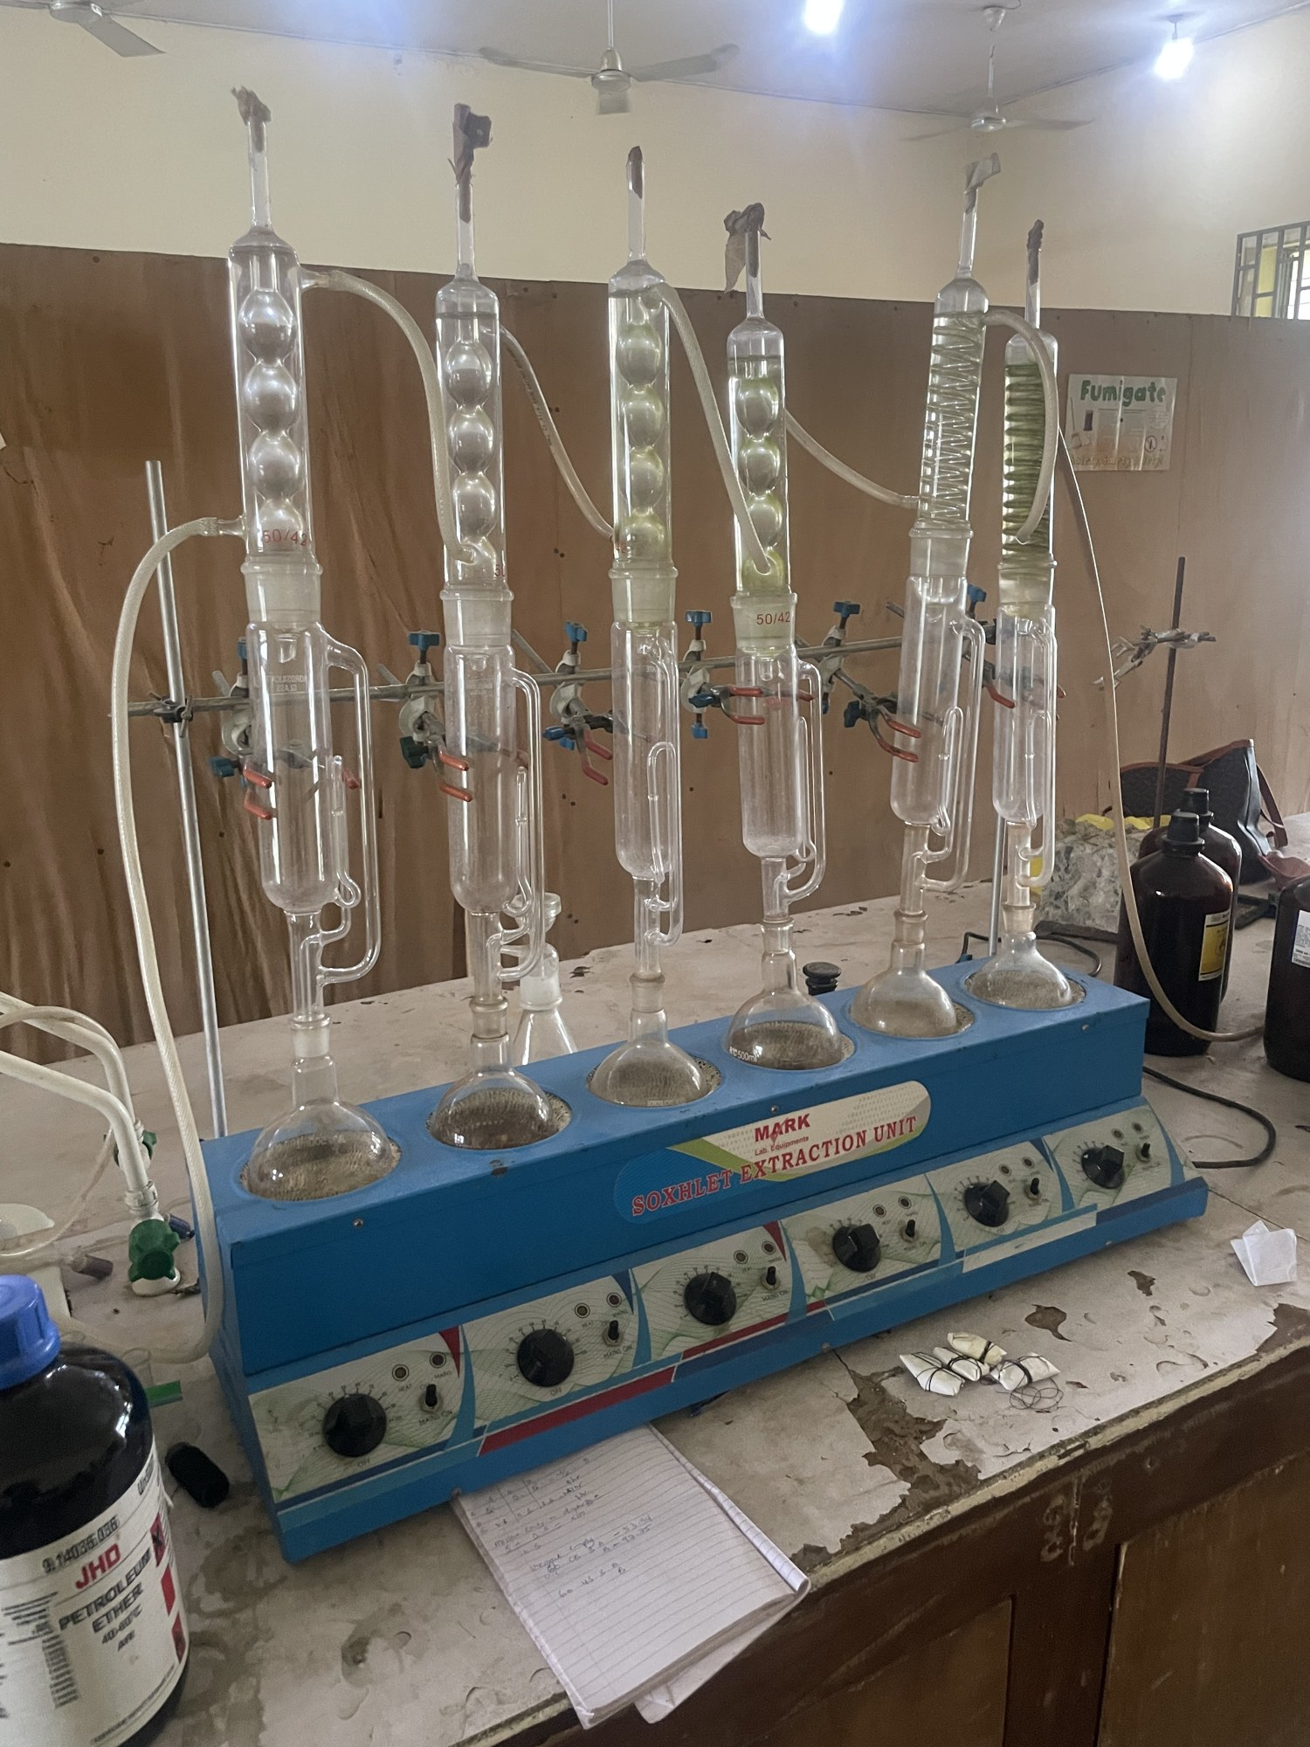
Materials and Methods
Preparation: seeds washed, dried, cracked, milled and sieved (2 mm).
Moisture content: oven drying at 105 °C to constant mass.
Pretreatment: oven at 50–90 °C for 5–20 min.
Extraction: Soxhlet, 20 g sample with 250 mL n-hexane for 6 h.
Design: face-centred central composite design, 2 factors at 3 levels, 13 runs.
Oil analysis: acid, saponification and iodine values, specific gravity, refractive index.
Soxhlet set-up (Fig. 3.1)
Udedeh, Wisdom Aniefiok · Effect of pretreatment on the oil yield of African star apple
4

Slide 5
Experimental Design
Factor | Symbol | Low (−1) | Centre (0) | High (+1)
Temperature (°C) | X₁ | 50 | 70 | 90
Duration (min) | X₂ | 5 | 12.5 | 20
13 runs: 4 factorial points, 4 axial points and 5 centre points.
Each run extracted in triplicate; an untreated control was extracted the same way.
Second-order model: Y = β₀ + β₁X₁ + β₂X₂ + β₁₂X₁X₂ + β₁₁X₁² + β₂₂X₂²
Udedeh, Wisdom Aniefiok · Effect of pretreatment on the oil yield of African star apple
5

Slide 6
Result 1: Oil Yield
Initial moisture content: 8.74%.
Untreated control yield: 10.82%.
Every pretreated run gave more oil (11.85% to 16.92%).
Highest yields at the centre point (70 °C, 12.5 min).
Udedeh, Wisdom Aniefiok · Effect of pretreatment on the oil yield of African star apple
6

Slide 7
Result 2: Analysis of Variance
Source | F | p | Remark
Model | 26.04 | 0.0002 | Significant
X₁ Temperature | 29.17 | 0.0010 | Significant
X₂ Duration | 11.89 | 0.0107 | Significant
X₁X₂ Interaction | 0.18 | 0.6821 | Not significant
X₁² Temperature² | 38.95 | 0.0004 | Significant
X₂² Duration² | 17.30 | 0.0042 | Significant
Lack of fit | 190.80 | < 0.0001 | Significant
Fitted model (coded):
  Y = 16.65 + 1.16X₁ + 0.74X₂ − 0.11X₁X₂ − 1.98X₁² − 1.32X₂²
R² = 0.949; adjusted R² = 0.913.
Temperature had a larger effect than duration.
Lack of fit was significant, so the model is best used to describe trends.
Udedeh, Wisdom Aniefiok · Effect of pretreatment on the oil yield of African star apple
7

Slide 8
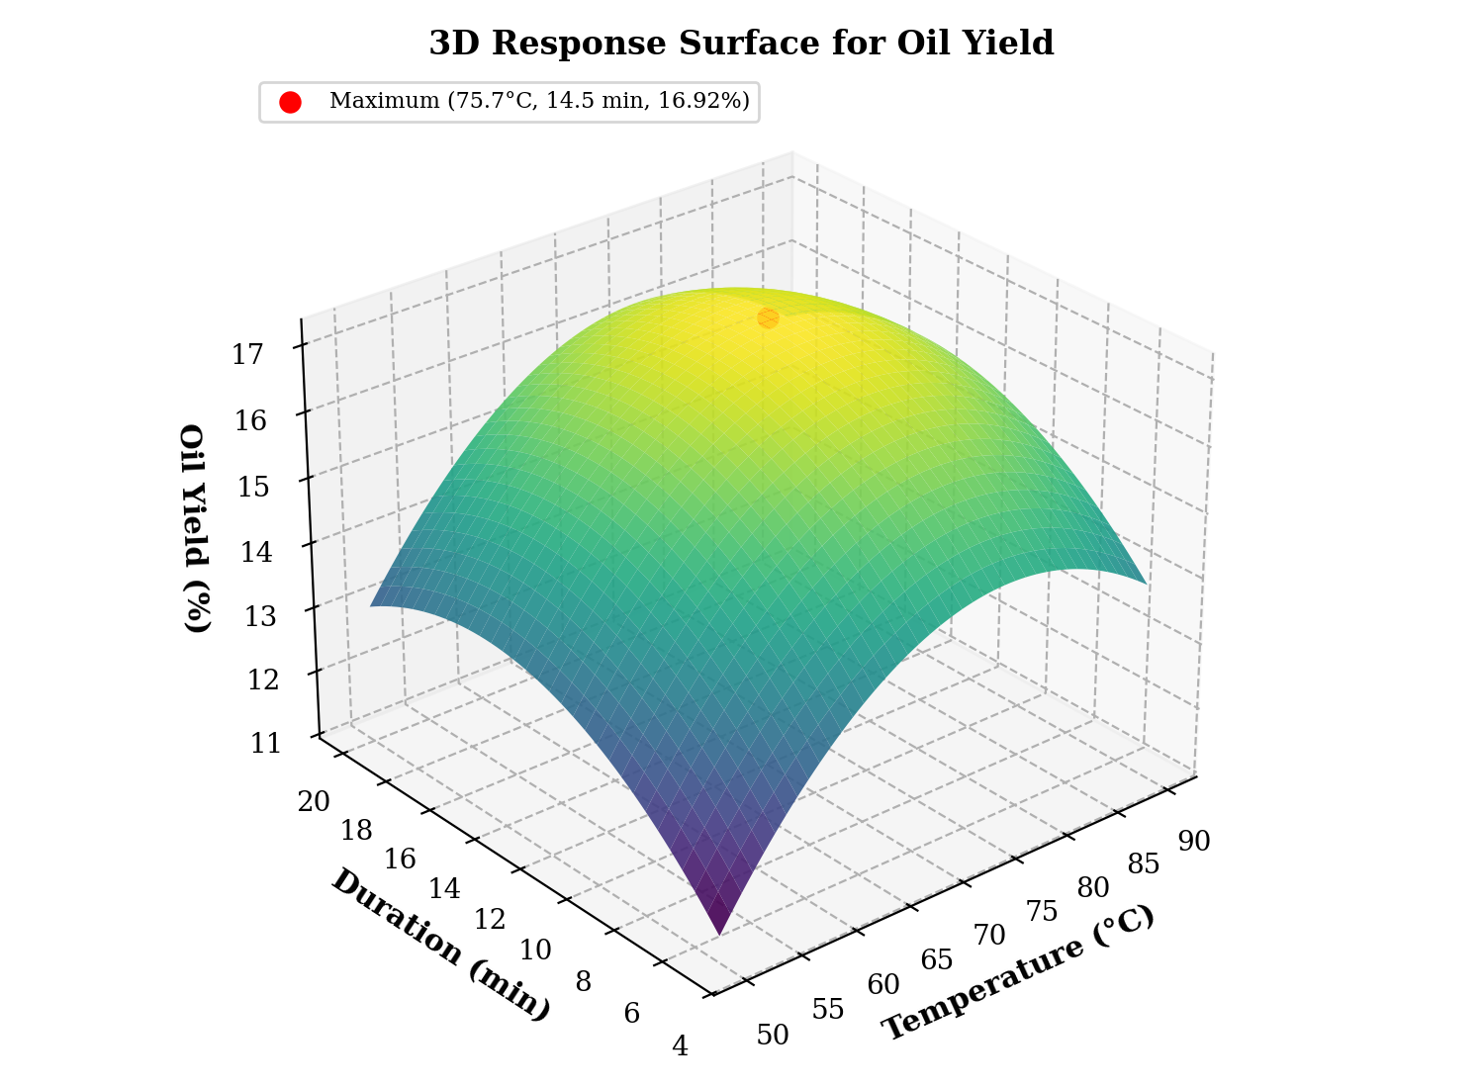
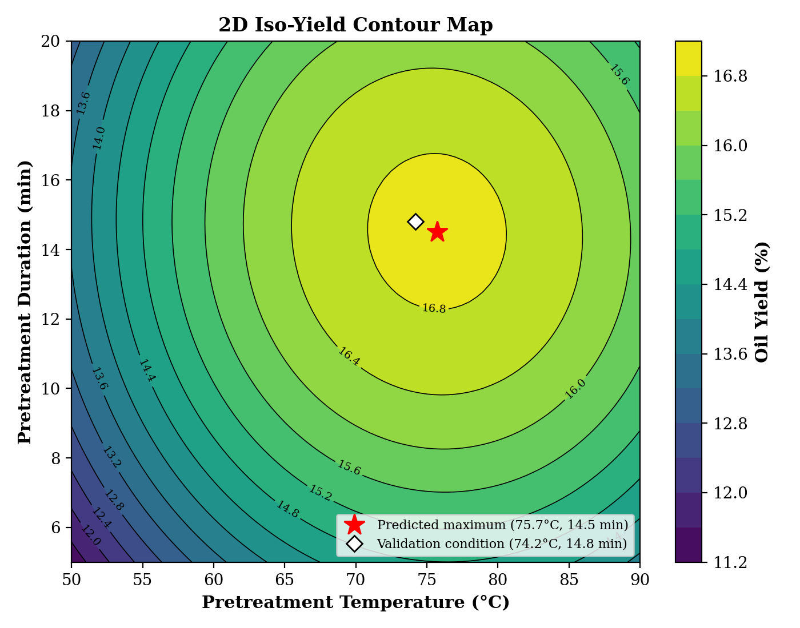
Result 3: Response Surface and Optimum
Fig. 4.23: Response surface
Fig. 4.24: Contour plot
Predicted maximum yield of 16.92% at 75.7 °C and 14.5 min.
Udedeh, Wisdom Aniefiok · Effect of pretreatment on the oil yield of African star apple
8

Slide 9
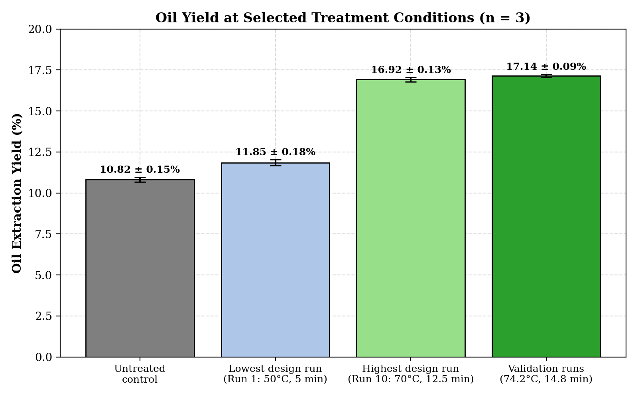
Result 4: Validation
Condition | Oil yield (%)
Untreated control | 10.82 ± 0.15
Predicted at optimum | 16.91
Observed at 74.2 °C, 14.8 min | 17.14 ± 0.09
Observed yield was within 1.36% of the predicted value.
Pretreatment increased oil yield by 58.41% over the untreated seed.
Fig. 4.1: Oil yield at selected conditions
Udedeh, Wisdom Aniefiok · Effect of pretreatment on the oil yield of African star apple
9

Slide 10
Result 5: Physicochemical Properties of the Oil
Property | Untreated | Pretreated | Reference
Acid value (mg KOH/g) | 3.85 ± 0.12 | 3.25 ± 0.10 | ≤ 4.0
Saponification value (mg KOH/g) | 188.32 ± 1.53 | 194.80 ± 1.59 | 180–200
Iodine value (g I₂/100 g) | 54.15 ± 0.89 | 58.66 ± 0.76 | < 100
Specific gravity (25 °C) | 0.9124 ± 0.0015 | 0.9168 ± 0.0012 | 0.890–0.930
Refractive index (25 °C) | 1.4652 ± 0.0006 | 1.4678 ± 0.0005 | 1.450–1.480
Pretreatment lowered the acid value, consistent with heat inactivating seed lipases.
All other properties stayed within the reference ranges for vegetable oils; the oil is non-drying.
Udedeh, Wisdom Aniefiok · Effect of pretreatment on the oil yield of African star apple
10

Slide 11
Conclusions
Oven pretreatment raised oil yield from 10.82% to 17.14%, an increase of 58.41%.
Temperature had a larger effect than duration, and the two did not interact significantly.
RSM gave a significant quadratic model (R² = 0.949).
The predicted optimum was 75.7 °C for 14.5 min; validation at 74.2 °C for 14.8 min gave 17.14%.
Pretreatment lowered the acid value and kept other oil properties within standard limits.
Udedeh, Wisdom Aniefiok · Effect of pretreatment on the oil yield of African star apple
11

Slide 12
Recommendations and Contribution to Knowledge
Recommendations
  Test continuous pretreatment (rotary drum, fluidised bed) at pilot scale.
  Try greener solvents such as bio-ethanol, ethyl lactate or supercritical CO₂.
  Carry out GC-MS fatty-acid profiling and thermal analysis of the oil.
  Carry out techno-economic and life-cycle assessments, including use of the seed cake.
Contribution to knowledge
  A validated pretreatment condition (74.2 °C, 14.8 min) for African star apple seeds.
  Second-order equations linking pretreatment conditions to oil yield.
  A practical way to turn star apple seed waste into useful oil.
Udedeh, Wisdom Aniefiok · Effect of pretreatment on the oil yield of African star apple
12

Slide 13
Thank You
Questions and comments are welcome.

