Slide 1
Gas station management system API

Slide 2
Top features
Manage users as Admin, Financier, Worker
Manage fuels
Process orders and bills
Take statistics on daily, monthly or yearly bases
Manage accounting

Slide 3
Technologies used

Slide 4

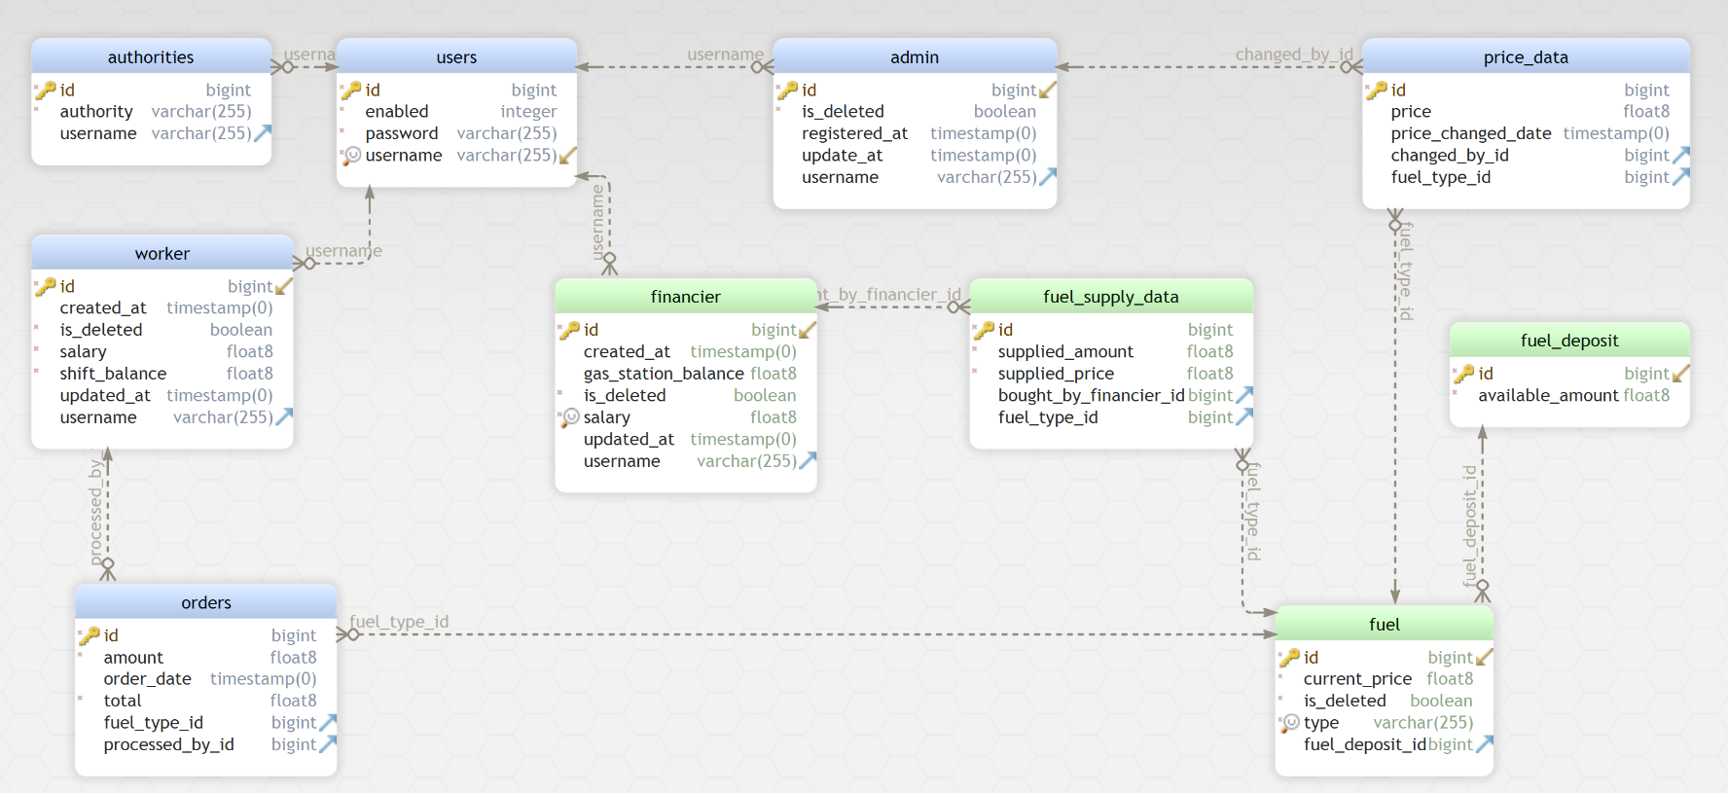
DataBase Schema

Slide 5
Features By Users
Admin
Manage financiers(Register, Update, Delete)
Manage workers(Register, Update, Delete)
Financier
Gas station accounting(Invest, Collect Incomes, Buy Fuel Supply)
Manage statistics(Daily, Monthly, Yearly)
Worker
Process orders
Check shift balance current and past

Slide 6
Developed By
Klement BINAJ
@iKub Labs

