Slide 1
CSS Breakpoint
Jonathan Allen

Slide 2
What Is It?
This was introduced in CSS3, It was designed to help a user make changes into large sections of the page as it changes sizes, such as from mobile to tablet to desktop.
It is a media query, show like this:
@media only screen and (min-width: 768px)

Slide 3
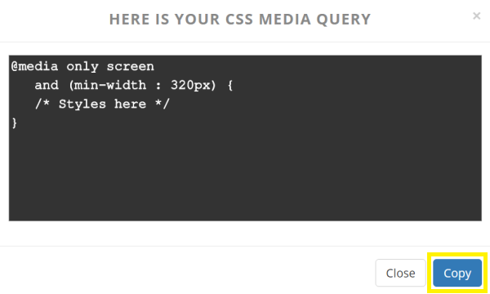
Example

Slide 4
A Good Practice
It is always good to start with the smaller site, or in other words you want to start with the mobile sites, this actually helps the speed for the site as well, it also makes it very easy to make the screen larger.
Instead of setting a max size start with the min so that it is any size will work.

Slide 5
Uses
Screen sizes
Screen orientation
Changing large amounts of your site quickly
Supporting different devices

Slide 6
Source
http://www.w3schools.com/css/css_rwd_mediaqueries.asp

