Slide 1
UI Design
Item organizer

Slide 2

























UX Affordances
Any, Nothing, Nada, Who-Cares? None-of-the-…, etc.
Validate Markdown
My Org
Sort direction rotation
Me, aka Current-User
Toggle Edit/Preview
Check Toggle
Unsorted
Ascending
Now, Today
Spellcheck
Descending
Entities
Fields
Item / Id
Kind (story, bug, etc.)
p2
Priority/Severity
Organization
State (status)
123
Rank (sub-sort)
Tags
Created Date
History
Created By
Attachments
Updated Date
Relationships
Assigned To
Name/Value Pairs

Slide 3

Page: Logged Out
Item Organizer

Slide 4
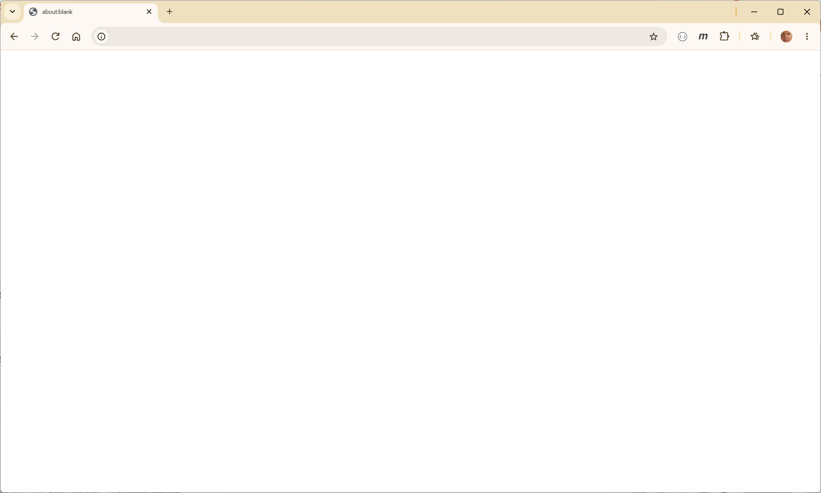




Page: Logged in
Item organizer
Stuart Williams (1), Root Organization (0)
Minimal Header
Client Area
No Footer!

Slide 5
Views
Views

Slide 6



Views: Item
12345
title
My Organization
Bug
triaged
p2
123456
bob@bob.org
2026-05-02 14:35
me@oh-my.com
2026-09-22 09:00
Abcdefg

Slide 7





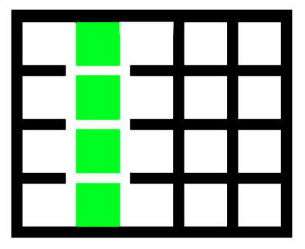

View: Item List/Search
/
me@oh-my.com
Bug, Task, …
blocked, testable
P2, P3, …
/
2026-05-02
2026-09-22
Cows, Fun,
Predecessor (43)
Values in (…)
/
1
/
7
GRID

Slide 8
View: Reporting
Report Type
Report Name

Slide 9
Panels
Main Panels

Slide 10

Panel: History
Date
Who
Text
2026-01-01 19:31
spookdejur@hotmail.com
Moo Cows are Fun
Date
Who
Text
Date
Who
Text
Date
Who
Text
Date
Who
Text

Slide 11

Panel: Tags
Cows
Monumental
Moo

Slide 12

Panel: Attachments
Date
Who
Caption
URL
2026-01-01 19:31
spookdejur@hotmail.com
Handy Doc
https://storage.mycloud.dsk/33d56sag4

Slide 13
Panel: Relationships
Relation
ID
Title
Parent
1
Parent Item
Predecessor
5
Do some other thing

Slide 14
Panel: Name / Value
ABC = DEF
Job Id = 132424
Zone = Alpha

Slide 15
Dialog: Specialty
Application Specifics

Slide 16


Dialog: Settings
Settings
Users
Organizations

Slide 17





Dialog: Login
Login
joe@nomail.org
*************

Slide 18


Dialog: Attachment
Attachment
Caption
https://storage.cloud/ders3n

Slide 19
Dialog: Add Relation
Add Relationship
Parent
12345
title

Slide 20


Dialog: Add/Edit Name Value
Name = Value
Project ID
12354

Slide 21
Dialog: Column Picker
Columns
Id
Title
Body
Organization
Kind
Priority
Assigned_To
Update_Date

Slide 22


Dialog: Reorder
Re-Order List by Rank
100
10

Slide 23


Dialog: User Picker
Pick a Person: {my purpose}
0
Admin
Admin
[0] Root Org
1
Stuart W
spookdejur@hotmail.com
[0] Root Org, [1] Child Org, …
7
Bob D
bob.dobbs@nomail.org
[9] Number 9 Org
Search for users here (ilike %text%)

Slide 24





Dialog: Edit a User
User: {purpose}
9
Bob D
bob.dobbs@nomail.org
Move this user to a new org parent
14
[9] Number 9 Org
Edit Users Organizations, Memberships, and Roles
Force Reset of Password
Remove user, all items will be re-assigned to user , check box to confirm:
1
[1] spookdejur@hotmail.com

Slide 25



Dialog: Reset Password
Reset-Password
ABC-123-6DC-HGF
*************
*************
^[a-z0-9!#$().-]{11,}$

Slide 26

Dialog: Organization Picker
Pick an Organization for {purpose}
0
Root Organization
1
Sub Organization
7
Sub Organization
9
> Sub-Sub Organization
10
> Sub-Sub Organization
Search for orgs here (ilike %text%)

Slide 27



Dialog: Organization Editor
Organization: {purpose}
10
Move this under a new parent
14
Add a child organization…
Remove organization and all its children, reassign all to parent, be SURE, check the box to confirm…

Slide 28
Dialog: Edit User Org Membership and Role Permissions
Organization Permissions
none
0
Root Organization
editor
7
Sub Organization
commenter
9
> Sub-Sub Organization
9
Bob D
bob.dobbs@nomail.org

Slide 29
Generic Dialogs
Multi-Scenario Uses

Slide 30
Dialog: Text Edit
Text Editor
Text

Slide 31
Dialog: Number Edit
Number
#
1234

Slide 32
Dialog: Pick ONE
Pick one (1): {purpose}
Item 1
Item 2
Item 3
Item 4
Item 5
Item 6

Slide 33
Dialog: Multi-Pick
Pick Many: {purpose}
Item 1
Item 2
Item 3
Item 4
Item 5
Item 6

Slide 34
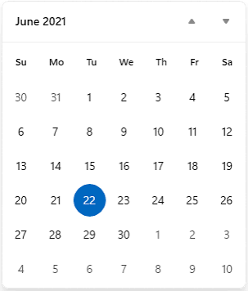



Dialog: Date Picker
Date for: {my purpose}
2021
06
22

Slide 35



Dialog: Download
Download
/usr/home/tmp/xyz.json

