Slide 1
Closing the Sim-to-Real Loop: Adapting Simulation Randomization with Real World Experience
Yevgen Chebotar, Ankur Handa, Viktor Makoviychuk, Miles Macklin, Jan Issac, Nathan Ratliff, Dieter Fox

Slide 2
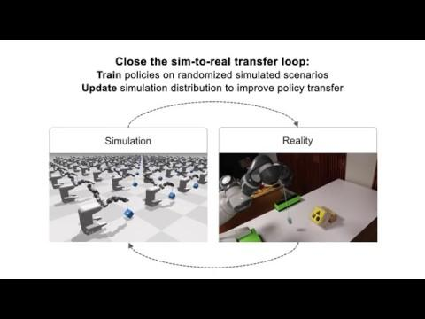
Overall Idea
Simulated environments allow us to train on a large variety of scenarios.
We want to train policies that assume little knowledge about the 3D world model and hope to transfer these policies to real world.
Train in simulation and run it in real world and repeat the process until the policy starts to solve the task in real world.

Slide 3
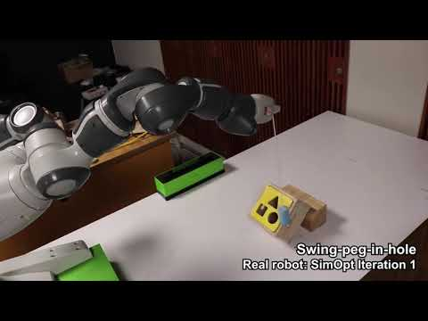
Closing the sim-to-real loop
Reality Gap:
Policies trained in simulation rarely transfer to real world.
Physics parameters in simulation do not match with the real world parameters.
We wish to close the gap between simulation and real world.
Physics Properties we want to optimise:
Rope density
Rope stiffness
Rope damping
Peg density

Slide 4
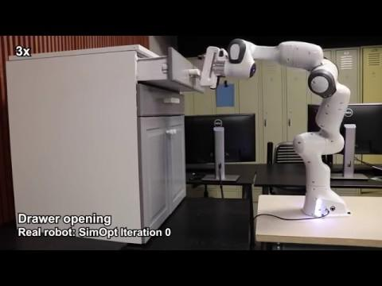
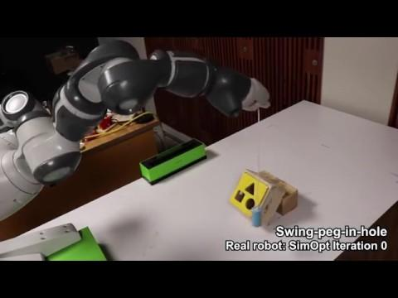
Experiments on two different tasks / robots
Franka: Opening a cabinet drawer
YuMi: Swinging peg-in-a-hole

Slide 5
Background
Ensemble methods (e.g. Sequential Monte Carlo Sampling) are important for robustness
Particle Filter, Del Moral et al., 1996
CMA, Hansen, 2006
Ensemble CIO, Mordatch, 2015
EPOpt, Rajeswaran, 2016
CAD^2 RL, Sadeghi, 2017
Domain Randomisation, Tobin, 2017
Deep Object Pose Estimation (DOPE), Tremblay, 2018

Slide 6
Motivation
Popular ensemble based methods (e.g. Domain Randomisation) define distribution on physics parameters to learn a robust policy
Peng et al., ICRA 18
Each parameter is treated independently
p(friction, damping) = p(friction)p(damping)
This is limiting
Distribution parameters are chosen ad-hoc and kept fixed throughout the training.
Real world does have correlations among various parameters and therefore independence assumption is not valid anymore.

Slide 7
Experiments on two different tasks / robots
Covariance of parameters as they are optimised
e.g. rope compliance, rope damping, rope density etc.
YuMi: Swinging peg-in-a-hole

Slide 8
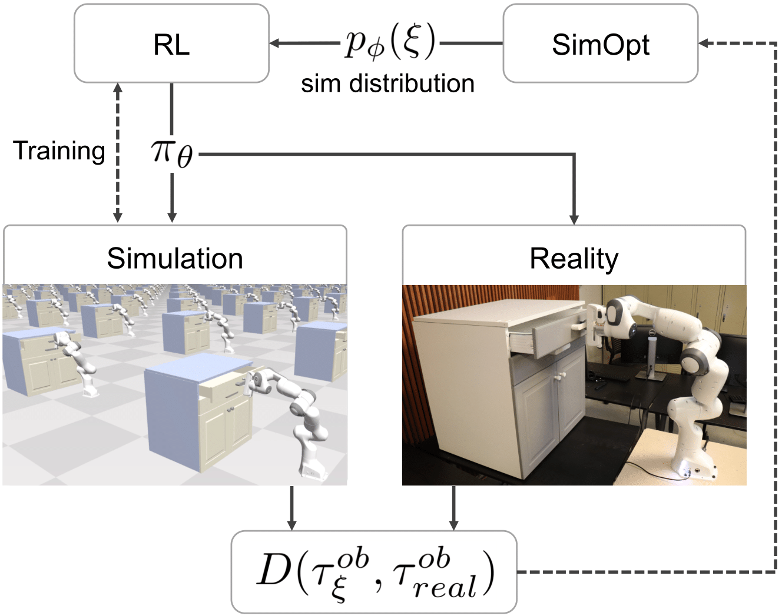
Overall Idea
Physics p

