Slide 1


Lockheed Martin Quarterly Reports 2021 to 2022
Data Analysis practice

Slide 2
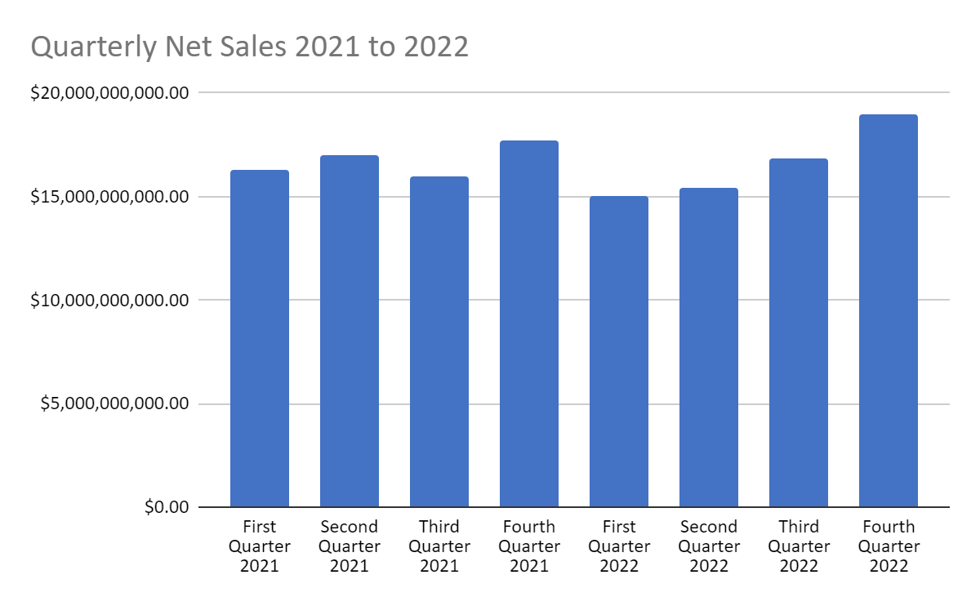
Quarterly Net Sales
These are the Quarterly Net Sales from 2021 to 2022
As you will notice sales dipped at the start of 2022 and exceeded 2021 performance by the 4th quarter

Slide 3
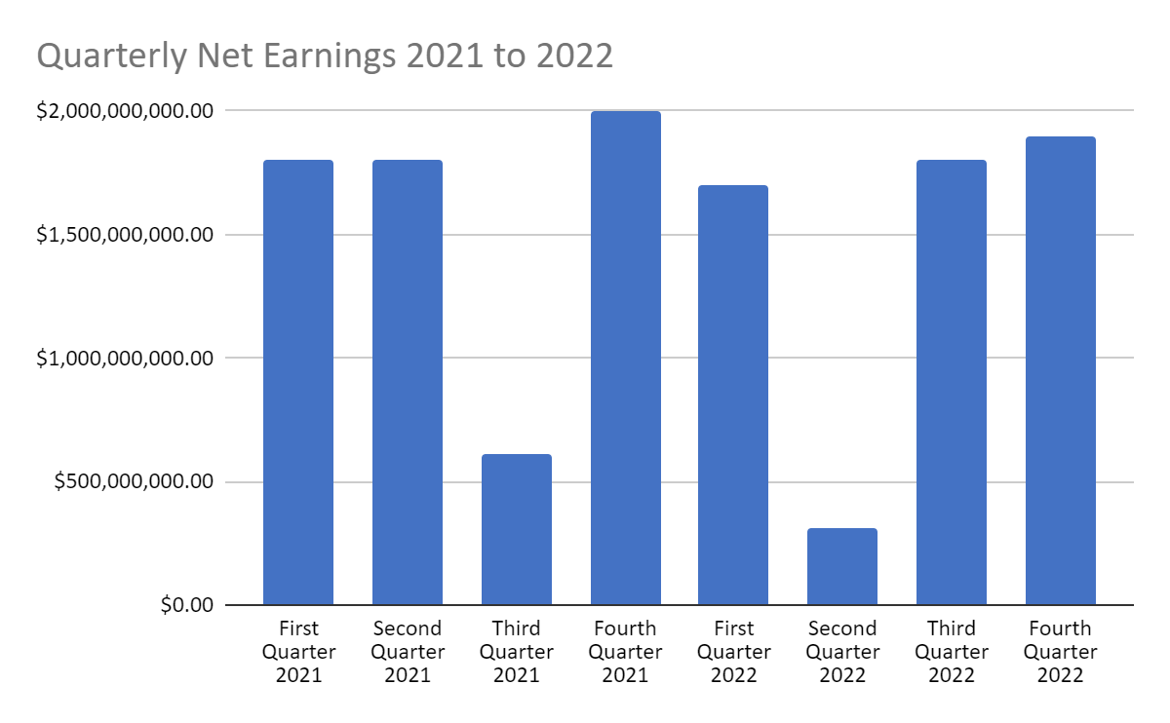
Quarterly Net Earnings
Third Quarter 2021 and Second Quarter 2022 are the lowest quarters for Net Earnings while sales remained the same.

Slide 4
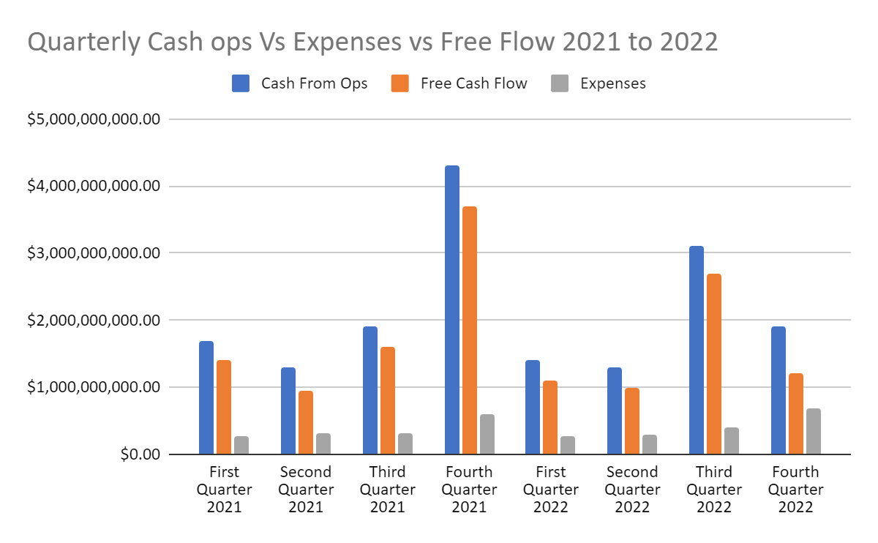
Quarterly Cash ops, Expenses, and Free Flow
The Final Quarter of 2021 was the highest by far. In comparison 2022 has taken a very sharp decline.
Compared to all other quarters 4th quarter 2021 is above average with third quarter 2022 just behind

Slide 5
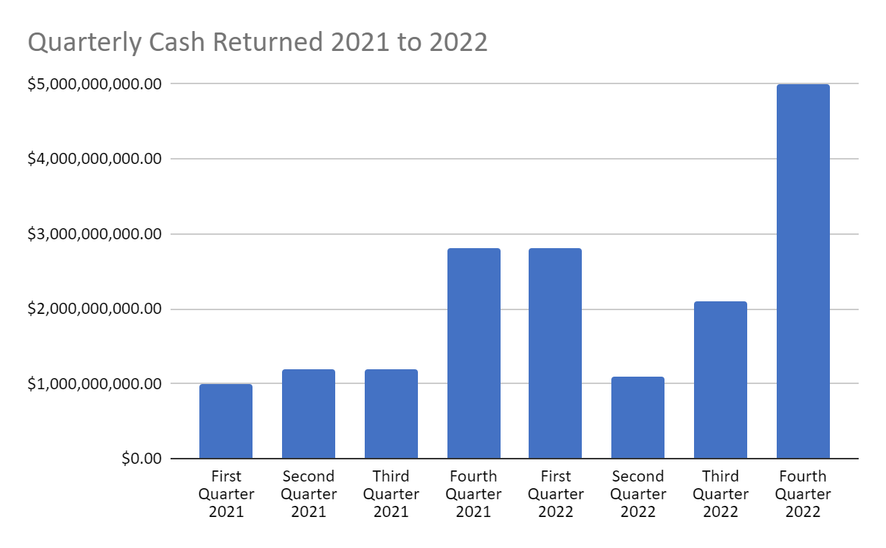
Quarterly Cash Returned
Between dividends and stock buybacks shareholders have done amazingly well in the final quarter of 2022

Slide 6
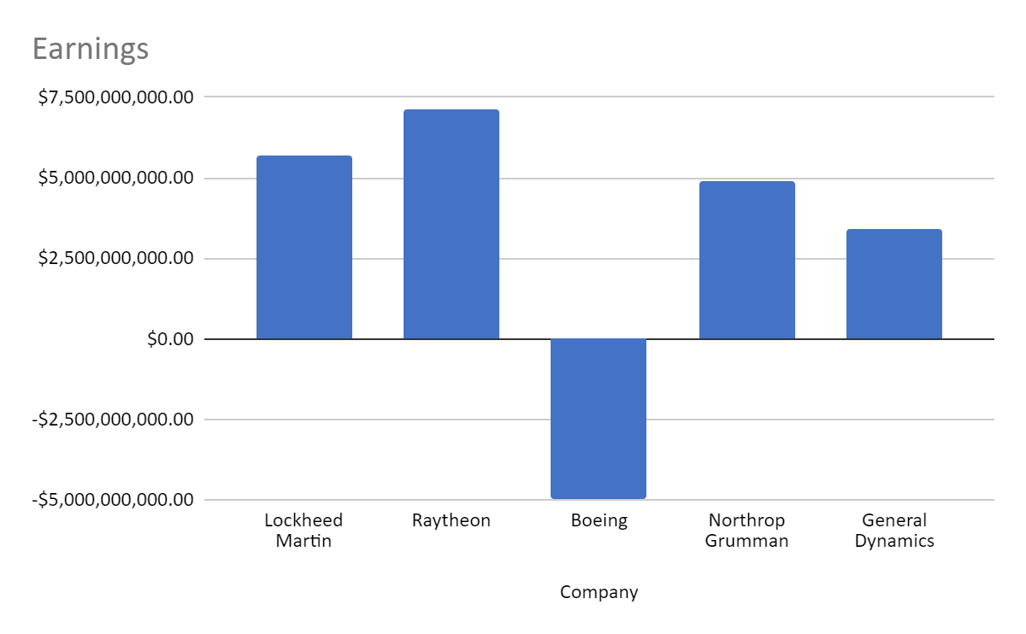
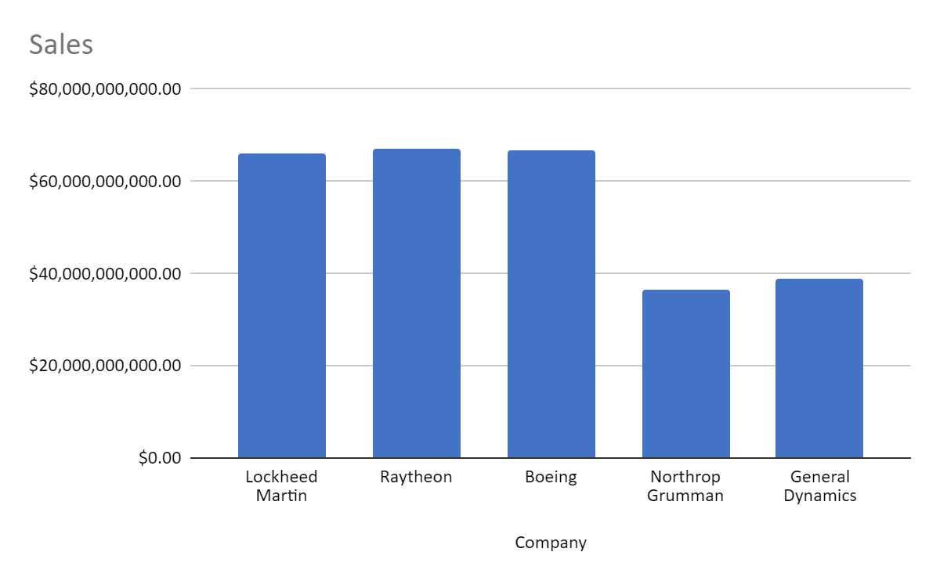
The Competition
Lockheed Martin’s competitors have been in sales with Lockheed, Northrop Grumman and General Dynamics are behind Lockheed, Raytheon, and Boeing
As for Earnings, Raytheon is ahead of Lockheed, Boeing has entered a 4-Billion-dollar shortfall

Slide 7

Final thoughts, notes & recommendations
Lockheed Martin has clearly made steady sales for the past two years and despite a few shortfalls their earnings remain steady.
Second Quarter 2022 and Third Quarter 2021 net earnings were subjected to a pension settlement charge of about 1.5 Billion.
My recommendation is to maintain your investment in Lockheed Martin and be weary of Boeing.

Slide 8

Credits
Credit goes to Lockheed Martin, Boeing, Raytheon, Northrop Grumman, and General Dynamics for making this information available to the public.

