Slide 1

PySide6 & Qt
A python library using the Qt (cute) framework for custom GUIs

Slide 2

PySide6 is a python library that allows interactive Graphical User Interfaces to be created to make functional displays or workpieces
PySide6 utilizes the Qt framework and is used for developing cross-platform applications
Major users of Qt are AMD, ESA, Disney, Siemens, and Panasonic to name a few
PySide6 is open-source and is regularly updated
Because it is based on python it is easy to get into and learn
Comes with a GUI Designer tool so it is quick and easy to set up your own GUI.

Slide 3
PySide6 allows the creation of GUIs that are simple or as complex as desired
During this workshop we will cover Buttons, Labels, and Layouts
Code will be provided at the end to play around with, with examples and explanations as to what is going on.
This code could be modified or used as desired as a basis for a custom GUI

Slide 4
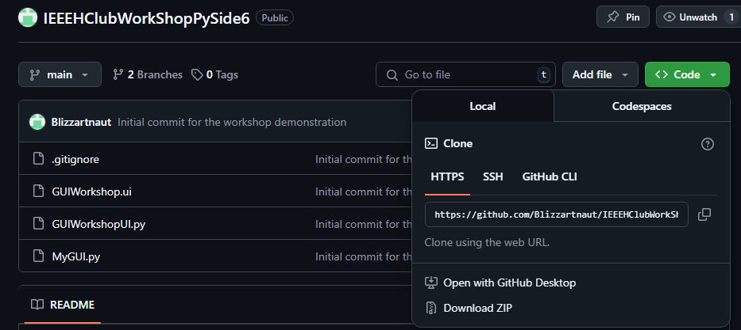
To get the full demo, please go to this repository, and if you have git already installed and know how to use it use the following command in the terminal
git clone https://github.com/Blizzartnaut/IEEEHClubWorkShopPySide6.git
For those unable to use git, go to the url indicated (this powerpoint is in an email sent out this morning), and download the zip file and extract it to whatever folder is convenient, preferably one on your systems PYTHON PATH

Slide 5
Second things first, in VSCode or whatever programming software you choose to use, make sure python is installed
If python is already installed use the following command to install PySide6 and addons
pip install –r requirements.txt
After this package is installed open up the QtDesigner by using the following command in a terminal
pyside6-designer

Slide 6
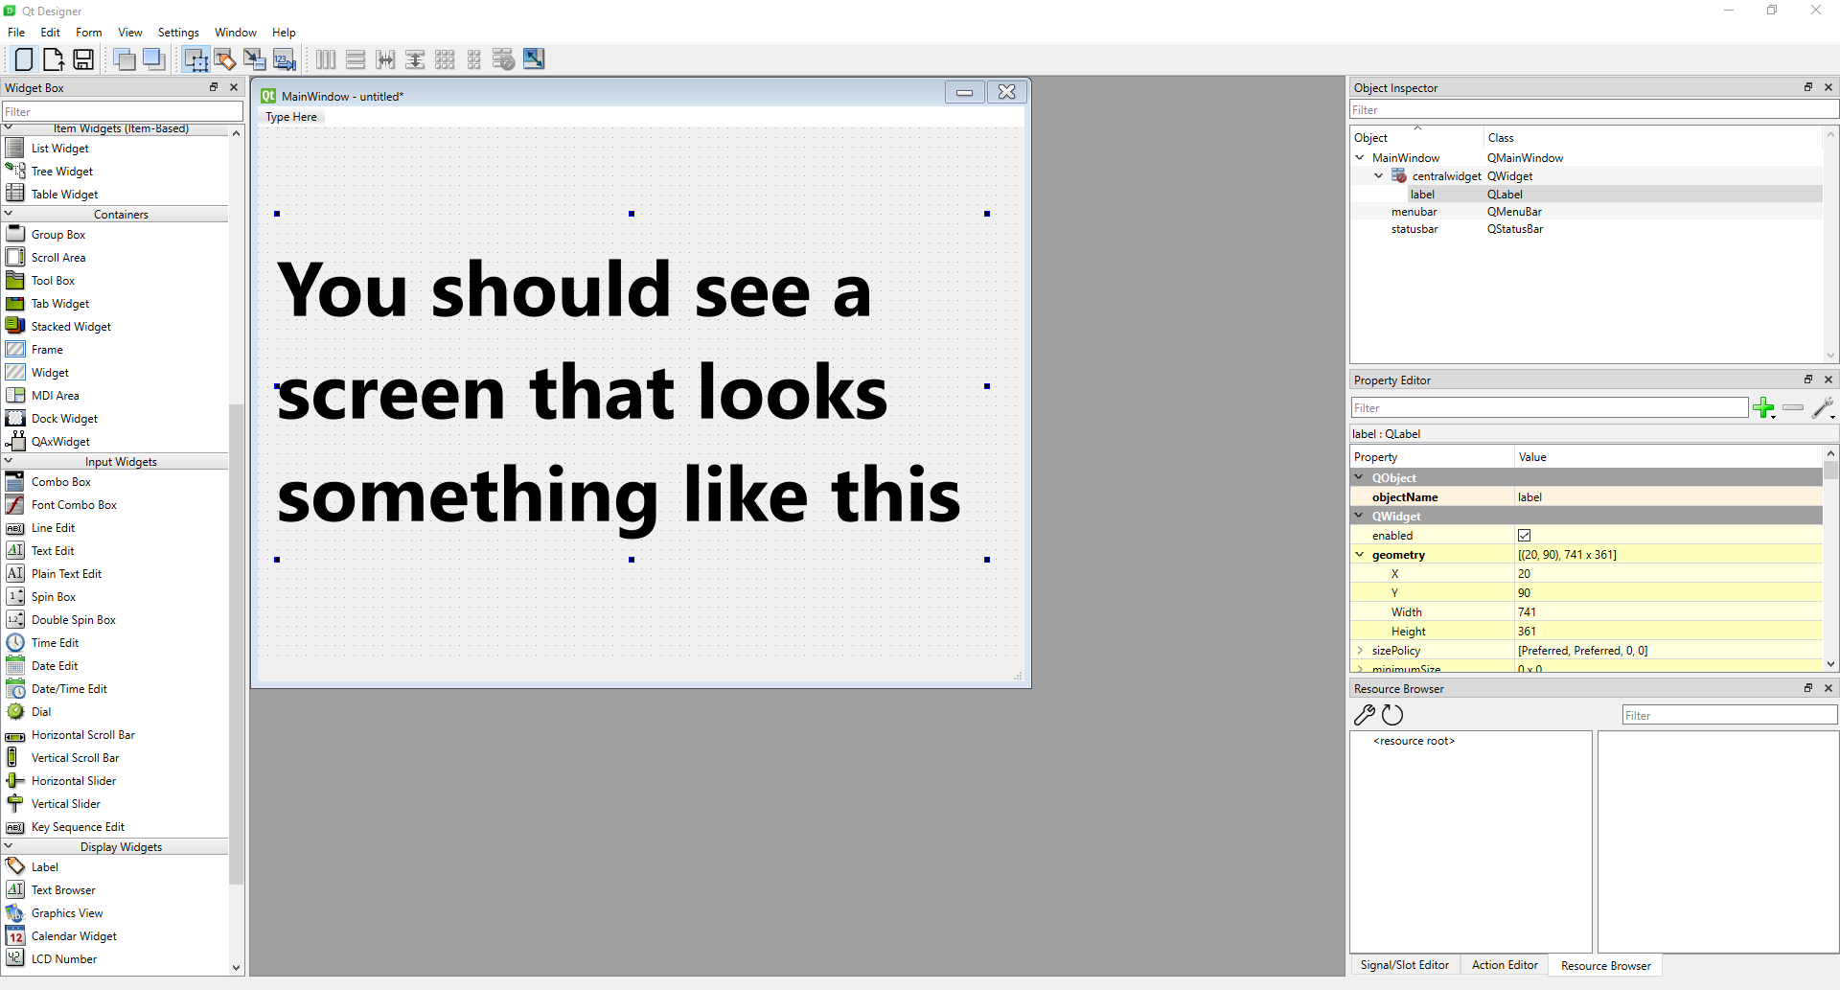

Slide 7
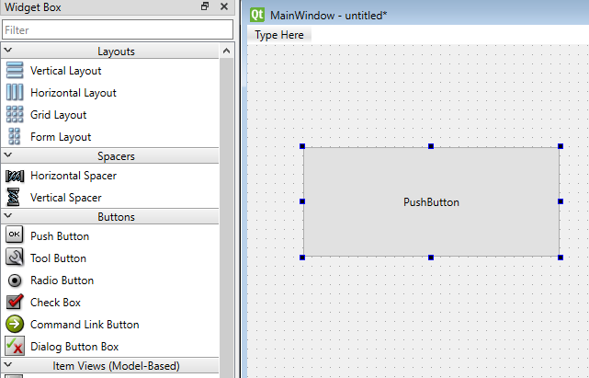
To add a button, drag the Push Button widget over to your MainWindow, place it where you feel it fits best, and you can move it, or resize it at any time.
Later, we will connect this button to something, to make this GUI interactive

Slide 8
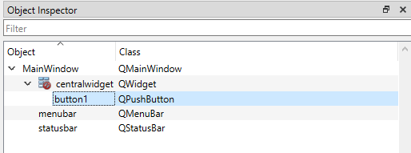
Rename your button to something that makes sense, here I am naming it button_next (not pictured), and then we will add a second button, named button_prev.
In this menu we have all the objects that comprise our GUI, starting with the MainWindow, everything is nested inside of this main object, and more complex arrangements can be made

Slide 9
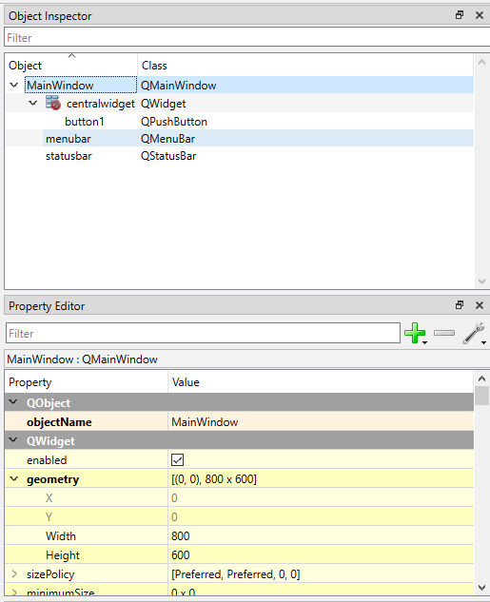
The box in yellow is the property editor for the object you have selected
In this instance we see the geometry of the object
[(0,0), 800 x 600]
This is the starting coordinate, 0,0, which is the upper-left most point in the UI
Followed by the width and height that the object expands to in pixels

Slide 10
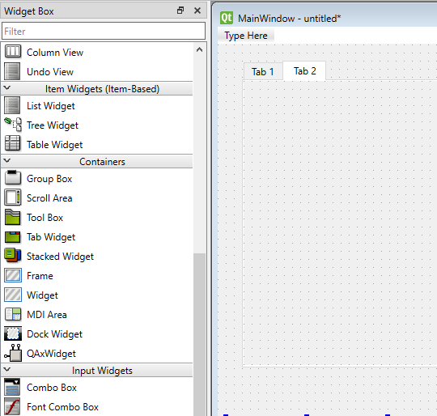
Next we will add a Tab Widget, this will allow us to place multiple objects inside a singular object
You will notice the object inspector now shows a tab widget with 2 tabs nested inside
To add a third tab, right click the tabWidget item, and click insert page, then click after current page
This gives us 3 tabs to place things inside
We will use the buttons to navigate the tabs

Slide 11
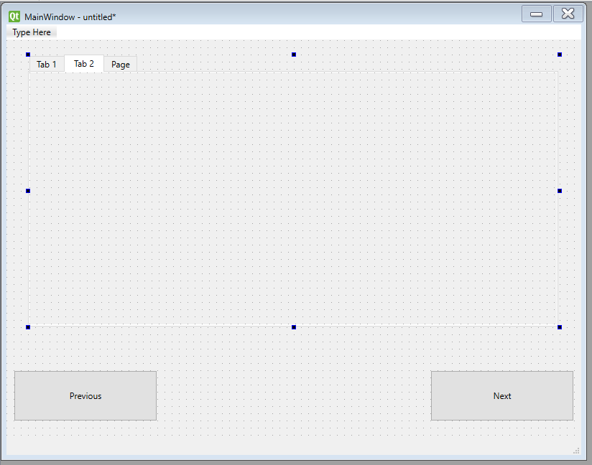
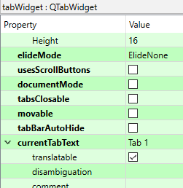
To replace the text inside of an object press F2, this works for most of the object in the editor, except tabs
To replace the text inside of the tab, or other objects, go to the property editor, and scroll down to the green, QTabWidget section, find the item, currentTabText, and then edit that line to set it to whatever you want

Slide 12
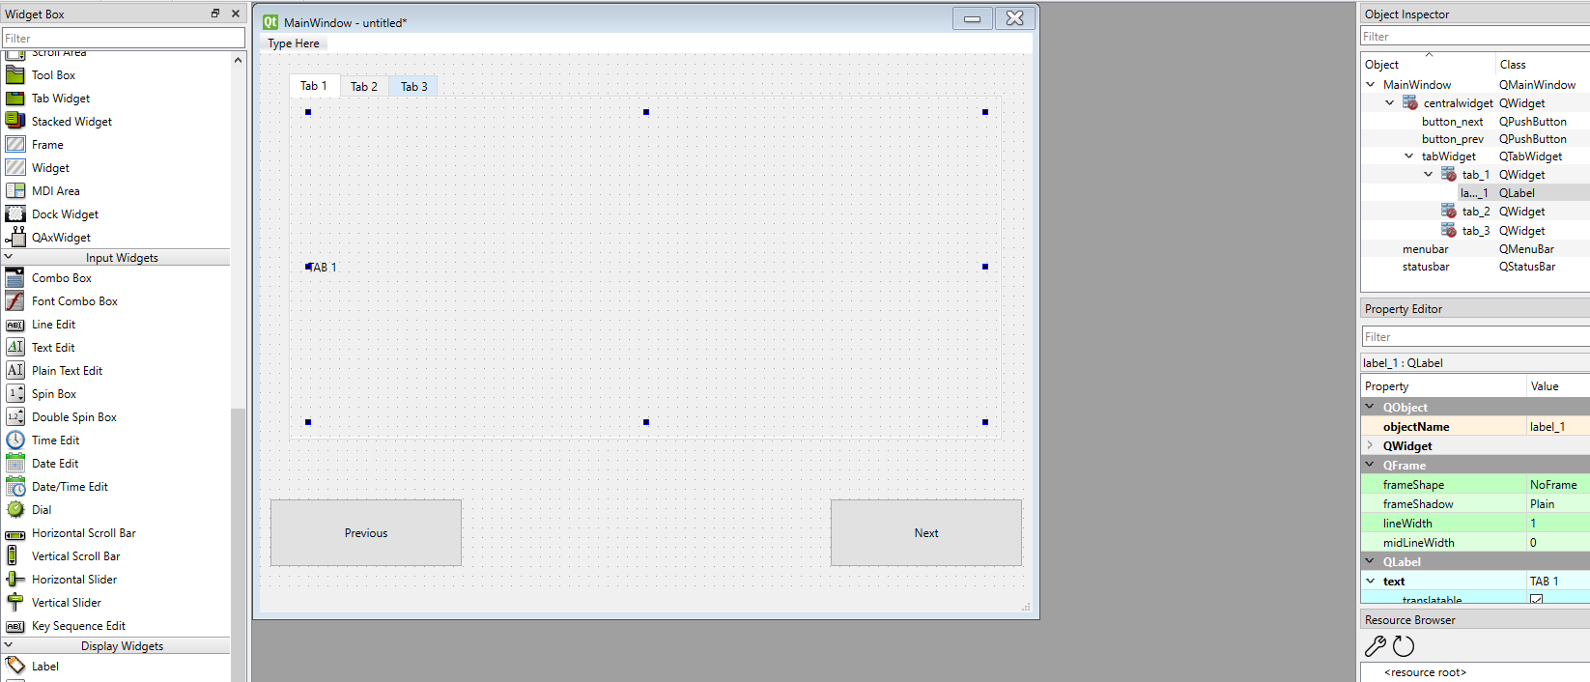
Now place a Label inside Tab 1, then repeat the same for the other tabs, by clicking the tab (either in the ui, or in the object inspector)
Ensure that when you place the label, let it fill up most of the room inside the tab window, this will be useful when we want to display stuff
Make sure the label names are useful, like label_1 for the label in tab_1

Slide 13
You have now created a basic UI, that when fully coded and connected will allow you with a literal click of the button(s) allow you to navigate through several pages on the screen, which will display some stuff for us
Before we can get to the coding section, we have to save the file, and then convert it into a PySide6 readable version, save it as GUIWorkshop
Save the file in the same folder as the as the one you extracted the demo to
In VSCode (or any editor you are using) in the terminal use the following command, which will convert your ui file into a python file, if you have saved it with the filename suggested, this command should work
pyside6-uic GUIWorkshop.ui –o GUIWorkshopUI.py

Slide 14
Now in the folder all this should be occurring in, open up the file MyGUI.py
I will go through what the code does, in an effort to save time, spending more time on the significant features within the scope of this workshop
The code simply connects the 2 buttons to click events, which then trigger 2 separate functions which iterate through the tabs on the tab widgets, which display a different thing for each tab in an effort to demonstrate some of the neat stuff this library can do
I don’t mind explaining what some of the non Qt code does, but our primary focus is on the pyside6 programming and GUI

