Slide 1
Microbial Modeling Lab
Nathaniel Alberti and Aiko Muraishi

Slide 2
Linear Programming solvers
We’ve used a sample FBA problem and tested different LP solvers to see how they compare.
COBRA toolbox supports many solvers – free ones include GLPK, IBM CPLEX, mosek, LP solve, and the “linprog” MATLAB function.
IBM’s CPLEX solver no longer runs on the most recent MATLAB platforms.
LP solve is deprecated.
MATLAB’s linprog function is noted as “not reliable” by COBRA toolbox.
We will be running comparisons between the GLPK and mosek solvers.

Slide 3
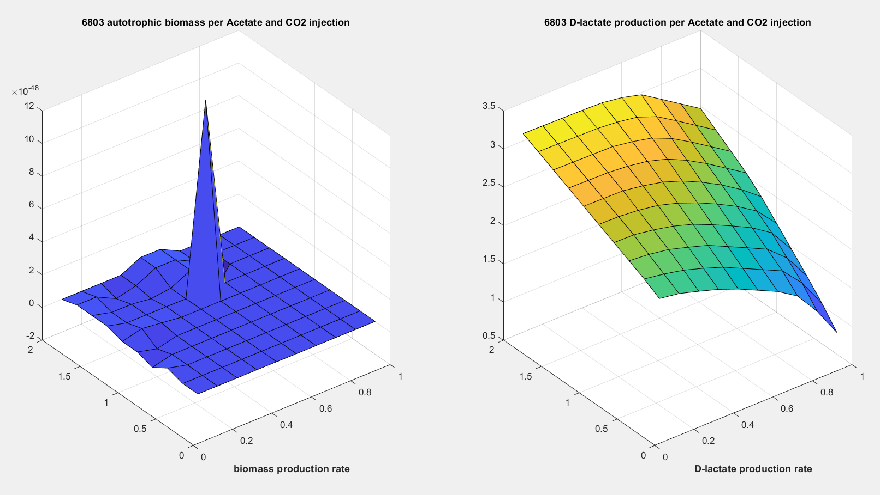
GLPK solver
Average runtime over ten trials: 2.0323 seconds.

Slide 4
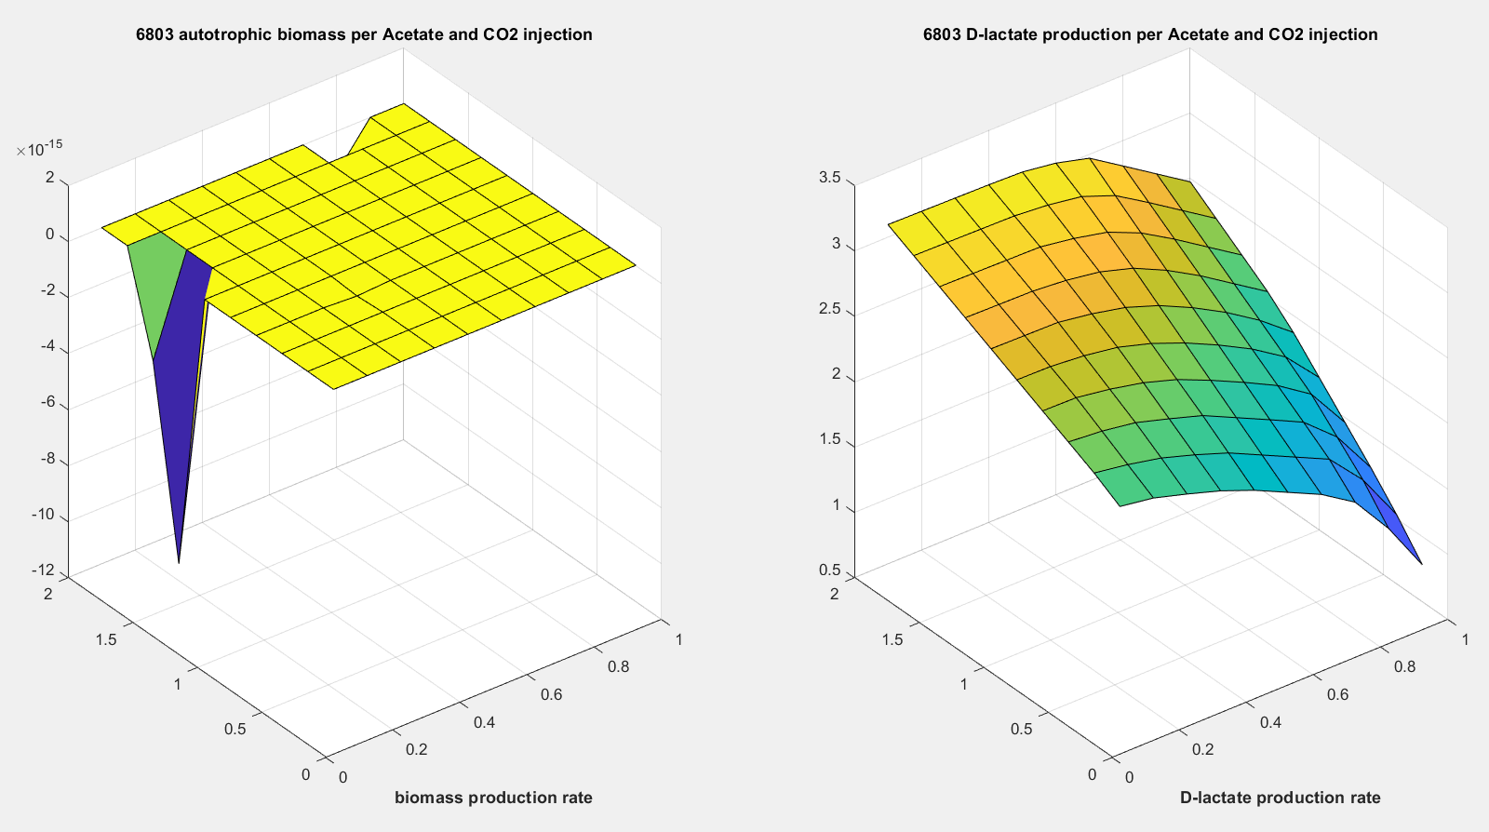
Mosek solver
Average runtime over ten trials: 1.0560 seconds.

Slide 5
Conclusion
Mosek runs on average twice as fast as GLPK on our test FBA problem.
As expected, they have the same results on lactate production, but they differ in the resulting biomass production.

